Slide 1
Introduction to UW’s NSF Expanding Capacity in Quantum Information Science and Engineering (ExpandQISE) Award
NSF ExpandQISE Award: 2228841
Department of Physics & Astronomy,
Department of Electrical Engineering and Computer Science,
University of Wyoming, Laramie, WY
09/15/2022

Slide 2
Outline
Overview of the NSF ExpandQISE Award
Research Project: Quantum Computing
Education Program Development in QISE
Impact and Outcomes

Slide 3
Overview of This Award
Partner Institution:
Purdue University
Awarded amount (five years): $ 5,000,000.00
UW is one of the only three awardees
QISE Workforce Development
Research
UG Minors,
Masters in Quantum Computing:
Quantum Materials for Topological Quantum Bits
Outreach
Native Americans,
Underrepresented Minorities
and Female Students
National Labs:
Argonne National Lab
Brookhaven National Lab
Quantum Industry:
Microsoft, IBM, Quantinuum,…

Slide 4
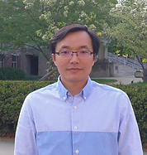
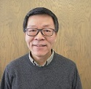
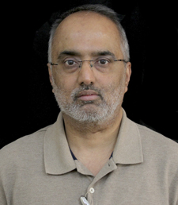
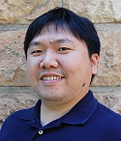

Our Team: Physics & Astronomy and EECS
Jifa Tian (PI)
Assistant Professor
Jinke Tang
Head and Professor
Suresh Muknahallipatna
Professor
One Postdoctoral Fellow
Five Ph.D. and
Four Undergraduate Researchers
TeYu Chien
Associate Professor
Yuri Dahnovsky
Professor

Slide 5
What is a Quantum Computer?
Research Project: Quantum Computing
Four areas of QISE Identified in National Strategic Overview for Quantum Information Science :
Quantum Computing, Quantum Sensing, Quantum Communications or Quantum Simulations.
A quantum computer is a machine that performs calculations based on the laws of quantum mechanics, which is the governing principle for particles at the atomic scale.

Slide 6




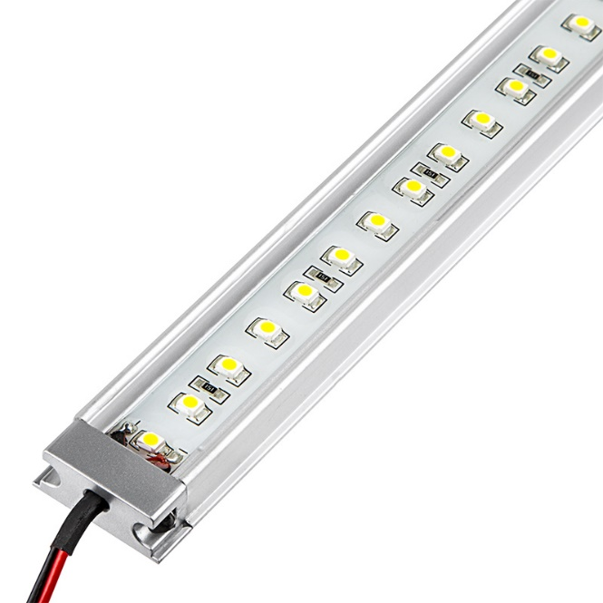

Revolution in Computing Technology
Evolution
Electric heating
Revolution
Burning
Incandescent bulb
Torch
Candle
Gas lamp
New approaches with completely different principles allow technology revolutions.
Quantum computing revolution is at its dawn era ➔ New workforce education with Quantum Mechanics is critical for its sustainable development
Semiconductors
Electron energies
LED light
Fluorescent bulb

Slide 7

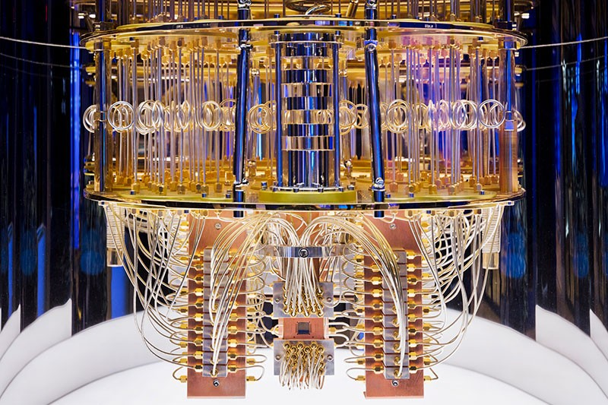

Classical vs Quantum Computing
Bits
Classical Computer
0 (off)
1 (on)
Quantum Bits (Qubits)
Quantum Computer
Credit: IBM

Slide 8
The Power of Quantum Computing
Applications Span Three General Areas
Simulating Quantum Systems
Artificial Intelligence
Optimization
Nearer Term
Longer Term
Quantum Simulation
▪Artificial Intelligence
▪Optimization
▪Cryptography
▪Materials
▪Petroleum and gas
▪Drug discovery
Quantum computers will let us do things we can’t do today!

Slide 9
The Systems to Create Qubits
Superconducting loops
Trapped ions
Silicon quantum dots
Diamond vacancies
Topological qubits
Pros
Fast working. Build on existing semiconductor industry.
Very stable. Highest achieved gate fidelities.
Stable. Build on existing semiconductor industry.
Can operate at room temperature.
Topologically protected. Greatly reduce errors.
Cons
Collapse easily due to noise and must be kept cold.
Slow operation. Many lasers are needed.
Only a few entangled. Must be kept cold.
Difficult to entangle.
Existence not yet confirmed.
Company
Google, IBM,…
Intel
Microsoft
G. Popkin, Science (2016)

Slide 10
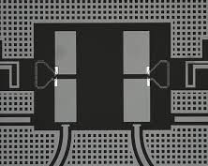
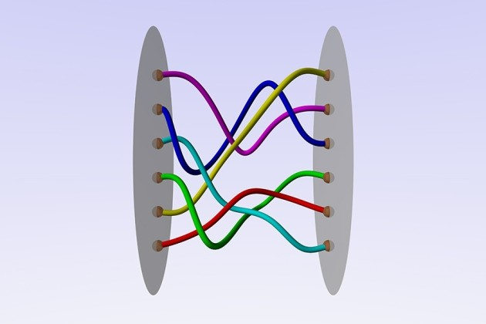

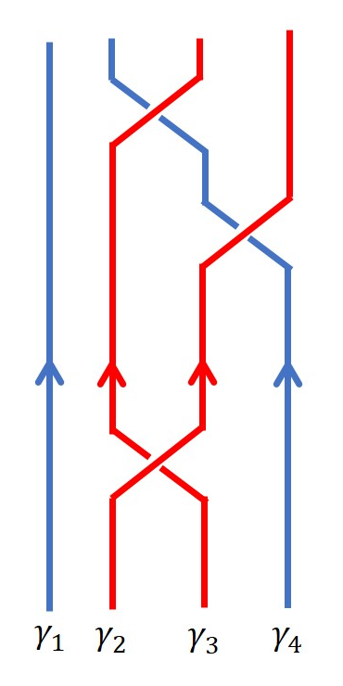
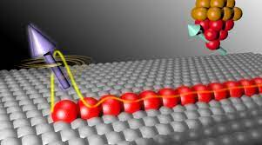
Our Research Project: Topological Qubits
Topological Josephson Junctions
Topological Qubits
Nanofabrication Technology
2D Superconductors
IBM
Cryogenics
Fault-tolerant Quantum Computation
Braiding Exchange
Scanning Tunneling Microscopy

Slide 11
Student Training & Internship Opportunities
National Labs: Argonne NL
Research training using the advanced facilities at Center for Nanoscale Materials (scanning tunneling microscope; nanofabrication ) and the Advanced Photon Source
Purdue
Partner Institution: Purdue
Research training and collaboration and REU at Purdue Quantum Science and Engineering Institute (low-temperature transport techniques) and Birck Nanotechnology Center (nanofabrication).
Industries
Industries: IBM, Microsoft …
National Labs
Opportunities for students to interact with industry through collaboration on projects, internships, and fellowships

Slide 12

Education Program Development in QISE
Physics
Chemistry
Mathematics
EECS
UG Feeder Degrees
Computational Science
Quantum Science
UG Minors
Masters in Computing:
QISE concentration

Slide 13
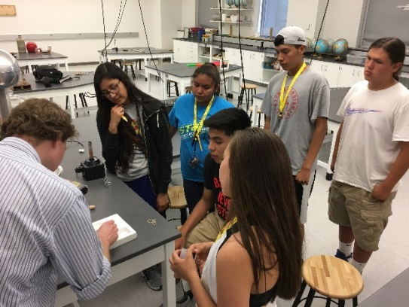


Outreach Activities
Annual Summer Quantum School at UW
Broadening Participation and Training:
Native Americans, Underrepresented minorities, and Female Students
1) Participating in Annual Native American Summer Institute
2) Participating in the "Wyoming Voices in the Field Conference"
Tier 1 Engineering initiative
MCNAIR SCHOLARS PROGRAM

Slide 14
Impact and Outcomes
Develop Cutting Edge Quantum Technologies
Attracting high-tech (semiconductor and/or quantum) industries to Wyoming
Build quantum block chain
2) Create Education Programs in QISE at UW to Prepare Future Workforce
Increase student's enrollment
Build collaboration/partnership with Wyoming seven community colleges
Open the career path to quantum industry

Slide 15
Impact and Outcomes
3) Maintain the State’s Economic Competitiveness and Fuel Transformative Scientific Advancement.
Offer new opportunities to oil & gas industry
Promote establishment of regional quantum ecosystem
Provide critical elements in global quantum supply chain
Diversify Wyoming’s resource-based economy
4) Increase the Impact of UW at the National Level
Set up a national educational model for expanding QISE-related research and education activities in the country’s rural regions and/or institutions with no or underdeveloped QISE programs

Slide 16
Thank you!

