Slide 1
Decarbonization in Wyoming: Opportunities and Imperatives
May 11, 2023
Prepared for the University of Wyoming Board of Trustees

Slide 2
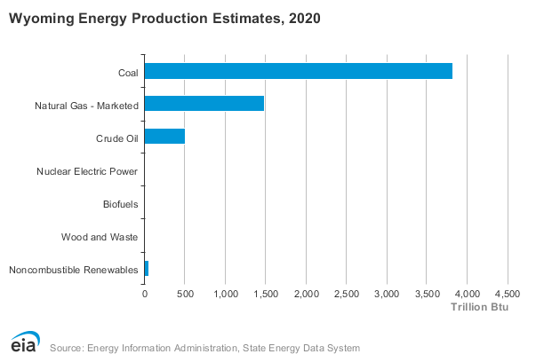
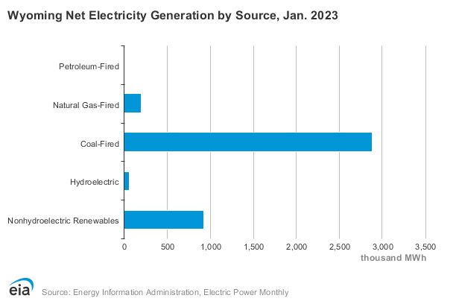
The First Frontier:
Fuel, Minerals, & Power Production

Slide 3
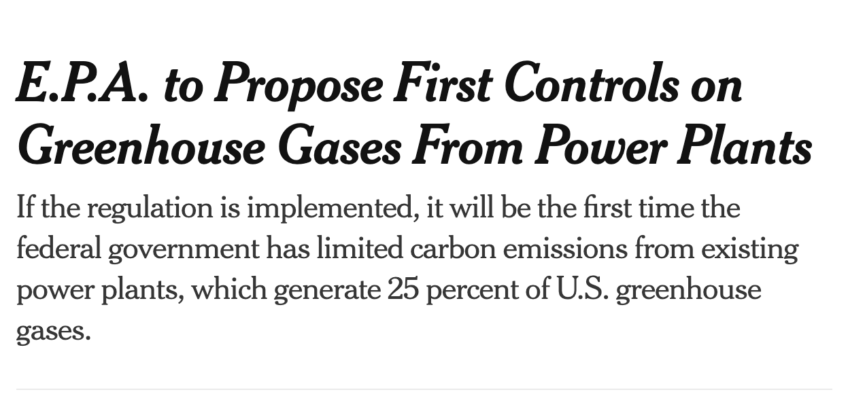
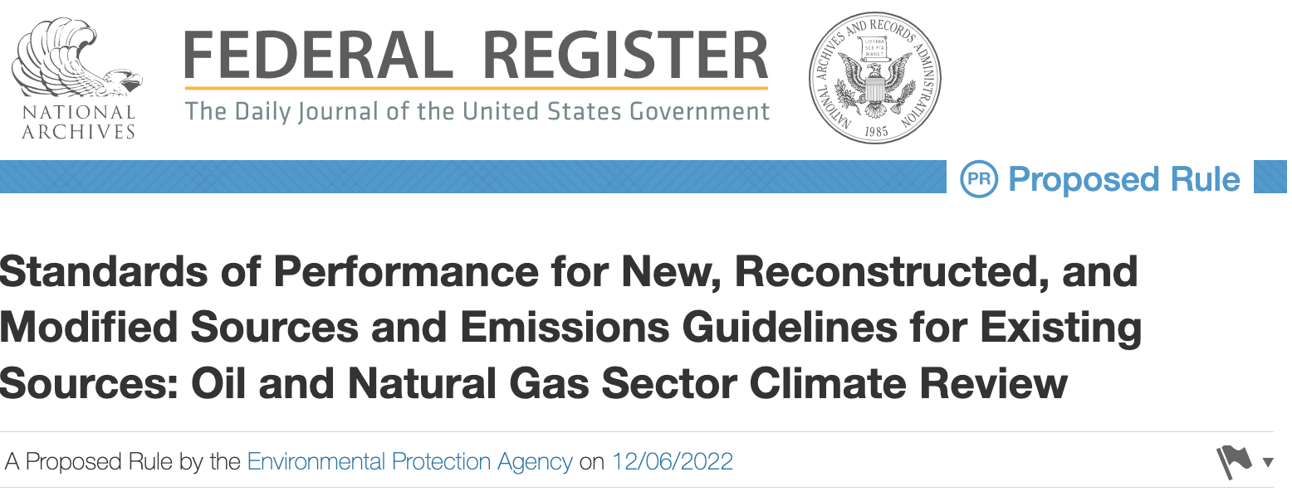
Transformative Energy Policies:
The Decarbonization IMPERATIVE

Slide 4
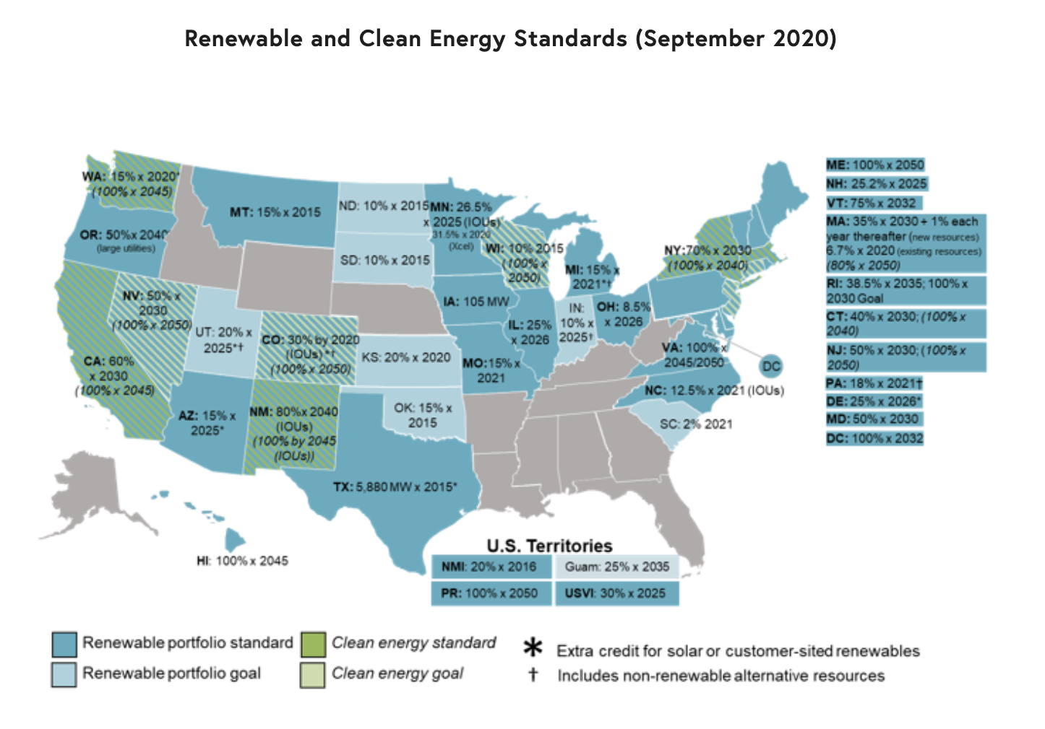
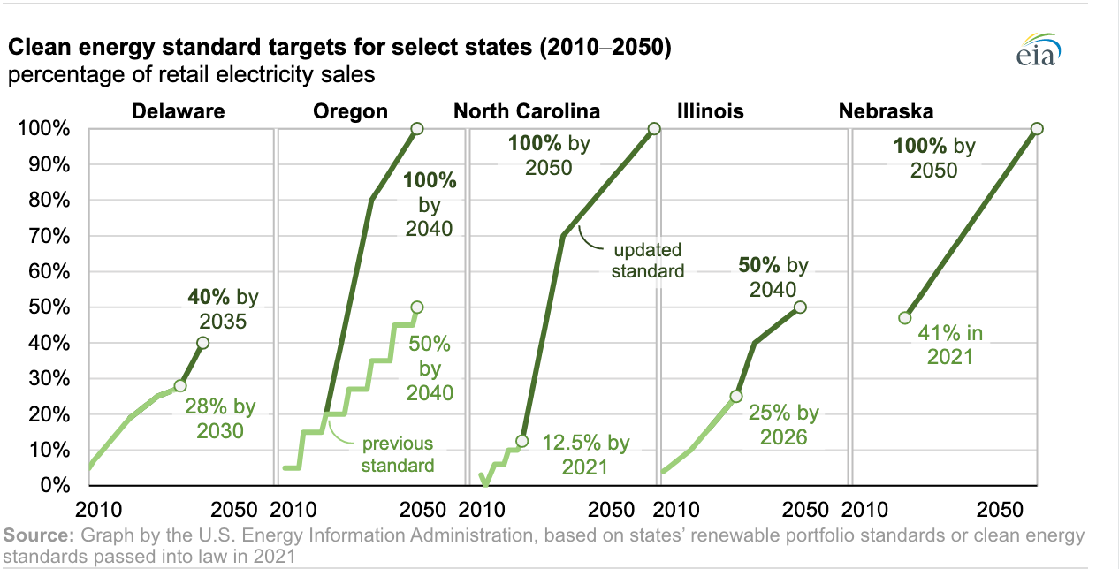
Closing Markets to Coal: RPS

Slide 5
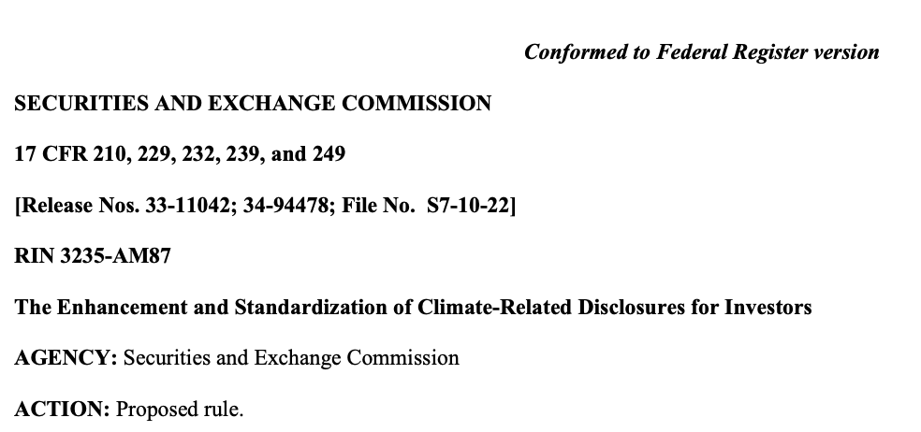
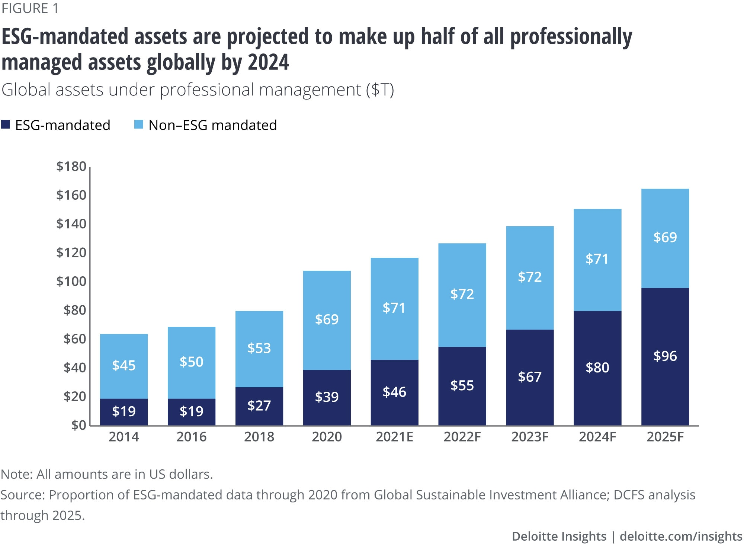
Emissions Reporting REQUIREMENTS

Slide 6
Trade Policies Impacting Wyoming Markets
The EU Border Carbon Adjustment Mechanism

Slide 7
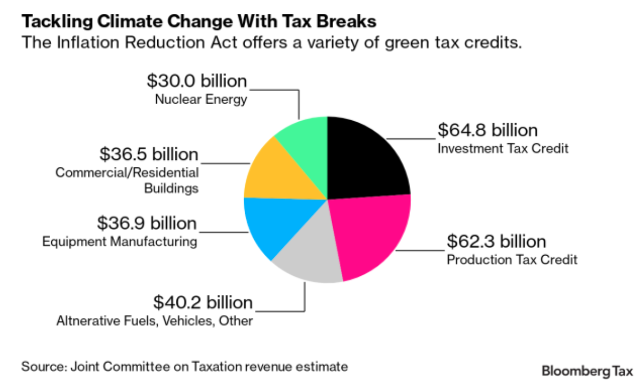
Energy & Economic Renewal

Slide 8
Opening New Frontiers
Decarbonizing & Optimizing Energy Inputs:
Industrial Heat & Power
Mining Operations
Upstream Oil and Gas
Enhanced Oil Recovery
Grid Reliability
Hydrogen & Ammonia Production
Decarbonizing Process Emissions:
Hydrogen & Ammonia Production
Electricity Generation
Ethanol Production
Gas Processing
Mineral & Chemical Processing
Advanced Nuclear & CCUS

Slide 9
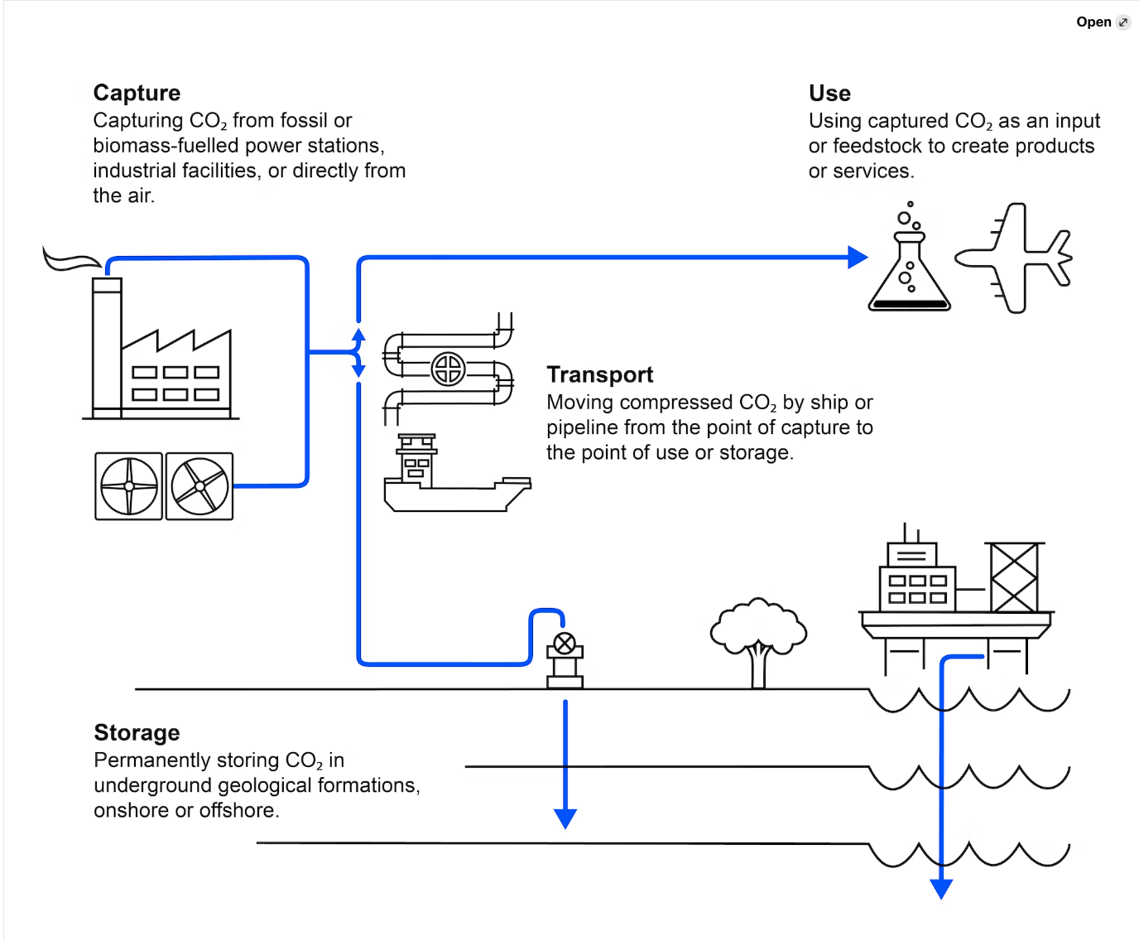
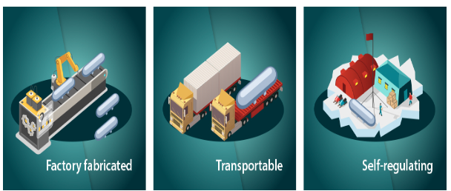
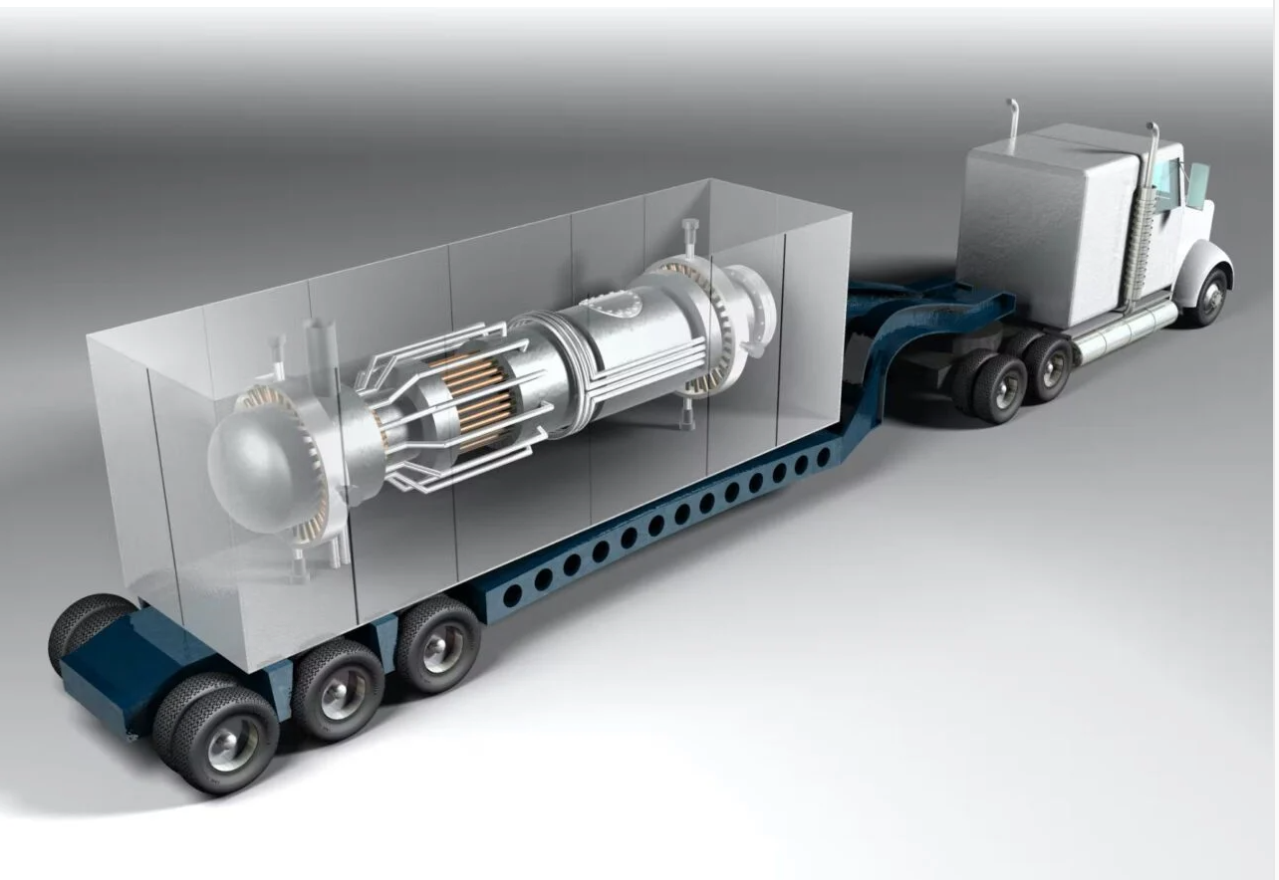
First Movers in Net-Negative Industry

Slide 10
My Research: Property & Permitting
Licensing and siting for nuclear energy
Public perceptions and regulatory drivers of market demand
Ownership and valuation of pore space
Use of public lands for carbon storage
Resolving multiple resource conflicts
Administrative regulation of sequestration projects
Energy Justice and Just Transition Policies for Coal and Oil and Gas Producing Communities

Slide 11
Priority and Possession of Pore Space
Tara Righetti, Capturing All The (Tax) Credit: Carbon Capture and Storage, Vibrant Environmental Blog, Environmental Law Institute (January 23, 2023).
Tara Righetti, Wyoming’s Place in the Energy Transition: A Look at Carbon Capture and Hydrogen, Wyoming Lawyer (June 2022).
K.K. DuVivier and Tara Righetti, Changing Paradigms for a Low Carbon World, 46 Harv. Env. L. Rev. Online 59 (2022).
Tara Righetti and Joe Schremmer, Waste and the Governance of Common Property, 93 Colo. L. Rev. 609 (2022) (Selected as one of the top 20 articles for 2021 by the Environmental Law and Policy Annual Review).
Tara Righetti, Associated and Incremental Storage: Opportunities for Increased CO₂ Removal with Enhanced Oil Recovery, in Climate GeoEngineering Law and Governance (Wil Burns, David Dana, and Simon Nicholson, eds.), Springer Nature (2021).

Slide 12
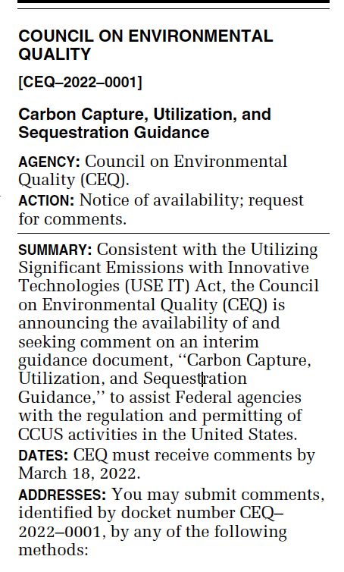
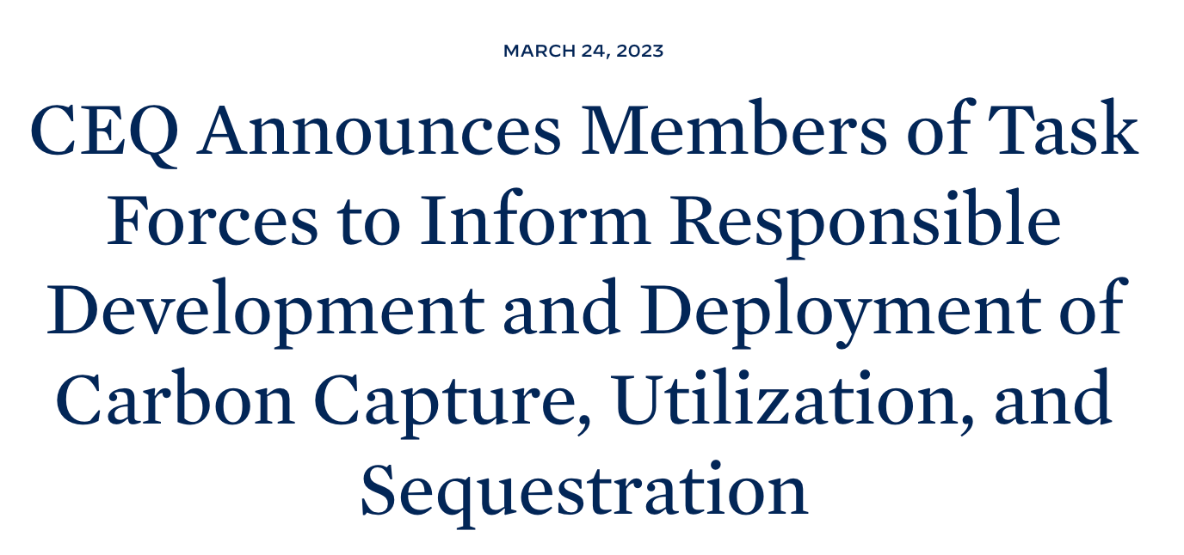
CCUS Pathways on Public Lands
Tara Righetti, Kris Koski, Jesse Richardson, & Sam Taylor, The Carbon Storage Future of Public Lands, 38 Pace Envtl. L. Rev. 181 (2021) (reprinted in Rocky Mountain Mineral Law Foundation Journal vol. 58, No. 2 (2021) (included on list of top 20 articles in the 15th edition of the Environmental Law and Policy Annual Review).

Slide 13
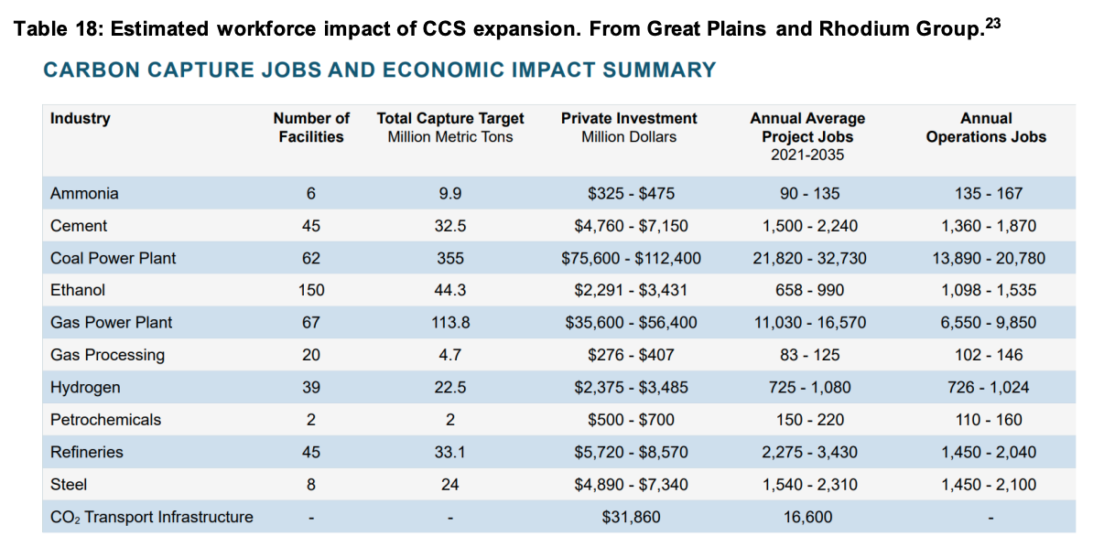
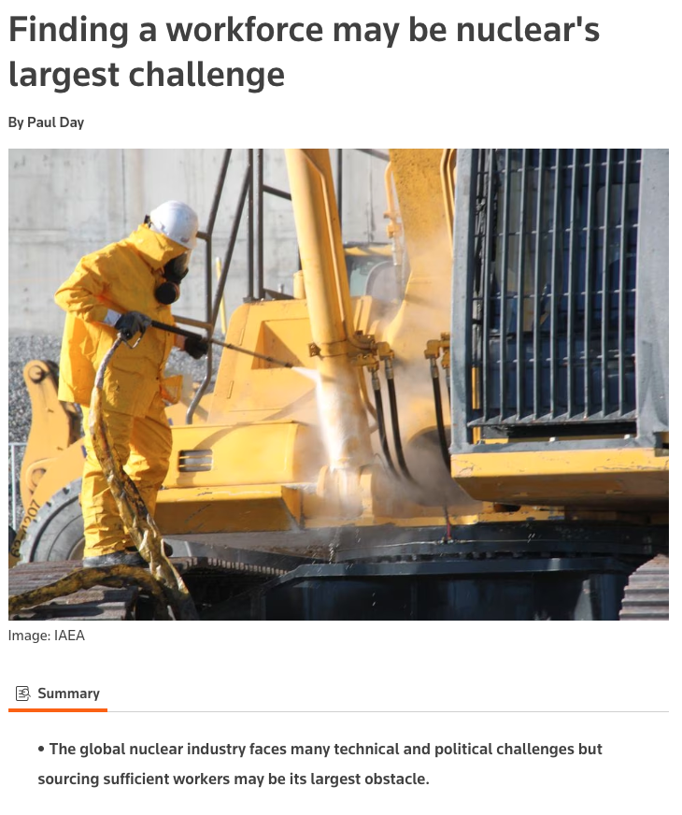
Preparing Future Energy Leaders

Slide 14
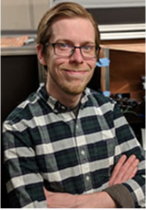
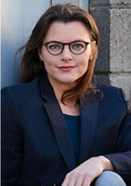
UW Nuclear Energy Research Center
Supported as part of the two million dollars ($2,000,000.00) exception funding appropriated by the legislature for a nuclear energy collaboration and training program.
Nuclear Energy Research Center Co-Directors
UW Nuclear Energy Research Center
Managed with other research centers under Scott Quillinan
Co-directors
Caleb Hill (Chemistry)
Tara Righetti (SER/Law)
Supporting faculty, staff and students to build collaborations and visit nuclear-focused institutions (universities, INL, Argonne, etc.)
Capacity building on campus (laboratory facilities, research support, new courses, conferences_
Early initiative provided support for proposal preparation
Caleb Hill (Chemistry) Tara Righetti (SER-Law)

Slide 15
Assessing and Building Capacity
Current Projects and Initiatives
Academics
Developing a Nuclear 101 class with possibility of developing a nuclear-related certificate
Nuclear Education Skills and Technology (NEST) program
Outreach
Research Exploration for Nuclear Energy in Wyoming (RENEW) Symposium
Faculty Visits to Idaho National Lab
Collaboration with labs, industry, and state agencies
Research
Awarded grants for summer research assistants and for faculty proposal development support
Areas of Expertise
Fuels
SER and Geology and Geophysics
Chemistry
Consensus siting and policy
Haub, SER, Honors, Law
Economics & Business
Management and Marketing
Energy and Resource Economics
Materials, Facilities, and Operations
Materials Science
Energy Systems Engineering
Civil Engineering

Slide 16
External Funding
Direct Funded Research:
Nuclear Regulatory Commission
NERC Faculty Scholars Program - $599,999 – Caleb Hill & Tara Righetti - Recommended for Funding
Department of Energy – Nuclear Energy University Program
Open Architecture for Nuclear Cost Reduction - $200,000 – Tara Righetti & Selena Gerace – Funded
Engaging Wyoming Communities in an Environmental Justice Approach for Advanced Nuclear Energy Facility Siting - $800,000 – Rachael Budowle (Haub), Tara Righetti (SER), Temple Stoellinger (Haub), Matthew Henry (Haub), Steve Smutko (Haub) – Funded
Department of Energy – Consolidated Innovative Nuclear Research
Interfacial Electric Fields as a Tool to Control Fuel Cycle Separations – Nuclear Science User Facilities - Hill, Rogers, Di Bona - $300,000 – Submitted
Establishing A Nuclear Chemistry Core Facility at the University of Wyoming – General Scientific Infrastructure –Hill, Rogers, Di Bona - $826,157 – Submitted
Department of Energy – Microreactor Program
Microreactor Applications in U.S. Markets - $77,428 – Tara Righetti, Eugene Holubynak, & Selena Gerace – Funded
Program Development Funding:
Battelle Energy Alliance - $341,615
Foundation Funds:
Rocky Mountain Power Foundation - $12,500

Slide 17
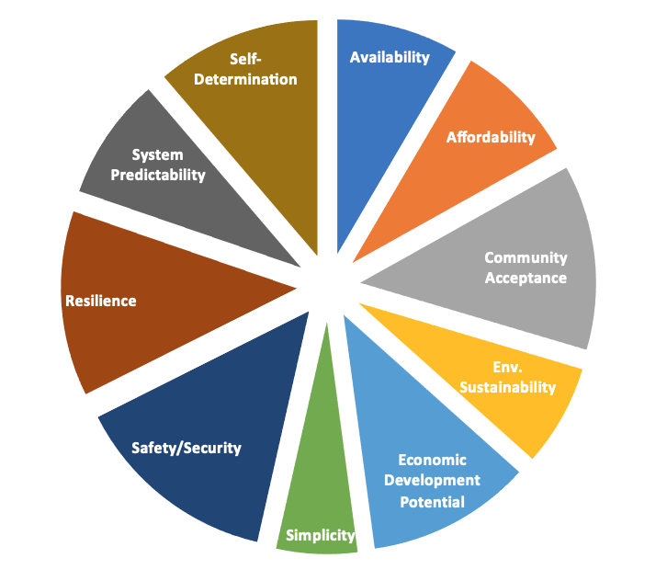
The Emerging Market Analysis Initiative
The Emerging Energy Market Analysis Initiative is a collaboration between Idaho National Laboratory, University of Michigan, University of Wyoming, Massachusetts Institute of Technology, University of Alaska, and Boise State University. The initiative is dedicated to advancing the understanding of energy markets options as the world transitions to new energy futures.

Slide 18
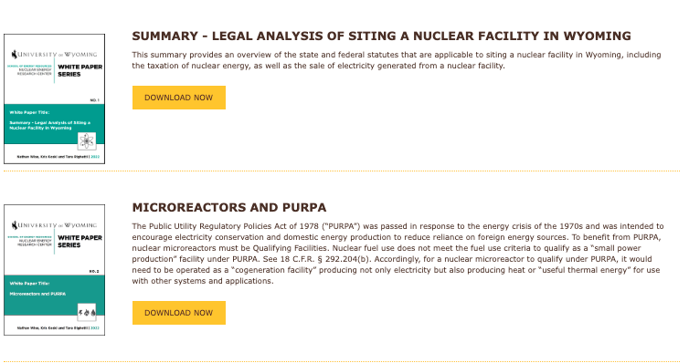
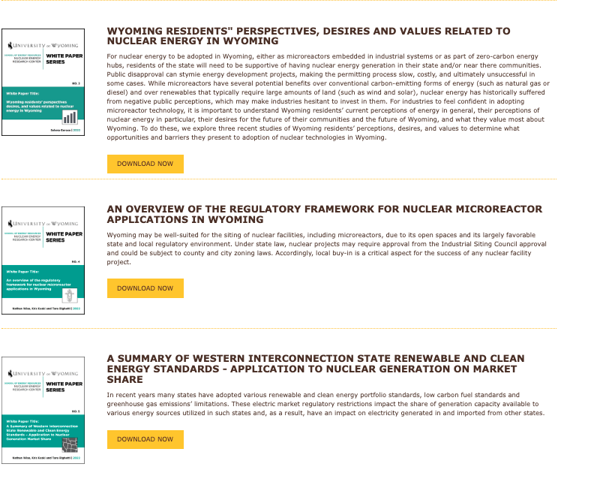
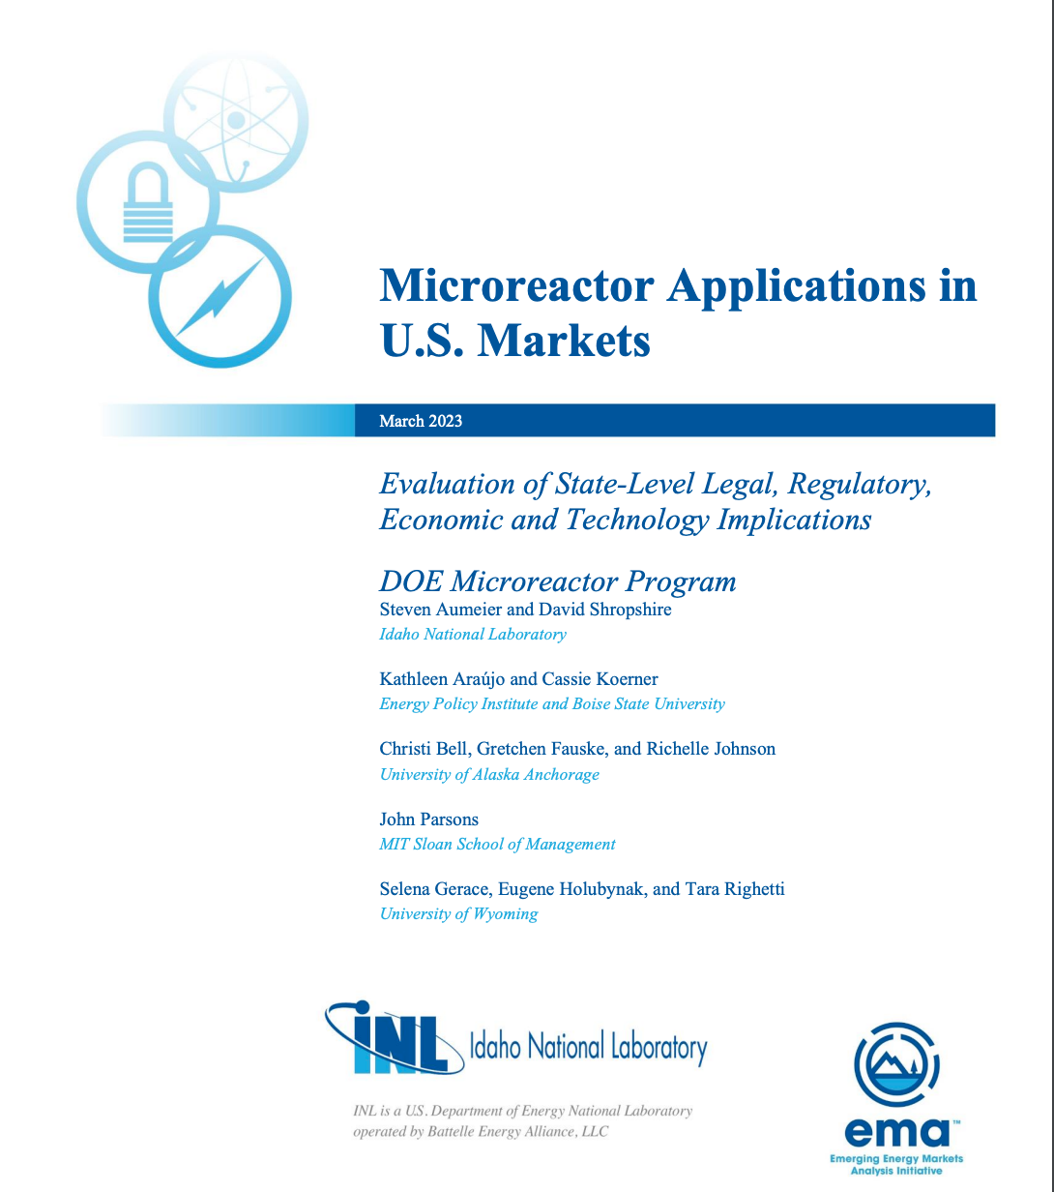
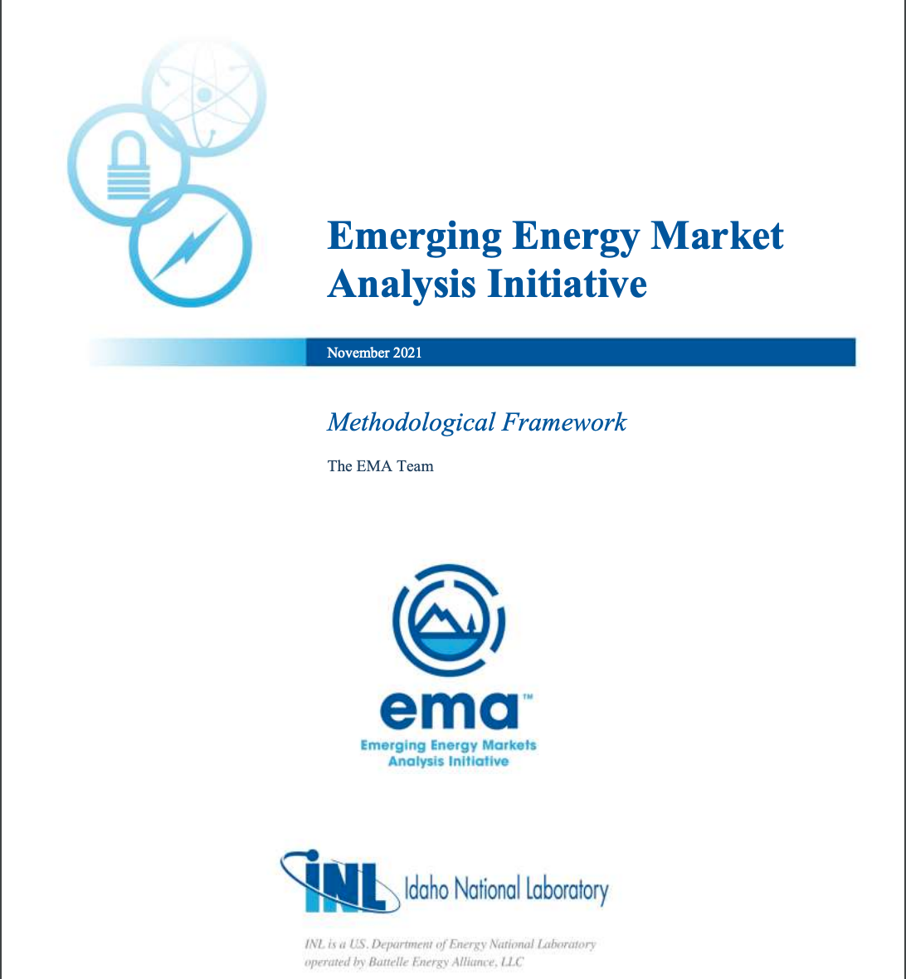
Publications and Whitepapers
White Paper Authors: Tara Righetti (SER), Kris Koski (SER), Selena Gerace (SER), Nathan Wise (J.D. ‘24)
Publication Authors: Tara Righetti (SER), Selena Gerace (SER), Eugene Holubynak (SER), Steve Smutko (Haub), Temple Stoellinger (Haub), Rachael Budowle (Haub)

Slide 19
Proposed 2024 Projects
NERC Faculty Scholar Program (NRC Grant) - $600,000
Recruit New Faculty
Supported by funds from NRC, SER, and provost
Targeting Associate Professor Level
Nuclear Focused, Tenure Track
Support Existing Faculty in Excellence Program
Provide 3 faculty with one month summer funding to support nuclear-related research projects
Support new faculty hire with one month summer funding
NERC Exception Funded Projects - $80,000
Professional Development Support
Grants to faculty, students, and staff to fund nuclear-related conference travel, trainings, and certifications
Distinguished Speaker Program
RFP for departments to bring in speakers on nuclear subjects
NERC Co-Director Stipends

Slide 20
Contact
Tara Righetti, J.D., CPL
University of Wyoming
Professor of Law
Occidental Chair in Energy and environmental Policies
Co-Director, Nuclear Energy Research Center
Tara.Righetti@uwyo.edu

