Slide 1
UW COE ©2023

Slide 2
TEI 2.0 Statewide Context
Original MECP planning with Superintendent Balow - January of 2022
Visioning mix of statewide and community-based educator competencies
Emergent UW framework to support in-service teachers - Arc-of-Career model
UW Wyoming Teacher Mentor Corps established
June UW response to teacher labor market problems - stemming teacher attrition
UW High Altitude Pathways program encouraging college and career readiness
Connecting to the State Board of Education’s Profile of a Graduate
Community Listening Sessions
Focus on K-12 Student Outcomes
Aligning with Governor Gordon’s RIDE Advisory Group
Community Listening Sessions
Recommendations focusing on Competency Based Education and College/Career Pathways
Notes:
ST - Reimagining and Innovating the Delivery of Education (RIDE)

Slide 3
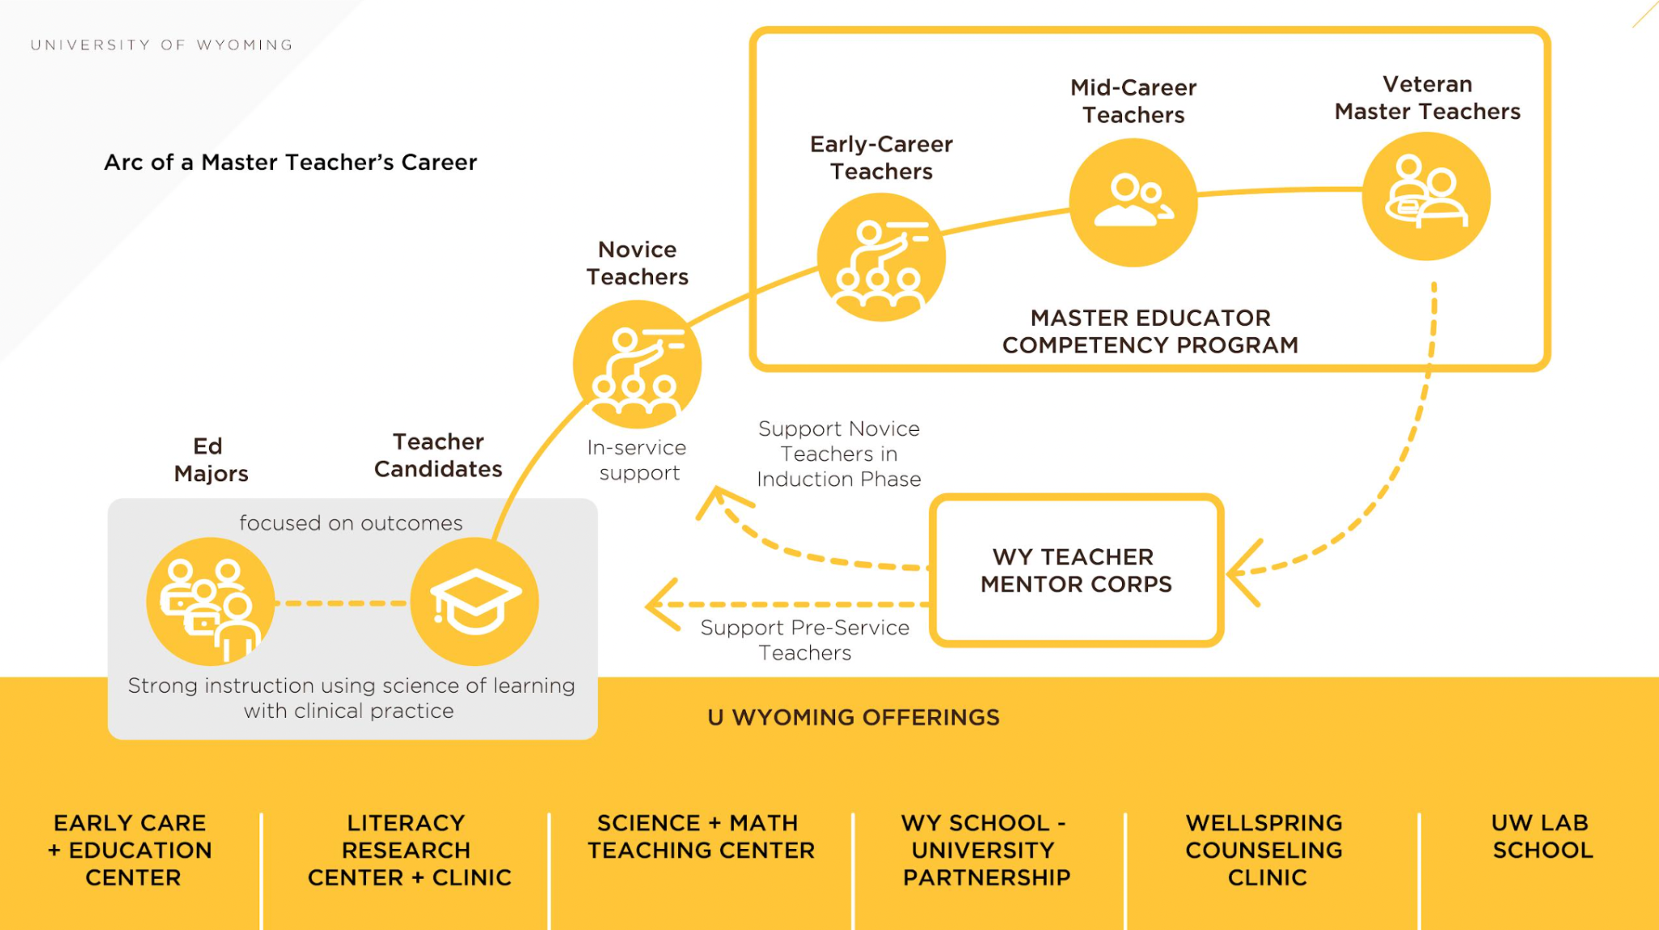
Investing in the Full “Arc”
Investing in the full career arc of the educator simultaneously meets the needs of P-12 educators and P-12 systems
UW COE ©2023
Notes:
ST

Slide 4
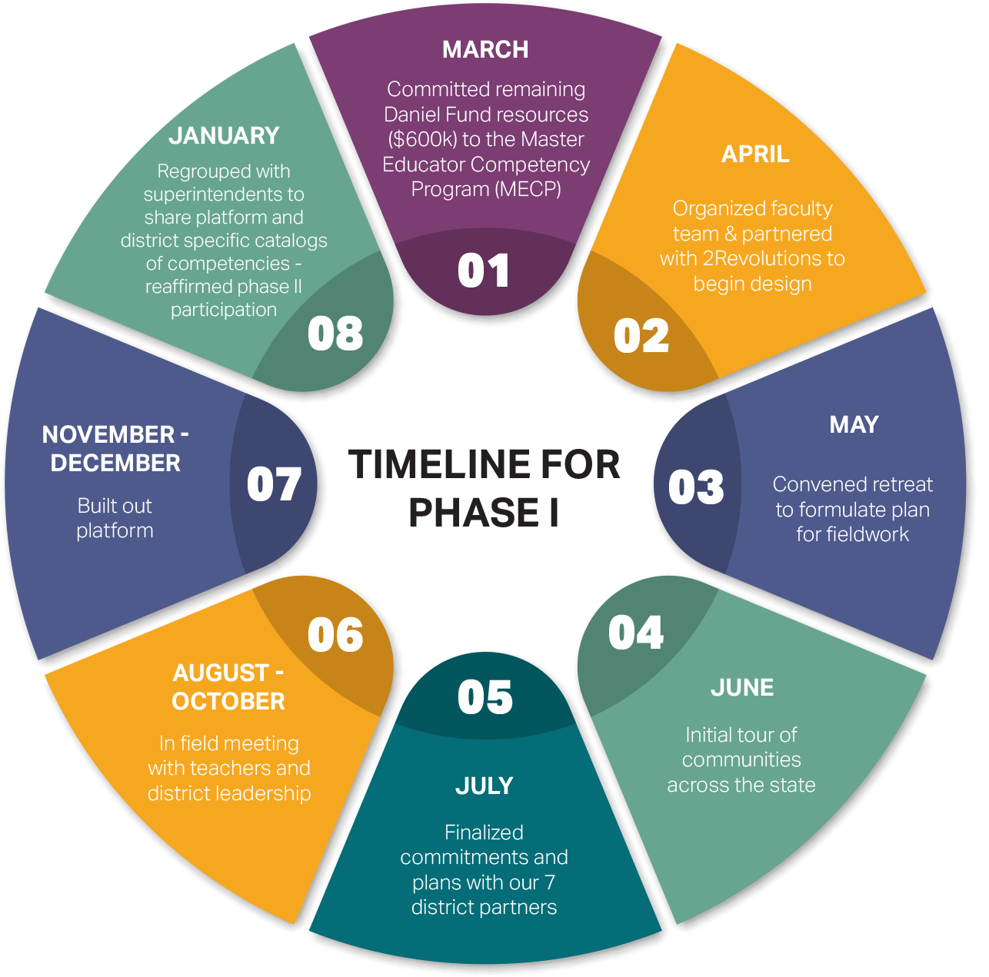
Timeline for Phase I
Notes:
ST

Slide 5
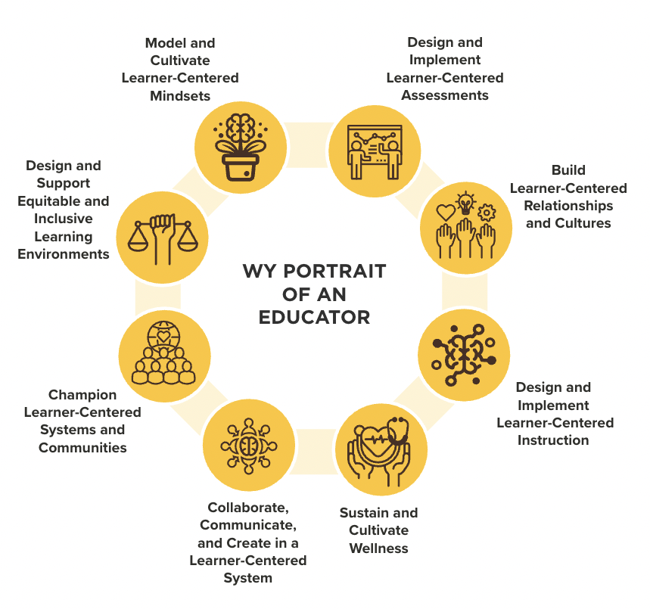
WY Portrait of an Educator

Slide 6
FIELD TEST RESULTS
Adaptive & Self-Pacing: People really appreciated the adaptive nature and the self-pacing that felt respectful of prior knowledge and experience
Navigation: Participants named navigation as one of the biggest challenges in this experience and even those who gave negative feedback reported being open to retrying the experience once navigation was simplified
Timing of Learning: Spring is a hard time for busy educators given their responsibilities so this should be presented in the Summer or Fall
Unpacking DoL: Participants were oriented to the navigation of the platform during the Orientation but next time our team would orient around Demonstrations of Learning directions and unpacking examples more explicitly
Joy & Engagement: Participants named that this worked better for some learning styles than others so there may be an opportunity to create different versions of offerings that enable more real-time collaboration or majority asynchronous experience

Slide 7
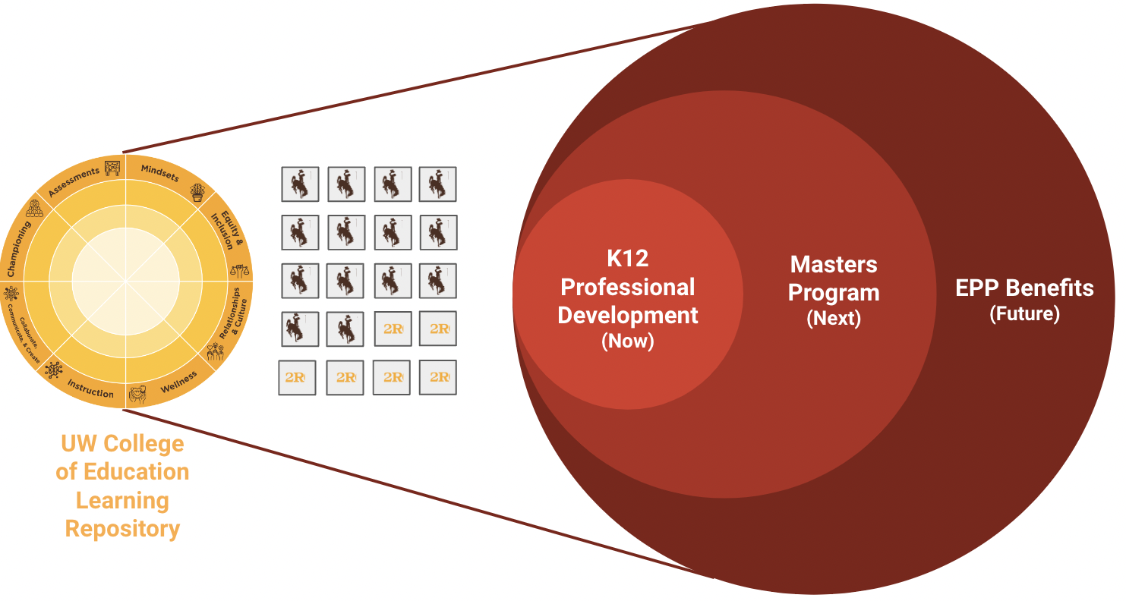
Bring the University to Them
P12 PD
(NOW)
Free- Some % of free content as part of our land grant mission; as a way to incentivize learners to get started
Freemium- Low cost credits based on validated learning experiences ($100/credit for first 3 credits)
Premium- Market-rate credits based on validated learning experiences ($200/credit for next 6 credits)
This is a green field, in desperate need of higher quality, greater flexibility and affordability
MA
(NEXT)
Vestibulum congue
NEW OPPORTUNITIES FOR PRICING & AFFORDABILITY
Up to 9 credits from PD can be used toward a 15 credit certification or a 32 credit MA
MA Program priced at $16k ($500/credit)
If a district can get to a cohort of 20 educators, price drops by 20% so full program is $12,800 ($400/credit)
Customized programs better meet local needs, more cost-effective, while maintaining quality and attracting a significantly higher # of learners
Give WY Educators the Learning Experience we Want Them to Give Learners
EPP
(FUTURE)
Provides badging capabilities to support broader/deeper learning
Allows us to rethink some of our learning model design to support longer more intensive residency and field based learning
Lots of potential to leverage this content and learning design to positively impact and enhance the value proposition; downstream innovation
Better Meeting Market Needs
Notes:
ST

Slide 8
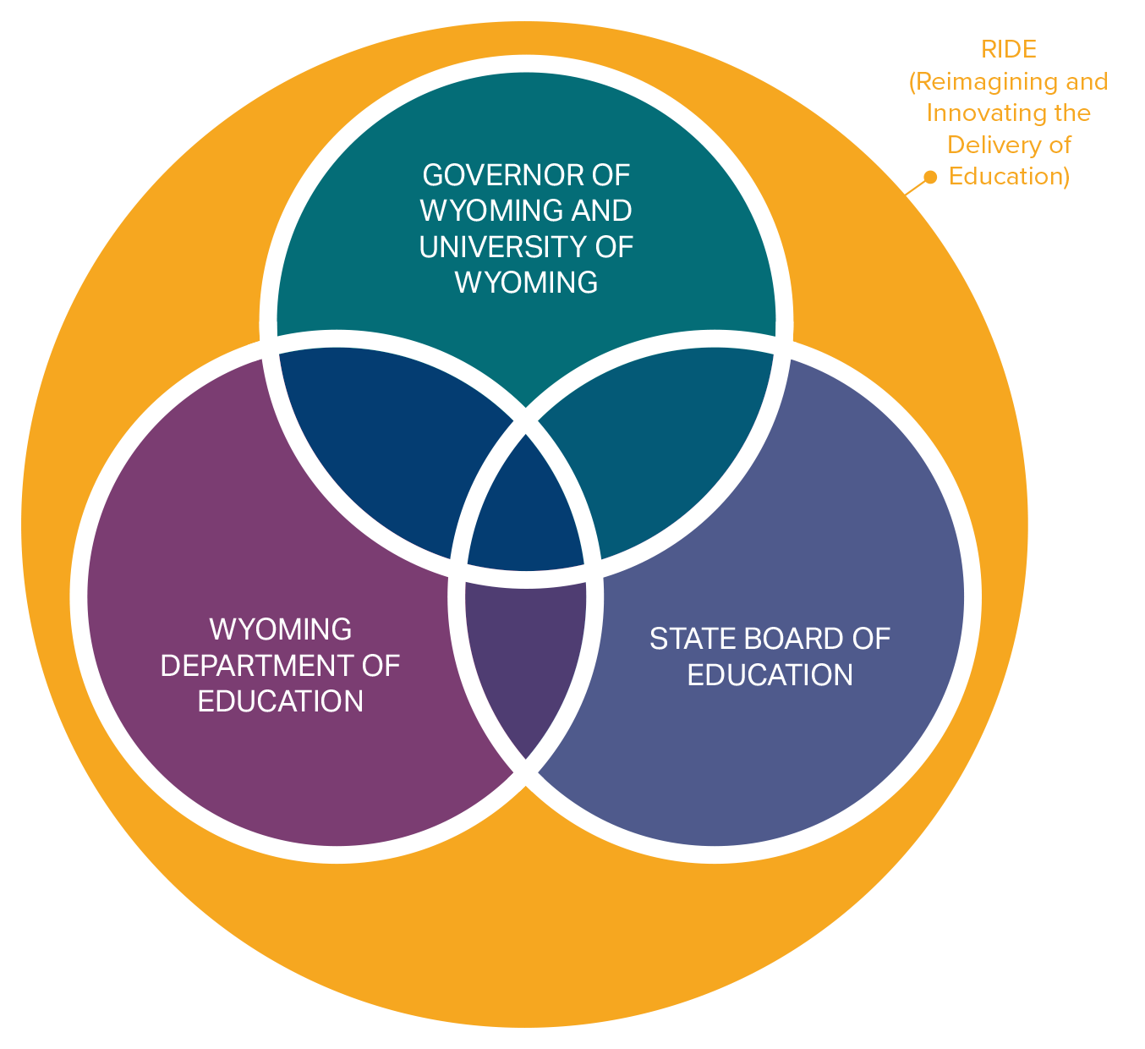
K-12 Competency Based Pilots
Novel partnership between the Wyoming State Board of Education, the Wyoming Department of Education, and UW College of Education, and the Governor’s Office.
Placing all of the state's power behind transitioning education in Wyoming toward a system that's center on individual student progress rather than seat time.
Notes:
ST - Reimagining and Innovating the Delivery of Education (RIDE)

