Slide 1
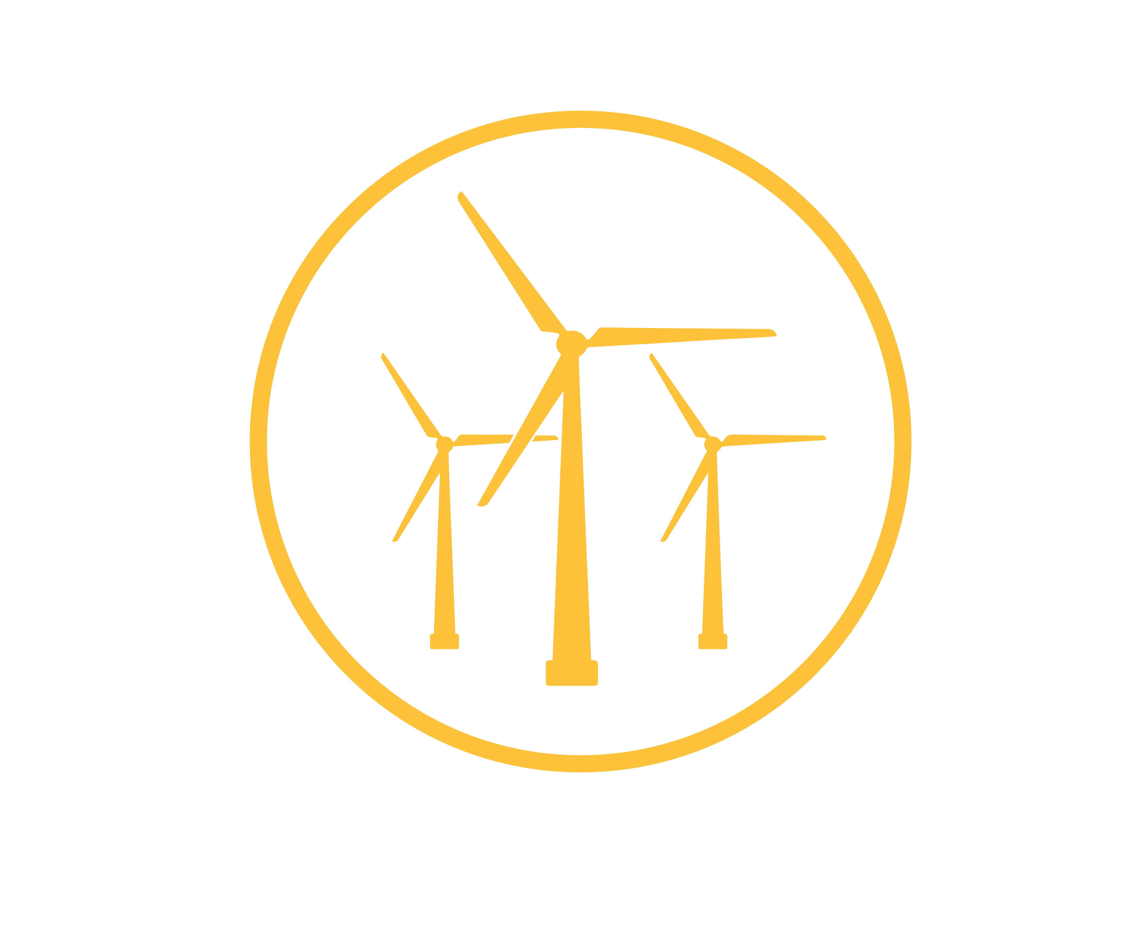
Wind Energy
Research Center
Jonathan Naughton
Michael Stoellinger
Directors

Slide 2
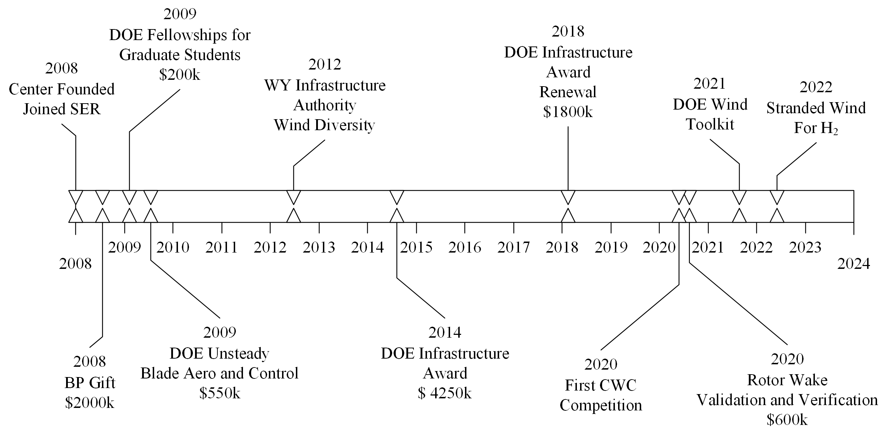
Center History

Slide 3
Core Research Competencies
  Modeling Winds
    Complex Terrain
  Modeling Wind Plants
    Individual Turbines and Wind Plants
    Onshore and Offshore
  High Performance Computing
    Massive Simulations
  Validation and Verification
    Approach to assess strengths and weaknesses of models
  Experimental Measurements
    Experiments in support of Model Validation

Slide 4
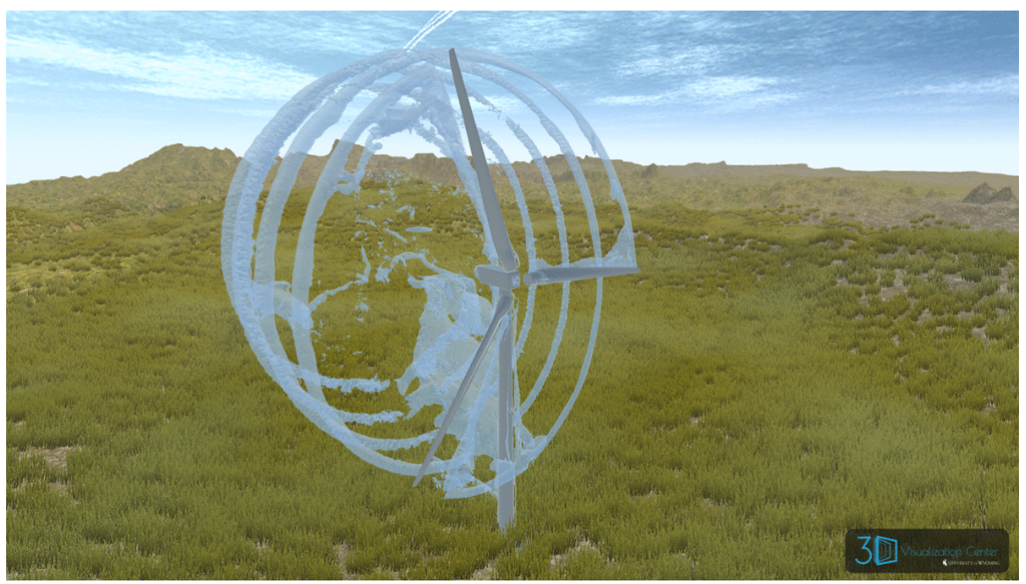
Notable Research – Wind Plant Simulation Framework

Slide 5
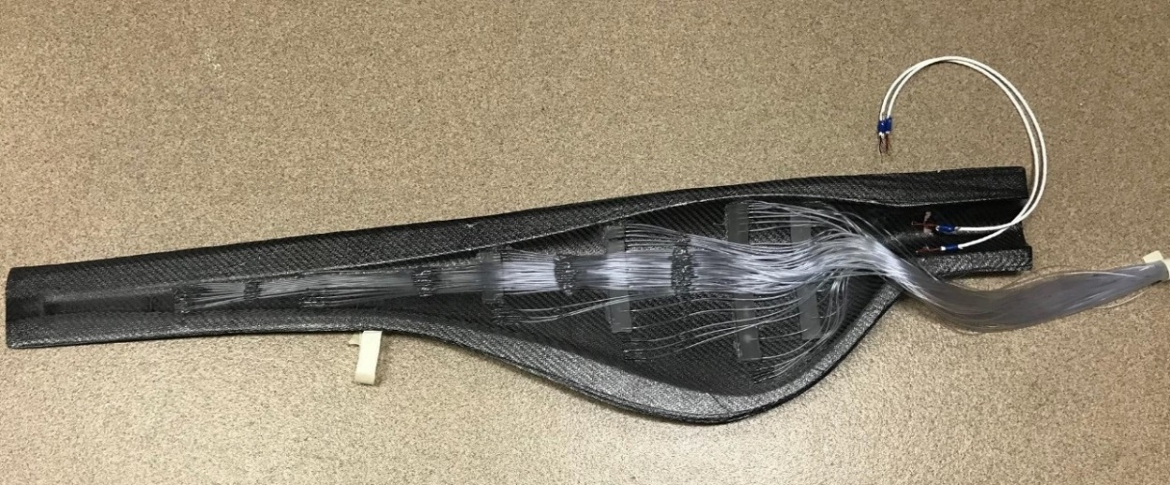
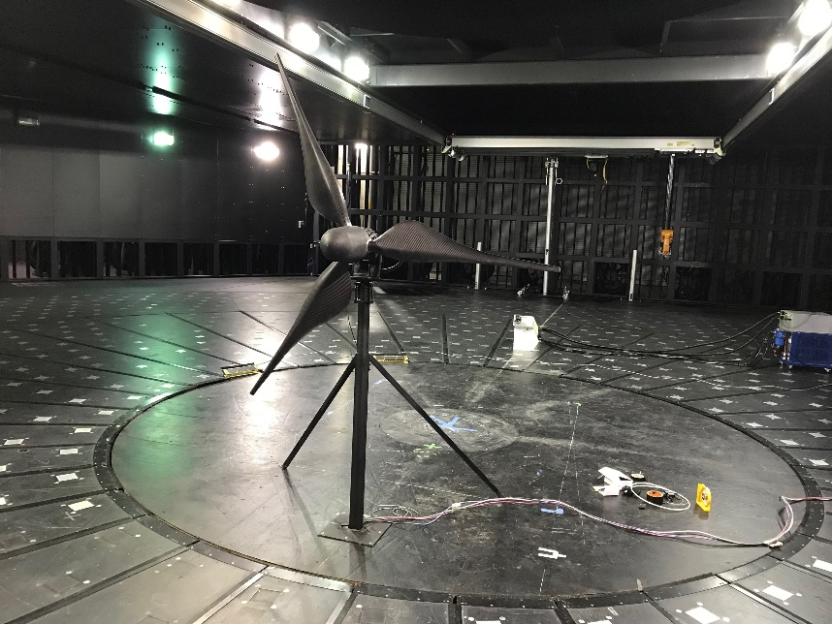
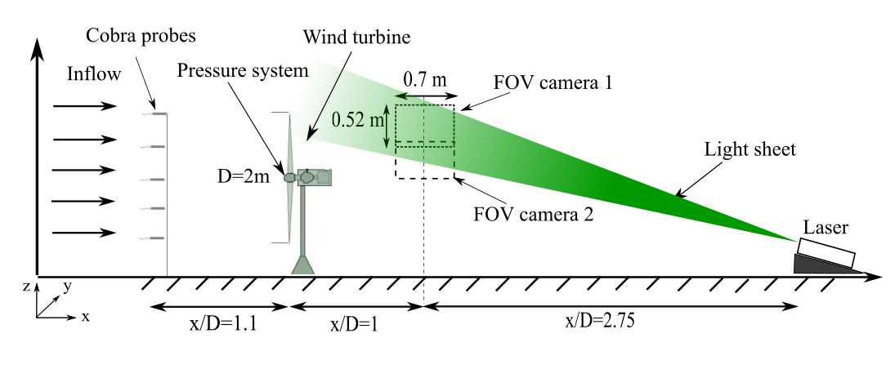
Notable Research – 2 m Diameter Turbine Test
Measured Wind Turbine Performance under Controlled Conditions
  Inflow, Blade, Wake

Slide 6
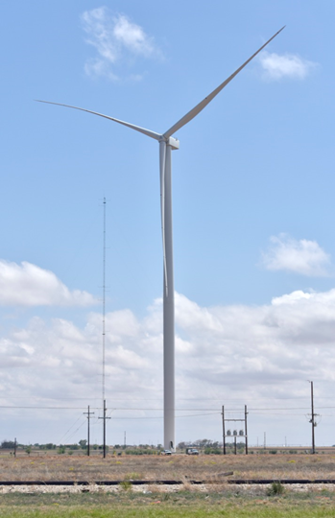
Current Work – RAAW Field Campaign
Collaboration
  University of Wyoming (PI)
  National Renewable Energy Laboratory
  Sandia National Laboratory
  General Electric
Campaign Location
  Lubbock, Texas
Campaign Timing
  September 2022 – October 2023
Campaign Turbine
  GE 2.8MW
    120-m hub height
    127-m rotor diameter

Slide 7
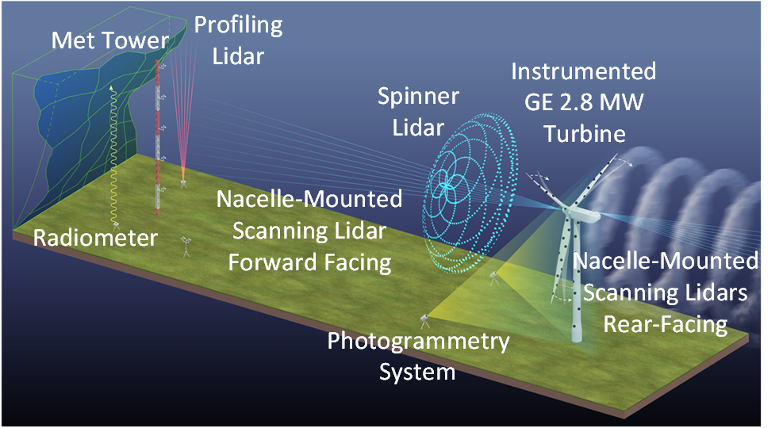
Current Work – RAAW Field Campaign
Heavily Instrumented Field Campaign
  Inflow
  Turbine
  Wake
Primary Use of Data
  Validation of Computational Codes
  Discovery

Slide 8
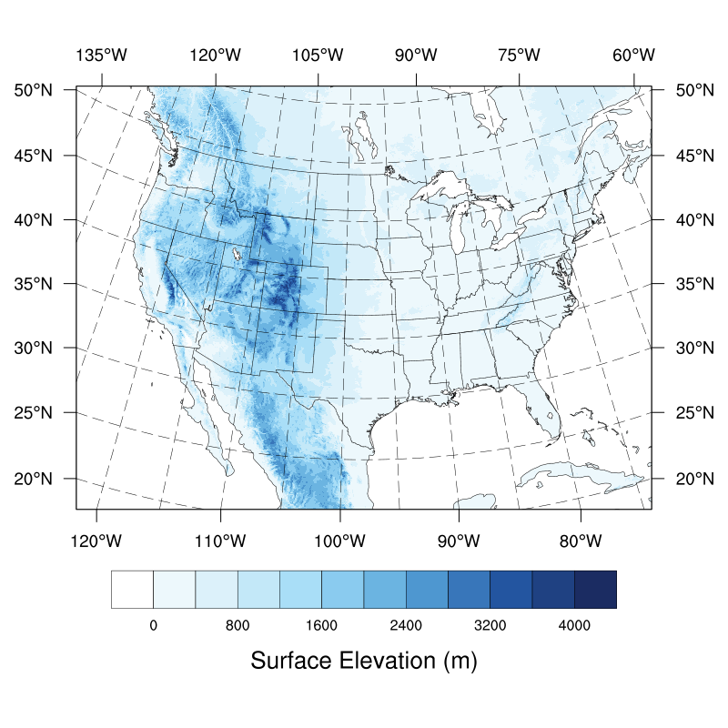
Current Work - WIND Toolkit Long-Term Ensemble Dataset
WIND TKE-LED
Expansion on the previous WIND Toolkit released in 2014
National dataset developed by researchers at National Renewable Energy Laboratory (NREL), Argonne National Laboratory (ANL), and the University of Wyoming
Covers entire contiguous US, Alaska, Hawaii, and offshore US
Modeled 20 years from 2001-2020
Will be publicly available soon

Slide 9
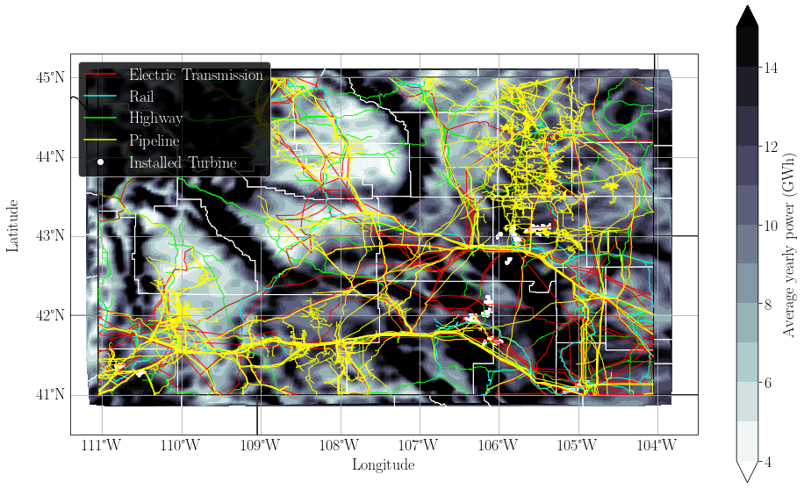
Current Work – Stranded Wind for H₂ Production
Wyoming features areas with large potential stranded wind resource
  A large portion of the wind resource is more accessible by highway and rail than electric transmission

Slide 10
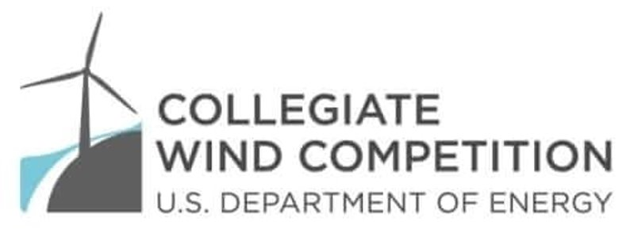
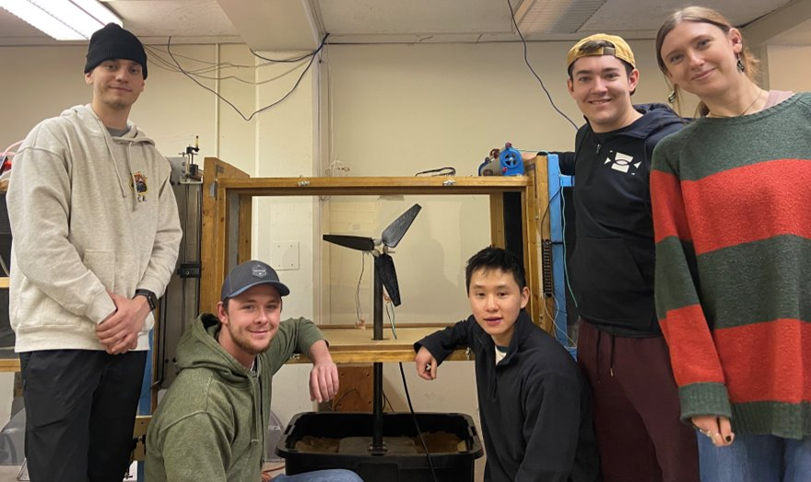
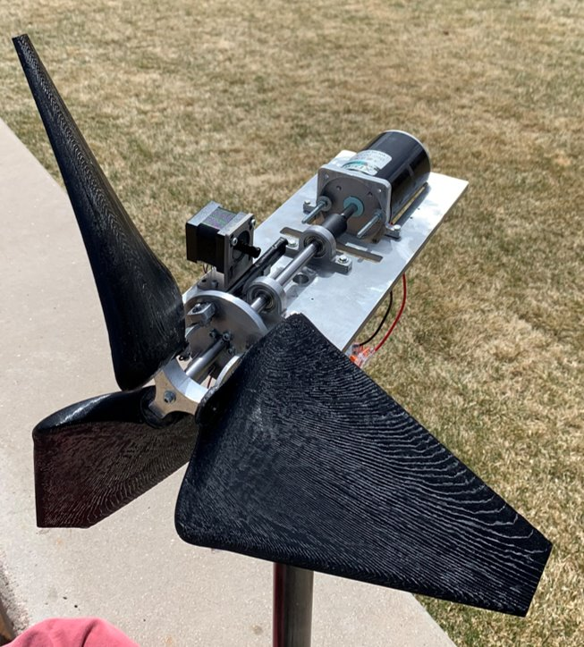
Undergraduate Student Involvement
Collegiate Wind Competition
  Turbine Design
  Wind Plant Layout
  Outreach and Industry Awareness

Slide 11
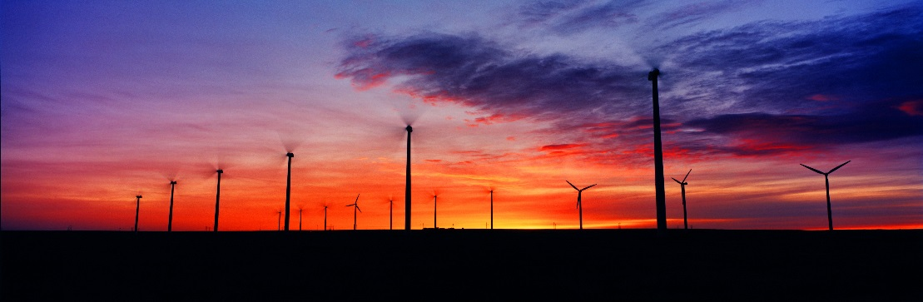
Collaborators
Government
National Renewable Energy Laboratory
Sandia National Laboratories
Pacific Northwest Laboratory
Industry
Siemens - Gamesa
Envision
GE Vernova
Power Company of Wyoming
Rocky Mountain Power
Argonne National Laboratory

Slide 12
Pending and Upcoming Opportunities
DoE: Building EPSCoR State/ National Laboartory Partnerships
High-Fidelity Computational Tools for Arrays of Large Modern Aeroelastic Wind Turbines
NSF EPSCoR Track 2
UW Participants: Nguyen, Muknahallipatna, Naughton
Collaborators: Sandia National Laboratories, GE Vernova
UW Participants: Stoellinger, Fertig, Heinz, Kirby Naughton
Partners: University of North Dakota, Kansas State University
DoE: Research to Improve Aerodynamic Performance of Offshore Wind Turbines
Steady and Unsteady High Reynolds Number Blade Aerodynamics
Collaboration with Other UW Entities
SER Hydrogen Energy Research Center (Eugene Holubnyak, Sarah Buckhold) - Stranded Wind for Hydrogen Production
Collaborators: Sandia National Laboratories, GE Vernova
UW Participants: Stoellinger, Kirby, Naughton
School of Computing (Andrew Kirby) – High Fidelity Simulations of Wind Turbines and Wind Plants

Slide 13
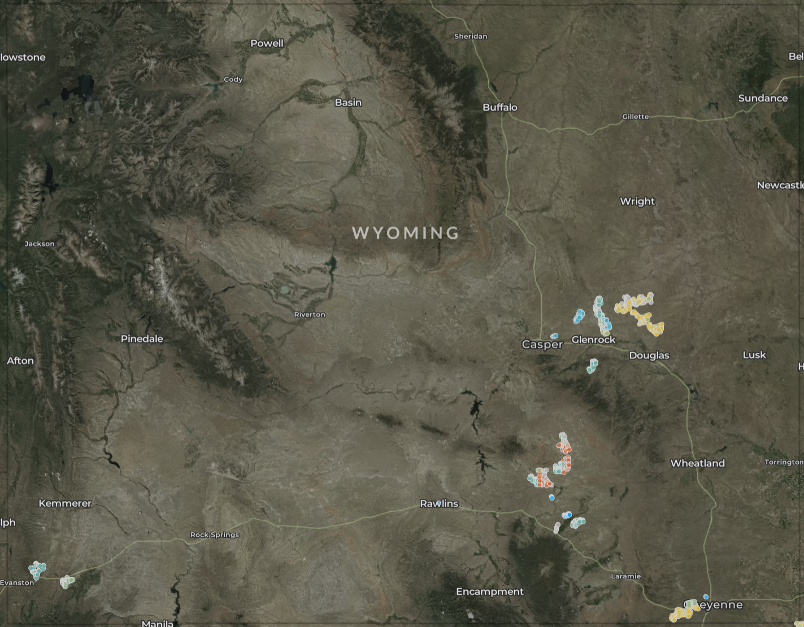
Wind and Wyoming
https://eerscmap.usgs.gov/uswtdb/
Current
  ~1500 turbines
  ~3200 MW rated capacity
Planned Projects (>5000 MW)
  Chokecherry – Sierra Madre
    ~ 3000 MW
  Rail Tie
    ~500 MW
  Boswell Springs
    ~ 330 MW
  Rock Creek
    ~ 590 MW
  Uinta Wind Project
    ~160 MW
  Two Rivers
    ~280 MW
  Lucky Star
    ~500 MW

Slide 14
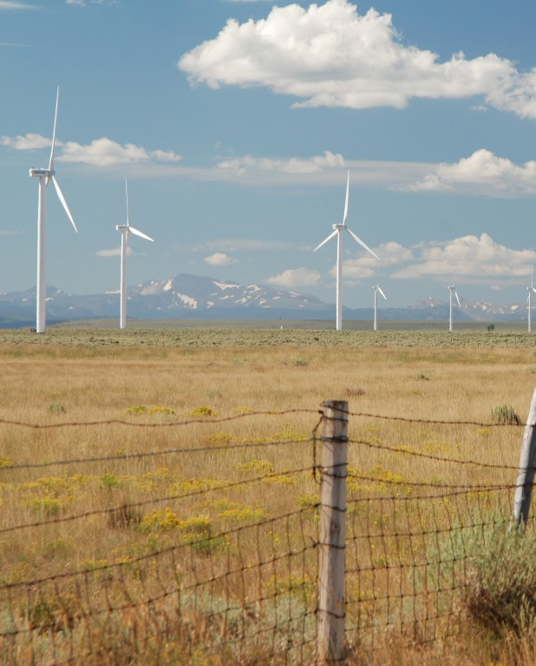
Summary
Long Duration Center
  Exciting Past
Continued Relevance of Wind Energy Research
  Ongoing Developments in Wind Energy
    Offshore Wind
    Complex Terrain
    Large Wind Turbines
  Interfaces with Other Technologies
    Transmission
    Storage
    Other Generation Technology
  Impacts on Wyoming

