Slide 1
Programmable Multicellularity: Why do this?
Conventional Biomanufacturing
With Microbial “Stem Cells”
“Aging” during biomanufacturing
> high metabolic stress
> toxicity / limited capacity
> slow growth / death

Slide 2
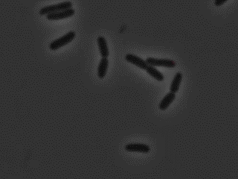
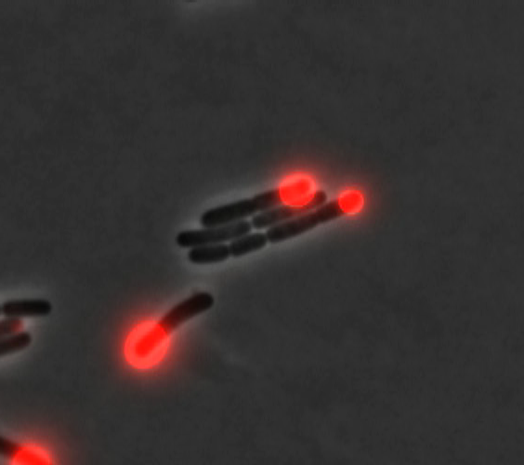
Step #1: programmable asymmetric cell division
Step #2:
differential gene expression.

Slide 3
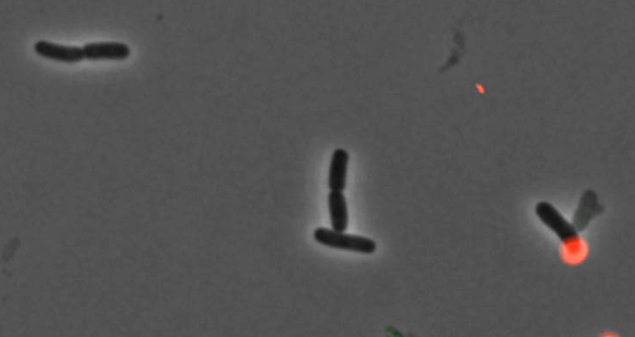
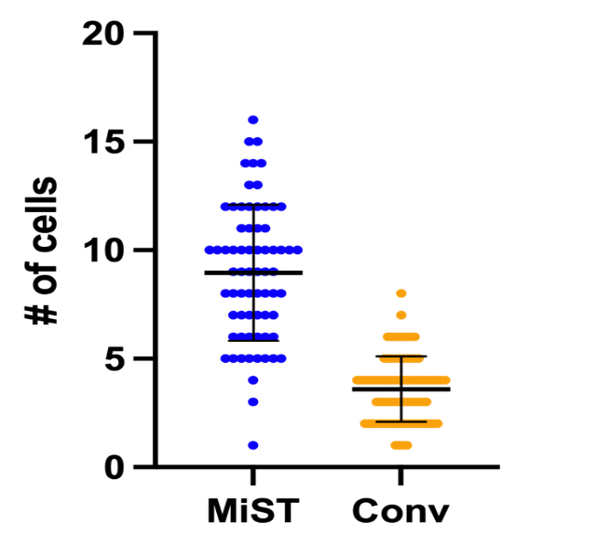
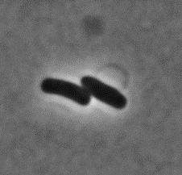
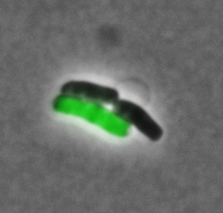
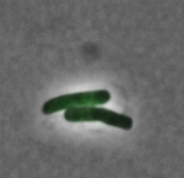
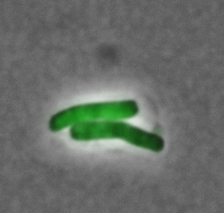
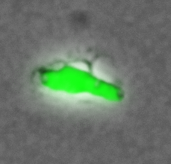
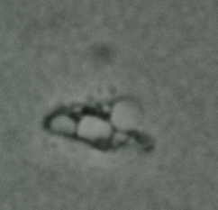
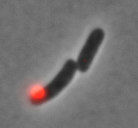
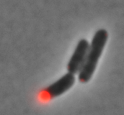
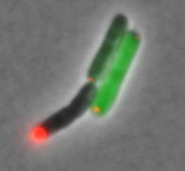
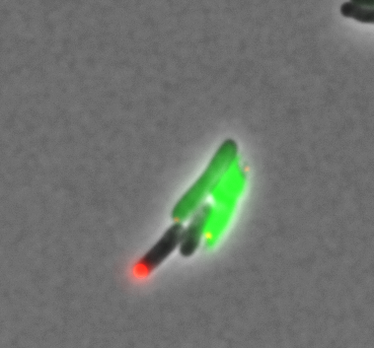
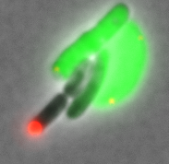
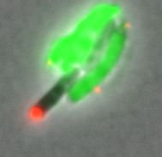
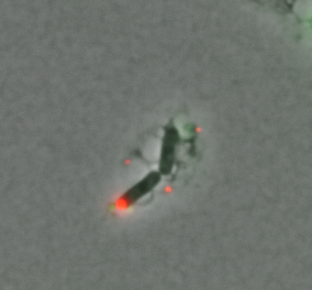
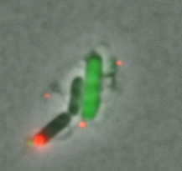
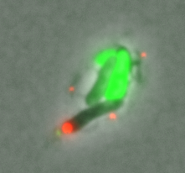
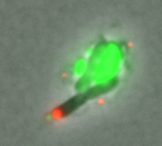
Bacterial “Stem Cells” extend production lifetime
# of cell divisions before death

Slide 4
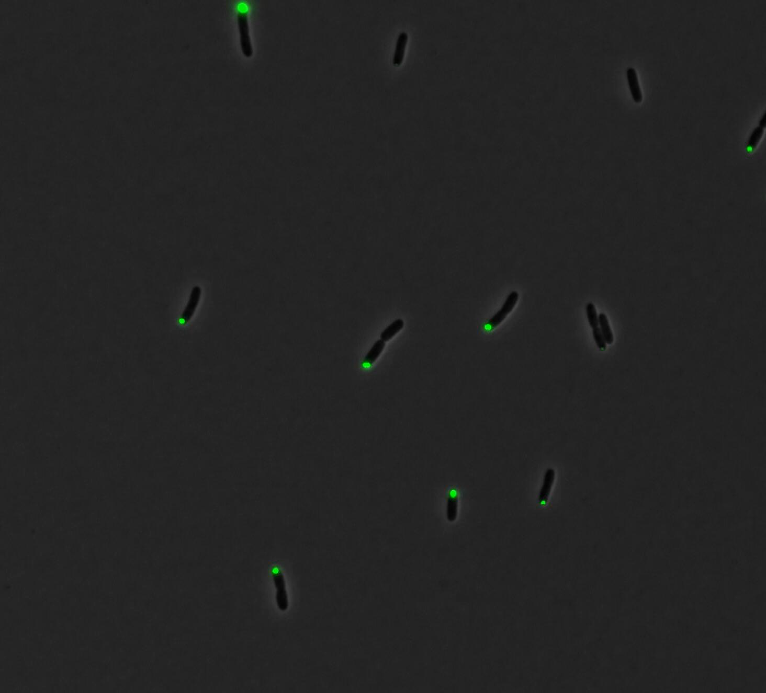
Fully committing factory cells to production
MiST
MiST
no Stem cells
BL21
4X higher yield
with stem cells
2X higher yield
over conventional production strains

Slide 5

SUPPORT FROM EXTERNAL SOURCES (Since 2020)
Federal Grants
One SIBR, One STTR, plus Wyoming matching funds: $675k total ($165k to UW)
NSF Research grant: $511k total (to Bowman / UW)
Other Financial Support and Investments
Innovation “Incubators”: Two. IndieBio and NSF Activate: $505k to AsimicA
Angel Investor to AsimicA: $75k
RETURN ON INVESTMENT
Personnel & Training:
1 scientist/founder + 1 lab tech (AsimicA), 3 PhD students (UW)
Publications: Two so far. One in Nature Biotechnology, 2 more in preparation
Patents: One Issued in 2021, One Provisional (To University of Wyoming and AsimicA)

Slide 6
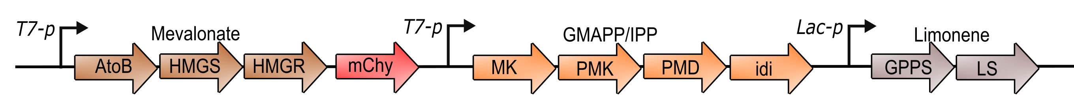
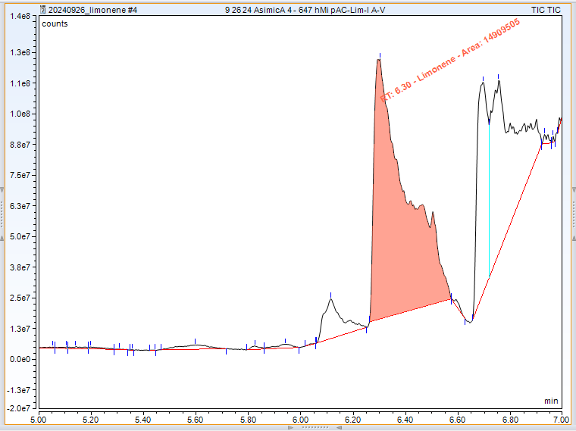
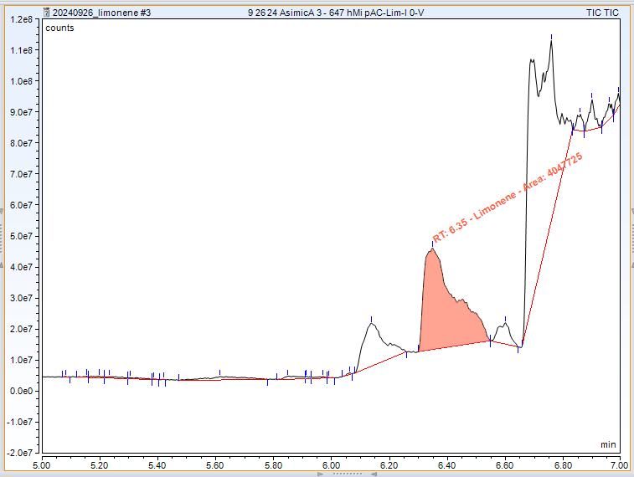
Current Directions: Valuable Products
A. Increased production of human insulin (commercially manufactured in E. coli)
MiST
Conv.
B. Increased production of limonene. (An industrial solvent and a precursor for fragrances and flavorings)
MiST
Conventional
C. (Near Future) Scalability: Demonstration in a bioreactor
limonene
limonene

Slide 7
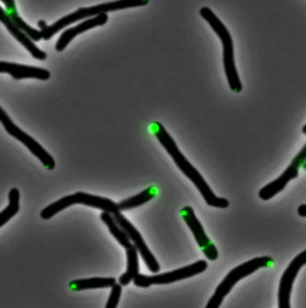
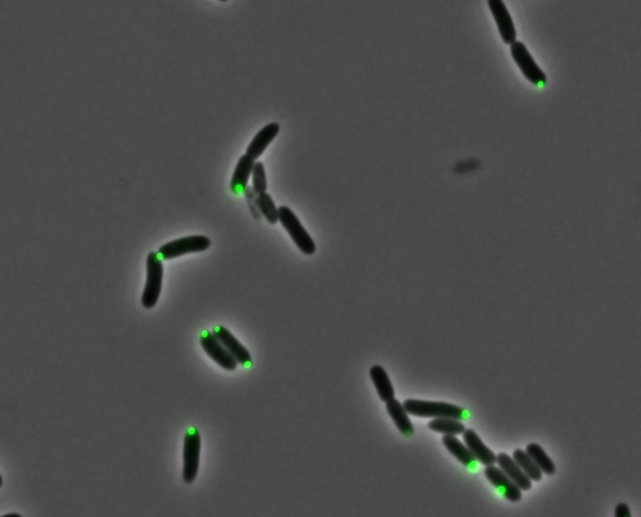
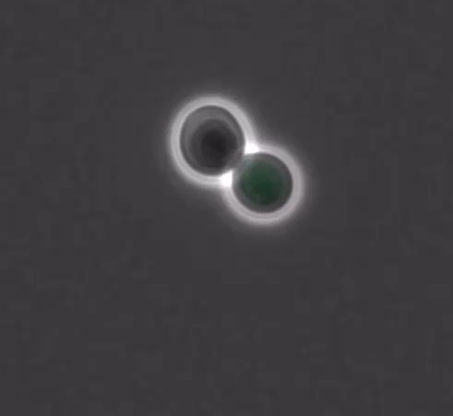
Current Directions: Additional Species
A. Pseudomonas putida (converts lignocellulosic feedstocks)
B. Rhodococcus jostii (makes oils / lipids).
C. Brewer’s Yeast Saccharomyces cerevisiae. Most common commercial producer (alcohols, terpenoids).

Slide 8
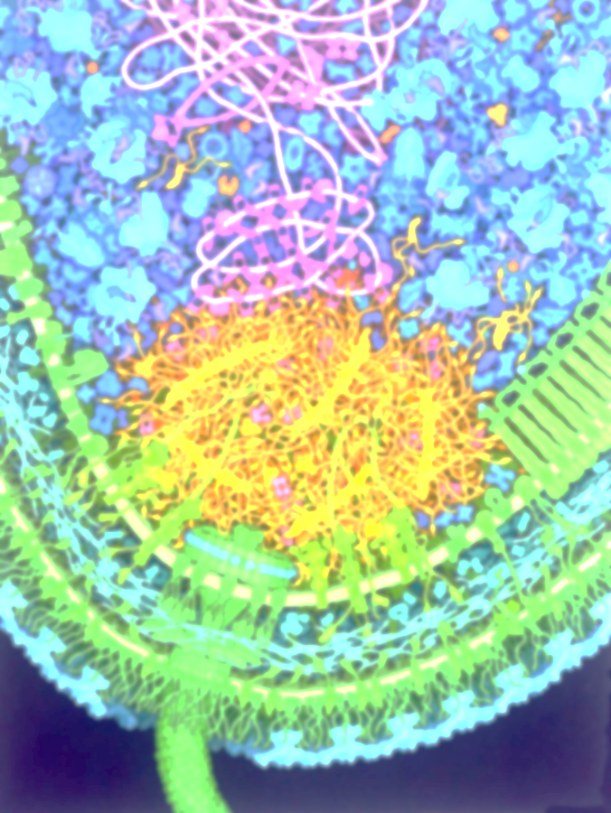




Thank you!
Understanding Cell Polarity
Biomanufaturing
Yasin Ahmed
Kaylan Schilling
Sammy Patterson
Abagail Straight
Ray Heffley
Ainsley Hokanson Tess Palen
Cody Mclarnon
Ellie Groves
Rachel Kaiser Maddie Sites
Ben Radosevich
Jacob Guidry
Steven Poyer
Nik Mushnikov
Ashley Park
Krisztina Varga (UNH)
Logan Brown (UNH)
Josh Holmes
Haibi Wang
Funding:

