Slide 1
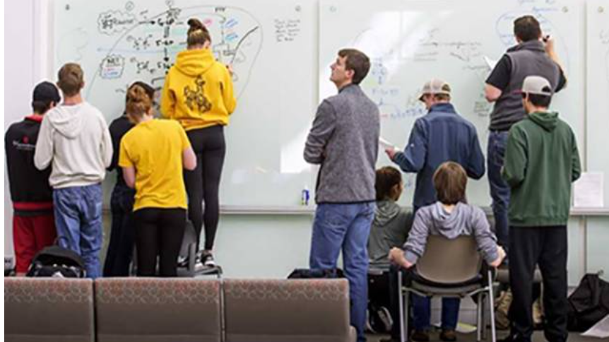
Follow-Up to November Discussion on Tutoring & Student Support Resources at UW
Academic and Student Affairs Committee, January 2026.
Notes:
This presentation is a direct follow-up to the Board’s discussion in November regarding tutoring access, structure, and responsiveness to student needs.
Since that conversation, our team pulled together several years of usage, outcome, and operational data. Today, our goal is not to walk you through programs in detail, but to answer three questions clearly:
How students use tutoring
Whether it’s working

Slide 2

Tutoring is coordinated across UW by step(Student tutoring engagement Program)
STEP oversees 45-50 tutors/semester. Some of these tutors are funded through partnerships with Center for Assistance with Statistics and Mathematics (8-10), Modern & Classical Languages (2-3), Business (4-6), and Engineering (4-6).
Tutors work between 2-16 hours/week (2 is minimum, 16 is enforced maximum)
On average, staff tutor 4-5 subjects
Typically 90-92% of tutors are UWYO undergraduate students.
Notes:
Tutoring is mostly centered around the 1st floor of the library because the satellite locations were in the bottom on Washakie. There are some discussions about space being available on the first floors of the new dorms for tutoring but no space has been allocated yet

Slide 3
Appointments Are the Dominant Student Preference
Based on 4 years of STEP data:
18,000+ appointments serving over 2,600 unique students
<800 drop-ins
4.87 / 5 average student satisfaction
Notes:
One of the clearest findings is that students overwhelmingly prefer scheduled appointments over drop-in tutoring.
Over a four-year period, we saw more than 18,000 one-on-one appointments serving over 2,600 unique students, compared to fewer than 800 drop-in visits.
Importantly, satisfaction with appointment-based tutoring is extremely high—nearly 4.9 out of 5—which tells us this model is meeting student needs as they experience them.

Slide 4

Most Appointments Are Booked Same-Day or Next-Day
Same day: ~32%
1 day out: ~23%
2–3 days: ~20%
4–7 days: ~23%
8+ days: ~2%
Notes:
One concern raised in November was the perception that students must plan tutoring a week in advance. That is not the case.
Nearly one-third of appointments are booked the same day, and over half are booked either same-day or the day before. Students can schedule as little as five minutes before a session begins.
We do see meaningful constraints during peak exam periods or in subjects where tutor recruitment is especially challenging, such as physics.

Slide 5
Does tutoring improve outcomes?
3+ visits to STEP : ~80% earn C or higher
3+ visits to Supplemental Instruction: ~89–90% pass
Higher GPAs among participants
Notes:
We also asked the most important question: does tutoring actually work?
The answer is consistently yes. Students who use STEP tutoring three or more times earn a C or higher at rates above 80%.
For Supplemental Instruction, which is structured, course-embedded, and drop-in by design, nearly 90% of students who attend multiple sessions pass the course.
These are not marginal gains—these are meaningful differences in student success.

Slide 6
Why drop-in works for math but more challenging for broader science areas
CASM = single discipline
Science = multiple fields
Drop-in excludes online students
Notes:
Math drop-in tutoring works well because CASM focuses on a single discipline with a predictable pipeline of qualified tutors.
“Science,” by contrast, includes biology, chemistry, physics, and engineering—each with different preparation pathways and staffing challenges.
Additionally, drop-in models do not serve online or distance students, whereas appointment-based tutoring does.

Slide 7
What happens when tutoring appointments aren’t available?
24/7 Tutor.com / TutorMe
Escalation option to STEP leadership
Supplemental Instruction for high-DFW courses
Life Sciences (Biology), Chemistry, Communications, Criminal Justice, Engineering, Kinesiology, Math, Micro- and Molecular Biology, Physics, Psychology
Notes:
Students have access to 24/7 online tutoring, same-day appointments in most subjects, and Supplemental Instruction in high-DFW courses.
If a student truly cannot find help, there is also a direct escalation path to STEP leadership to intervene.

Slide 8
Some Options
Improve communication (no new cost)
Department-based drop-in (TA-led)
Notes:
If the Board would like to see changes, there are a couple cost-neutral and realistic paths forward.
One is improved communication so students and faculty better understand existing options.
Another is a department-based model, similar to Chemistry’s tutorial room, where drop-in support is staffed by TAs or GAs.

Slide 9
Current state and next steps summary
STEP and partner tutoring units as well as Supplemental Instruction are highly used, effective, and aligned with how students actually seek help.
We are absolutely open to evolving the model, and changes should be guided by data, staffing realities, and student behavior.
We look forward to the Board’s guidance on priorities and next steps.

