Slide 1
What’s light got to do with it? Exploring the role of plant-reflected light in crop yield loss and weed management
Andrew Kniss
Professor & Head
Department of Plant Sciences

Slide 2

What’s light got to do with it? Exploring the role of plant-reflected light in crop yield loss and weed management
(got to do)
Andrew Kniss
Professor & Head
Department of Plant Sciences

Slide 3
My Research Program:
Herbicide evaluation & development in Wyoming crops
sugarbeet, dry bean, corn, wheat, barley, proso millet, sainfoin
new products, synergistic interactions, economics, use recommendations
Non-target impacts of pesticide use
mammalian toxicity, non-target insects, herbicide-resistant weed evolution in biotech crops
Crop-weed interactions
yield impacts, competition, cultural management practices

Slide 4
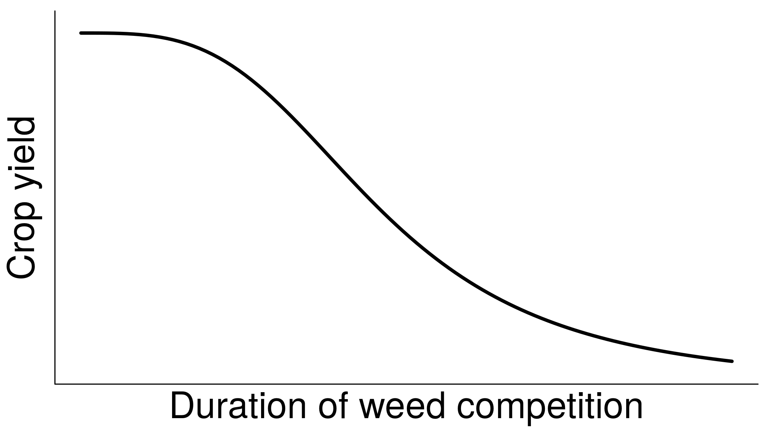
Yield loss due to weeds

Slide 5
Yield loss due to weeds
Competition!
Nutrients
Water
Light

Slide 6
Yield loss due to weeds
Yield begins to decrease once weeds use too many resources and the crop doesn’t have enough.
Right?

Slide 7


Slide 8
Yield loss due to weeds
Yield begins to decrease BEFORE weeds use enough resources to limit the crop.

Slide 9
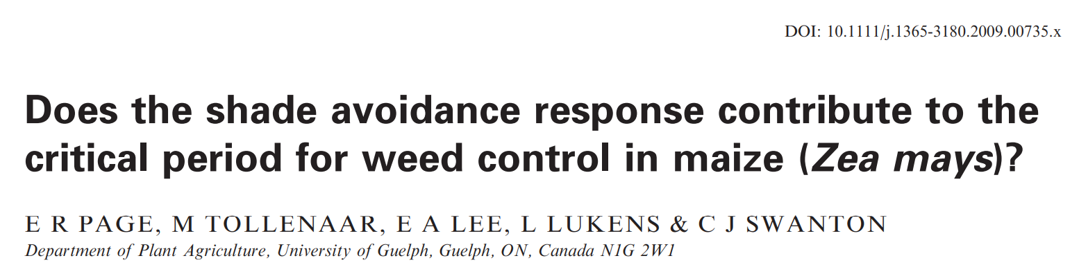
“Early physiological changes triggered by leaf-reflected light contribute to the onset of the critical time of weed removal.”
Page et al. (2009) Weed Research. 49(6):563

Slide 10
Shade Avoidance
is not
Shade!

Slide 11


Slide 12
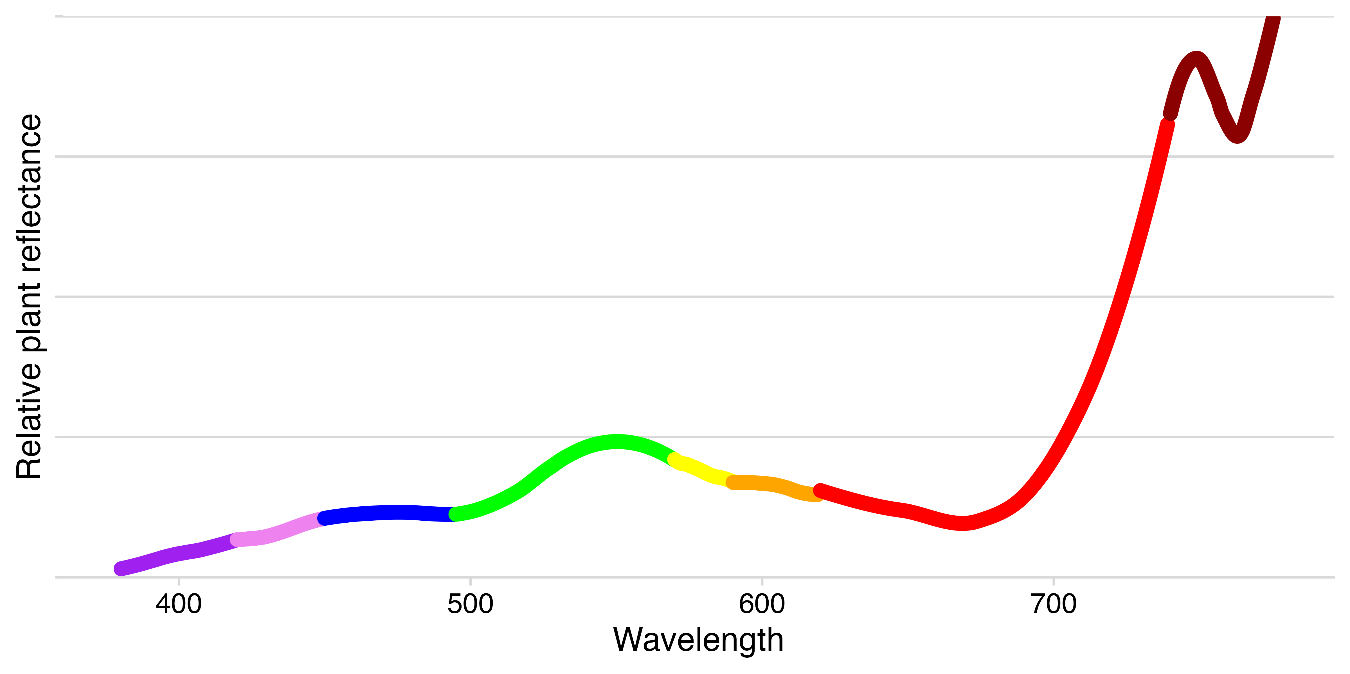

Slide 14
Far-red
R:FR ratio
drives the phytochrome reactions
Red

Slide 15
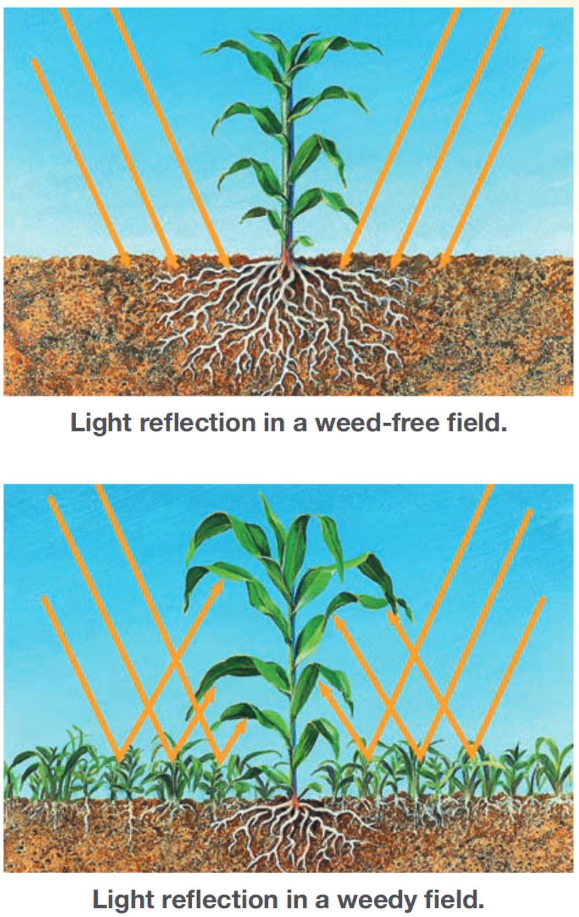
Hypocotyl elongation
Petiole elongation
Hyponasty
Smaller leaves
Suppressed axillary buds
Reduced branching
Increased stem height
Node elongation
Reduced root growth
(decreased root:shoot)
Delayed flowering
Early flowering
Reduced seed number
Shade
Avoidance
Syndrome
Image Source: Swanton & Syngenta

Slide 16
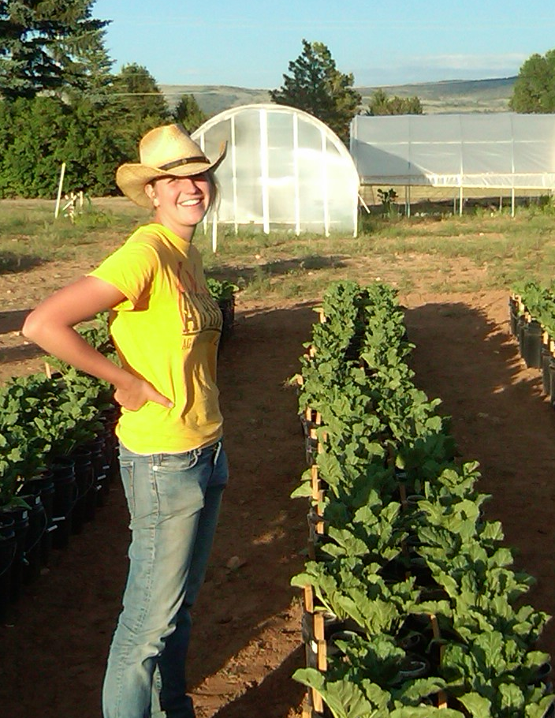
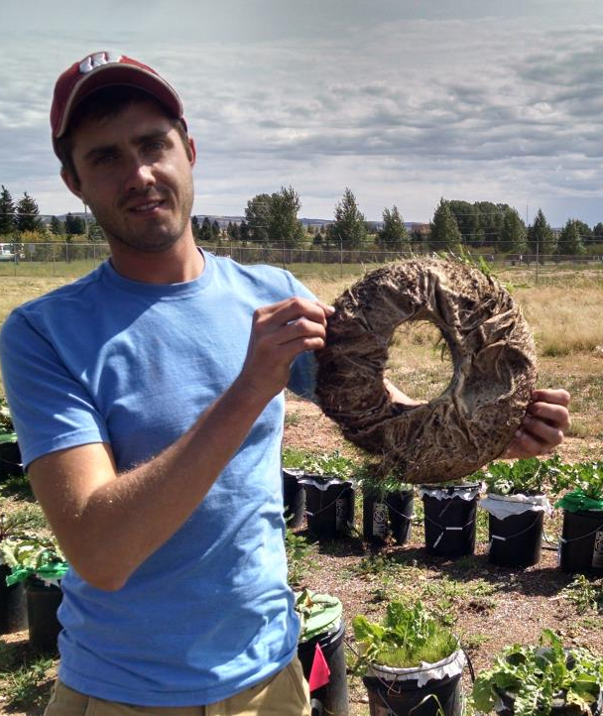
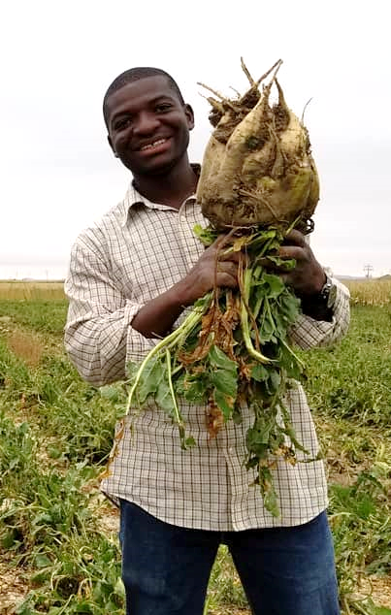
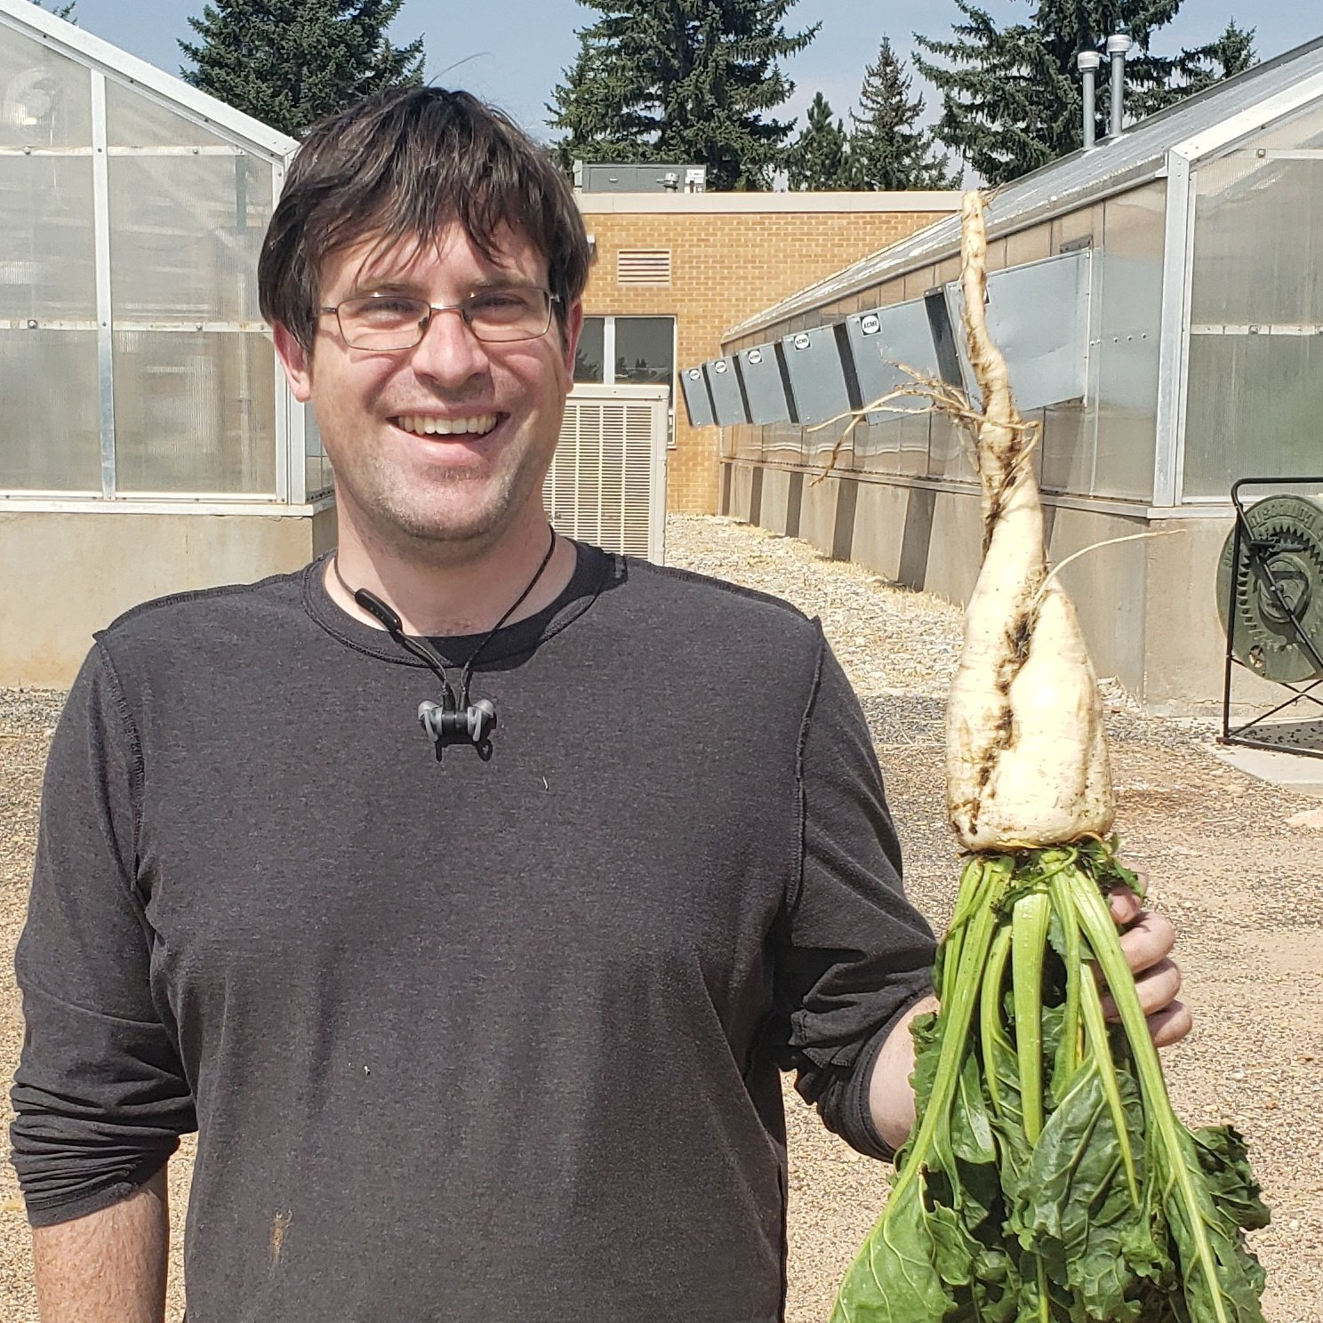
Louise Lorent
Tom Schambow
Albert Adjesiwor
Joe Ballenger

Slide 17
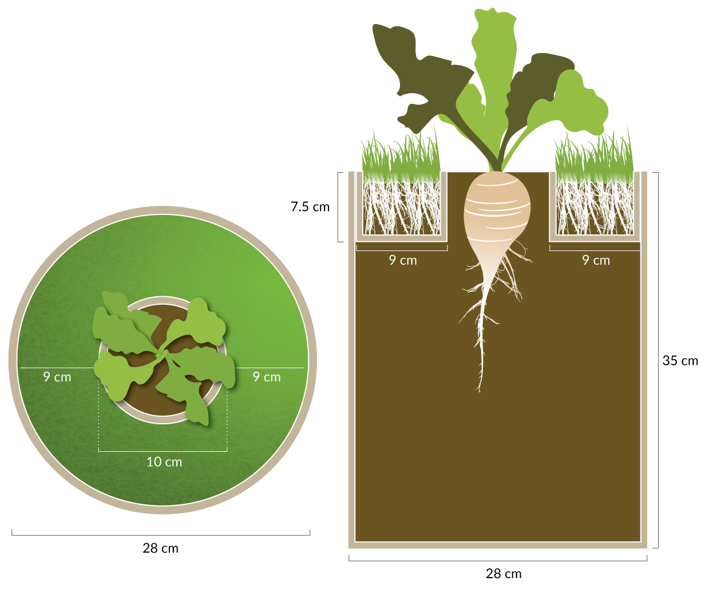
Image: Jessica Perry
Schambow et al. (2019) Weed Science. 67(3):311-317

Slide 18
 | Environment | Leaf area | Leaf biomass | Root biomass
 |  | –– cm² –– | –––––––– g ––––––––
Sugarbeet | soil | 12,600 | 44 | 288
 | grass | 4,700* | 31* | 85*
Table beet | soil | 6,900 | 34 | 188
 | grass | 2,300* | 27* | 52*
70%
72%
Schambow et al. (2019) Weed Science. 67(3):311-317

Slide 19
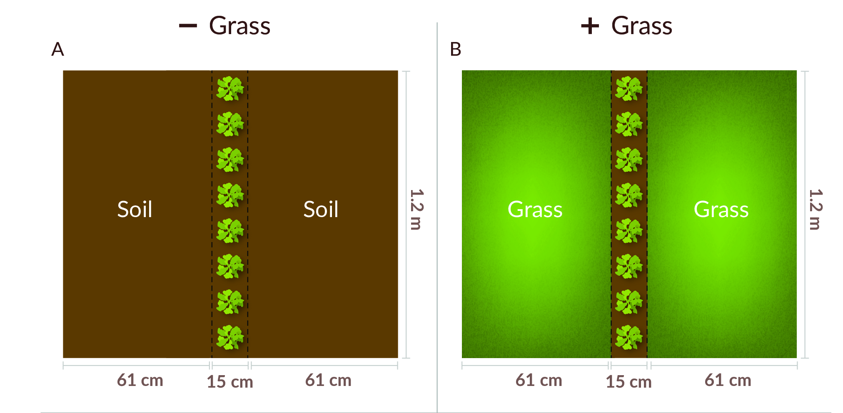
Image: Jessica Perry
Ballenger et al. (2024) Weed Science 72(2):159

Slide 20
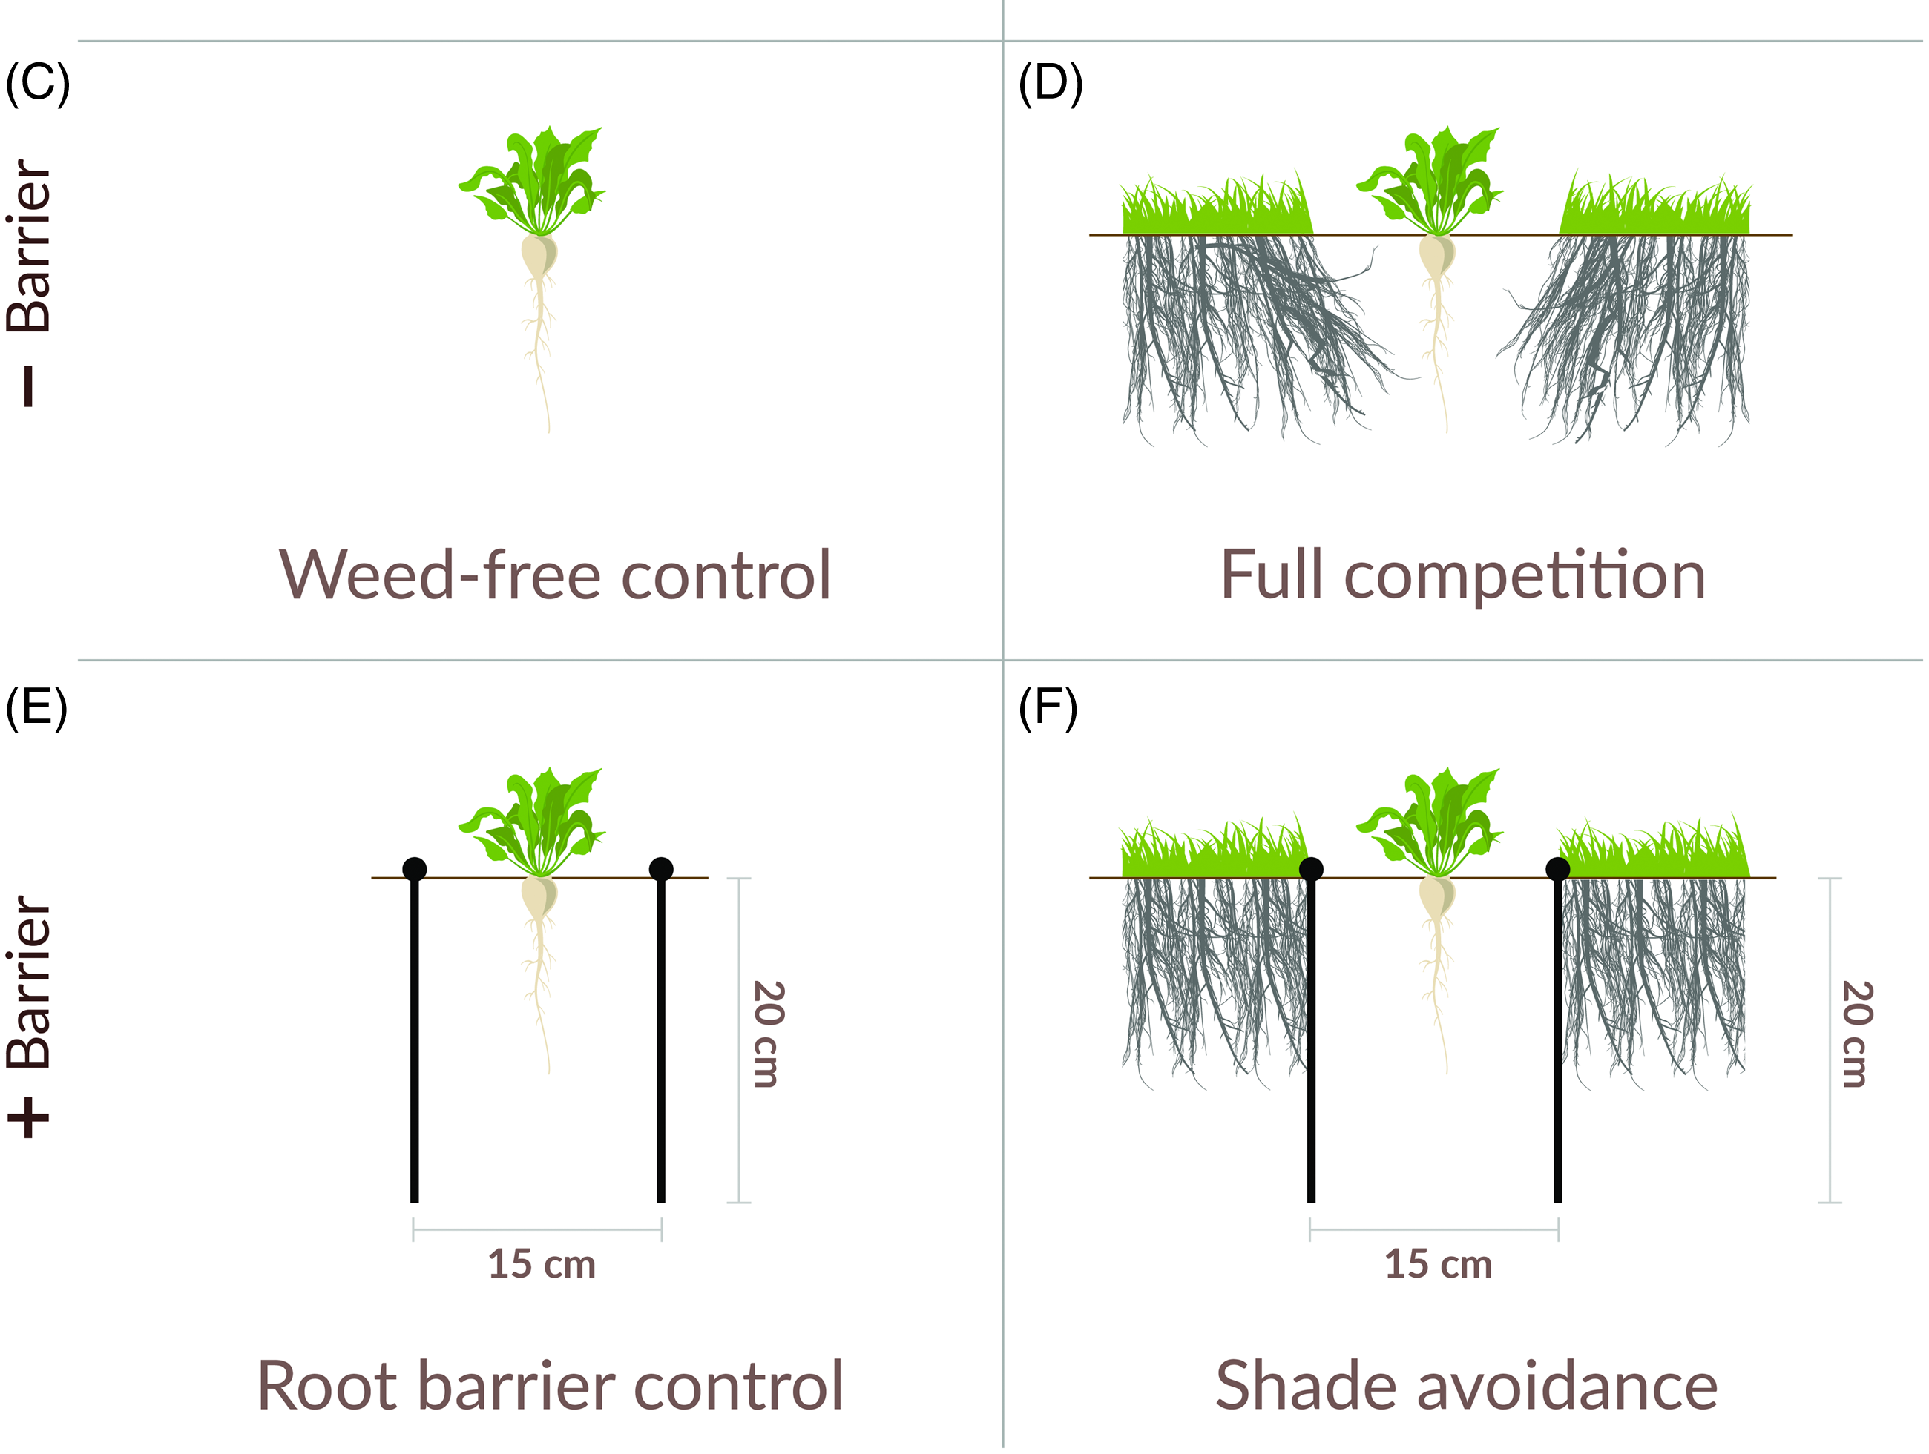
Image: Jessica Perry
Ballenger et al. (2024) Weed Science 72(2):159

Slide 21
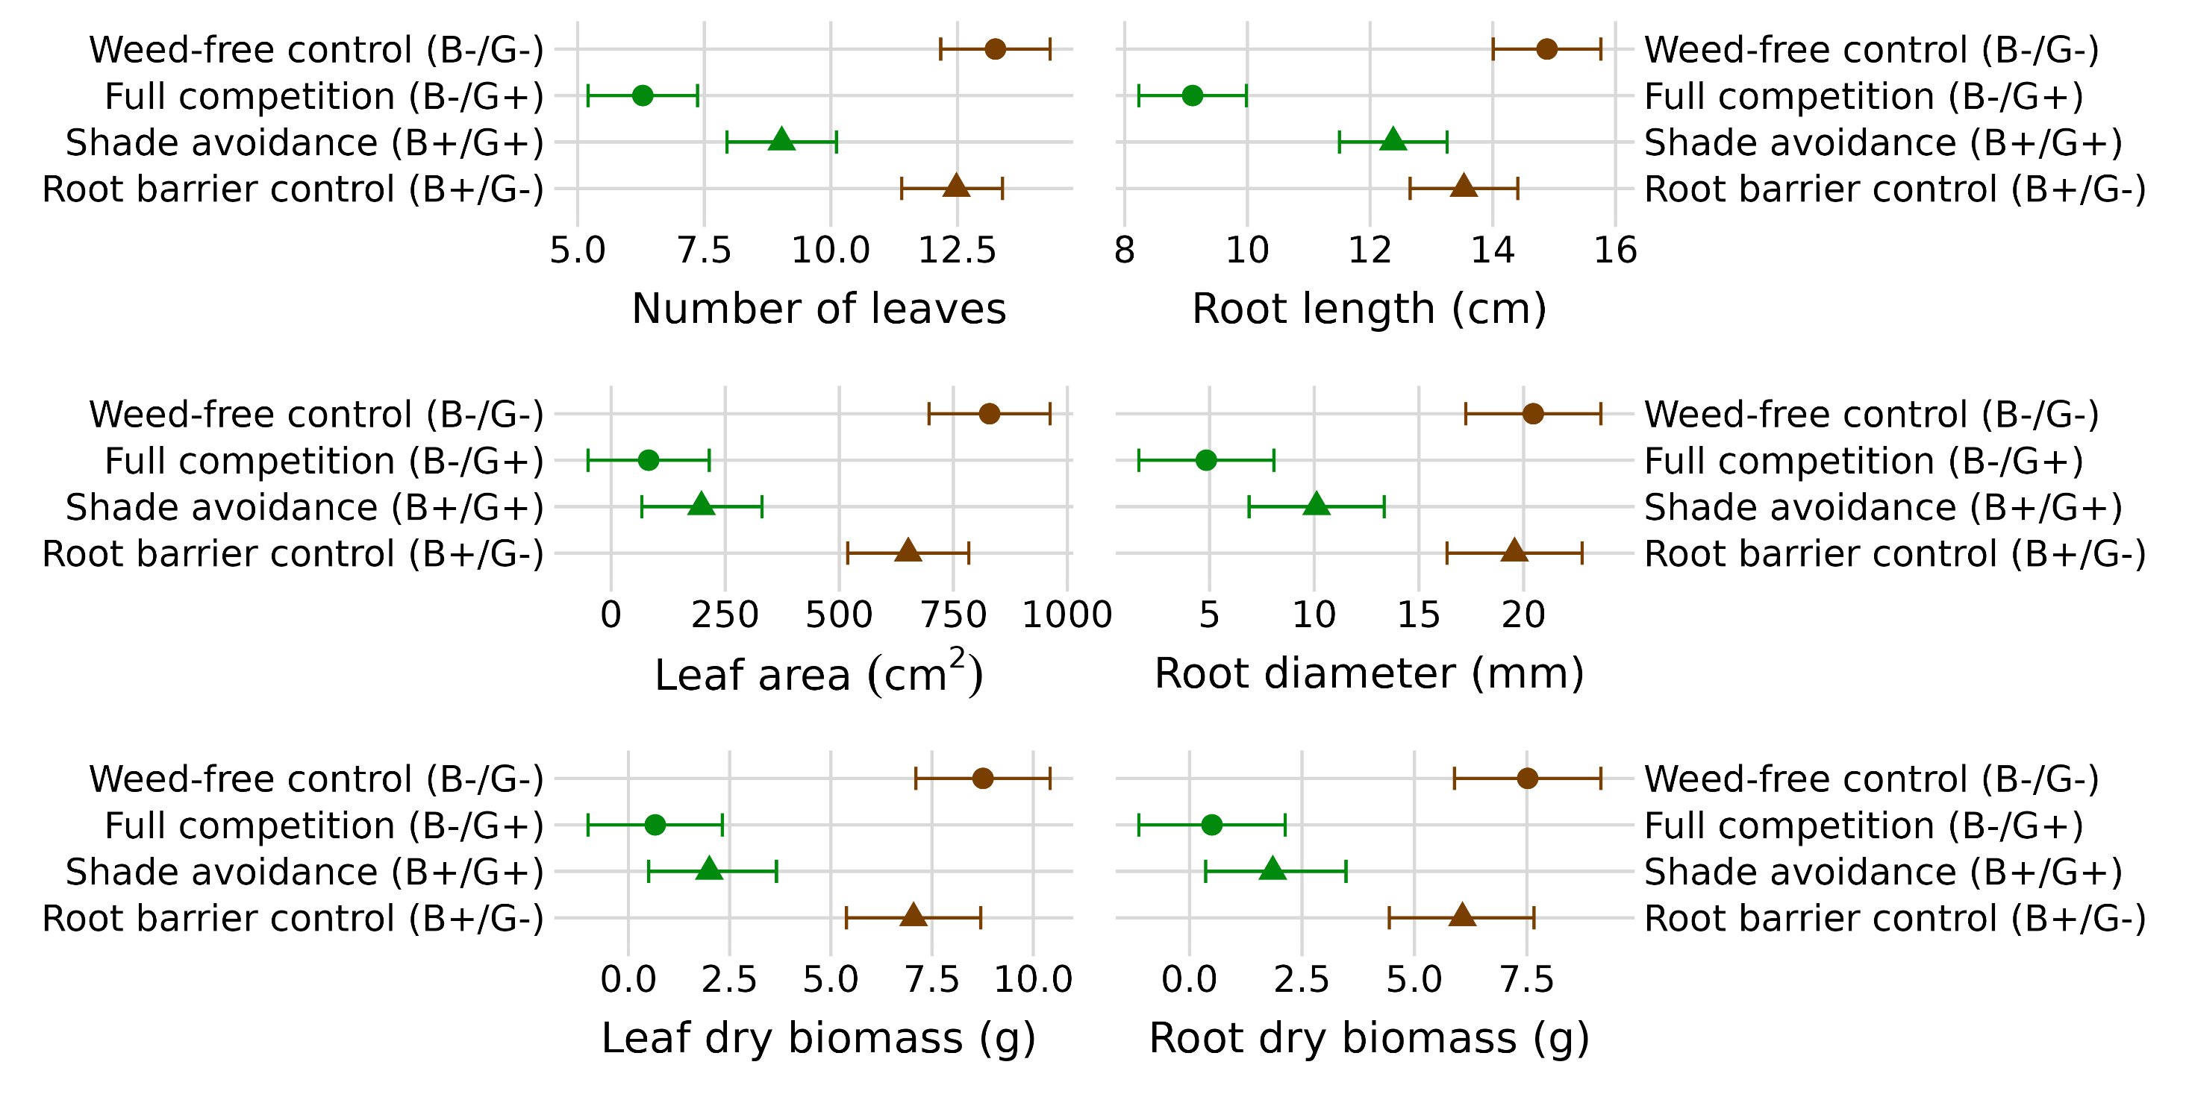
Effect of weeds
Ballenger et al. (2024) Weed Science 72(2):159

Slide 22
Effect of root interaction
Ballenger et al. (2024) Weed Science 72(2):159

Slide 23
Effect of shade avoidance
Ballenger et al. (2024) Weed Science 72(2):159

Slide 24
Effect of plant-reflected light:
Full weed competition reduced sugarbeet yield by 93%
Shade avoidance response is responsible for 69% of that
Ballenger et al. (2024) Weed Science 72(2):159

Slide 25
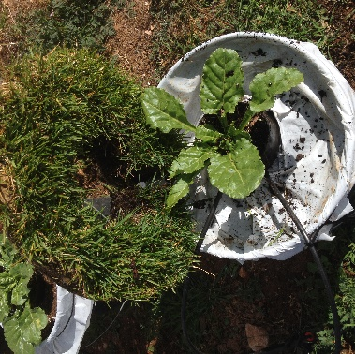
What if we ‘control’ the weeds?

Slide 26
2 true leaves
Emergence
Harvest
Weeds present at emergence and removed at 2 TL stage caused
31% loss
in yield potential
Weeds added at 2 TL stage and left until harvest caused
22% loss
In yield potential
Adjesiwor et al. (2021) Plant Cell Environment. 44(11):3538

Slide 27
Far-red light inhibits seed germination!
Sunlight

Slide 28
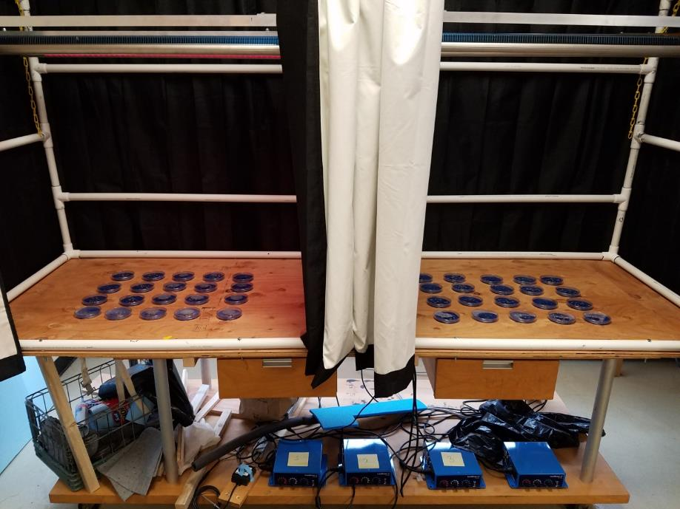

Slide 29
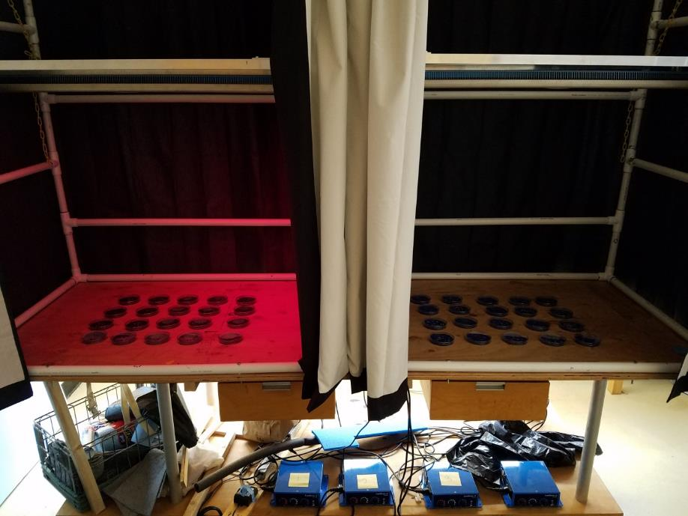

Slide 30
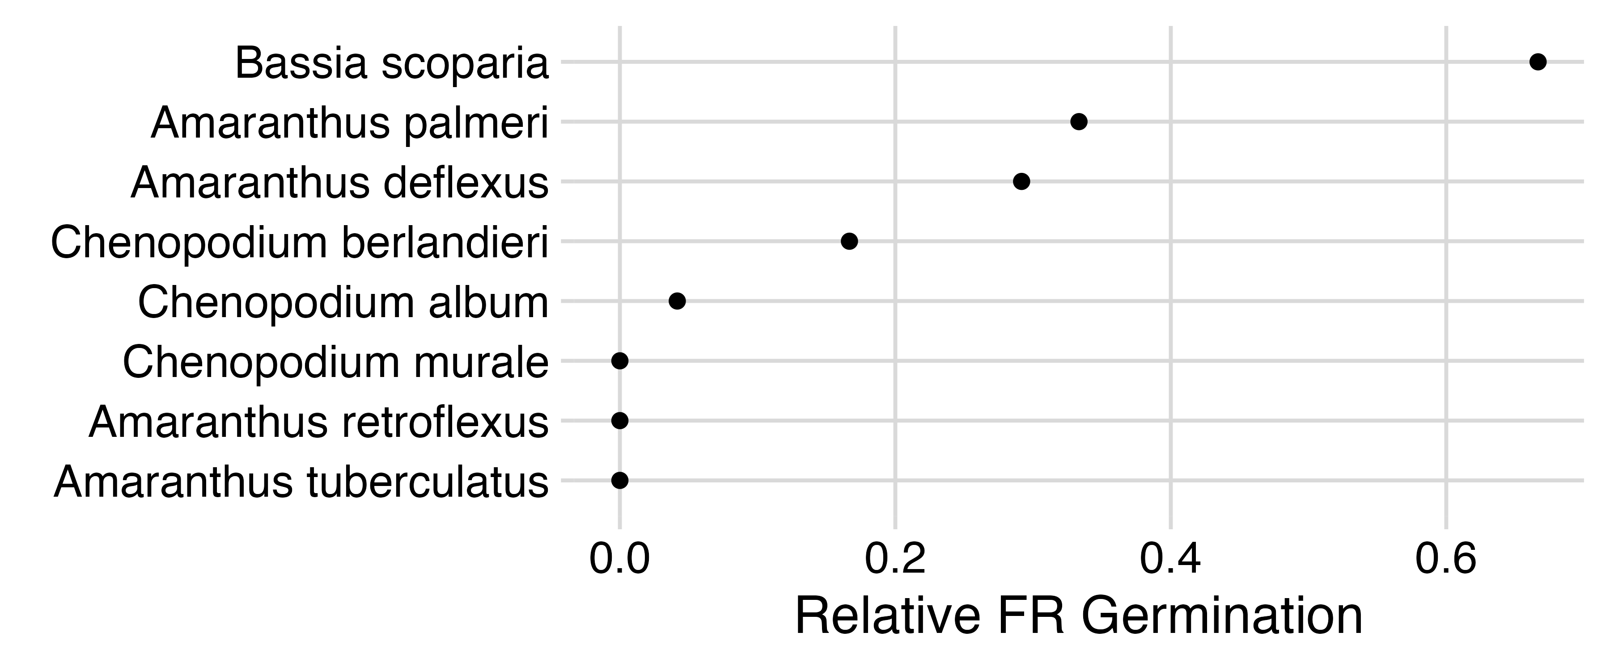
Kyla Bush, Undergraduate McNair Scholar

Slide 31
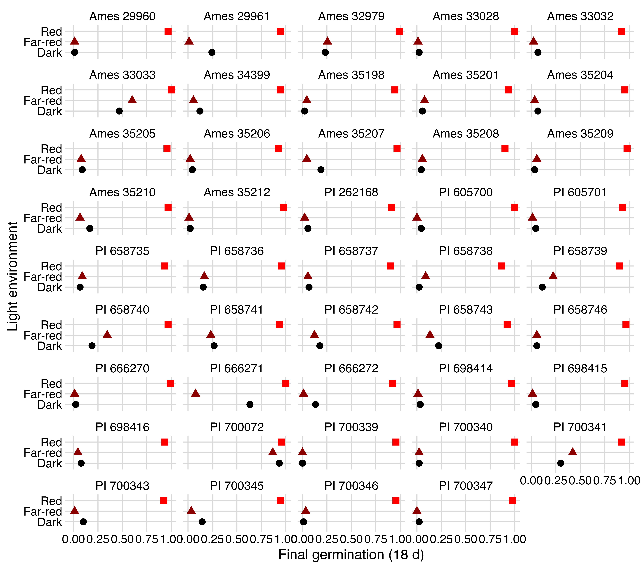
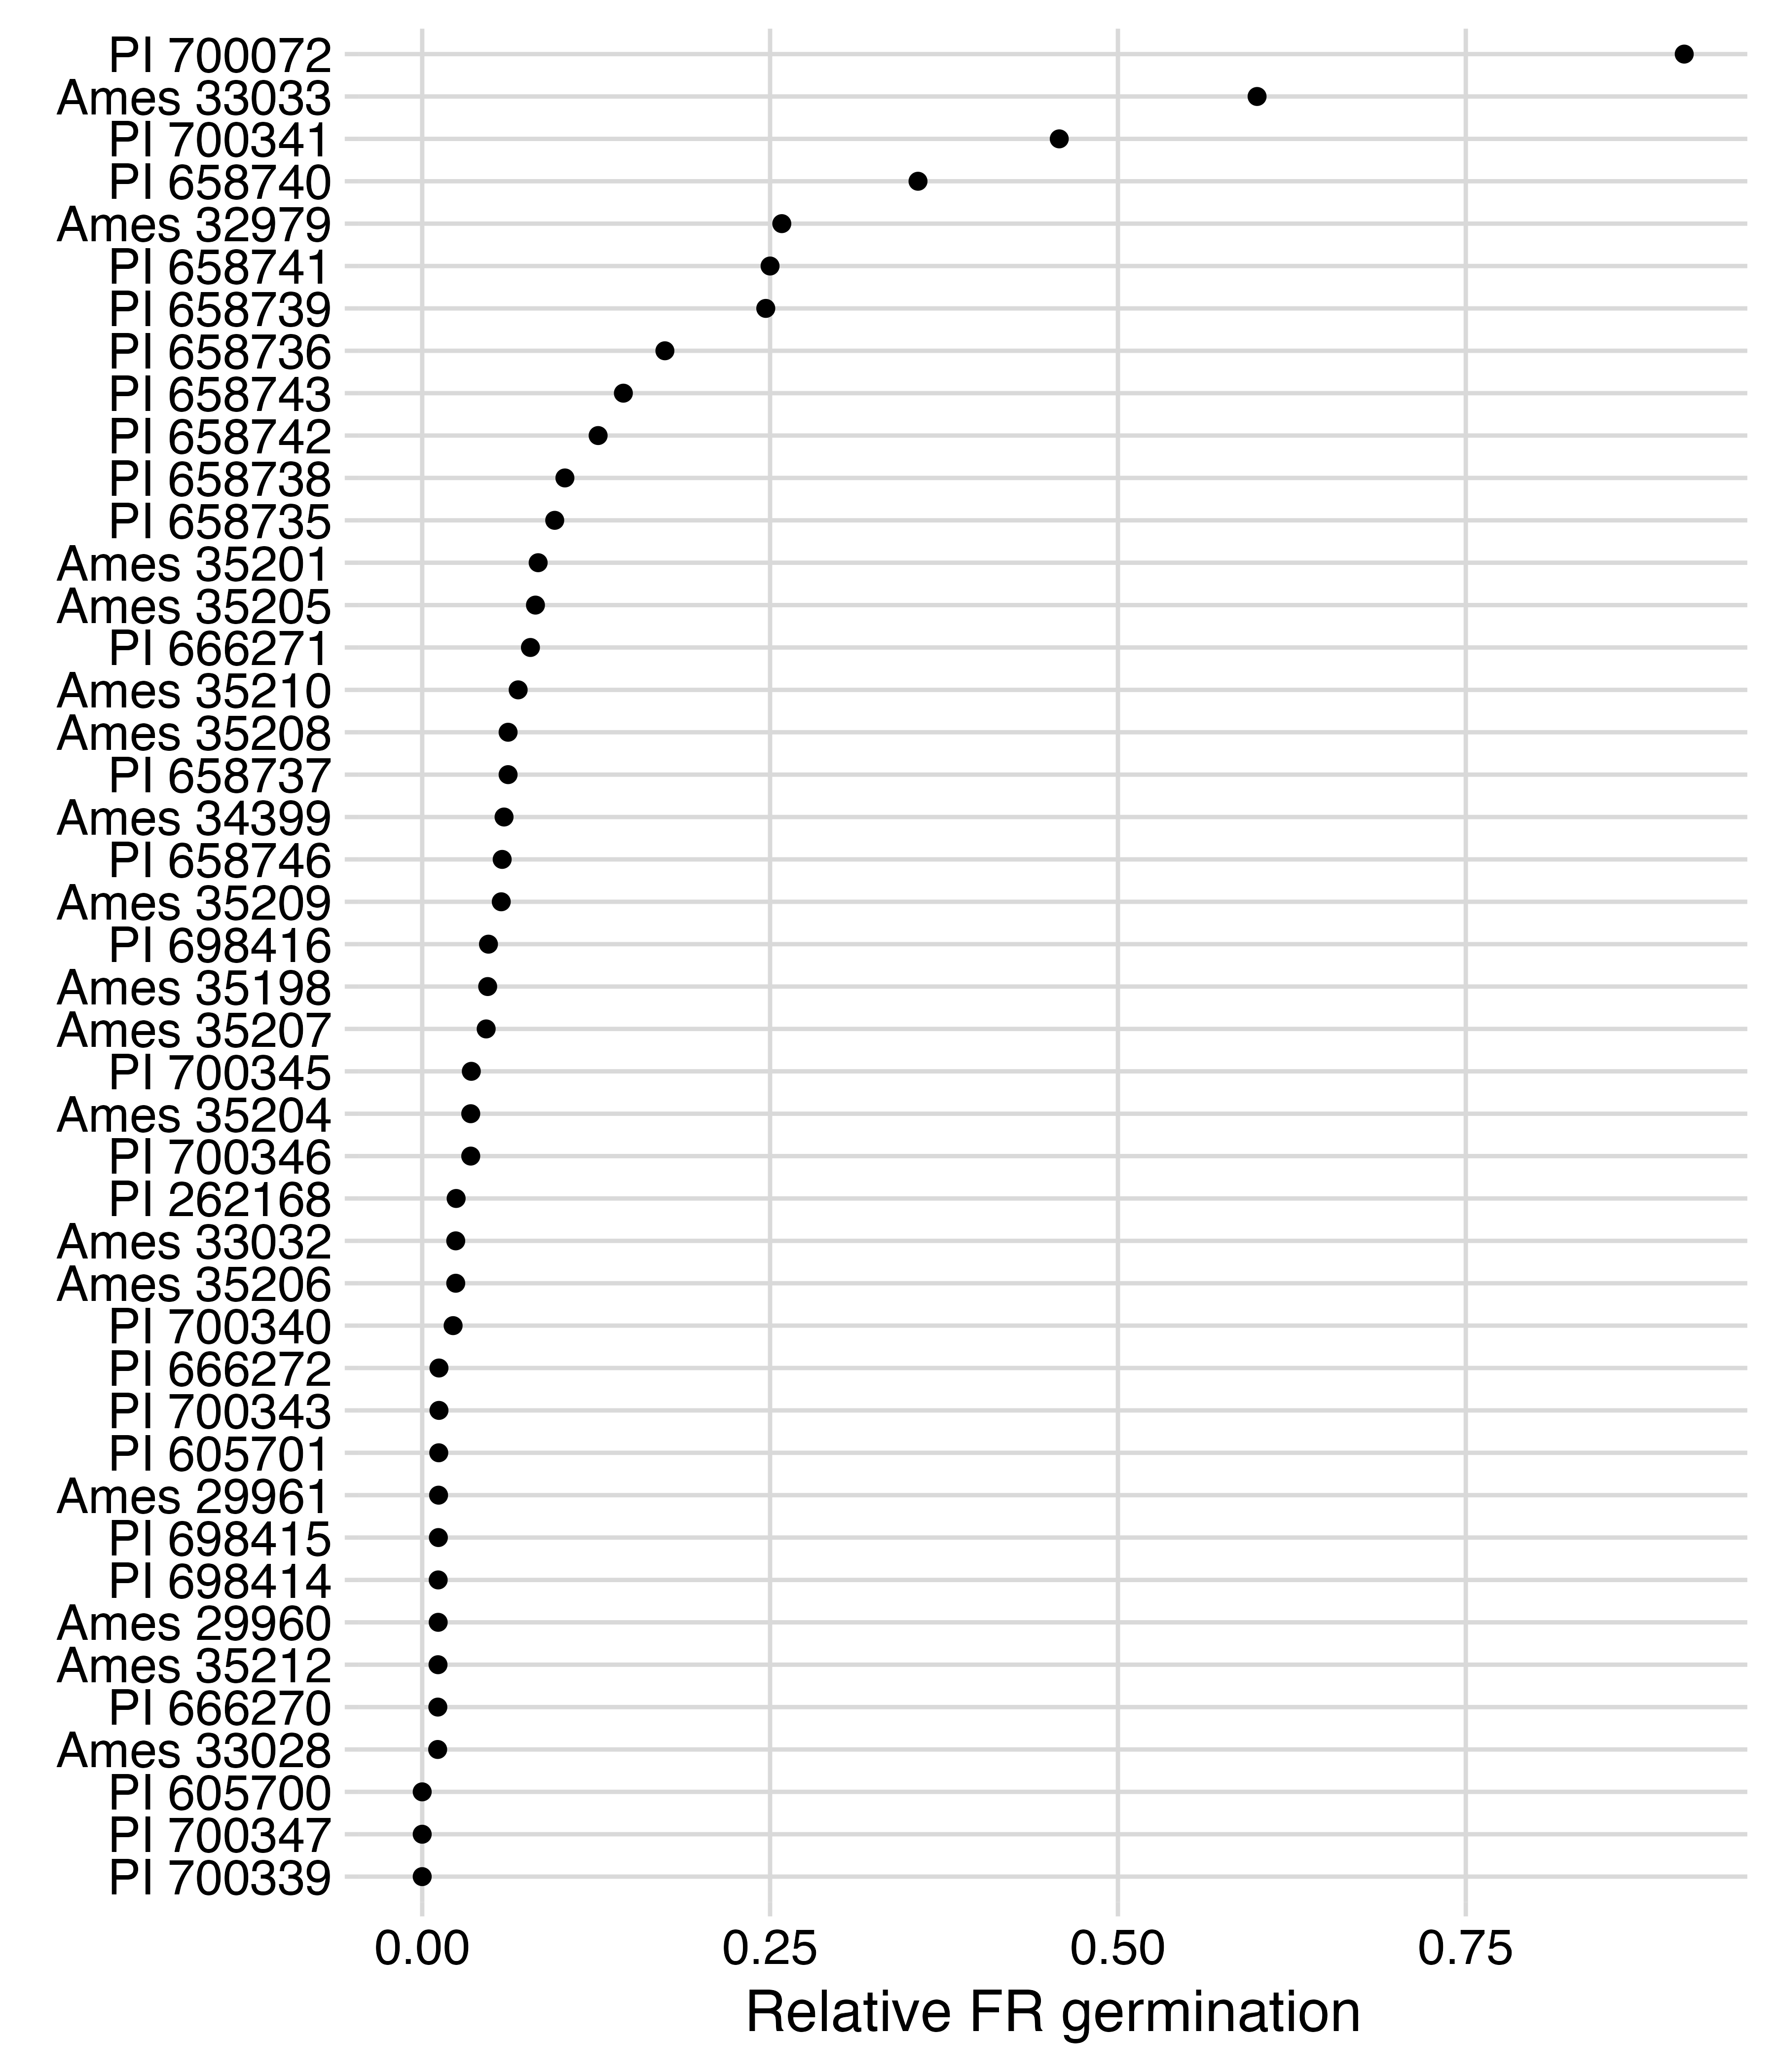
Strongly suppressed by far-red light
Common lambsquarters
Jonah Ziyaaba, PhD student

Slide 32
Less suppressed by far-red light
Common lambsquarters
Jonah Ziyaaba, PhD student

Slide 33
Continuing & Future Work:
Can we breed for reduced response to shade avoidance cues?
How does R:FR impact nitrogen allocation and metabolism in dry edible beans?

Slide 34




Thanks to:
Albert Adjesiwor
Louise Lorent
Tom Schambow
Joe Ballenger
Tina Turner
David Claypool
Tyler Hicks
Osama Saleh
Elizabeth Mosqueda
Brent Ewers
Cynthia Weinig
Funding:
Western Sugar Cooperative
USDA-NIFA AFRI grant (2016-67013-24912)
USDA-NIFA Hatch Capacity fund (WYO-631-22)

