Slide 1
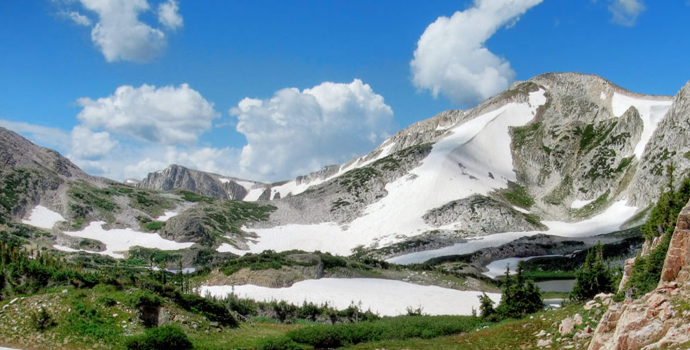
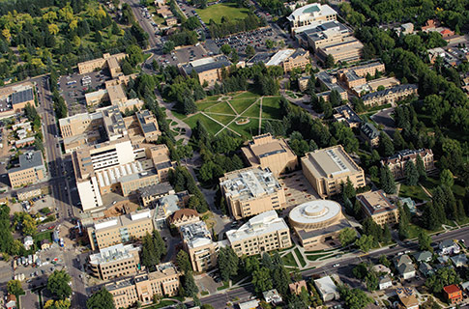
The role, status, and progress of research and economic development administration at UW
Edmund J. Synakowski
Vice President for Research and Economic Development
January 23, 2019

Slide 2
Research: an enormous asset to education
It’s about the students. From RPI, here are the top five reasons to attend a research university
Research universities incorporate the latest research into classes. Faculty who are active in research are in touch with the latest developments in their field and are more likely to incorporate their work in their classes.
Students benefit from contact with research active faculty and graduate students. Research active faculty have strong industry and academic connections and can help their students network academically and professionally.
Research universities utilize state-of-the-art facilities for research and collaboration. Research universities support government-, industry-, and private foundation- sponsored research in advanced laboratories, using the latest tools and technologies.
Employers value the skills taught at research universities. Students who graduate from research universities are critical thinkers, problem solvers, collaborators, and creative leaders.
Leading research universities provide opportunities for entrepreneurial ventures. By interacting with and learning from top faculty researchers, students discover new processes, create new products, and innovate new services.

Slide 3
Research drives economic growth and transformation
It’s also about the economic vitality of the region. In 1987, the Nobel Prize was awarded to economist Robert Solow (MIT), “for his contributions to the theory of economic growth”
From the Royal Swedish Academy of Sciences:
Solow showed that “…technological development will be the motor for economic growth in the long run… (I)f continuous technological progress can be assumed, growth in real incomes will be exclusively determined by technological progress.”
Research has been an essential catalyst for economic growth on the Front Range

Slide 4
The relationship between research universities and industry is evolving to respond to economic needs
“Universities and industry have been collaborating for over a century, but the rise of a global knowledge economy has intensified the need for strategic partnerships that go beyond the traditional funding of discrete research projects. World-class research universities are at the forefront of pioneering such partnerships.”
From “Making Industry-University Partnerships Work,” Science-Business Innovation Board, 2012

Slide 5
UW is classified as a Tier 2 Research Institution, per Carnegie Classification of Institutions of Higher Ed
R1: Doctoral Universities – Highest Research Activity
130 universities nationally
This level includes U of NE, U of CO; CSU
R2: Doctoral Universities – Higher Research Activity
139 universities nationally
This level includes U of ID, ND, SD, and MT; also ID, ND, SD, MT State
R3: Doctoral Universities – Moderate Research Activity
163 universities nationally
We aspire to become an R1 Doctoral University
UW

Slide 6
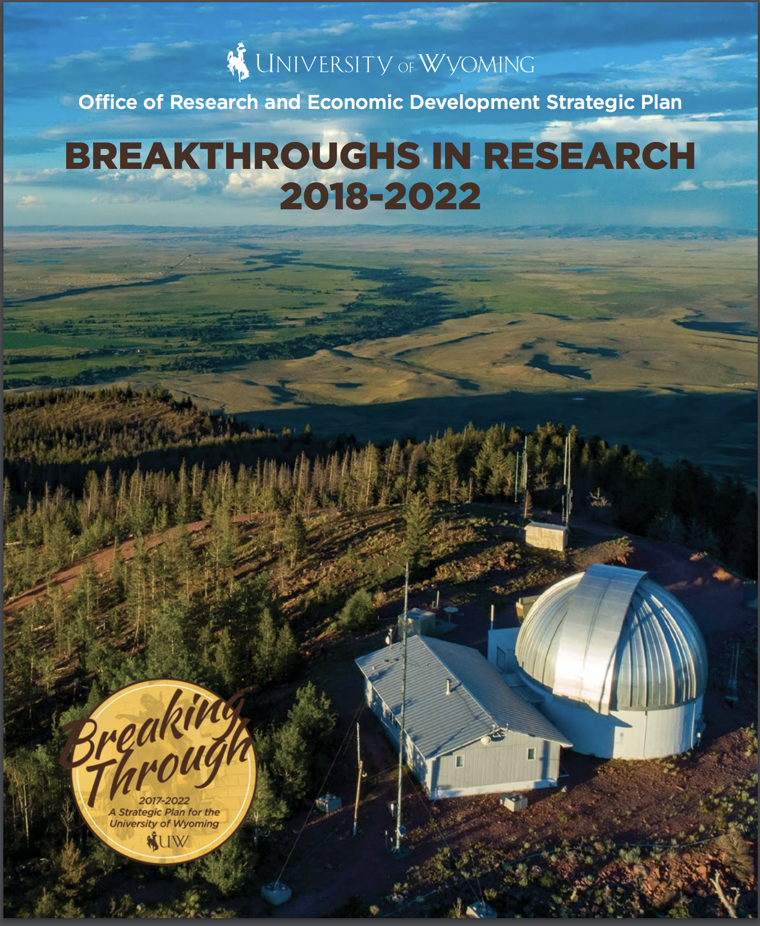
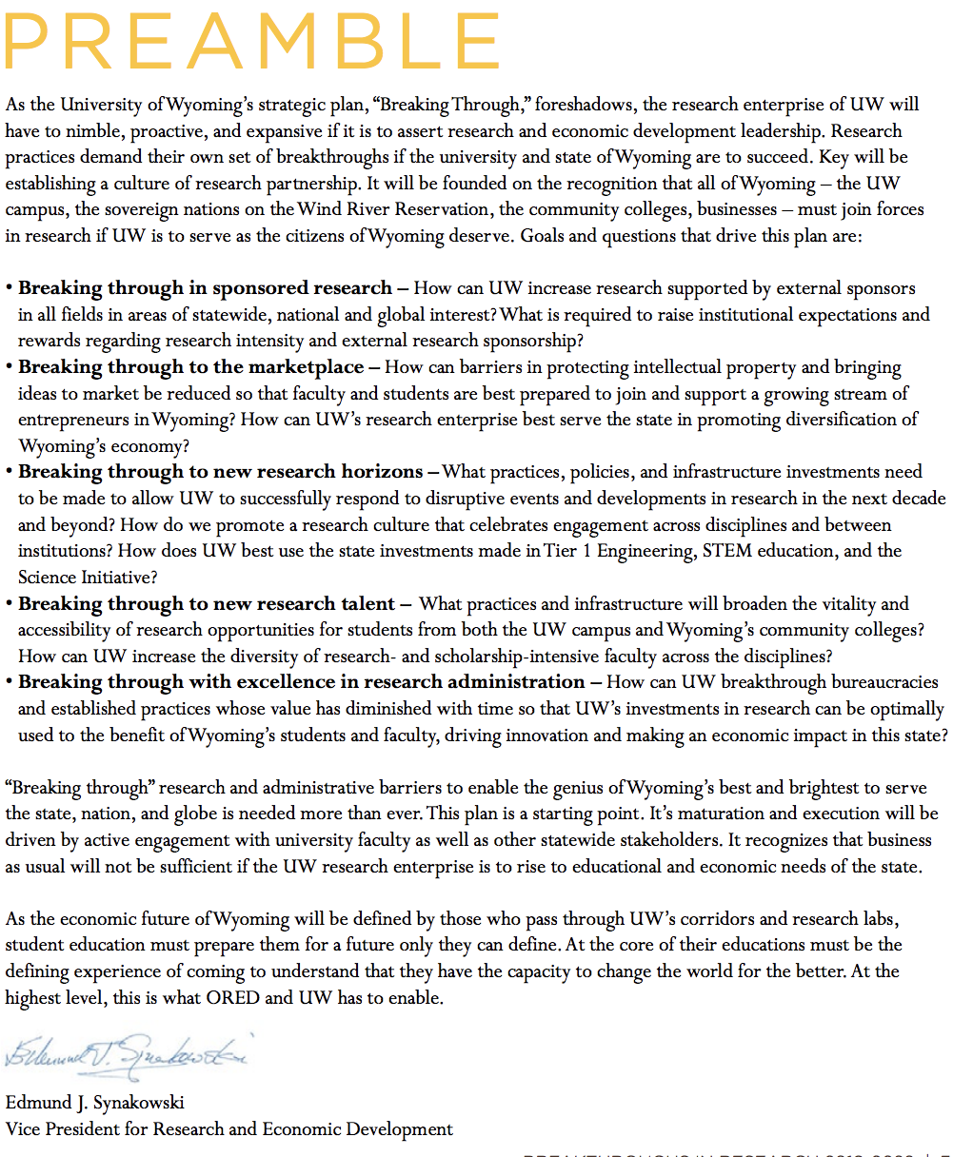
UW’s Office of Research and Economic Development has developed a strategic plan

Slide 7
Office of Research and Economic Development: services, recent actions, plans (1)
State of play 1.5 years ago:
many departures from ORED, which was already lean
Given our ambition: must reorganize ORED, and strengthen and modify processes so they are scalable to a larger research effort, and are transparent
Significant new hires have been made to enable the new ORED org
New Associate VP for Research (D. Hulme)
Increased research service capacity (pre-proposal): 2 FTE ➔ 4.5
proposal and budget preparation; award negotiation with sponsors
training in proposal writing (contracted seminars)
grant setups and awards are now under Div. of Finance and Administration
ORED retained post-award activities that do not have a financial component

Slide 8
Office of Research and Economic Development: services, recent actions, plans (2)
Hired first Director, Research Integrity and Compliance (C. Broccardo)
Hired new Tech Transfer Office Director (H. Nowak)
Broader impacts development for proposals – 0.5 FTE on board. Will grow this function.
UW/Community College Research Network
Planning underway. Lever INBRE program (NIH) and Science Initiative
Plan to establish Office of Undergraduate Research
What UW does is among the best in the country. How we promote and optimize it is not
New office will become a single point of contact and clearing house
Goal: promote, look for synergies and efficiencies between programs

Slide 9
Office of Research and Economic Development: services, recent actions, plans (3)
Promote a research culture: the overall aim of a new Research Strategic Plan
urgency regarding sponsored research: ORED partnering with SI in seed grant program
Research partnerships: the focus of the new Research Strategic Plan
Worked with Division of Finance and Administration to distribute Indirect Cost Recovery (ICR, or IDC) revenue – Backlog of IDC from 2016 cleared, 2018 recently distributed across campus
Indirect costs are real costs to the University associated with carrying out extramurally funded research

Slide 10
To help identify solutions to challenges, Point Consulting has recently arrived to assess and advise
For ORED: research services (pre-proposal) have had capacity challenges, most recently in issuing sub-awards for grants, as FTE levels were low. As we staff up, we need to
better understand if we are at the right staffing level
if our practices in serving the colleges, and in how we work with the Office of Sponsored programs can be improved
Point Consulting Group arrived on January 14 and has begun interviewing our staff, as well as the staff in the Office of Sponsored Programs. Jerry Fife is leading this work, with Mary Beth Rudofski
Deliverables will include a report, with observations and recommendations to ORED and the president

Slide 11
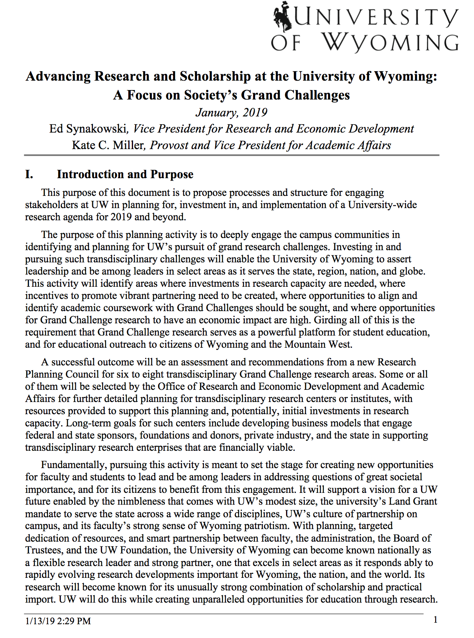
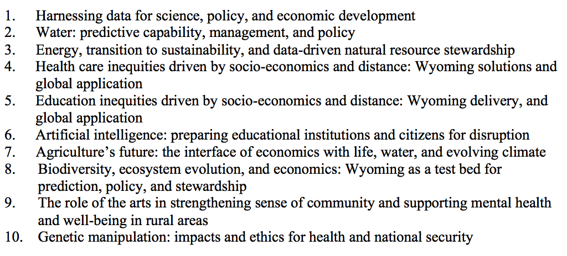
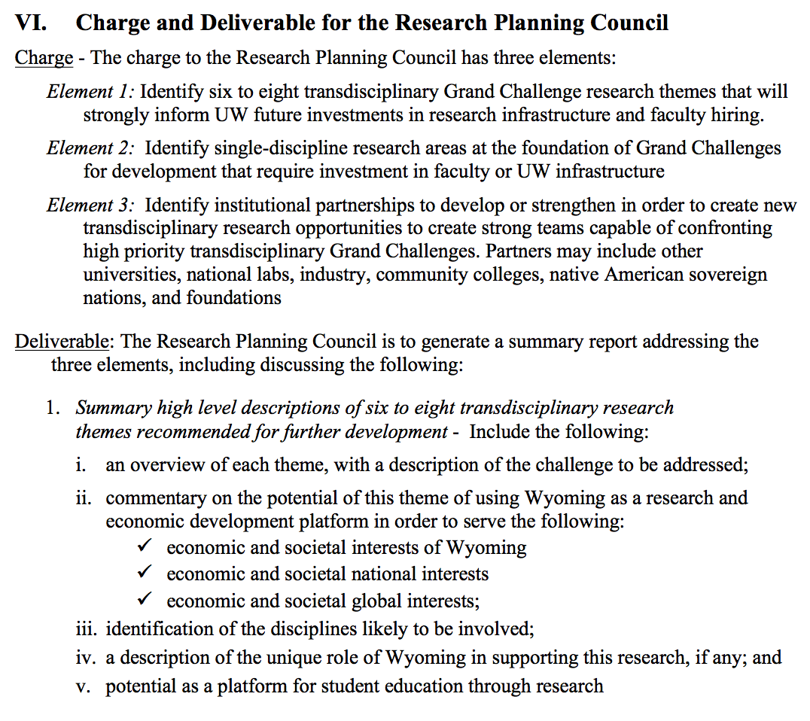
The research planning activity charge has been developed. The aim is to report to the BoT this summer
Sample Grand Challenges
The Charge and Deliverable for the Research Planning Council
First page of document describing the research planning activity

Slide 12
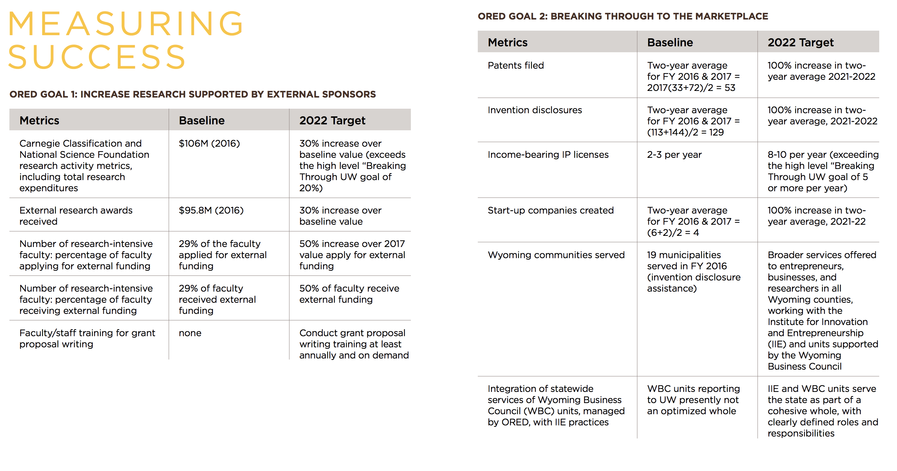
The strategic plan has metrics – progress, but a long way to go (1)
New Tech Transfer director hired
IIE being launched
low
New single contract with WBC gives needed flexibility

Slide 13
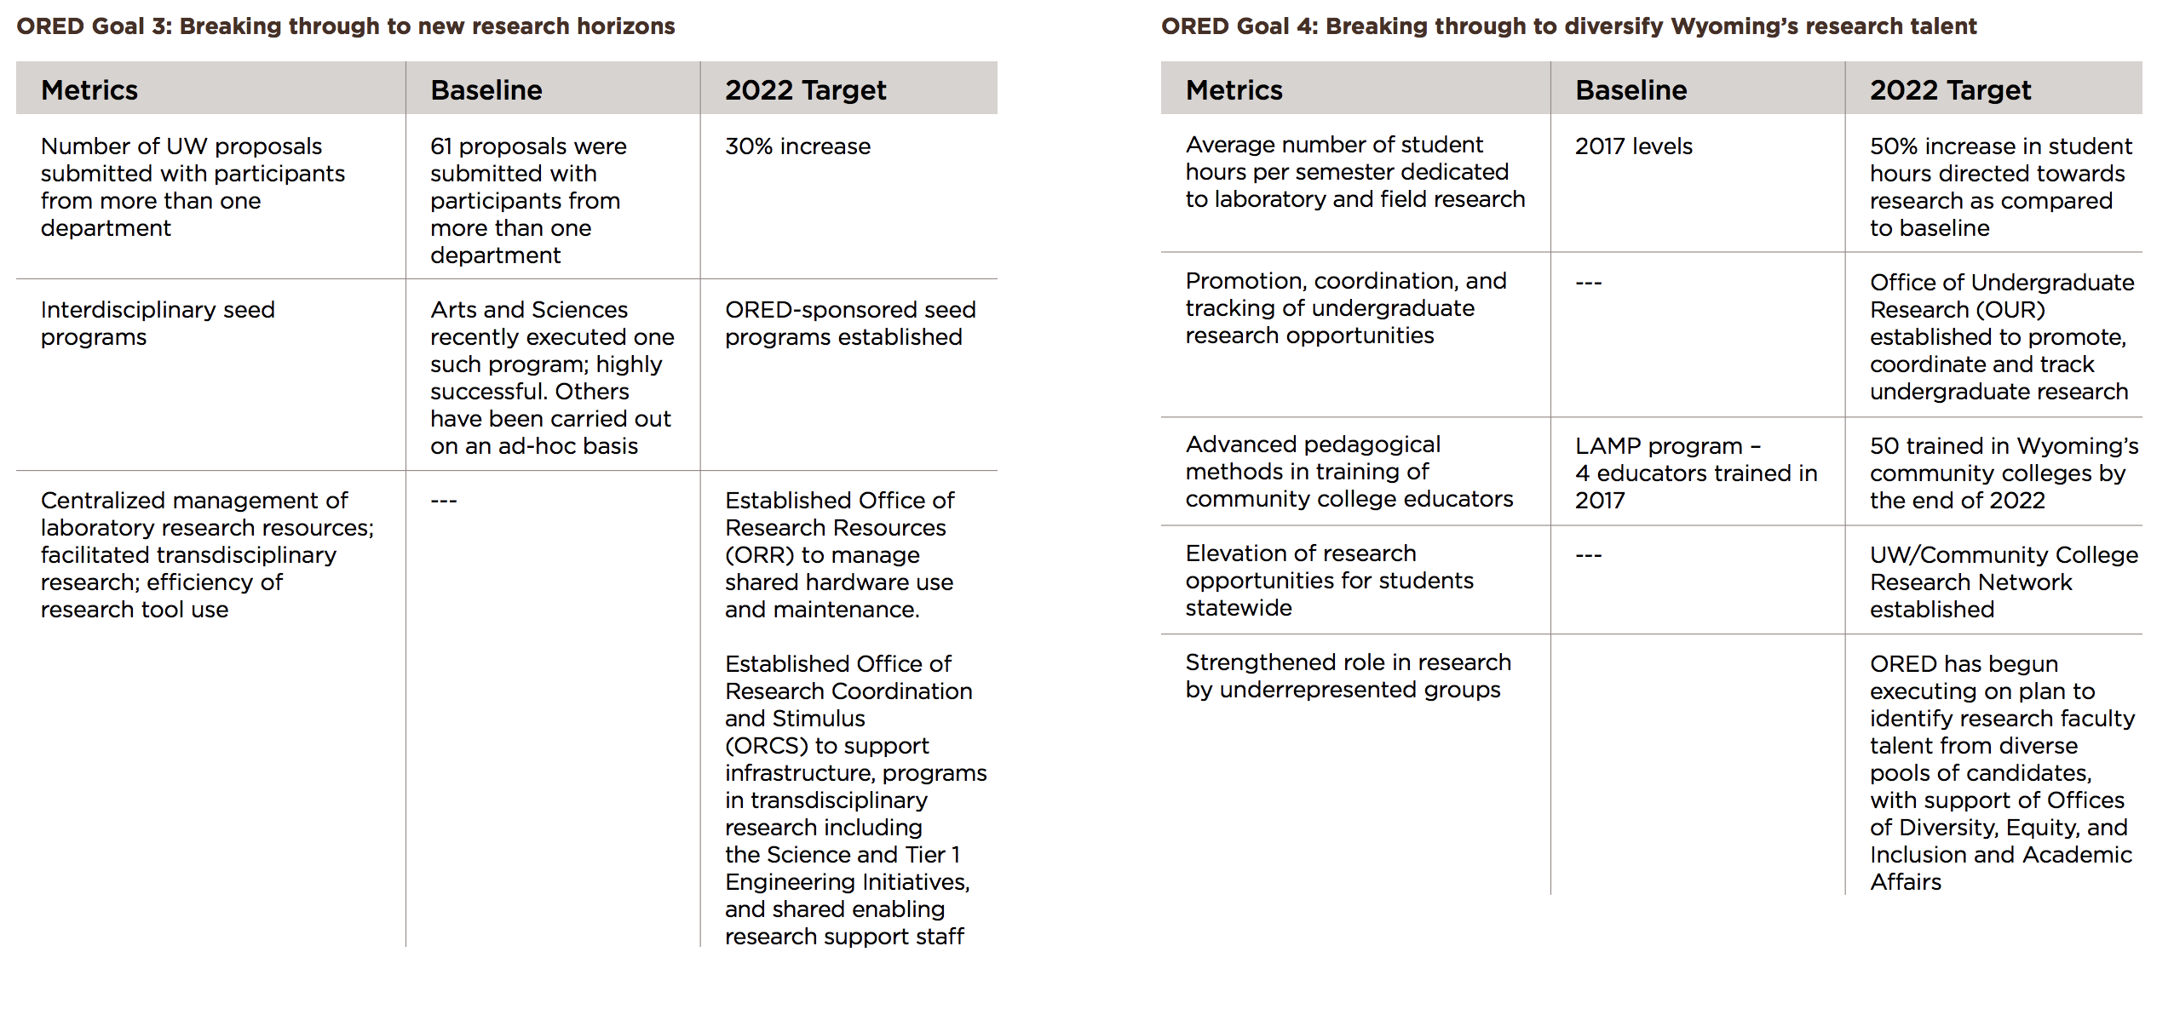
The research strategic plan has metrics – progress, but a long way to go (2)
Substantial increase in 2018
Planning begun
Begun
Partnering with Science Initiative seed program
Focus of soon-to-be-launched strategic planning

Slide 14
The research strategic plan has metrics – progress, but a long way to go (3)
Begun; not completed. Post-award moved to Div. of Finance and Administration
Progress. Has been a challenge, as capacity had been far lower than national norm. Capacity increased from 2 to 4.5 FTE
New position filled, Director of Research Integrity and Compliance
Grand Challenge strategic planning process to begin and will inform choices
Substantial progress in understanding the flow of research dollars across UW.
Centralizing of budgeting underway

Slide 15
Regulations to be reviewed: process
Board Committee reviews and provides suggested edits/comments/changes to General Counsel
GC works with the President and the Regulation Committee to review
After the President and the Regulation Committee approves, GC sends to campus for review (Faculty Senate, Staff Senate, ASUW, Executive Council, D&Ds) (they typically get 4 weeks)
Then back to the Research and Economic Development and Regulation Committees to review and possibly incorporate campus feedback
After final version is ready, to Full Board for approval

Slide 16
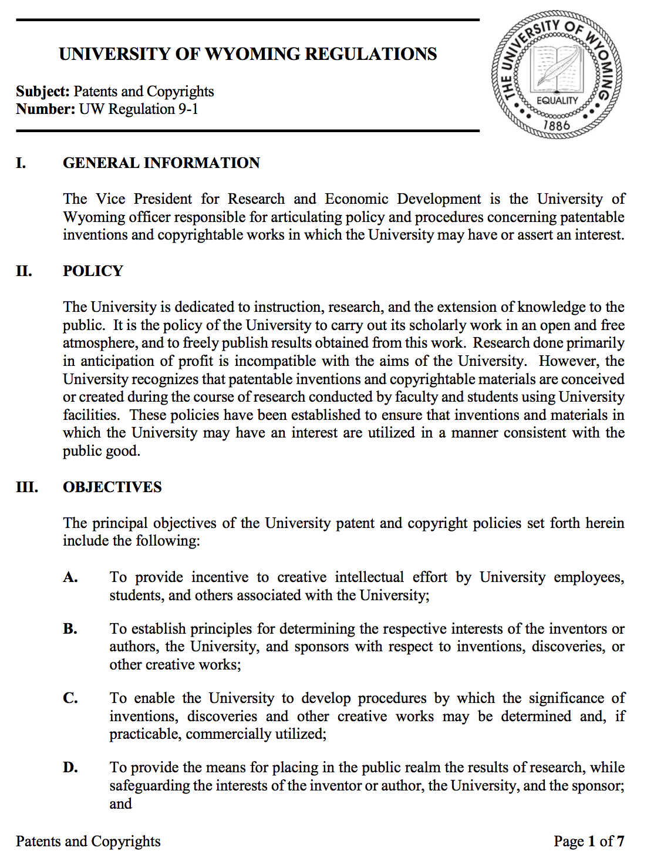
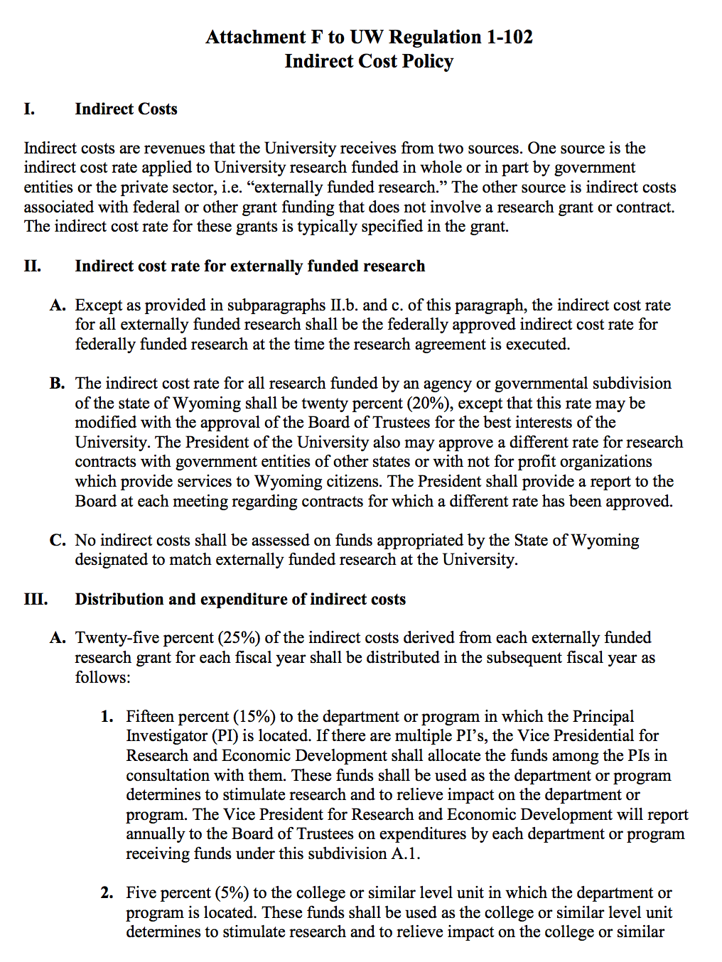
There are two regulations that need review at present

