Slide 1
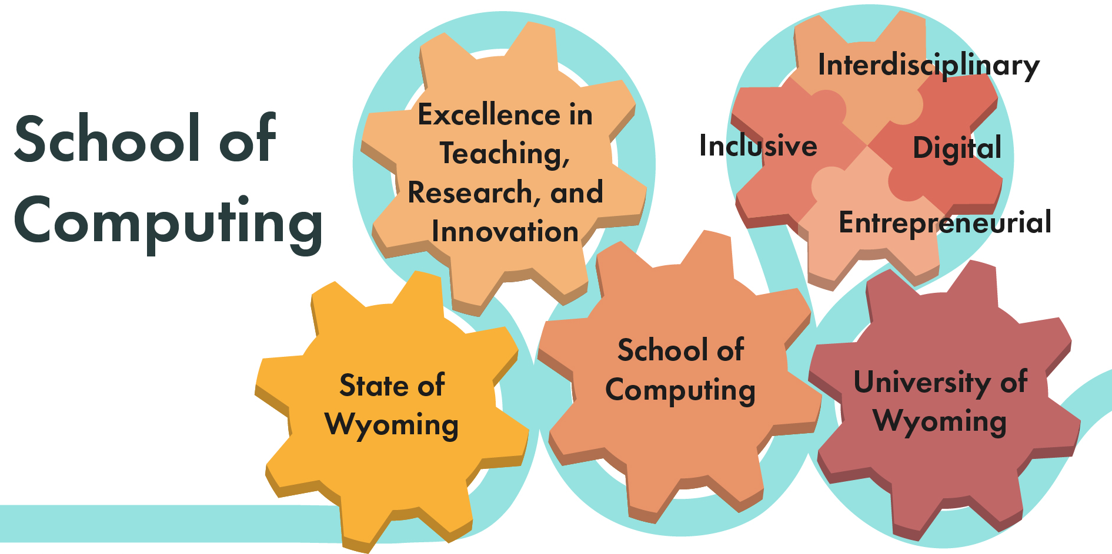
Budget Committee
January 12, 2022
Gabrielle Allen
Bryan Shader

Slide 2


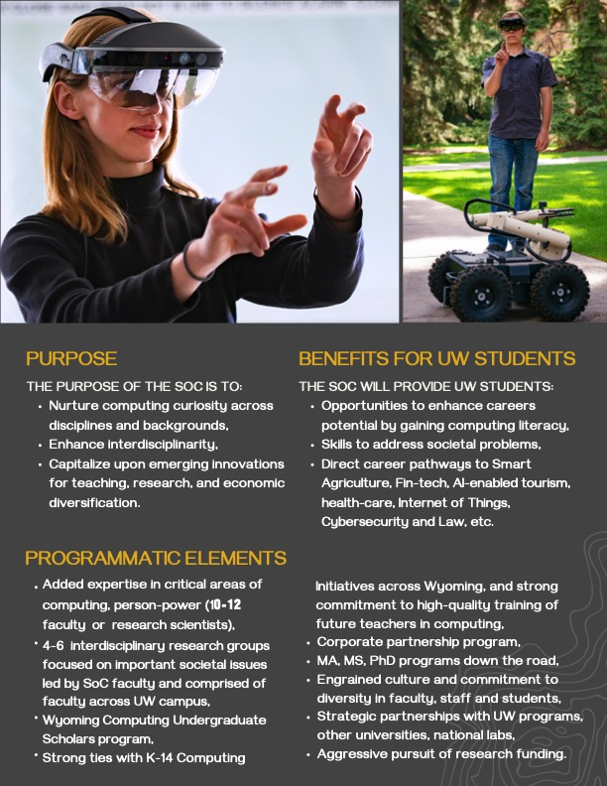

Slide 3
When built out the SoC will
  be a cross university school with joint appointments possible
  with any department UW,
  have degrees at both grad and undergrad level,
  develop strong partnerships with corporations, national labs,
  and UW departments and programs,
  build out a structure appropriate to the resources that are available,
  and
  develop a diverse external funding portfolio to
  enable UW respond better to strategic opportunities for UW
  and for Wyoming.

Slide 4
The proposed plan
The SoC will be overseen by Provost, initially incubated
in the CEAS, and still have broad, campus-wide mission.
Dean Wright and CEAS supportive of this arrangement.
This will
    ensure resources are invested in students, faculty and staff, or programs for them,
    aid in a coordinated development of the SoC alongside the strengthening of the CS/ECE department,
    provide more immediate benefits to students and to the State of Wyoming, and
    allow prioritizing programs that support faculty across the disciplines to develop research and educational collaborations with the SoC.

Slide 5
Base Budget
  A complete, detailed and sustainable budget for the first four years is presented.
  Based solely upon $3M/year of the $5.5M of reclaimed funds targeted in July 2021 for new strategic initiatives.
  The SoC is one of several new initiatives that were funded.
  (WIP, WORTH, CEI are the others)
  The annual operating budget at the end of the four years is $3M/year, and the total costs over the four years is $12M.

Slide 6
  Budget principles
  Emphasize student programs, and development of state-of-the art labs for various aspects of computing.
  Invest in faculty through joint hires with UW departments, and an affiliate faculty program.
  Focus on measurable highly visible quality and standards.
  Minimize administrative costs.

Slide 7
Base operating budget (after 4 years)
10-13 FTEs in computing $ 1,500,000
Operational budget $60,000
5 Graduate Assistants $162,500
15 undergraduate scholars $150,000
Faculty affiliates* $100,000 * Starts at $240K first two years
Director stipend** $50,000 **Starts at $112K first two years
Business manager & office manager $165,000
Benefits $800,000
Total $2,960,000/year
One-time expenses
Start-up for education and research labs: $2,400,000
Recruitment costs $ 150,000
Notes:
Balance out to 3,000,000 Compare with another of this size. Allocate in initial years for incubation and growth.

Slide 8
ARP Phase 1 Funding for SoC
$1.15 M (confirmed before IDCs)
Admin and staff until June 30, 2022
1.5 Research Scientist,
3 Graduate Assistants,
$50K Visiting Scholars program,
$100K Cybersecurity training for Wyoming companies
$750K Training & curricular development with CCs

Slide 9
Potential one-time revenues for SoC
ARP Phase 2
2023-2026 (requested)
$4.4 M total specifically for SoC
Visiting Scholars/Faculty Affiliates program for departments $2M
3 Research Scientists for 3 years
Start-up for computing teaching and research labs $2.2M
Digital Infrastructure and Technology
WIP Training $3.85 M (includes 3 UW FTEs for 3 years)
Upgrades to UW’s Advanced Research Computing Center $10M
Additional funds for Data Hub
Over $20M in total.

Slide 10
Potential one-time revenue:
Reserve Funds
January 2022 and June 2023 ($1M/year)
Seed money for curricular, research, economic impact, and state-wide engagement, corporate partnership activities around the SoC.
  90K in salary and benefits for a full-time director
  217K in salary and benefits to hire 1-1.5 Research Scientists who can work with faculty to enhance their scholarship through computing, pursue external grants, pursue corporate partnership project, and supervise undergraduate student projects
  395K for SoC faculty affiliates program that will support 7-10 targeted computing projects with a Wyoming impact
  98K in salary, tuition and benefits for two-three GA-ships to help in recruiting computing students to UW
  52K for recruiting, advertising, office/space and operating costs (during first 6 months of SoC).
  70K for undergraduate computing scholars
  75K statewide K-14 and community engagement around computing

Slide 11
Potential one-time revenue:
Reserve Funds
In each of the remaining 3 years, $1M/year seed funds for broadening impact of and participation in SoC.
Broad categories are:
212K Research Scientists to support academic and corporate computing research on issues of
importance to Wyoming.
200K Start-up for development of specialized computing labs for students and faculty
350 K Faculty affiliates program that will support 7-10 targeted computing projects with a Wyoming impact
These provide seed money for curricular, research, economic impact, and state-wide engagement,
corporate partnership activities
75K Statewide K-14 and community engagement around computing
150K Computing student recruitment activities at both undergraduate and graduate levels
Seed money for curricular, research, economic impact, and state-wide engagement, corporate partnership
activities around the SoC.

Slide 13
