Slide 1

Graduate Coordinators Workshop
Overview
Office of Graduate Education
  Transdisciplinary Graduate Programs, Recruitment Efforts,
  Funding Opportunities, Professional Development
  Q & A
Office of Admissions
  Conditional Admission Process
  Q & A
Office of the Registrar
  Graduate Forms, Registration
  Q & A
Office of Scholarships & Financial Aid
  Graduate Scholarships, Federal Aid
  Q & A
International Students & Scholars Office
  Financial Aid Requirements for Admission, Enrollment
  Requirements to Maintain Immigration Status, OPT students’
  enrollment & assistantships information
  Q & A
November 12, 2019

Slide 2

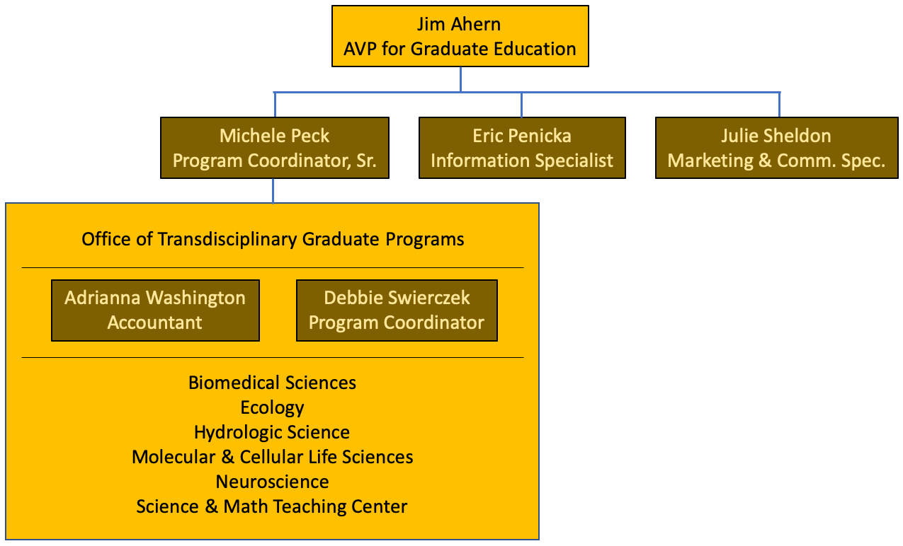
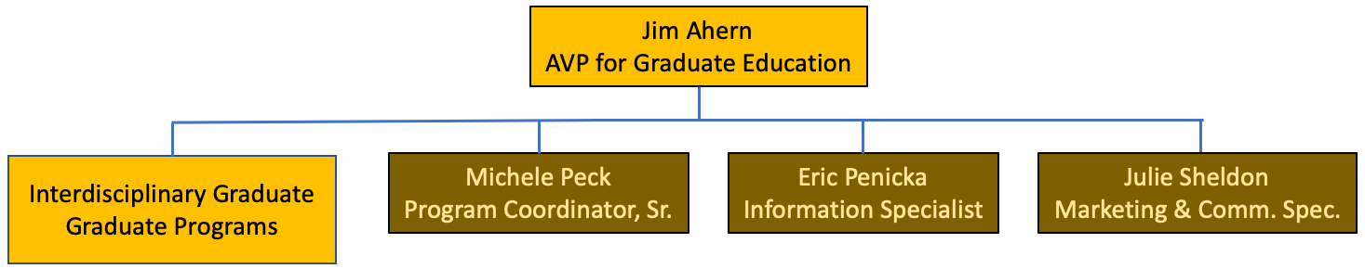
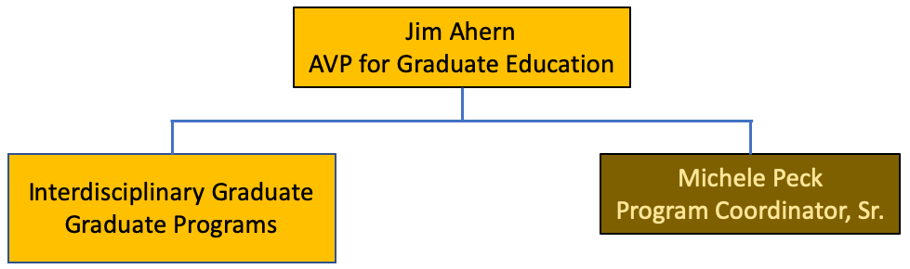
TODAY
May 2019
2017
UW Graduate Education is Evolving

Slide 3
Enhancing Graduate Recruitment
Revised Graduate Recruitment Initiative
GRE Search Service
Modernizing Graduate Programs’ Websites: RNL
Reaching a Broader International Audience: Keystone

Slide 4
Funding for Graduate Students
GTA funding allocations
URDM & WGE Graduate Assistantships
Barkhurst Dissertation Writing
Fellowships
Graduate Student Conference
Travel Funding
Update on Energy Science
Graduate Assistantships
Total Office of Graduate
Education GTA Funding:
$5.5m
 | GTAs | GTAs as Percent of Grad. Students | Undergrad. FTE per 1 GTA | GTAs as Percent of all GAs
U.W. (peer rank) | 551 (11th) | 29.1% (4th) | 16.3 (1st lowest) | 60.2% (5th)
Peer Mean | 667.3 | 21.7% | 27.8 | 51.0%
Peer s (n) | 315 (18) | 9.3% (18) | 9.5 (18) | 10.4% (18)

Slide 5
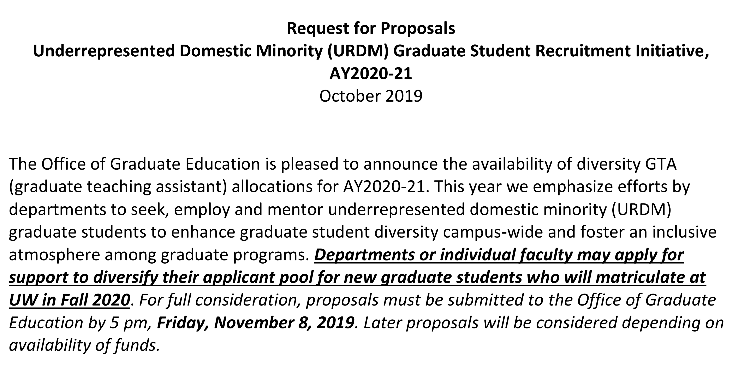
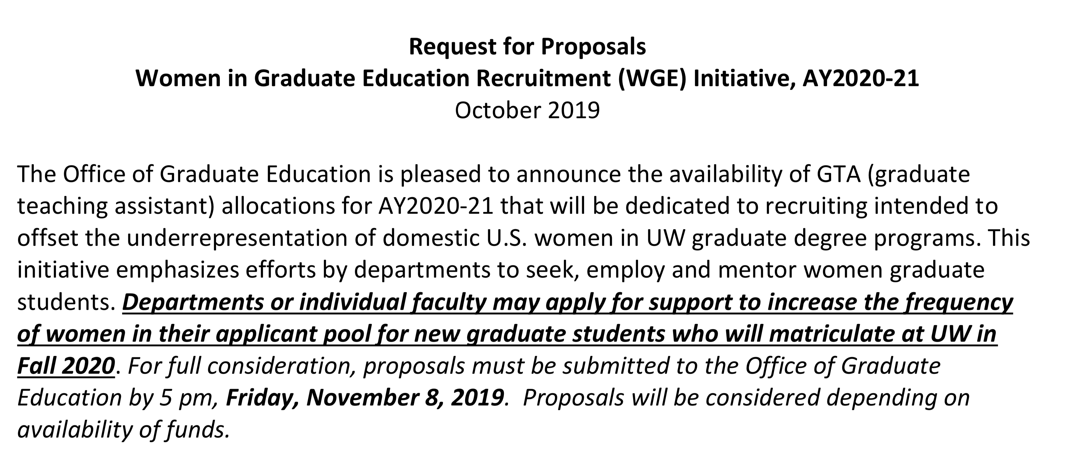
Funding for Graduate Students
GTA funding allocations
URDM & WGE Graduate Assistantships
Barkhurst Dissertation Writing
Fellowships
Graduate Student Conference
Travel Funding
Update on Energy Science
Graduate Assistantships
See: http://www.uwyo.edu/uwgrad/faculty-staff/index.html

Slide 6
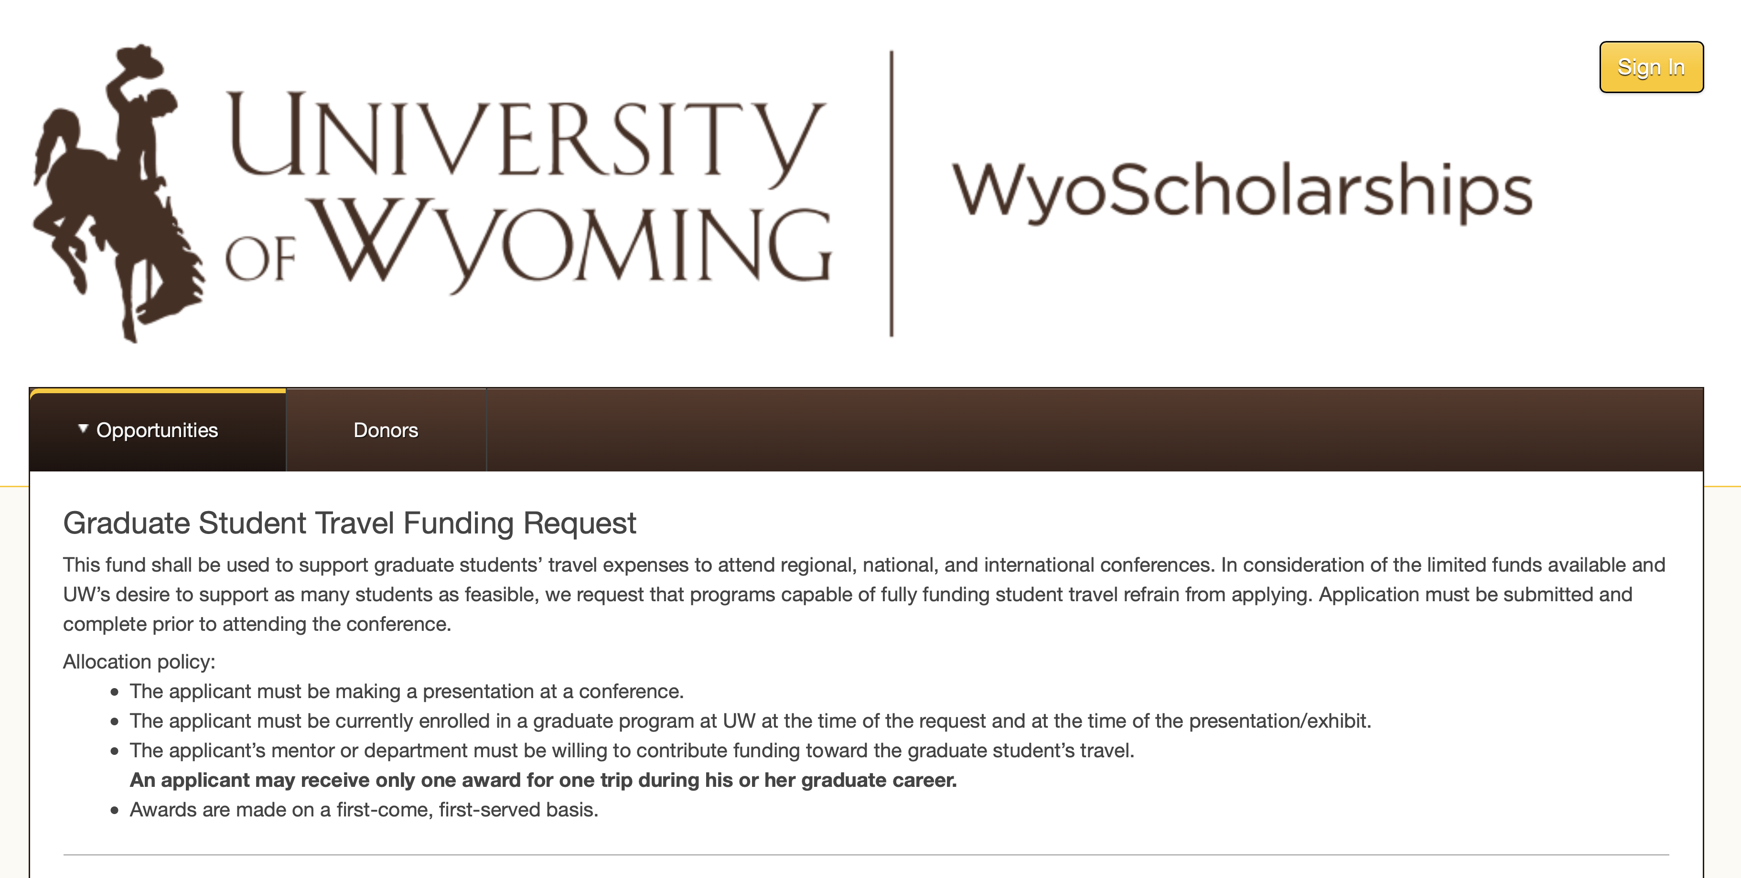
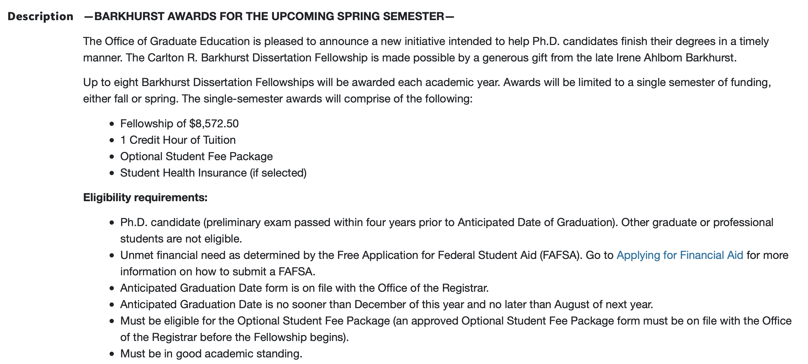
Funding for Graduate Students
GTA funding allocations
URDM & WGE Graduate Assistantships
Barkhurst Dissertation Writing
Fellowships
Graduate Student Conference
Travel Funding
Update on Energy Science
Graduate Assistantships

Slide 7
Funding for Graduate Students
GTA funding allocations
URDM & WGE Graduate Assistantships
Barkhurst Dissertation Writing
Fellowships
Graduate Student Conference
Travel Funding
Update on Energy Science
Graduate Assistantships

Slide 8
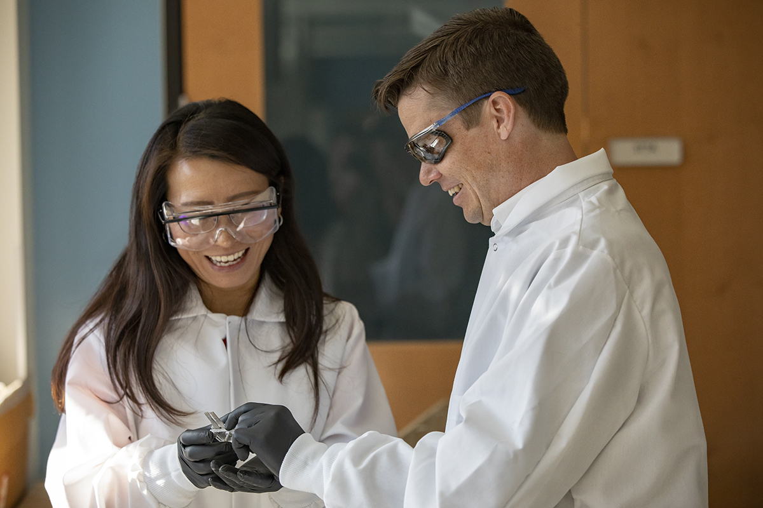
Funding for Graduate Students
GTA funding allocations
URDM & WGE Graduate Assistantships
Barkhurst Dissertation Writing
Fellowships
Graduate Student Conference
Travel Funding
Update on Energy Science
Graduate Assistantships
Current Energy GA Program Funding Ends in June 2020
UW will request $1.4m for FY2021 – 2022

Slide 9


Partnerships for Professional Development
With the Graduate Student Network:
Socials, Lightning Talks, Writing Workshops & More
With Global Engagement:
International Graduate Student Workshops
With the Writing Center/E-CTL: Graduate Learning Communities
Spring 2020 - Scholarly Writing Practices
With the Office of Diversity, Equity & Inclusion:
Diversity training for graduate mentors

Slide 10
Q & A

