Slide 1
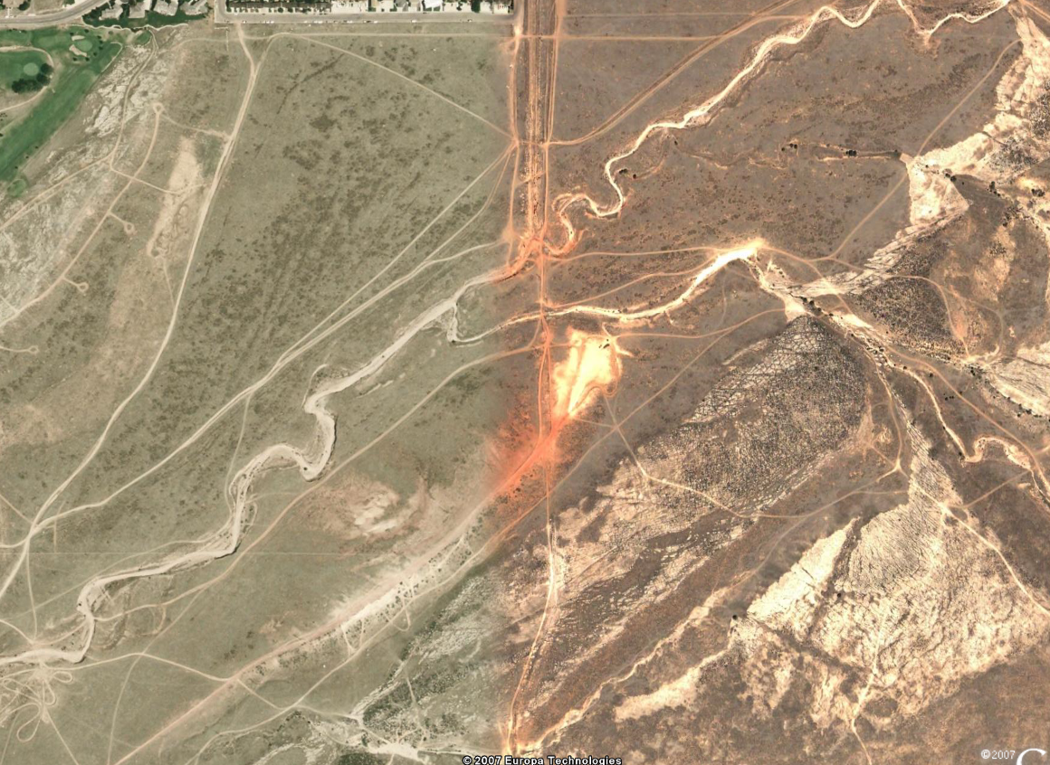
13
10
9
6
2
7
1
40-Team A.
41-Emma
42-Brian
43-Hans
44-Jerod
11
5
4
3
12
8
16
22
15
19
21
26
23
28
24
42
39
17
25
35
41
18
31
43
32
40
44
20
14
30
38
29
36
27
34
33
37

Slide 2
13
10
9
6
2
7
1
40-Team A.
41-Emma
42-Brian
43-Hans
44-Jerod
11
5
4
3
12
8
16
22
15
19
21
26
23
28
24
42
39
17
25
35
41
18
31
43
32
40
44
20
14
30
38
29
36
27
34
33
37

