Slide 1
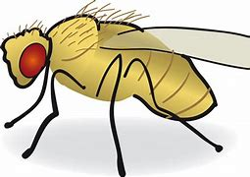
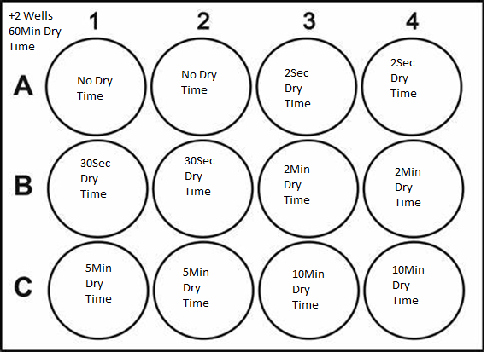
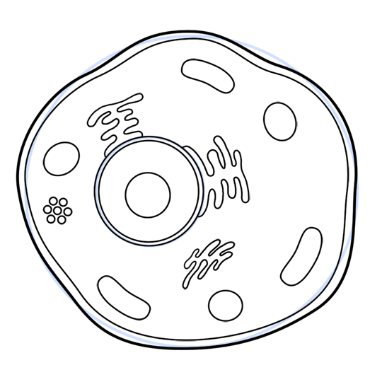
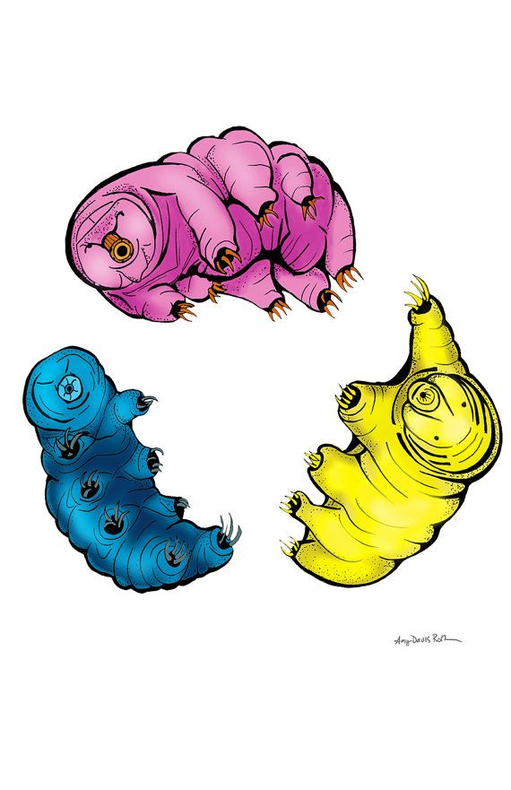
Use of Proteins to Produce Fruit Flies Tolerant to Dehydration Schoborg Lab Collaboration with Boothby and Oakey Labs University of Wyoming
Question: Can fruit flies become desiccation tolerant with the use of proteins known to confer desiccation tolerance in other organisms?
Results
DTP | Expressed in cells? | Subcellular Localization | Original Organism
AavLEA | Yes | Nucleus, Cytoplasm, and Spindle Poles | Nematode Worm
AtLEA4-2 | Yes | Nucleus, and Cortex | Plant
AvLEA-1c | Yes | Nucleus | Rotifer
Ce_Dur1 | Yes | Nucleus | Nematode Worm
Hypothesis- DTPs known to convey desiccation tolerance in other organisms can confer tolerance to drosophila (fruit fly) cells
Why it Matters
It takes an abundance of time to care for fruit flies who are a powerful model organism used to research human disease.
Experimental Design
Experiment 1. Drying Cells
Remove media Count survivability
from cells for allotted
amounts of time
0
Experiment 2. Confirm Expression
& Stability of DTPs in fly cells
Clone Transfect Microscopy
Fly cells extremely sensitive to drying
Cryopreservation has been tried to reduce maintenance time of fruit flies—all failed.
Composite
DAPI
GFP
Spindle Poles
Other organisms are known to use Desiccation Tolerance Proteins (DTPs) to protect from dehydration; including tardigrades and plants.
AavLEA
Conclusion and Future Projects
Cells have little to no desiccation tolerance
Proteins can express in cells
The next step is to finish imaging proteins with live imaging and to combine experiments to see if desiccation
tolerance is conferred
Acknowledgements
Missy Stuart-training/troubleshooting
Dr. Todd Schoborg-training, teaching, and entrusting
me with this research
Unknown if fruit flies use proteins to fight desiccation.

