Slide 1
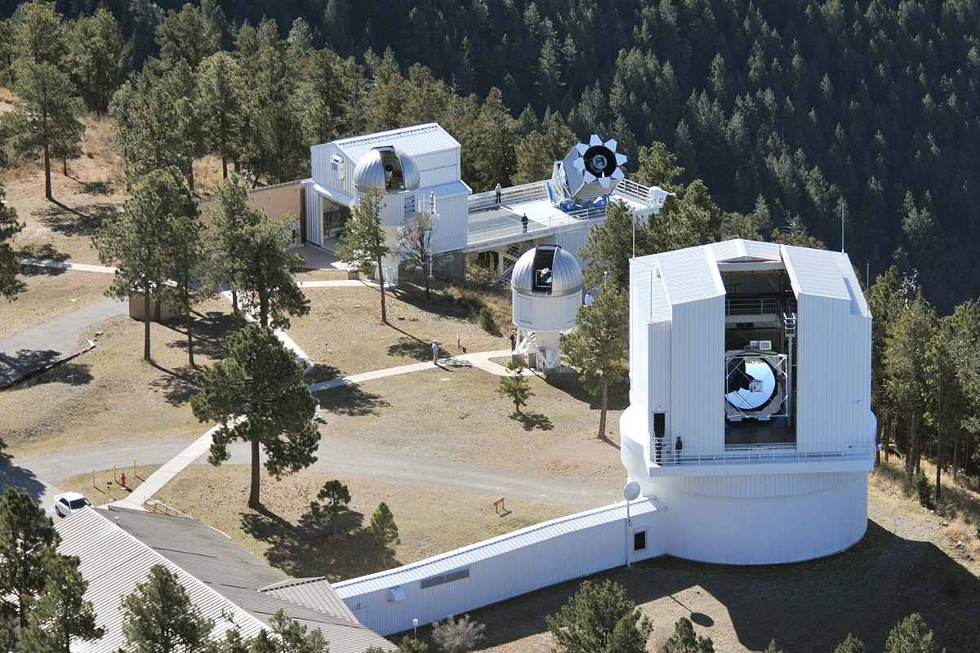
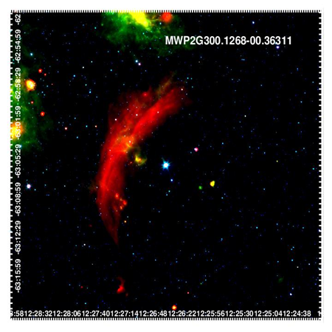
Cataloging and Classifying Stars That Drive Stellar Bow Shock Nebulae
Michael Lindman, Will Chick, and Dr. Chip Kobulnicky
University of Wyoming, Department of Physics and Astronomy
mlindman@uwyo.edu
Abstract
Background
The goal of this research is to classify 187 new stellar bow shock candidates to add to the existing catalog of 709 candidates. We utilized the Wyoming Infrared Observatory and the Apache Point Observatory to collect data on the bow shock stars from our list of targets, and we have successfully obtained stellar spectra of 30 stars from this list. This data was reduced to produce finalized spectra that will be further analyzed using Python to determine multiple characteristics of these stars. Many of the observed stars appear to be O and B type stars, but further analysis is needed.
A bow shock star is a star that powers a large arc shaped nebula made of dust and gas.
The nebula is formed when the interstellar medium, the space between stars, hits the outflowing stellar wind, ejected stellar material, coming from the central star.
There are currently 709 known bow shock stars contained in the largest catalog to date.
Further analysis was conducted on many of the stars in the catalog to determine their properties and characteristics such as galactic locations and environments.
The Wyoming Infrared Observatory (WIRO) and the Apache Point Observatory (APO) in New Mexico have been used to collect data on some of the bow shock stars in the catalog.
The Milky Way Project has provided many of the new bow shock candidates for this research.
Figure 2: Apache Point Observatory.
Methods
Obtain galactic and equatorial coordinates, ultraviolet, blue, and visual photometric magnitudes, and parallax for each star.
Use the SIMBAD database, the GLIMPSE catalogs, the Gaia Archive, and the USNO catalog to obtain the data.
Create red, green, and blue (RGB) images of each star using data from the GLIMPSE catalogs.
Use DS9 image display to create the images.
Collect stellar spectra of the stars using spectrographs at WIRO and APO.
Use IRAF to reduce each raw spectrum to produce a finalized spectrum.
Use Python code to plot each spectrum and analyze the data.
Objectives
Collect at least one stellar spectrum for each of the 187 new bow shock stars.
Reduce each stellar spectrum to produce a finalized spectrum for analysis.
Catalog and classify each star based on their characteristics.
Study each star to learn more about the formation of bow shock stars and their characteristics.
Figure 1: RGB image of a bow shock star.

Slide 2
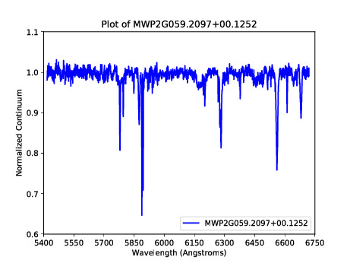
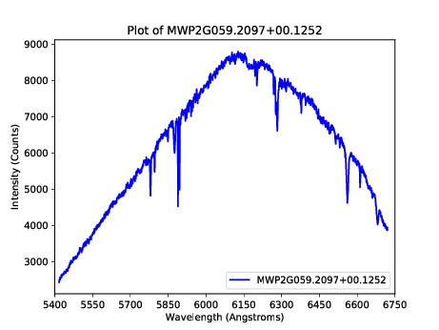
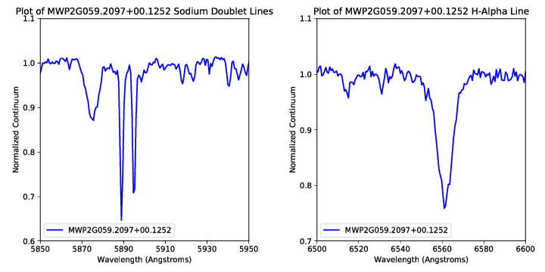
Figure 3: A bow shock spectrum plotted using Python.
Figure 4: Sodium doublet and H-Alpha lines of a bow shock spectrum.
Figure 5: A non-normalized bow shock spectrum.
Results
Discussion
Future Work
We collected coordinate data, photometric magnitude data, and parallax data from multiple databases where possible. No data could be found for some stars.
I created 187 RGB images using ds9 for each of the new bow shock stars.
We obtained stellar spectra of 30 of these bow shock stars using WIRO and APO.
We reduced the raw stellar spectrum for each of the 30 stars using Image Reduction and Analysis Facility (IRAF) to create a finalized spectrum.
For stars observed at WIRO, the final spectra are all normalized.
For stars observed at APO, there are normalized and non-normalized final spectra.
I used Python code to create plots of each spectrum that allowed me to compare my reductions to previous reductions completed by other team members.
I also used Python code to begin some data analysis, but not much has been completed.
The lack of data in on many of the stars in this new list suggests the databases have not been provided the necessary information thus suggesting that many of these stars have no previous identification or studies in the literature.
Initial findings show that most of the stars we observed are likely O and B type stars, with possibly one M-type supergiant.
I will need to fit standard stellar spectrum plots to each my plots to determine if my data matches the standards for each stellar classification.
More analysis is also needed to determine other characteristics such as velocities, magnitudes, and compositions for each star.
These initial results will allow us to build this new catalog that will be added to the existing catalog and expand current knowledge of bow shock stars.
This research will lead to more discoveries about bow shock stars and their characteristics and features.
Continue cataloging and classifying the 187 stars to add to the existing catalog of 709.
Obtain a spectrum for each star in the new catalog to analyze and collect data from.
Learn more about bow shock star characteristics.
Have a finished and published research paper by the end of the spring semester in 2022.
References
Jayasinghe, T., Dixon, D., Povich, M. S., et al. 2019, MNRAS, 488, 1141, doi: 10.1093/mnras/stz1738
Kobulnicky, H. A., Chick, W. T., Schurhammer, D. P., et al. 2016, ApJS, 227, 18, doi: 10.3847/0067-0049/227/2/18
Acknowledgments
I would like to thank Chip Kobulnicky and Will Chick for their help with this research. I would also like to thank the Wyoming Research Scholars Program and the Wyoming NASA Space Grant Consortium for their funding and support of this research.

