Slide 1
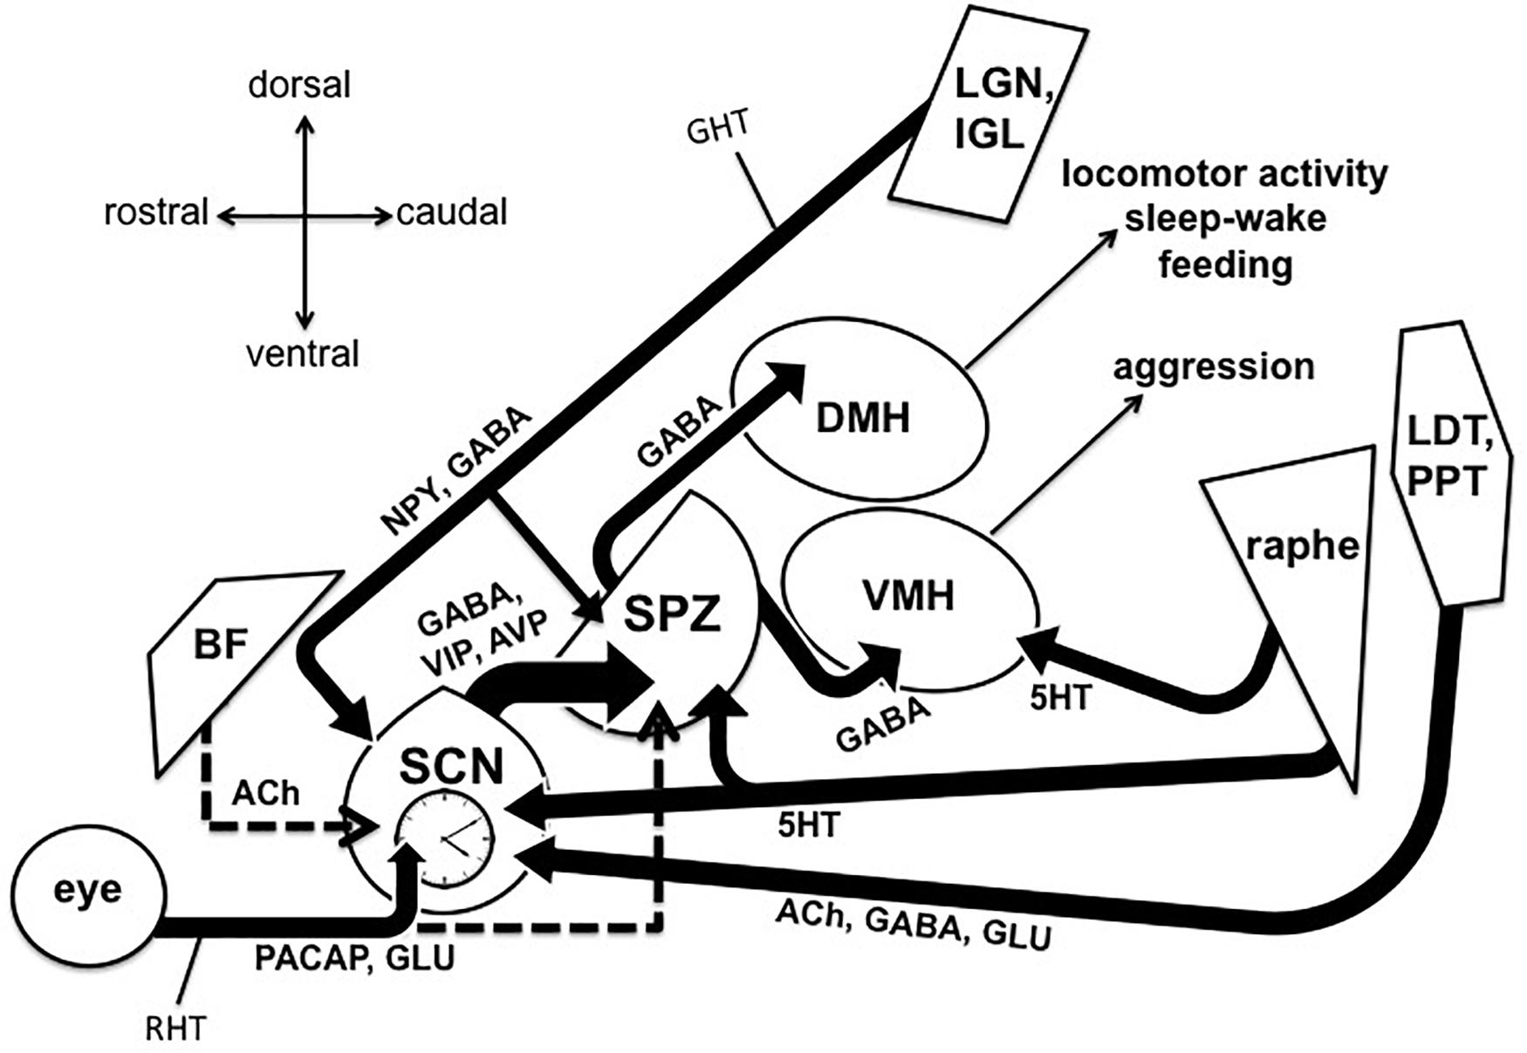
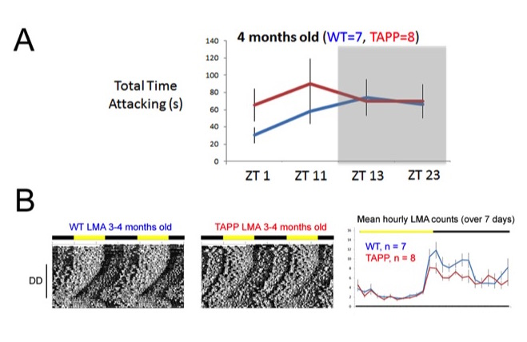
Identifying Pathways for Circadian Disruption and Sundowning-Associated Aggression in Alzheimer’s Disease
Abstract
Sundowning syndrome is a feature of Alzheimer’s disease (AD) and other dementias, characterized by early evening outbursts of agitation, aggression, and delirium. Due to its temporal nature, our lab believes that sundowning indicates disruption to the suprachiasmatic nucleus (SCN), which regulates circadian rhythms. Sleep/wake rhythms are facilitated by the SCN-SPZ-DMH pathway, but recent research shows that the SCN-SPZ-VMH pathway regulates daily rhythms of aggression propensity. We hypothesize that certain structures in the SCN-SPZ-VMH pathway may be compromised in Alzheimer’s disease patients (Fig.1) and may underlie the symptoms observed in sundowning. To support this hypothesis, our first aim is to determine the relationship between AD pathology and rhythms of aggression propensity by using immunohistochemical markers to identify AD pathology in TAPP mice that have undergone aggression propensity and locomotor activity (LMA) observations.
Preliminary results
Research assistants are continuing to blind-score the recorded resident/intruder tests; however our preliminary data reflects that TAPP mice express increased aggression in their sleep/wake transition periods, and decreased locomotor activity during their normal wake periods, in comparison to their WT controls (Fig.2). This groundwork strengthens our hypothesis that aggression and LMA rhythms are interconnected by a hypothalamic pathway, and that dysfunction in this circuit underlies abnormalities in the temporal expression of these behaviors.
Ongoing work
Aside from blind-scoring the behavioral interaction videos, our lab is currently processing the brain tissue that was harvested from those TAPP and WT mice. The tissue, sliced into 30μm coronal slices, is processed with antibodies that stain for amyloid-beta plaques and tau neurofibrillary tangles, which are signatures of AD pathology. After staining and mounting tissue, we can examine the SCN, SPZ, DMH, VMH, and other areas that project to the circadian circuits.
Methods (Prior & Current)
Figure 1. The subparaventricular zone (SPZ) projects to the dorsomedial hypothalamus, which controls sleep-wake; the SPZ also projects to the ventromedial hypothalamus, which plays a large role in aggression. The SCN-SPZ-VMH pathway is the central focus of our lab.
Preliminary work: Our PI acquired TAPP mice (bred to produce the amyloid-beta plaques and tau tangles seen in Alzheimer’s patients) as well as a non-mutant wild-type (WT) strain. All mice were 3-4mo at the time of preliminary tests. LMA rhythms were observed in TAPP and WT mice over a period of 5 weeks in different light-dark cycles. Through this period, both the TAPP and WT mice were observed in a series of resident/intruder tests, where the resident mouse was being tested at different time intervals surrounding light-dark transitions. In these tests, an “intruder mouse” was introduced to the cage of either a TAPP or WT resident mouse; their interactions were recorded for 10min under dim red-light.
Current work: Myself and other research assistants are blind-scoring these interactions; we don’t know which light-dark cycle interval we are observing, nor do we know if we are observing resident TAPP or WT mice. Behavior recording is accomplished through the ObserverXT Noldus platform, where research assistants track agonistic and neutral behaviors, and our individual results can be compared against each other for accuracy.
Next Steps & Clinical Application
In future work, our lab will incorporate female mice into this project, which will undergo the same LMA and aggression propensity tests as the males. Additionally, our lab will begin staining for myelin basic protein to explore the role of white matter degeneration as an early indicator of AD pathology.
Sundowning symptoms take their toll on Alzheimer’s patients and their caretakers, and often play a part in the decision to institutionalize those patients. Finding dysfunctional pathways that regulate both aggression and circadian rhythms might identify a therapeutic pathway target to alleviate sundowning symptoms.
Figure 2. Preliminary results show that the TAPP mice exhibit increased attack time (2A) and blunted active period LMA (2B, right); additionally, double plotted actograms (2B, left) reflect a fragmented structure in TAPP LMA after being exposed to continuous darkness (DD) for 3wks.
Todd WD, et al. 2018. A hypothalamic circuit for the circadian control of aggression. Nat Neurosci, 21:717-724. PMCID: PMC5920747
Todd WD. 2020. Potential pathways for circadian dysfunction and sundowning-related behavioral aggression in Alzheimer's disease and related dementias. Front Neurosci. 14: 910. PMID: 33013301
Saper CB. 2013. The central circadian timing system. Curr Opin Neurobiol 23(5):747-751. PMID: 23706187

