Slide 1
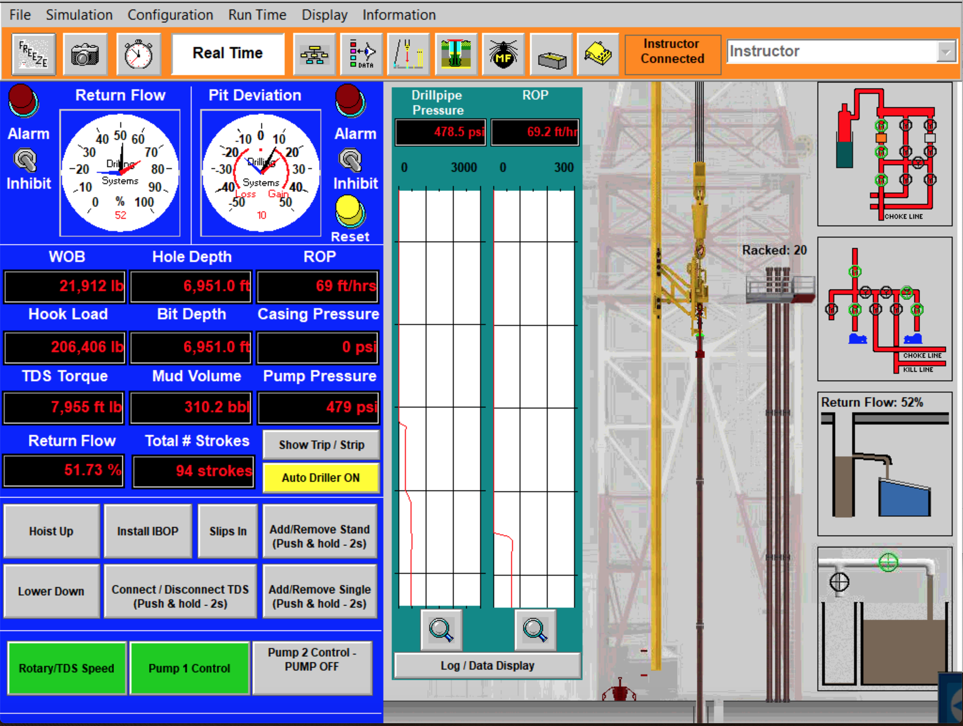
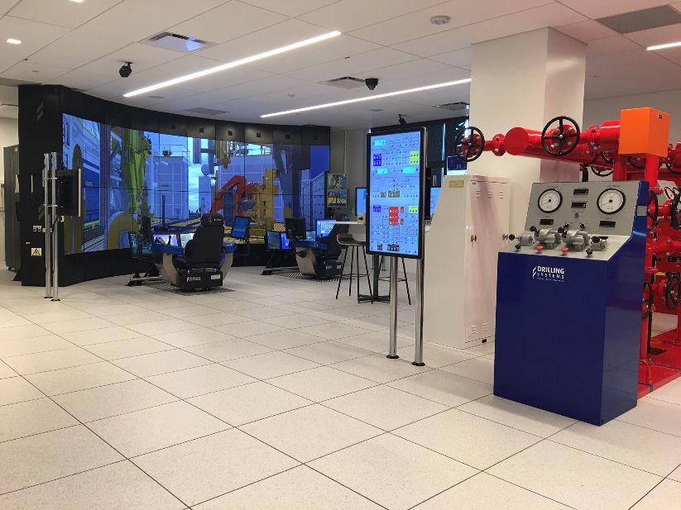
Benefits Of Using Nano-particle Additives In Water Based Drilling Fluids
Jacob Schneider – jschne29@uwyo.edu, University Of Wyoming School Of Engineering And Applied Sciences, Department Of Petroleum Engineering
Introduction
Current Research
In recent years, one of the largest challenges that the petroleum industry has faced has been how to make the industry more environmentally friendly
As regulations continue to become stricter, it has become vital for companies to look at high tech solutions to replace outdated technology
The overall goal of my research is to find one or more nanoparticle additive(s) to be used with a mixture of other additives to replicate the properties of OBs
My current phase of research involves going through an assortment of simulations in both drilling simulators to understand completely how they work
While doing this, I have been conducting literature review to find what other nanoparticles have been used and where these researchers have found success
I am using the following excel table with various drilling fluids to assess what additives give what kind of effect to each fluid
Background Information
There are three main types of drilling fluid that are used in the drilling industry: water-based muds (WBs), oil-based muds (OBs), and gaseous drilling fluid
WBs are the most common type of mud that is used, but when drilling in shale formations, OBs are almost always used because of the properties of the fluid
OBs create a myriad of environmental problems, with the main problems including highly contaminated drilled cuttings, exceedingly toxic produced fluid, and oil leak off into various formations
Using nanoparticles as an additive in WBs can cause the rheologic properties of the WBs to mimic and improve upon the properties that make OBs useful in sensitive shales
The picture above shows the main control panel for the online drilling simulator, this is where most of the functions are carried out during a simulation
Future Research
Using the data that I collect from the excel table I will then replicate the composition of the best fluids and test the properties of these fluids in the drilling fluid lab
Once my own set of data is gathered for these solutions, I will plug this data into the drilling simulator and run each fluid through various simulations in the DrillSim 6000 and 5000
By doing this, I should be able to determine a few different nano-particle additives that can each be used in different well control situations and in different geologic environments
My research goal is to build of research already done on nanoparticle addatives in drilling fluids and to provide more data so that OBs can eventually be phased out of use
References: Tawfik Elshehabi, Jose Aramendiz, Abdulmohsin Imqam, Mortatha Al-Yasiri, Afrah Awad, Shahid Pervaiz, Dongsheng Wen
Shown above is the DrillSim 6000 located in the Engineering Education and Research Building

