Slide 1
Project Update
September 6, 2016

Slide 2


Today’s Agenda
How did we get here?
What are we doing?
Who is doing it?
2

Slide 3
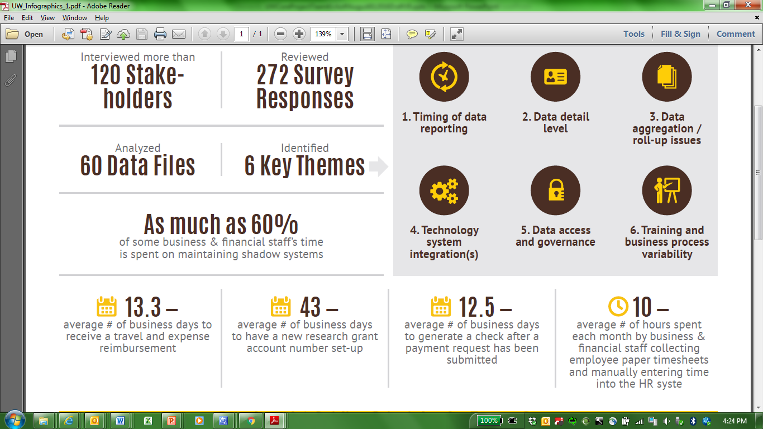
Current Systems Significantly Hinder UW’s Ability to Efficiently and Effectively Conduct Business
3
Notes:
Talk about themes in relation to data.

Slide 4
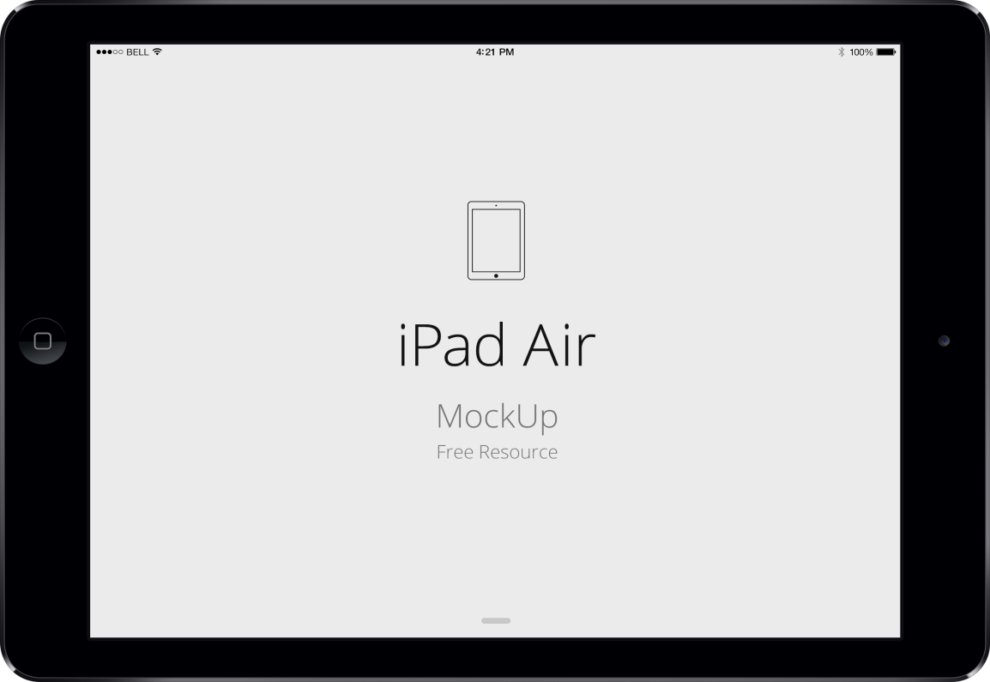
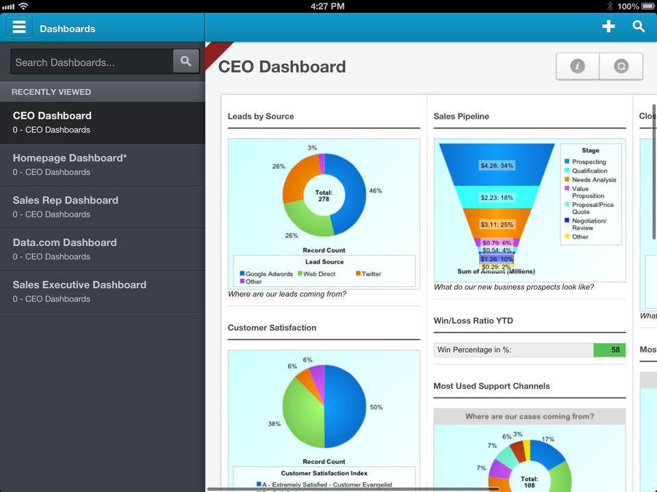
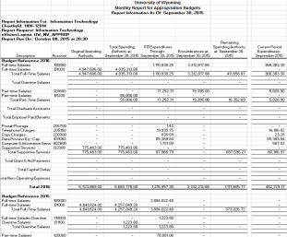
What UW’s Systems Should Be
Upgrading the current back office systems provides the University of Wyoming with the ability to move to more contemporary solutions.
60+ PISTOL PDF/Excel Reports
4
Notes:
Talk about the reasons why Oracle was selected as part of this slide – overall cost, better integration, embedded reporting, one-stop shop

Slide 5
Today’s Agenda
How did we get here?
What are we doing?
Who is doing it?
5

Slide 6

What is WyoCloud?
Oracle Cloud Solutions:
  Financial Management
  Human Capital Management
  Grants Management
  Budgeting
  Supply Chain Management
  Reporting & Analytics
6
Notes:
WyoCloud Branding introduction – removing the tie to WyoSolutions

Slide 7
What is in Scope?
At the conclusion of the WyoCloud implementation, the University of Wyoming will have modern Financial Management, Human Capital Management, Grants Management, Budgeting & Planning, Supply Chain Management, and Reporting & Analytics technology solutions.
Workstream | Workstream Description
Project Management, Financials, Human Capital Management, and Grants | Project management includes project scope and schedule oversight, full staffing and backfill plan, and initiation of change management and project governance activities Financial Management System implementation includes General Ledger, Asset Management, Financial Reporting, Accounts Payable, Procurement, Expenses, integrations, and development Human Capital Management System implementation includes Core HR, Payroll, Benefits, Time & Labor Lead, Recruiting, Performance Management, integrations, and development Grants System implementation includes Billing & Accounts Payable, Project Costing, Project Contracts, Application/Integration Development
Budgeting | Budgeting includes budgeting, forecasting, and financial modeling using data from systems across the enterprise
Business Intelligence and Reporting | Business Intelligence and Reporting implementation will provide a University-wide reporting solution with initial capabilities to report against student, financial, human resource, and foundation data
Change Management and Business Process Design | Change Management and business process design includes campus communications, training , and efforts focused on redesigning the University’s business processes to utilize system workflow capability and enhance efficiency
Performance Improvement | Performance Improvement includes projects aimed at improving efficiency, reducing costs in various areas of the university, and/or increasing or diversifying revenue streams
7

Slide 8
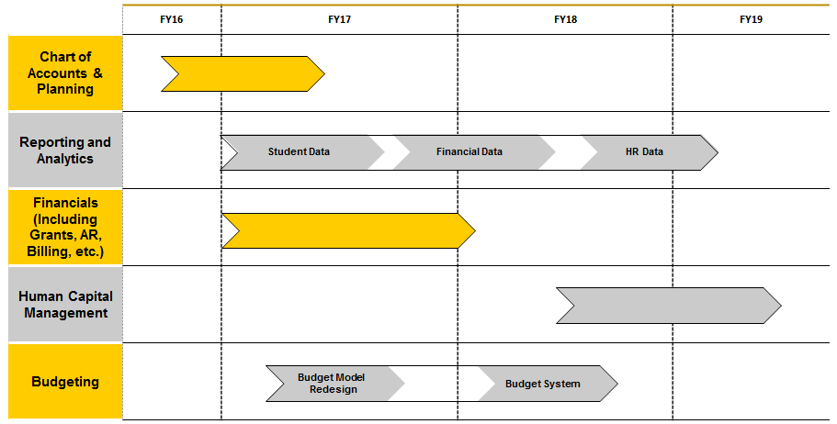
Current Implementation Timeline
The current implementation timeline outlines eight tasks over a 36 month period, resulting in a go-live for Financials in July 2017 and HCM in January 2019.
8
Notes:
8
Erased first and last row from timeline

Slide 9

Solution-Driven Approach
SOLUTION-DRIVEN
(Package-Enabled)
SOLUTION - DRIVEN APPROACH ATTRIBUTES
Presumption that out-of-the-box will work 80% + of the time
Time spent on defining and solving true gaps
Drives process improvement discussion via leading practice “straw man”
Prevents non-strategic differentiator scope creep
Immediate end-user hands-on, day-in-the-life process experience mitigates change risk
35% project time savings typical
Will this work for you?
Plan
(To Be Solution)
Design
(Prototype)
Configure
Validate
(Test)
Transition
Realization
9
Notes:
Susan

Slide 10
Workstream Updates
The Oracle Fusion Cloud implementation team has made significant progress to-date; however, much work is still to be done before the planned July 1st go-live date.
Workstream | Accomplishments (July-Aug) | Planned Activities(Sept – Dec)
Chart of Accounts | Established Chart of Accounts project team (have held 4 meetings) Finalized future-state CoA segment structure and began developing CoA values and value hierarchies | Perform detailed mapping of PISTOL CoA values to future-state CoA structure Finalize future-state Chart of Accounts values and numbering scheme
Reporting | Built first prototype report Identified reporting content to be supported by future environment Mappings developed for Class Enrollment Subject Area | Build integrations for each of the 13 subject areas Review populated delivered reporting content Begin developing custom reporting content
Finance | Identified Oracle implementation team members Held Orientation Workshop Sessions meant to begin to acclimate the implementation team to the Oracle Fusion Cloud software Finalized Business Process Mapping/Configuration 1 approach and schedule | Hold Business Process Mapping/Configuration 1 meetings to complete Oracle Configuration questionnaires Complete 1st round of system testing Hold Business Process Mapping/Configuration 2 sessions to complete Oracle Cloud Fusion system configuration Complete 2nd round of system testing Develop Conversion Plan Develop Integration Plan
Budget Model Design | N/A | Design phase to start in November
Notes:
HURON – fix colors on chart. Don’t know if this would be better as a bulleted list or if it would be better as a graphic of some sort. We are looking to do updates on what was done on each of these active workstreams and what the planned activity is for the next 4 months.
UW – we need to highlight whatever most closely aligns with the needs and concerns of the group. ie. Student Affairs should expect deliverables in March and what will that look like – doesn’t need to be on the slide.

Slide 11
Today’s Agenda
How did we get here?
What are we doing?
Who is doing it?
11

Slide 12



This Will be a Partnership
12

Slide 13
UW Main Executive Steering Committee
The Executive Steering Committee will be responsible for high-level strategic decisions, while the Program Directors will coordinate day-to-day activities with 6 – 7 Project Functional Leads, who will serve as functional experts and leaders for the implementation of each individual module.
13
Notes:
HURON – please delete Mark Bercheni under HCM and say AVP-HR

Slide 14
Subject Matter Experts
Financials/ERP
Reporting
Integrations
General Ledger SME
Juanita Carroll
Financial Reporting SME
Janet Lowe
Juanita Carroll
PJ Shumway
SME
Tana Marsh
Dave Moehrke
Charles Marsh
Jon Klinker
Accounts Payable SME
Jon Kelly
Asset Management SME
Arin Westnitzer
HR Reporting SME
Mark Berchini
Sheralyn Farnham
James Thien
Accounts Receivable SME
Aaron Courtney
HCM
Admissions SME
Christy Oliver
Compensation SME
Mark Berchini
Procurement SME
Office Staff
Financial Aid SME
Steve Scott
Carrie Gose
Payroll SME
Sheralyn Farnham
COA SME
Juanita Carroll
Travel and Expense SME
Jon Kelly
Martha Miller
Greg Livingston
Student Records SME
Steve Massie
Benefits SME
Eric Goldenstein
Student Financials SME
Dave Henry
Project Grant Billing SME
Jonnie Jenkins
Student Reporting SME
Mary Aguayo/Cony Pownall
Project/Grants SME
Jonnie Jenkins
Capital Non-Sponsored Project Costing SME
Darcy Bryant
14
Updated 8/10/2016

Slide 15
Resources
WyoCloud website: http://www.uwyo.edu/wyocloud/
Send questions about WyoCloud to wyo-cloud@uwyo.edu
15

