Slide 1
Contracts
The New Process with WyoCloud

Slide 2
Summary
Office of General Counsel Checklist
Initiating Contract Process
Process for using UW templates
Process for using external supplier contracts
DocuSign
Questions
Notes:
Clarification: The contracts module applies to contracts that come through the Office of General Counsel Contract Process right now. Doesn’t include research agreements that currently go through the Research Office, or purchases of goods, etc.

Slide 3
Office of General Counsel Checklist

Slide 4
WyoCloud “Checklist”

Slide 5
Checklist v. WyoCloud
Checklist
WyoCloud

Slide 6
Initiating the Contract Process
Now: Email/Campus Mail/In-person
WyoCloud
Notes:
Currently, the creation of contracts is done before you send the completed contracts to our office. Once completed, contracts are sent to our office for review via email, campus mail, or delivered in person. The new way to initiate contracts will be within WyoCloud. The contract owner (can be accountant/office associate/business manager/faculty member – as long as they take the training) will sign into WyoCloud, open up the Contracts module and click on Create Contract. A pop-up box will appear that looks like the one on the slide and that will start the process toward creating a contract. There are more steps involved, but on a high level, that is the major difference between initiating the contract process now and initiating the contract process in WyoCloud.

Slide 7
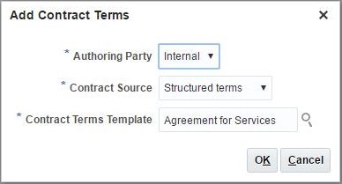
Process – UW Template Contracts
Current Process
WyoCloud

Slide 8
Process – External Supplier Contracts
Current Process
WyoCloud

Slide 9
DocuSign
Notes:
To use DocuSign in the system, on the main page of each contract, there will be a checkbox that says “Enable electronic signature.” That box must be checked in order to use DocuSign. Other than making sure the box is checked, the rest of the steps involved with DocuSign are going to be completed by the legal office. The contract owner will receive emails along with the signers about the DocuSign contract. The final email from DocuSign that the contract owner will receive will state that the contract has been fully executed. That way, the contract owner can activate the contract within WyoCloud.

Slide 10
Questions?

