Slide 1
Core Project Team Kickoff
August 1, 2016

Slide 2
Today’s Agenda
How did we get here?
What are we doing?
Who is doing it?
How are we doing it?
2

Slide 3
Current Systems Key Themes and Observations
The themes and observations Huron discovered through our interviews with and surveys of University of Wyoming stakeholders are summarized below.
Theme 1:
Timing of data reporting
Real-time financial data is unavailable or difficult to access
Theme 2:
Data detail level
Current transaction level details maintained within PISTOL are insufficient
Theme 3:
Data aggregation / roll-up issues
The current structure and organization of University data does not allow for “roll up” reporting at the department, school, or division level.
Theme 4:
Technology system integration(s)
Current Enterprise systems maintained at the University are not integrated
Theme 5:
Data access and governance
Access to real-time financial data is restricted.
Theme 6:
Training and business process variability
Very minimal, if any, training is provided on the various technological systems
3

Slide 4
Current Systems Significantly Hinder UW’s Ability to Efficiently and Effectively Conduct Business
4

Slide 5
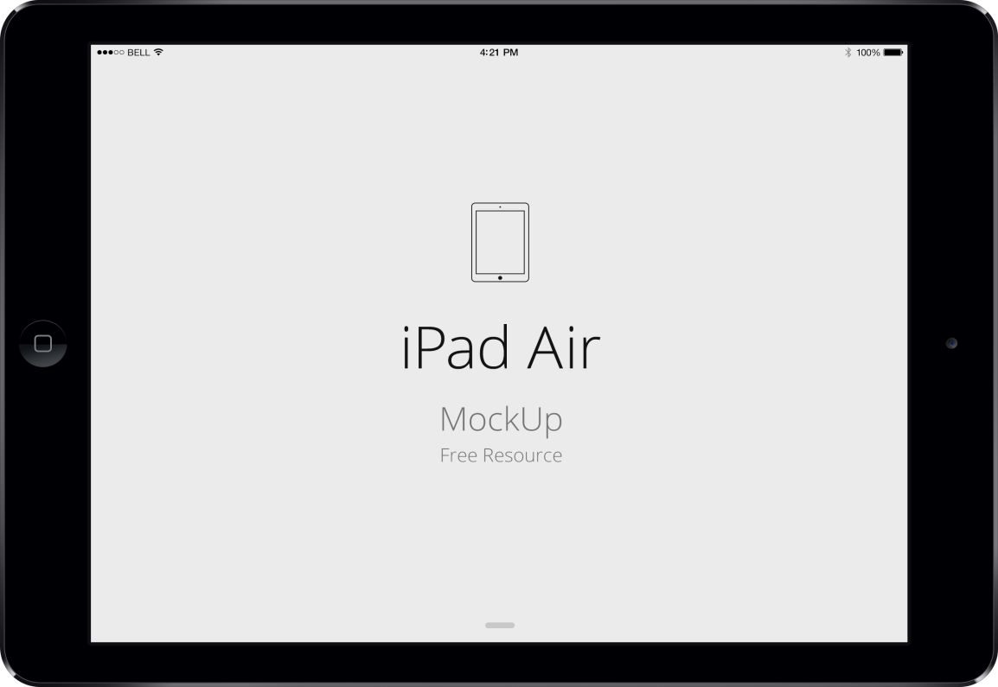
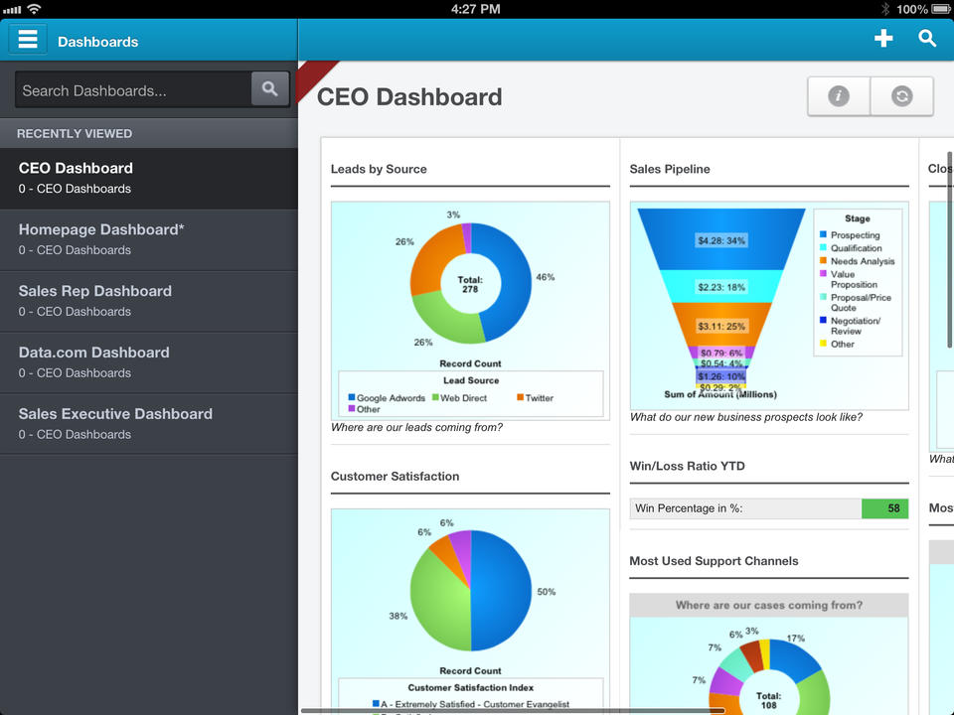
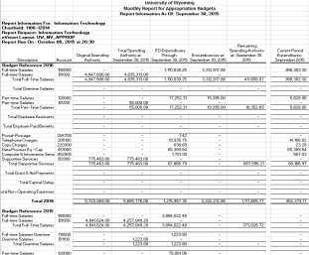
What UW’s Systems Should Be
Upgrading the current back office systems provides the University of Wyoming with the ability to move to more contemporary solutions.
60+ PISTOL PDF/Excel Reports
5

Slide 6
Guiding Principles
In order to provide structure to our review, Huron worked with a broad group of stakeholders to develop the following list of guiding principles to use to identify and document current reporting gaps.
Technology systems and reporting at the University of Wyoming should:
Support the academic, research, and service missions of the University by closely aligning decision making with the university’s strategic plan to meet university priorities and expectations;
Be timely and current and allow users to access both systems and data at their own inclination from both on-campus and remote locations;
Be flexible, comprehensive, and integrated, allowing users to access, aggregate, and query both basic and detailed information from multiple data sources using user-defined criteria at all levels of the organization, and allow for any desired future changes or reorganization;
Be transparent and clear, (clear data definitions, commonly understood and consistent formats, complete and accurate) be driven by a reliable, trusted data source to allow for sound data-driven analyses, and promote fiscal trust, responsibility, and accountability;
Be intuitive, easy to use, and easily trainable to ensure users at all levels are able to understand both the enterprise systems and the data they produce; and
Enable multi-year forecasting and strategic resource planning to ensure future strategic priorities are met at all levels of the organization.
SP
TC
FCI
RT
ET
MY
In addition to being used to identify current reporting gaps, the guiding principles detailed above should be used to ensure that selected solutions meet the desires and needs of campus stakeholders.
6

Slide 7
Systems Selection Timeline
The timeline below depicts what work was done in preparation for issuing the system RFPs and the specific selection steps taken.
2/9/16 - ERP RFP Issued
During Phase 1, Huron found that the University faced many challenges regarding its ability to efficiently and effectively report upon data.
4/25/16-4/29/16 - On Campus ERP Demos
5/2/16-5/4/16 - Campus Survey, SC Meetings with Functional Leaders
5/26/16 Selection Committee Formal Recommendation
6/15/16 - BOT Meeting
ERP and BI Vendor Selection Timeline
Feb. 2016 – June 2016
Phase 1
(Aug. 2015-Oct. 2015)
Phase 2
(Nov. 2015-Feb. 2016)
6/15/16 - BOT Meeting
During Phase 2, Huron documented University business processes and developed an initial estimate for what it might cost to purchase and implement a new Cloud ERP technology solution.
Selection Committee Formal Recommendation
5/20/16 - Campus Survey
5/17/16-5/19/16 – On Campus BI Demos
3/1/16 - BI RFP Issued
The Board of Trustees met on June 15th, 2016 to review and take action on the ERP and BI recommendations put forth by the University of Wyoming Selection Committee.
7

Slide 8
ERP and BI Systems Recommendation
The Selection Committee unanimously recommended that the University of Wyoming select Oracle’s cloud software for its ERP (Financial, Human Capital, Grants & Budget Management) and BI systems.
Rational for Recommendation:
Oracle’s proposed pricing resulted in the lowest 10-year total cost of ownership while also offering more functionality. In addition, selecting the same vendor for both ERP and BI gives the University the best negotiating position to secure the lowest possible price during contract negotiations.
Selecting the same vendor for all modules (Financials, HCM, and BI) also ensures a better “fit” together and more streamlined system integrations – this is also considered an industry best practice.
Oracle had the stronger financial module and from the selection committee’s standpoint the financial functionality was more mature and refined.
The budgeting tool was also more mature and proven and has already been implemented at a number of universities.
During the on-campus software demonstrations, Oracle often had answers to the specific questions being asked by campus stakeholders; which was reassuring that the software could meet the majority of UW’s needs.
The contract and procurement modules were stronger and proven.
Throughout the RFP process, Oracle demonstrated the highest levels of professionalism and overall commitment to the University of Wyoming.
Oracle offers Platform as a Service (PaaS) functionality which would allow the University to build unique functionality that is not offered in Oracle’s core ERP cloud software.
Oracle’s BI solution offers pre-built Extract Transform Load (ETL) functionality, data models, reports and dashboards which would be a definite jump start to implementation. Oracle described this as a 70-80 percent head start, but Huron estimates this is closer to 50% given there is no student ETL (mapping) done for Banner.
The approach to security meets the standards and needs of the University of Wyoming.
There will be one system (dashboard or place) that users will go to for Financials, HR, Budget, Grants Post-Award and BI.
8

Slide 9
Today’s Agenda
How did we get here?
What are we doing?
Who is doing it?
How are we doing it?
9

Slide 10
WyoSolutions & WyoCloud
WyoSolutions is the University of Wyoming’s comprehensive approach to provide modern and sophisticated solutions to today’s demands and challenges on our University. WyoSolutions represents a portfolio of interconnected strategic projects all with the common purpose of re-inventing the way the University of Wyoming operates in order to better support our core missions of teaching, research and service.
Workforce Organization & Structure
Financial Crisis Advisory Committee
Performance Improvement Opportunities
Diversified Revenue Plan
Student Success
Faculty Performance Support
Modern Cloud Systems:
Financial Management
Human Capital Management
Grants Management
Budgeting
Supply Chain Management
Reporting & Analytics
WyoCloud is one of the WyoSolution projects/initiatives, and it describes the Oracle Cloud Systems implementation of Financial Management, Human Capital Management, Grants Management, Budgeting & Planning, Supply Chain Management, and Reporting & Analytics.
10

Slide 11
What is in Scope?
At the conclusion of the WyoCloud implementation, the University of Wyoming will have modern Financial Management, Human Capital Management, Grants Management, Budgeting & Planning, Supply Chain Management, and Reporting & Analytics technology solutions.
Workstream | Workstream Description
Project Management, Financials, Human Capital Management, and Grants | Project management includes project scope and schedule oversight, full staffing and backfill plan, and initiation of change management and project governance activities Financial Management System implementation includes General Ledger, Asset Management, Financial Reporting, Accounts Payable, Procurement, Expenses, integrations, and development Human Capital Management System implementation includes Core HR, Payroll, Benefits, Time & Labor Lead, Recruiting, Performance Management, integrations, and development Grants System implementation includes Billing & Accounts Payable, Project Costing, Project Contracts, Application/Integration Development
Budgeting | Budgeting includes budgeting, forecasting, and financial modeling using data from systems across the enterprise
Business Intelligence and Reporting | Business Intelligence and Reporting implementation will provide a University-wide reporting solution with initial capabilities to report against student, financial, human resource, and foundation data
Change Management and Business Process Design | Change Management and business process design includes campus communications, training , and efforts focused on redesigning the University’s business processes to utilize system workflow capability and enhance efficiency
Performance Improvement | Performance Improvement includes projects aimed at improving efficiency, reducing costs in various areas of the university, and/or increasing or diversifying revenue streams
11

Slide 12
Current Implementation Timeline
The current implementation timeline outlines eight tasks over a 36 month period, resulting in a go-live for Financials in July 2017 and HCM in January 2019.
Project Work Stream | Approximate 36 Month Timeline
 | FY16 |  | FY17 |  |  |  |  | FY18 |  |  |  |  |  |  | FY19
Software Selection
Chart of Accounts & Planning
Reporting and Analytics
Financials (Includes Grant Financials)
Human Capital Management (HCM)
Budgeting
Grants (A/R, Billing, etc.)
Performance Improvement Opportunities
Student Data
Financial Data
HR Data
Budget Model Redesign
Budget System
12
Notes:
12

Slide 13
Today’s Agenda
How did we get here?
What are we doing?
Who is doing it?
How are we doing it?
13

Slide 14
This Will be a Partnership
14

Slide 15
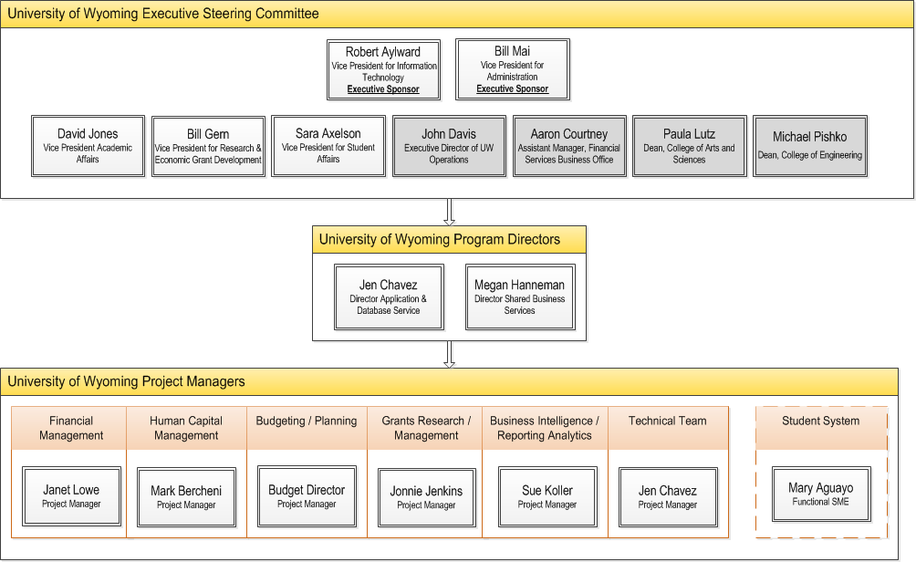
UW Main Executive Steering Committee
The Executive Steering Committee will be responsible for high-level strategic decisions, while the Program Directors will coordinate day-to-day activities with 6 – 7 Project Managers, who will serve as functional experts and leaders for the implementation of each individual module.
Denotes additional Performance Improvement Committee members for the 10-week assessment
15

Slide 16
Project Roles
 | Role Title | Resource
PMO | Project Manager | Jen Chavez
 | Project Manager | Megan Hanneman
Change Management | Change and Training Lead | Stacy Holzwarth
 | Change and Training Analyst | New resource
Leads | Finance Lead (GL, AP, AR, AM) | Janet Lowe
 | Procurement Lead | Martha Miller
 | Project Contracts / Grants Lead | Jonnie Jenkins
 | CoA Lead | Janet Lowe
 | Reporting Lead | Sue Koller
 | HCM Core Lead | Mark Berchini; Sheralyn Farnham
Subject Matter Experts (SMEs) | GL SME | Juanita Carroll
 | AP SME | Jon Kelly
 | AM SME | Arin Westnitzer
 | AR SME | Aaron Courtney
 | COMP SME | Mark Berchini
 | PY SME | Sheralyn Farnham
 | BEN SME | Eric Goldenstein
 | T&E SME | Jon Kelly; Martha Miller; Greg Livingston
 | Student SME | Christy Oliver -AD; Steve Scott - FA; Carrie Gose- FA; Cony Pownall - SR; Dave Henry - SF
 | Financial Reporting SME | Janet Lowe; Juanita Carroll; PJ Shumway
 | HR Reporting SME | Mark Berchini; Sheralyn Farnham; James Thien
 | Procurement SME | Procurement Office Staff
 | Project Grant Billing SME | Jonnie Jenkins
 | Capital (non-sponsored) Project Costing SME | Darcy Bryant
 | Projects/Grants SME | Jonnie Jenkins
 | COA SME | Juanita Carroll
 | Integrations SME | Tana Marsh; Dave Moehrke; Charles Marsh; Jon Klinker
16

Slide 17
Project Roles
 | Role | Resource
Reporting | Student Reporting Integrations Lead | Charles(Chuck) Marsh; Jon Klinker
 | Student Reporting Analyst | Cony Pownall
 | Financial Reporting Integrations Lead | Tana Marsh
 | Financial Reporting Analyst | Tana Marsh; Jon Kelly
 | HR Reporting Integrations Lead | TBD
 | HR Reporting Analyst | TBD
 | Reporting DBA | Jerome Cornelius
Conversion | Conversion Lead | Dave Moehrke; Tana Marsh, Charles Marsh, Jon Klinker - Leads
 | Conversion Developers | Spencer, Shelby Piche; Banner Developers as needed
Interfaces and Integrations | Interfaces Lead | Chris Muenster
 | Paas/Integration Lead Developer | Dave Moehrke-Lead; 1 or 2 Other Developers
 | PaaS/Integration Developer 1 | Dave Moehrke-Lead; 1 or 2 Other Developers
 | Paas/ Integration Developer 2 | Dave Moehrke-Lead; 1 or 2 Other Developers
Testing | Testing Lead | Chris Muenster
 | Student Reporting Testing Support (4 resources quarter time) | Leverage SME's to determine consumers of reports
 | Testing Support (8 resources half time) | Leverage SME's to determine additional resources
Security | Security Lead | Gaylene Feldbush
Cutover | Cutover Lead | Chris Muenster
17

Slide 18
Expectations
University of Wyoming
Huron
When needed, this project is a top priority.
You don’t have to have all the answers.
Need to ensure the right people are at the table.
Be open and direct.
Share all the background and context – help us help you.
Ask questions – lots of questions.
Hold each other accountable.
Your time is respected and used effectively and efficiently.
Preparation materials and agendas are sent to you in advance whenever possible.
We don’t have all the answers – we need your help.
Be open and direct.
Teaching and training – make us keep explaining.
Hold each other accountable
18

Slide 19
Today’s Agenda
How did we get here?
What are we doing?
Who is doing it?
How are we doing it?
19

Slide 20
Solution vs. Requirements Driven Approach
SOLUTION-DRIVEN
(Package-Enabled)
SOLUTION - DRIVEN APPROACH ATTRIBUTES
Presumption that out-of-the-box will work 80% + of the time
Time spent on defining and solving true gaps
Drives process improvement discussion via leading practice “straw man”
Prevents non-strategic differentiator scope creep
Immediate end-user hands-on, day-in-the-life process experience mitigates change risk
35% project time savings typical
Will this work for you?
Plan
(To Be Solution)
Design (Prototype)
Configure
Validate
(Test)
Transition
Realization
As Is
Documentation
To Be Design
(Visio)
To Be Design vs. Fit/Gap
Tech Design
Solution Development
Testing
UAT
Deployment
REQUIREMENTS-DRIVEN
(Blank White Board)
REQUIREMENTS - DRIVEN APPROACH ATTRIBUTES
Presumption of customization
Time spent defining and documenting “as is”
Approach impedes process improvement focus
Approach encourages “wish list” scope creep
Significant delay until end user hands-on, day-in-the-life exposure increases project risk
What do you want?
20
Notes:
Susan

Slide 21
Timeline and Scope
Design
Jul - Nov
Configure
Oct - Apr
Validate
Nov - Jun
Transition
Jun - Jul
Realization
Jul - Aug
Confirm Scope
Conduct configuration kickoff
Create initial business process inventory
Gather configuration data (to build First Test prototype)
Plan Project, integration & Conversions
Configure and Validate
Update Business Process Maps
Extract, Transform, Load, Reconcile and Validate Data (Initial)
Implement and Validate Integrations
Prepare Cutover Strategy
Final configuration
Complete Data Conversion
Finalize Business Process Maps
Conduct System Integration Test
Conduct End User Validation
Conduct End user Training
Verify Production Readiness
Go Live
Transition to Steady-State Operations
Post Go-Live Support
Project Management and Change Management
21

Slide 22
Orientation Workshops
August 22-September 1
What to Expect
Objectives
Schedule
Participants
Deeper Dive into the Oracle ERP Cloud
How to Prepare
Planned Outcomes
22

Slide 23
Orientation Workshops
Date | Time | Topic
August 22 Monday | 1 PM to 4 PM | Navigation, User Interface, Security
August 23 Tuesday | 9 AM to 12 PM | Enterprise Structure, Chart of Accounts, Ledgers
August 23 Tuesday | 1 PM to 4 PM | General Ledger, Allocations
August 24 Wednesday | 9AM to 12 PM | Suppliers, Procurement Contracts, Requisitions
August 24 Wednesday | 1 PM to 4 PM | Purchasing, P-Card
August 25 Thursday | 9 AM to 12 PM | Accounts Payable, Expenses
August 29 Monday | 1 PM to 4 PM | Budgeting Control and Encumbrance Accounting
August 30 Tuesday | 9 AM to 12 PM | Grant Awards, Grant Projects, Grant Contracts
23

Slide 24
Orientation Workshops
Date | Time | Topic
August 30 Tuesday | 1 PM to 4 PM | Grants Billing, Grants Budgeting
August 31 Wednesday | 9 AM to 12 PM | Asset Management
August 31 Wednesday | 1 PM to 4 PM | Sub-ledger Accounting
September 1 Thursday | 9AM to 12 PM | Reporting Tools
September 7 Wednesday | 9AM to 12 PM | Conversion and Integration Tools
September 7 Wednesday | 1 PM to 4 PM | Follow up Items
September 8 Thursday | 9AM to 12 PM | Follow up Items
24

Slide 25
Next Steps (2 Weeks)
Calendar and reserve the conference rooms for the Orientation Workshops (Wyoming/Huron)
Prepare and distribute the materials for the Orientation Workshops (Huron/Oracle)
Schedule a project planning meeting with the team to discuss key milestones and tasks (Huron)
Release the WyoCloud Sharepoint site week of August 1, 2016 (Huron)
Schedule a demo of the WyoCloud Sharepoint site (Huron)
25

Slide 26
Appendix

Slide 27
30 Day Roadmap
No # | Task | Huron | Wyoming | Oracle
 | GOVERNANCE
1 | Determine and Schedule Executive Steering Committee Meetings |  | X
2 | Accrual Accounting Transition Decision |  | X
3 | Establish Project Checkpoints (Huron QA) | X
4 | Confirm Project Governance including decision making, escalations | X
5 | Complete detailed Project Plan | X
6 | Develop Project Controls including Scope Mgmt., Staff Mgmt., Business Process Design strategy) | X
7 | Confirm Resource Plan (Assign resources to various tasks) | X | X
8 | Complete project plan maintenance procedures | X
9 | Establish Status Reports | X | X
 | INFRASTRUCTURE
10 | Provision Oracle Environments/instances for (ERP, Reporting) |  |  | X
11 | Acquire Team Work Location ( including location for design sessions) |  | X
12 | Project Financial plan including Staffing Plan and Budget Tracking | X | X
13* | Identify Testing Management Tools | X
 | CONTRACTS
14 | Complete Huron SOW | X | X
15 | Complete Oracle Contract |  | X | X
 | BUSINESS PROCESS
16 | Develop Configuration and Business Process Mapping Workshop Schedule | X | X
17* | Finalize the new COA Structure ( Segments only)/Decision to Implement Accruals | X | X
 | PEOPLE
18 | Assignment of Banner SME |  | X
19 | Assignment of Reporting Liaison |  | X
20 | Identify required Wyoming backfill and secure resources |  | X
21 | Produce Project Orientation Guide for Huron and Wyoming | X
22 | Develop Awareness and Desire (AD) Communication Campaign | X
23* | Identify Phases for the Project Website Launch ,Branding and Communication | X | X
 | TECHNICAL
24 | Access to Banner Schema (Read Credentials) |  | X
25 | Access to Banner ODS (Read Credentials) |  | X
27

Slide 28
60 Day Roadmap
No # | Task | Huron | Wyoming | Oracle
 | GOVERNANCE
1 | Complete Work Product Tracking Sheet (RACI) | X | X
2 | Create Issue and Risk Management Plan | X
3 | Initial Risk Log developed | X
 | INFRASTRUCTURE
4 | Create Environment Strategy | X | X | X
 | BUSINESS PROCESS
5 | Create Initial Business Process Inventory – ERP | X
6 | Conduct COA Mapping exercise | X | X
7 | Launch Business Process Workshops | X | X
 | PEOPLE
8 | Launch Project Website | X | X
9 | Identify and launch Change Champion Network | X | X
10 | Conduct core Project Team Kick Off | X | X
11 | Create Communication Plan and Communication Matrix | X
12 | Develop Readiness Assessment Strategy | X
13 | Launch Project Website | X | X
 | TECHNICAL
14 | Provide Technical Workshops on Tools for (Conversion, Security, Integration) |  |  | X
15 | Integration Strategy and Plan | X
16 | Reconcile Integration Inventory for Outbound and Inbound | X | X
17 | Confirm Prioritization of Integration Inventory and in scope items | X | X
18 | Initial Review of Pre-Built Reports with SME’s for Student | X | X
28

