Slide 1
2 CFR 200 New Update Effective 10/1/2024 Uniform administrative requirements, cost principles, and audit requirements for federal awards
Kirsten Rigg
kirsten.rigg@wyo.gov
Kim Lamb
kim.lamb@wyo.gov

Slide 2
Background Information

Slide 3
Flow of Federal Funds
Federal Awarding Agency (FHWA, FTA, NHTSA)
WYDOT
(Recipient)
LPA (Subrecipient)
LPA
(Recipient)
Contractor

Slide 4
WYDOT FY 2024 Pass-Through Funding
CFDA # | Program Title | Amount Provided To Subrecipients
20.106 | Airport Improvement Program | 39,339,148
20.205 | Highway Planning and Construction | 6,688,298
20.500 | Federal Transit Capital Investment Grants | 0
20.505 | Metropolitan Transportation Planning | 117,444
20.509 | Formula Grant for Rural Areas | 9,027,760
20.513 | Enhance Mobility of Seniors & Individuals with Disabilities | 446,007
20.516 | Job Access & Reverse Commute Program | 0
20.526 | Bus & Bus Facilities Formula Program | 1,728,419
20.600 | State and Community Highway Safety | 897,909
20.602 | Occupant Protection Incentive Grants | 0
20.607 | Alcohol Open Container Requirements | 10,078
20.616 | National Priority Safety Programs | 582,785
20.933 | National Infrastructure Investments | 0
 | Total Federal funds pass-through WYDOT to subrecipients | 58,837,848

Slide 5
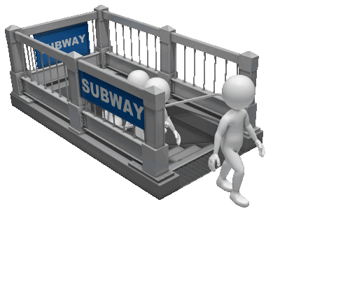
2 CFR 200 Uniform Requirements
2 CFR 200 consists of the following:
Subpart A: Acronyms & Definitions
Subpart B: General Provisions
Subpart C: Pre-award Requirements
Subpart D: Post Award Requirements
Subpart E: Cost Principles
Subpart F: Audit Requirements
Appendix I – XII

Slide 6
2 CFR 200 REVISION
Revised Guidance Effective Dates
Subparts A-E
Effective for new awards issued on or after 10/1/24
Subpart F
Effective for fiscal years beginning on or after 10/1/24
www.ecfr.gov/cgi-bin/text-idx?tpl=/ecfrbrowse/Title02/2cfr200_main_02.tpl

Slide 7
2 CFR 200 General Provisions
2 CFR 200.112 Conflicts of interest
Subrecipients must disclose in writing any potential conflict of interest to WYDOT
2 CFR 200.113 Mandatory disclosures
Subrecipient must promptly disclose in writing to WYDOT all violations of federal criminal law involving fraud, bribery, or gratuity violations potentially affecting the federal awards

Slide 8
2 CFR 200 Pre-award requirements
2 CFR 200.214 Suspension and Debarment
Restricts awards, subawards, and contracts with certain parties that are suspended or debarred from participation in Federal assistance programs or activities.
www.sam.gov is the website that you can use to determine suspension and debarment.
It is a good idea to print out a copy of the search that shows the entity that will be used is not suspended or debarred to keep for your records.

Slide 9
2 CFR 200 Pre-award requirements
2 CFR 200.216 Prohibition on certain telecommunications and video surveillance equipment or services
Applies to recipients and subrecipients
Cannot procure, obtain, extend, renew or enter into a contract to obtain telecommunication equipment or services from specific manufacturers.
List of manufacturers changes so if purchasing this type of equipment verify entities are not on this list.
If you need help determining if an entity is on this list reach out to your grant administrator or Internal Review and we can help.

Slide 10
2 CFR 200 Subpart D Administrative Requirements

Slide 11
2 CFR 200.302 Financial Management
Financial management system must be sufficient to:
Permit the preparation of required reports; and
Track expenditures to establish funds have been used appropriately
Financial management system must provide the following:
Identification, in its accounts, of all federal awards received & expended;
Accurate, current, and complete disclosure of financial results;
Records that adequately identify amount, source & expenditure of federal funds;
Effective control over and accountability for all funds, property, & other assets;
Comparison of expenditures with budget amounts; and
Written procedures to implement requirements and for determining the allowability of costs

Slide 12
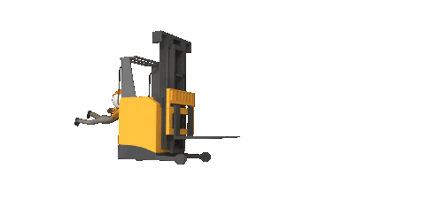
2 CFR 200.303 Internal Controls
Subrecipients must:
Establish & maintain effective internal control over subaward
Comply with Federal statutes, regulations, and the terms & conditions of subaward
Evaluate & monitor compliance
Take prompt action when instances of noncompliance are identified
Take reasonable cybersecurity and other measures to safeguard protected personally identifiable information (PPII) & other information designated as sensitive

Slide 13
2 CFR 200.305 Payment
WYDOT pays on a reimbursement basis which means the following:
Subrecipients must pay all employees, contractors, consultants, etc. prior to requesting reimbursement from WYDOT
WYDOT must make payment to subrecipient within 30 calendar days after receipt of the reimbursement request, unless request is determined to be improper

Slide 14
2 CFR 200.306 Cost Sharing
Any cost sharing and all contributions must meet the following criteria:
Are verifiable from records;
Are not included as contributions for any other Federal award;
Are necessary and reasonable;
Are allowable;
Are not paid by the Federal government under another Federal award;
Are provided for in the approved budget
Conform to other applicable provisions of this part

Slide 15
2 CFR 200.317-.327 Procurement Standards
When conducting procurement transactions under a federal award:
The subrecipient must have and use documented procurement procedures that conform to 2 CFR 200.317-327
Procurement transactions must be conducted in a manner providing full and open competition (200.319)
Methods of procurement (200.320)
Informal
Micro-purchases and Simplified Acquisitions
The simplified acquisition threshold for procurement activities administered under federal awards is set by the FAR at 48 CFR part 2, subpart 2.1(https://www.ecfr.gov/current/title-48/part-2/subpart-2.1)
Formal
Sealed Bids and Proposals
Non-competitive

Slide 16
2 CFR 200.317-.327 procurement Standards Cont.
Procurement Continued:
The subrecipient, when possible, should ensure that minority businesses, veteran-owned businesses, women’s business enterprises, and labor surplus area firms are used when possible (200.321)
The subrecipient should, to the greatest extent practicable under a Federal award, provide a preference for the purchase, acquisition, or use of goods, products, or materials produced in the United States (including but not limited to iron, aluminum, steel, cement, and other manufactured products) (200.322)
The subrecipient should, to the greatest extent practicable procure recovered materials (200.323)

Slide 17
2 CFR 200.317-.327 Procurement Standards Cont.
Regardless of the size of the purchase:
The purchase must comply with the subrecipient’s documented procurement procedures
The purchase must be necessary to carry out the Federal award
The purchase must be made with open competition to the extent required
The organization is in compliance with their conflict of interest policy
Subrecipients MUST
Incorporate a clear & accurate description of the technical requirements for the material, product or service to be procured; and
Identify all requirements which the offerors must fulfill & all other factors to be used in the decision

Slide 18
2 CFR 2 CFR 200.317-.327 Procurement Standards Cont.
Procurement Records (200.318 (i))
Entity must maintain records sufficient to detail the history of each procurement transaction.
This includes but is not limited to:
Rationale for the method of procurement
Selection of contract type
Contractor selection or rejection
Basis for contract price
Each entity must have a WRITTEN procurement policy that includes the requirements of 2 CFR 200.317-327

Slide 19
2 CFR 200.332 Requirements for WYDOT
As the pass-through entity, WYDOT must:
Verify the subrecipient is not excluded or disqualified by reviewing SAM.gov to see if subrecipient has been suspended or debarred
Clearly identify the subaward in the documentation and include:
Federal award identification information
Requirements imposed by pass-through entity
If requested, negotiate indirect cost rate
Evaluate each subrecipient’s risk of noncompliance
Impose specific subaward conditions, if necessary
Monitor the activities of the subaward
Consider results of subrecipient audits, on-site reviews or other monitoring
Consider taking enforcement action for noncompliance

Slide 20
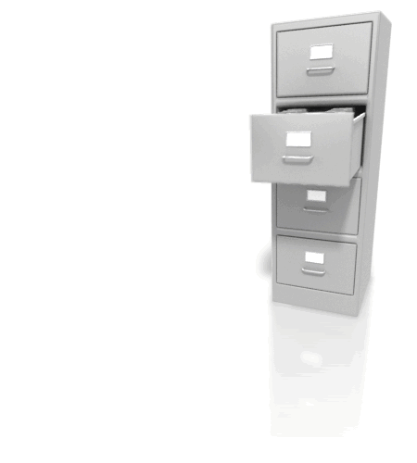
2 CFR 200.334 Retention Requirements for Records
Financial records, supporting documents, statistical records & all other records pertinent to subawards must be retained for 3 years from the date of the submission of the final expenditure report

Slide 21
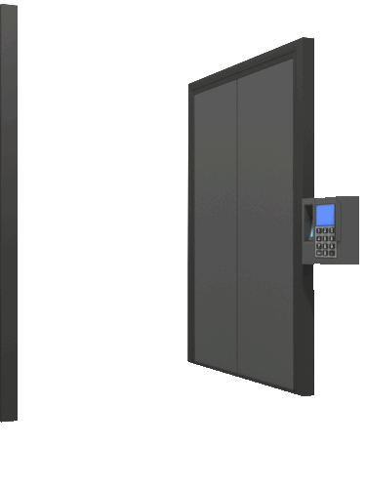
2 CFR 200.337 Access to records
Federal awarding agency, Inspectors General, the Comptroller General of the United States, and WYDOT must have the right of access to any documents, papers, or other records which are pertinent to the subaward.
The right also includes timely & reasonable access to personnel for interviews & discussion related to documents.

Slide 22
2 CFR 200.339 Remedies for Noncompliance
If WYDOT determines that noncompliance cannot be remedied by imposing additional conditions, WYDOT may take on or more of the following actions:
Temporarily withhold payment pending correction of deficiency
Disallow all or part of the cost of the activity not in compliance
Wholly or partially suspend or terminate the subaward
Initiate suspension or debarment proceedings
Withhold further subawards
Take other remedies that may be legally available

Slide 23
2 CFR 200 Subpart E Cost Principles

Slide 24
2 CFR 200.402 – Composition of Costs 2 CFR 200.406 – Applicable Credits 2 CFR 200.413 – Direct Costs 2 CFR 200.414 – Indirect Costs
Allowable Direct Costs
+ Allocable Indirect Costs
- Applicable Credits
Total Cost of Federal Award

Slide 25
2 CFR 200.403 Factors Affecting Allowability of Costs
Cost must meet the following criteria to be allowable:
Necessary & Reasonable
Conform to Federal award
Consistent treatment (federal/non-federal)
Consistent treatment (direct/indirect)
In accordance with GAAP
Not duplicated (cost sharing/other award)
Adequately documented
Cost must be incurred during the approved budget period

Slide 26
2 CFR 200.404 Reasonable Costs
What is a reasonable cost?
Ordinary/necessary
Restraints and requirements
Sound business practices
Arm’s-length bargaining
Federal, State, Local, Tribal laws & regulations
Terms and conditions of the award
Market prices for comparable costs
Prudent acts
Established practices

Slide 27
2 CFR 200.405 Allocable Costs
What is an allocable cost?
Incurred specifically for the Federal award
Benefits both the Federal award and the other work
of the subrecipient
Is necessary to the Federal award and in accordance with these cost principles

Slide 28
2 CFR 200.407 Prior Written Approval
Prior Approval may be sought in advance of incurring costs:
Reasonableness and allocability are difficult to determine
Avoid disallowance or dispute by getting advance approval from WYDOT

Slide 29
2 CFR 200.412 classification of costs
Each cost incurred for the same purpose in similar circumstances must be treated consistently either as a direct or an indirect cost to avoid possible double-charging of Federal Awards

Slide 30
Indirect costs Rate
An indirect cost rate is a percentage calculated by dividing an organization’s total indirect costs by its direct costs.
Only ALLOWABLE costs can be included in the rate
If entity wants to charge an indirect cost rate to their subaward there are two options:
1. Develop and submit an indirect cost rate proposal and cost allocation plan.
2. May elect to charge a de minimus rate of up to15%

Slide 31
Note: if you choose to charge an indirect cost rate, the amount of your subaward does not change!

Slide 32
Application of Indirect Costs
$100,00 total award with 80/20 match
 | With 10% Indirect Cost Rate | Without 10% Indirect Cost Rate
Federal Share | 80,000 | 80,000
Available for Construction | 72,000 | 80,000
Indirect Cost Paid | 8,000 | 0
Local Share | 20,000 | 20,000
Total Award | $100,000 | $100,000

Slide 33
Should we use an indirect cost rate?
Benefits to claiming indirect costs
Flexibility with local funds
Cash management tool
“Pitfalls” of claiming indirect costs
Less federal dollars for projects
Administratively burdensome

Slide 34
2 CFR 200.415 Required Certifications
All subrecipients must provide the following two certifications:
1. Expenditures are proper and in accordance with the terms and conditions of the award.
2. Indirect Cost Plans include only costs that are allowable under the Uniform Guidance (2 CFR 200) and allocable to the Federal award.

Slide 35
2 CFR 200.420 – 476 General Provisions for Selected Items of Cost
List of selected items of cost is not all inclusive
Apply whether or not an item is direct or indirect
Based on treatment provided to similar or related items of cost

Slide 36
2 CFR 200.420 – 476 General Provisions for Selected Items of Cost
Selected Items of Cost (not all inclusive)
Advertising and Public Relations (2 CFR 200.421)
Alcoholic Beverages (2 CFR 200.423)
Depreciation (2 CFR 200.436)
Entertainment & Prizes (2 CFR 200.438)
General Costs of Government (2 CFR 200.444)
Maintenance & Repair Costs (2 CFR 200.452)
Materials & Supplies (2 CFR 200.453)
Professional Service Costs (2 CFR 200.459)
Rental Costs (2 CFR 200.465)
Training and Education (2 CFR 200.473)
Travel (2 CFR 200.475)
Review 2 CFR 200.403 (factors determining allowability) if there are difficulties determining if a cost is allowed

Slide 37
2 CFR 200 Subpart F Audit Requirements

Slide 38
2 CFR 200.501 Audit Requirements
If subrecipient expends $1,000,000 or more in combined Federal dollars during their fiscal year they are required to hire a qualified CPA to conduct Single Audit

Slide 39
2 CFR 200.508 Auditee Responsibilities
The auditee must:
Procure for the audit
Prepare appropriate financial statements, including the schedule of expenditures of Federal awards
Promptly follow up and take corrective action on audit findings
Provide CPA with access to personnel, accounts, books, records, supporting documentation, and other information as needed/requested

Slide 40
2 CFR 200.509 Auditor selection
Factors to consider when evaluating proposals for audit services from a CPA firm:
Responsiveness to the RFP,
Relevant experience,
Availability of staff with professional qualifications & technical abilities,
The results of peer review & external quality control reviews, and
Price
The objective is to obtain a high-quality audit that conforms to the requirements of a Single Audit
A CPA who prepares the entities indirect cost allocation plan may not also be selected to perform the Single Audit when the entity recovered indirect costs exceeding $1 million during the prior year.

Slide 41
2 CFR 200.510 Financial Statements & SEFA
Auditee must prepare:
Financial Statements that reflect its financial position for the fiscal year being audited
Schedule of Expenditures of Federal Awards (SEFA) at a minimum must include:
List individual Federal programs by Federal agency
The name of the pass-through entity & indentifying number assigned by the pass-through, if applicable
Total Federal awards expended for each individual Federal program and the Assistance Listing number (old CFDA #) This number can also be found on SAM.gov.
Notes that describe significant accounting policies used in preparing the schedule, and note whether or not the 15% de minimis cost rate was elected

Slide 42
2 CFR 200.511 Audit Findings Follow-Up
Auditee is responsible for follow-up and corrective action on all audit findings
Summary schedule of prior audit findings must report the status of all prior year audit findings
Corrective action plan must be prepared and include:
Name(s) of the contact person(s) responsible for corrective action
Corrective action planned
Anticipated completion date
If you do not agree with the audit findings or believe corrective action is not required, then the corrective action plan must include an explanation & specific reasons.

Slide 43
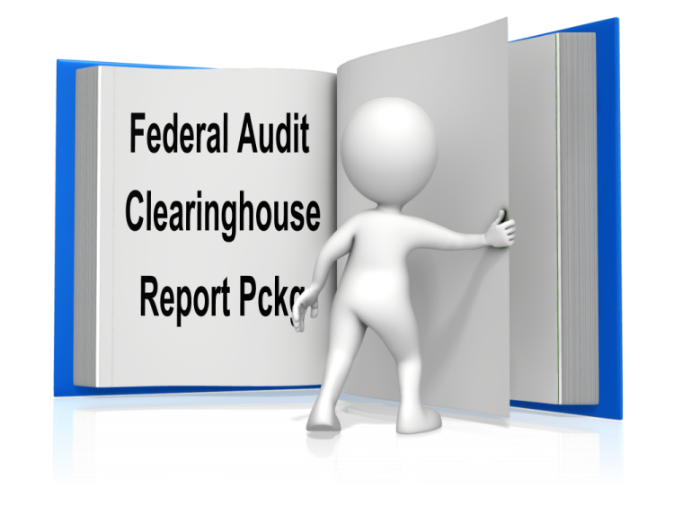
2 CFR 200.512 Report Submission
Audit Report must be completed, the data collection form and reporting package must be submitted to the Federal Audit Clearinghouse (FAC) within the earlier of:
30 calendar days after receipt of the auditor’s report(s), or
9 months after the end of the audit period
Single Audits for 2023 FYE and beyond will need to be submitted through the GSA FAC site. Here is the submission website: https://www.fac.gov
Reporting package must include:
Financial statements & SEFA
Summary schedule of prior audit findings
Audit Report
Corrective action plan

Slide 44
Certification form
SINGLE AUDIT - CERTIFICATION FORM
SECTION A – Entity Information
Entity Name: |  |  |  | Fiscal Year Ending: (MM/DD/YYYY) / / 2023
Street Address: |  |  |  | EIN #:
City: | State: |  | Zip:
Contact Name: |  | Title:
Phone: | Fax: |  | Email:
SECTION B – Independent Auditor Information
Firm Name:
Street Address:
City: | State: |  | Zip:
Phone: | Fax: |  | Email:
SECTION C – Subject to Single Audit Requirements
◻ AUDIT ELIGIBLE – Our entity is subject to the Single Audit requirements. Our entity expended $1,000,000 or more in total Federal Awards for the fiscal year end noted above. Note: Submission of your Single Audit Report and any Management Letters is required to be sent to WYDOT Internal Review at the time you submit your Federal Audit Clearinghouse reporting package. Date audit report is expected to be issued:
SECTION D – Exempt from Single Audit Requirements
EXEMPT STATUS – Our entity is exempt from the Single Audit requirements for the following reason (check one): Our entity expended less than $1,000,000 in total Federal Awards for the fiscal year noted above. Our entity is a for-profit organization and is not subject to the Single Audit requirements. Note: Your entity is not required to submit any other documentation. However, you are required to have your records available for audit.
SECTION E - SIGNATURE SECTION
I am this entity’s representative who is authorized to sign financial documents. I certify that we are in compliance with Federal laws and regulations. The statements made herein are true and correct to the best of my knowledge. Representative Signature: Date: Representative Printed Name: Title:

Slide 45
2 CFR 200.521 Management Decisions
Management Decision issued by Internal Review:
Obtain copy of subrecipient audit reports if findings pertain to WYDOT funding:
Review audit report for accuracy
Review corrective action plan for reasonableness
Issue a management decision to subrecipient clearly stating:
Whether or not the audit finding is sustained
Reason for the decision
Expected auditee action to repay disallowed costs, make financial adjustments, or take other action

Slide 46
Common Issues Found
Common issues found with Single Audit Reports
Inaccurate SEFA
This usually happens because the financial system did not identify all federal funds or they are incorrectly identified
Corrective action plan does not include who will take corrective action and by when
Not obtaining an audit and submitting required information to FAC by required deadlines
Not having a written procurement policy

Slide 47
Monitoring

Slide 48
Subrecipient Monitoring
Per 2 CFR 200, WYDOT is required to conduct oversight monitoring which could include the following:
Review subrecipient reimbursement requests
Review subrecipient reports/documents
Review single audits
Schedule site visits
Conduct subrecipient audits based on risk
Project inspections by WYDOT or Federal Agencies
Approval for certain activities
Provide technical assistance & training
Communicate (phone, email, etc.)
Follow subrecipient coverage in news

Slide 49
Subrecipient Monitoring
Project Delivery Systems & Internal Control Questionnaire required for subrecipients:
Questionnaire must be filled out by new subrecipients prior to award
WYDOT Internal Review & Planning must both approve ICQ
Approval on ICQ is good for 4 years & then must be updated

Slide 50
Project Delivery Systems & Internal Control Questionnaire

Slide 51
Subrecipient Responsibilities
Follow the subaward agreement
Have documented internal policies and procedures
Ensure the organization has a financial management system
Establish a budget to track expenditures
Keep informed of changes in policies, procedures or requirements
Request prior approvals when necessary
Maintain communication with Federal and State partners
Permit WYDOT access to records
Prepare necessary reports
Make the most of site visits by WYDOT

Slide 52
Final Thoughts
Read and understand the terms and conditions of subaward agreement & revisit frequently
Read & understand 2 CFR 200
Familiarize all staff with provisions, regulations and program policies and procedures
Ensure supporting documentation is present
If it isn’t documented, it didn’t happen!
Attend WYDOT training when available

Slide 53
