Slide 1
LPA Civil Rights Requirements
ADVOCACY, COLLABORATION, AND EDUCATION

Slide 2
Title VI
Labor Compliance
Policy Reviews
Prevailing Wage/Davis Bacon
Disadvantaged Business Enterprise
ADA

Slide 3
Title VI- non-discrimination regarding access to programs and services

Slide 4
What are the Title VI Assurances?
The written commitment to comply with Title VI of the Civil Rights Act of 1964, 49 CFR, part 2, and all related regulations and directives. The LPA assures that no person shall on the grounds of race, color, national origin, gender, age or disability be excluded from participation in, be denied the benefits of, or be subjected to discrimination under any program, activity or service.
1052.A FHWA Title VI Assurances

Slide 5
Why is Title VI Required?
To receive Federal financial assistance, any Federal dollars that are assigned to the LPA to support any program and activity, by way of grant, loan or contract, other than a contract of insurance or guaranty, assurances must be in place prohibiting discrimination.
All public entities (counties, cities etc.) are required to have a Title VI plan.

Slide 6
Good News:
At a minimum the form 1052.A must be signed and attached to the contract.
We have created a Title VI template that is approved by FHWA for fulfillment of the regulations.
Template is very user friendly and assures that the correct information is being identified.

Slide 7
EEO Officer Identification
Every local agency must identify an EEO Officer
The EEO officer is responsible for dealing with Title VI (discriminatory) issues that may arise within the agency receiving the funds.

Slide 8
Limited English Proficiency (LEP)

Slide 9
Limited English Proficiency (LEP)
LEP is required if and when information is requested.

Slide 10
Davis Bacon-Prevailing Wage

Slide 11
Prevailing Wage- Davis Bacon
Prevailing wage determinations are attached to each contract.
Pay-Rolls must be submitted weekly. (No two week pay periods)
Overtime is calculated as 1.5 base rate and fringe benefits are added back into calculation (No OT on fringe)

Slide 12
Prevailing Wage Requirements
Employees must be paid the prevailing wage listed in the contract.
Wages are Updated Annually
Strongly encourage firms to take part in survey

Slide 13
Employee Job Site Interviews
Interviews should be conducted on 100% of workforce
If issues are discovered, the contractor should be notified promptly
LEP Wage determination and interview questions

Slide 14
Americans with Disabilities Act (ADA)

Slide 15
The ADA was signed into law on July 26, 1990 by President George H.W. Bush.
Title II of the ADA applies to state and local governments and prohibits discrimination in the provision of facilities, services, and programs.
Transportation accessibility is enforced by the Department of Justice & the U.S. Department of Transportation.

Slide 16
What authority requires public agencies to make public right-of-way accessible for all pedestrians with disabilities?
Title II of the Americans with Disabilities Act of 1990 (ADA) (42 U.S.C. §§ 12131-12164)
The Rehabilitation Act of 1973 – Section 504 (29 U.S.C. §794)
Notes:
The authority that require public agencies to make public rights-of-way accessible for all pedestrians with disabilities are Title II of the Americans with Disabilities Act of 1990 and the Rehabilitation Act of 1973 Section 504.
Title II of the ADA applies to state and local governments and prohibits discrimination in the provision of facilities, services, and programs. Transportation accessibility is enforced by the DOJ & DOT.
“No qualified individual with a disability shall, by reason of such disability, be excluded from participation in or be denied the benefits of the services, programs, or activities of a public entity, or be subjected to discrimination by any such entity”
And the Rehabilitation Act of 1973 – Section 504 applies to programs and activities that receive federal funds and prohibits discrimination in those areas. This is enforced by the DOT/FHWA.
Which makes it illegal for Federal government, contractors, or any entity receiving Federal financial assistance to discriminate on basis of disability. It obligates state and local government to ensure people with disabilities to have equal access to programs, services, and activities receiving Federal financial assistance.
Both Section 504 of the Rehabilitation Act and the Americans with Disabilities Act provide standards that LPA’s can follow in order to ensure that all of the programs and activities that they offer are accessible for individuals with disabilities.

Slide 17
Are private contractors required to comply with the Americans with Disabilities Act?
Yes!
If the private entity is providing service under a contract or other arrangement with a public entity, the private entity “stands in the shoes” of the public entity under 49 C.F.R. Section 37.23 and is subject to the requirements applicable to the public entity.
While a public entity may hire contractors, it may not “contract away” its ADA responsibilities.
Notes:
DOT ADA regulations apply to both public and private operators of transportation services to the general public.
According to the US DOT - If the private entity is providing service under a contract or other arrangement with a public entity, the private entity “stands in the shoes” of the public entity under 49 C.F.R. Section 37.23 and is subject to the requirements applicable to the public entity.
While a public entity may hire contractors, it may not “contract away” its ADA responsibilities. It is the contractors role to comply and it is our role to ensure they comply.

Slide 18
Public Rights−of−Way Accessibility Guidance (PROWAG)
WYDOT has adopted the PROWAG as its standard for implementing ADA on the state highway system
These guidelines are issued under Title II of the ADA & the Architectural Barriers Act of 1968 (ABA).
Provides minimum guidelines for the accessibility of pedestrian facilities in the public right-of-way including slopes & measurements
Applies to alterations & additions to existing pedestrian facilities in the PROW, as well as newly constructed pedestrian facilities
PROWAG final rule published August 8, 2023
https://www.access-board.gov/prowag/
Notes:
When WYDOT is taking care of pedestrian access routes, we are following the PROWAG.
WYDOT has adopted PROWAG as its standard for implementing the ADA on the state highway system.
How many of you have heard of the PROWAG?
These guidelines are issued under Title II of the Americans with Disabilities Act of 1990 (ADA) and the Architectural Barriers Act of 1968 (ABA).
Provides minimum guidelines for the accessibility of pedestrian facilities in the public right-of-way including slopes and measurements
Applies to alterations & additions to existing pedestrian facilities in the PROW, as well as newly constructed pedestrian facilities
PROWAG final rule published August 8, 2023
Awaiting adoption by DOJ & USDOT. Once adopted, rules will be mandatory.
https://www.access-board.gov/prowag/

Slide 19
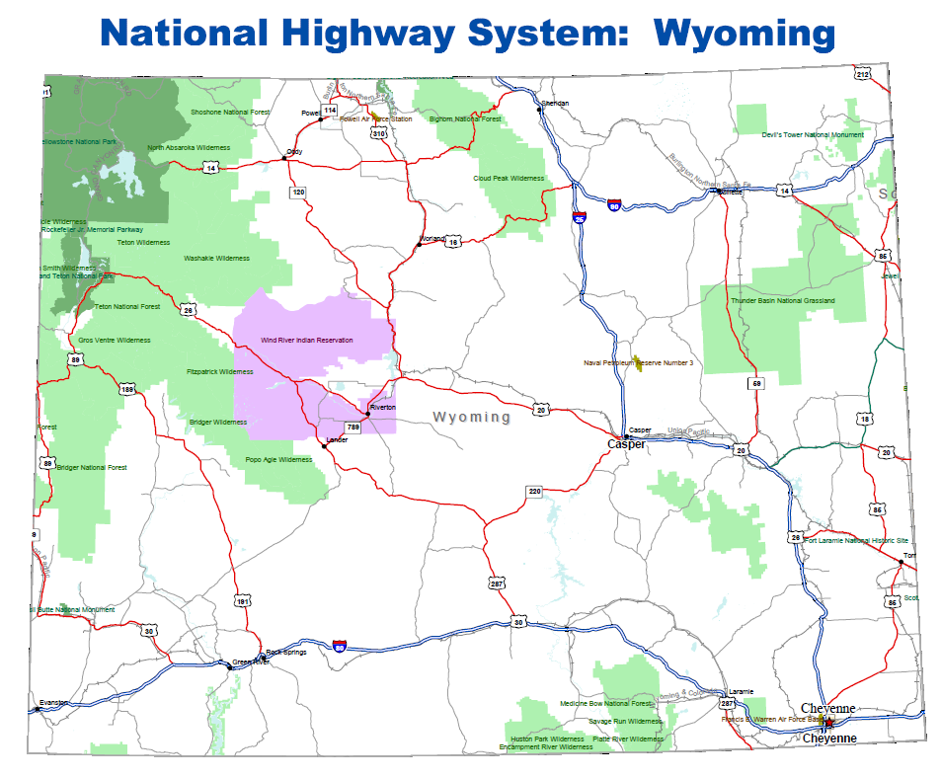
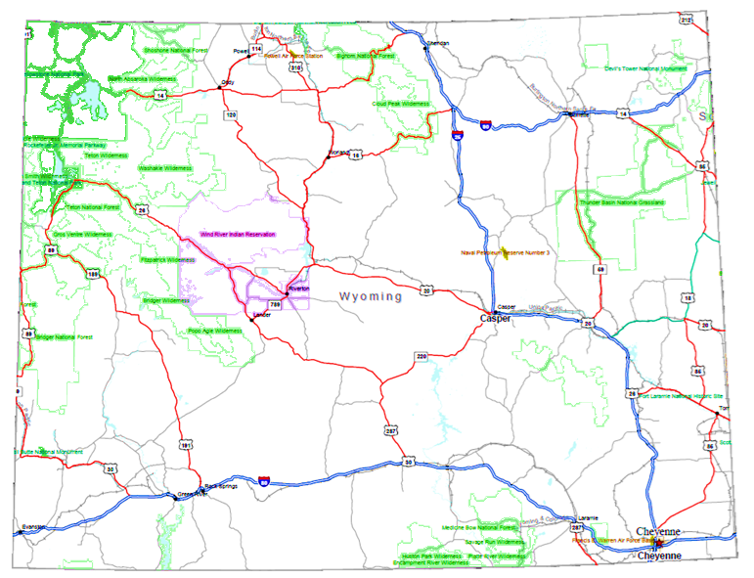
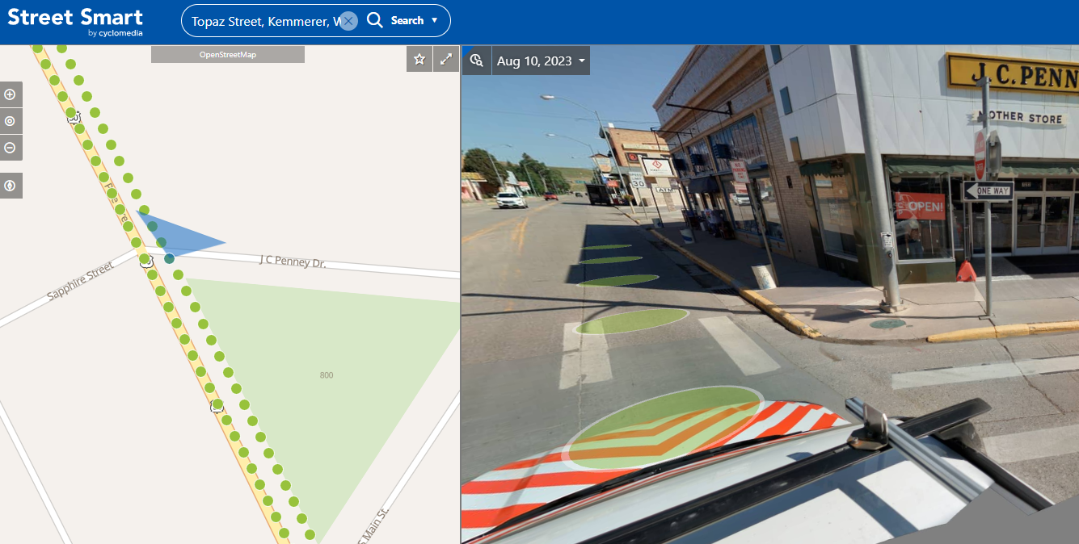
Notes:
WYDOT is responsible for the Pedestrian Access Route within the rights-of-way on ALL state routes in Wyoming, and is committed to addressing identified barriers within the state’s rights-of-way.
WYDOT contracted with Cyclomedia to survey rights-of-way. This data is available and can be viewed in their Street Smart program. This is example is from Kemmerer that was collected in August 2023.

Slide 20
Key Accessible Features of Pedestrian Facilities
Pedestrian Access Routes (PAR)
An accessible, continuous, and unobstructed path of travel for use by pedestrians with disabilities within a pedestrian circulation path.
Required to be accessible & traversable by persons with disabilities
Firm, stable & slip resistant, without large openings or abrupt changes in level
No haphazard protrusions/obstructions; cannot reduce width to less than 48”
Alternate PAR
If a PAR is closed for construction, a temporary alternate PAR with basic accessible features MUST be provided.
Cannot prevent persons with disabilities from reaching their destination
Notes:
When constructing or altering public rights of way, you need to ensure they are readily accessible to and usable by pedestrians with disabilities per the PROWAG.
These are some key accessible features of pedestrian facilities specified in the PROWAG:
Pedestrian Access Routes (PAR) – A PAR is an accessible, continuous, and unobstructed path of travel for use by pedestrians with disabilities within a pedestrian circulation path. Sidewalks, shared use paths and other pedestrian circulation paths must contain a “pedestrian access route,” which is required to be accessible to and traversable by individuals with disabilities.
The portions of these sidewalks and paths that comprise the pedestrian access route must be wide enough to minimize the possibility of a pedestrian using a mobility device falling into a roadway when passed by another pedestrian. Pedestrian access routes have specified cross slopes and running slopes so that they are traversable by pedestrians using manual wheelchairs or other mobility aids without exhaustive effort. Surfaces of paths in the pedestrian access route must be firm, stable, and slip resistant, without large openings or abrupt changes in level. Objects may not hazardously protrude onto sidewalks, shared use paths, or other pedestrian circulation paths, and cannot reduce the width to less than 48 inches.
Alternate PAR – this is a big one that is often missed. Alternate pedestrian access routes ensure that construction in the public right-of-way does not prevent pedestrians with disabilities from reaching their destinations. If a PAR is closed for construction, a temporary alternate PAR with basic accessible features must be provided.
Accessible Pedestrian Signals -- All new and altered pedestrian signal heads installed at crosswalks must include “accessible pedestrian signals” (APS), which have audible and vibrotactile features indicating the walk interval so that a pedestrian who is blind or has low vision will know when to cross the street. Pedestrian push buttons must be located within a reach range such that a person seated in a wheelchair can reach them. The walk speed used to calculate the crossing time allows pedestrians with disabilities sufficient time to cross.

Slide 21
Key Accessible Features of Pedestrian Facilities
Curb Ramps
Must be provided where pedestrian crossing is permitted
One curb ramp or blended transition be provided for each crosswalk at an intersection corner.
Curb ramps & blended transitions must lead directly into crosswalks.
Perpendicular curb ramp runs & parallel curb ramp landings must be contained wholly within the width of the crosswalk they serve.
Detectable warning surfaces are required
Adhere to PROWAG requirements for slope and other measurements (e.g. Cross slope: 2.1% max.; Running slope: 8.3% max.)
Notes:
Curb Ramps.
Where pedestrian crossing is permitted, curb ramps must be provided so that persons who use wheelchairs can access them.
One curb ramp or blended transition be provided for each crosswalk at an intersection corner.
Curb ramps & blended transitions must lead directly into crosswalks.
Perpendicular curb ramp runs & parallel curb ramp landings must be contained wholly within the width of the crosswalk they serve.
Adhere to PROWAG requirements for slope and other measurements
Cross slope: 2.1% max.
Running slope: 8.3% max.

Slide 22
Key Accessible Features of Pedestrian Facilities
Accessible Pedestrian Signals
New or altered ped signal heads MUST include accessible pedestrian signals (APS) with audible & vibrotactile features
Pedestrian push buttons must be located within a reach range such that a person seated in a wheelchair can reach them.
Reach range limits: 48” high, 15” low
Pedestrian Signal Phase Timing: Calculate pedestrian clearance time using a walking speed of 3.5 ft/s (1.1 m/s) or less. Requires the walk interval be seven (7) seconds min.
Push button (operable part) must be operable with one hand; no more than 5 lbs force
Notes:
Accessible Pedestrian Signals -- All new and altered pedestrian signal heads installed at crosswalks must include “accessible pedestrian signals” (APS), which have audible and vibrotactile features indicating the walk interval so that a pedestrian who is blind or has low vision will know when to cross the street.
Pedestrian push buttons must be located within a reach range such that a person seated in a wheelchair can reach them. Reach range limits: 48” high, 15” low
Pedestrian Signal Phase Timing: Calculate pedestrian clearance time using a walking speed of 3.5 ft/s (1.1 m/s) or less. Requires the walk interval be seven (7) seconds min. *A faster walking speed is allowed if a passive detection device is provided that automatically adjusts the pedestrian clearance time based on the pedestrian’s actual clearance of the crosswalk.
Push button (operable part) must be operable with one hand; no more than 5 lbs force

Slide 23
Key Accessible Features of Pedestrian Facilities
Crosswalks
Curb ramps, detectable warning surfaces required where a pedestrian circulation path meets a vehicular way and crossing is allowed
Where pedestrian crossing is prohibited at an intersection or is not intended midblock or at a roundabout, do not provide a curb ramp or crosswalk.
Additional treatments required at multilane roundabouts & channelized turn lanes
Edge detection or vertical edge treatment must be provided along the street side of a sidewalk where crossing is prohibited/not intended.
Notes:
Crosswalks
Curb ramps, detectable warning surfaces required where a pedestrian circulation path meets a vehicular way and crossing is allowed
Where pedestrian crossing is prohibited at an intersection or is not intended midblock or at a roundabout, do not provide a curb ramp or crosswalk.
Additional treatments required at multilane roundabouts & channelized turn lanes
Edge detection or vertical edge treatment must be provided along the street side of a sidewalk where crossing is prohibited/not intended.

Slide 24
Key Accessible Features of Pedestrian Facilities
On-Street Parking
Non-residential MUST have designated accessible spaces sized so persons with disabilities may exit a parked vehicle & maneuver to the sidewalk without entering a vehicular way
Standard size, designated accessible on-street parking spaces must be near an existing crosswalk with curb ramps
Transit Stops
Boarding & alighting areas at sidewalk or street level & elevated boarding platforms must be accessible
PAR must connect boarding & alighting areas & boarding platforms to other pedestrian facilities
Notes:
On-Street Parking
Non-residential MUST have designated accessible spaces sized so persons with disabilities may exit a parked vehicle & maneuver to the sidewalk without entering a vehicular way
Standard size, designated accessible on-street parking spaces must be near an existing crosswalk with curb ramps
Transit Stops
Transit Stops: Boarding and alighting areas at sidewalk or street level, as well as elevated boarding platforms, must be sized and situated such that a person with a disability can board and alight buses and rail cars. Pedestrian access routes must connect boarding and alighting areas and boarding platforms to other pedestrian facilities. Transit shelters must have clear space for use by a person in a wheelchair.

Slide 25
ADA Project Reviews
The WYDOT Civil Rights Office may select completed ADA projects within WYDOT rights-of-way for review and inspection.
We will look for ADA compliance in areas such as:
Running, cross & counter slopes
Widths
Landing (Turning space)
Clear Area
Curb Ramps
Detectable Warnings
Grade Breaks
Notes:
The WYDOT Office of Civil Rights selects completed projects for ADA reviews within the WYDOT rights-of-way to check for compliance. We also work with Local Government to review projects that have received funding through WYDOT such as TAP grants. If there are questionable findings, that could hold up payment.
All ADA projects within the WYDOT rights-of-way are tracked through Project Development and other departments for completion and compliance. This information is used for FHWA regulations and to aid in updating the WYDOT ADA Transition Plan. It is also used for project planning, development, and the tracking process within WYDOT.
Please contact our office or the U.S. Access Board with questions, and refer to the PROWAG. There may be times when a project can only meet the max extent feasible so it’s important to talk & walk through your job to ensure compliance up front.

Slide 26
ADA Administrative Requirements
Title II requires all public entities to:
Provide public notice about the ADA
Conduct a self-evaluation
Title II requires all public entities with 50+ employees to:
Designate an ADA Coordinator
Develop a Transition Plan
Establish a grievance procedure
Notes:
WYDOT currently has all of these in place and they are available on our internet.

Slide 27
ADA Self-Evaluation & Transition Plan
Self-evaluation: Review of all programs, activities, and services operated by the public entity for ADA compliance.
Applies to all public entities (28 CFR 35.105)
Identify barriers & solutions
Transition Plan: Plan of action outlining removal of barriers & a schedule for improvements.
Required of public entities with 50+ employees (combined full & part-time) (28 CFR 35.150(d)(1))
An inventory of barriers (28 CFR 35.150(d)(3)(i)), (28 CFR 35.150(a))
Prioritized schedule of when barriers will be eliminated & deficiencies corrected (28 CFR 35.150(d)(2)), (28 CFR 25.150(d)(3)(iii))
Description of the methods that will be used to make facilities accessible (28 CFR 35.150(d)(3)(ii))
Notes:
A transition plan is basically a plan of action outlining the physical changes required for ADA compliance and a schedule of completion for improvements.
Government entities receiving Federal financial assistance with greater than 50 employees (combined full and part-time) must have a Transition Plan in place
Less than 50 employees, still need to evaluate programs for discrimination…but not required to have a Transition Plan
A Transition Plan should at a minimum include:
Designation of at least one person responsible for the implementation of the plan & to coordinate ADA/504 compliance
An inventory of barriers (i.e., identification of physical obstacles)
A schedule to remove those barriers
Information on how they will be made accessible
Develop a compliance process

Slide 28
Complaint/Grievance Procedure
Required of public entities with 50 or more employees (28 CFR 35.107(b))
Outlined in the Transition Plan; available on the Internet
Provides a formal complaint process to those who believe they have been discriminated against (with relation to access of our activities, services, and programs) because of their disability
Notes:
A grievance procedure is required of public entities with 50 or more employees.
It provides a formal process to those who believe they have been discriminated against because of their disability.

Slide 29
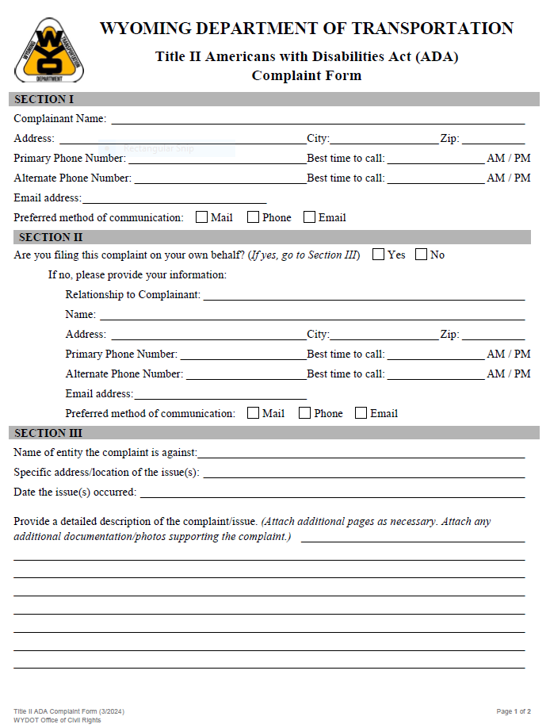
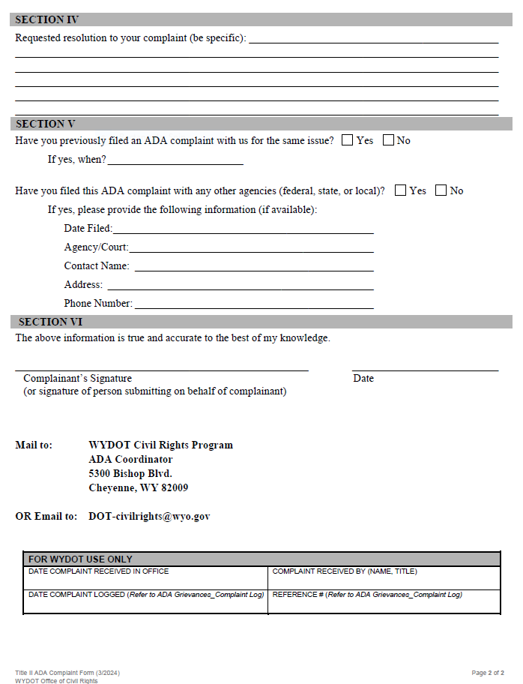
Complaint/Grievance Procedure
Notes:
Our complaint form has been recently updated and is available on our website.

Slide 30
Disadvantaged Business Enterprise (DBE)

Slide 31
Disadvantaged Business Enterprise
The DBE program is intended to ensure nondiscrimination in the award and administration of DOT-assisted contracts
Program objectives include:
Create a level playing field
Remove barriers
Provide promotion, development and opportunities

Slide 32
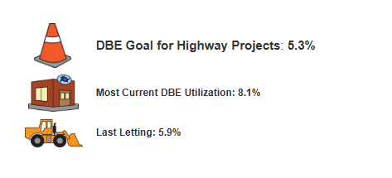
DBE Requirements
Annual Goal - 5.3%
https://www.dot.state.wy.us/home/business_with_wydot/contractors/Disadvantaged_Business_Enterprise.html

Slide 33
DBE Requirements
DBEs must be solicited for all subcontracting opportunities
Firm availability/directory
Wyoming Quote Request – WYO-QR
http://www.dot.state.wy.us/home/business_with_wydot/contractors/Disadvantaged_Business_Enterprise.html

Slide 34
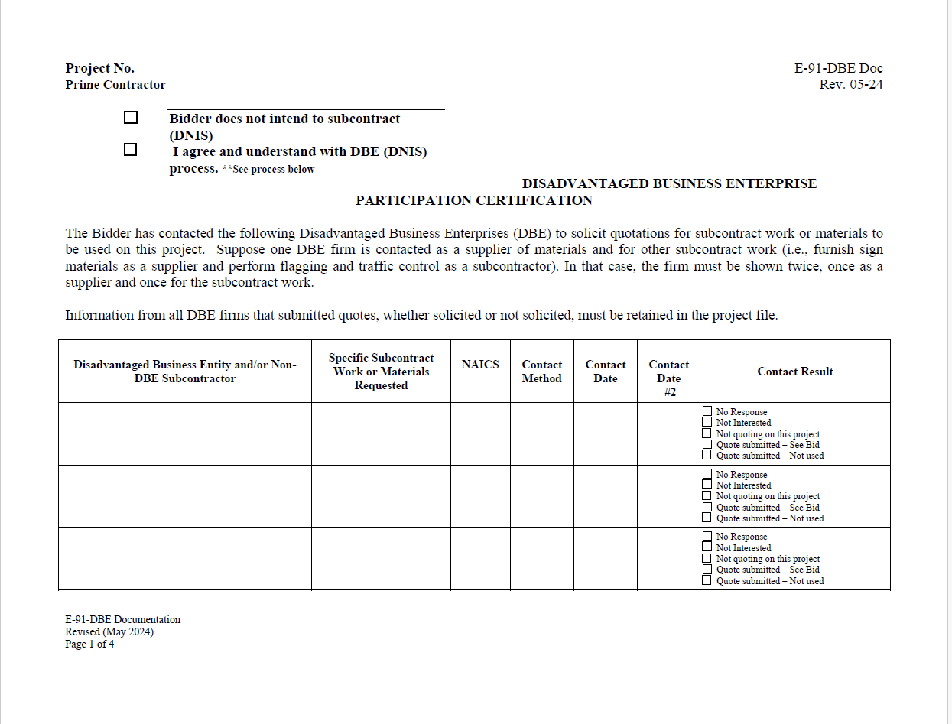
DBE Requirements
DBEs must be solicited for all subcontracting opportunities
Documented solicitation (E-91-LPA)
Program Rule Changes May 2024
Notes:
Initially, this information will be collected by a letter of request to be sent to all firms listed on the Invitation to Bid (prime/subcontractors, DBEs, suppliers, etc.) and Prequalified Contractors lists, along with any additional information available from the EBS or E-91. The bidders list in entirely is reviewed yearly; however, the relevant data is maintained throughout the year.

Slide 35
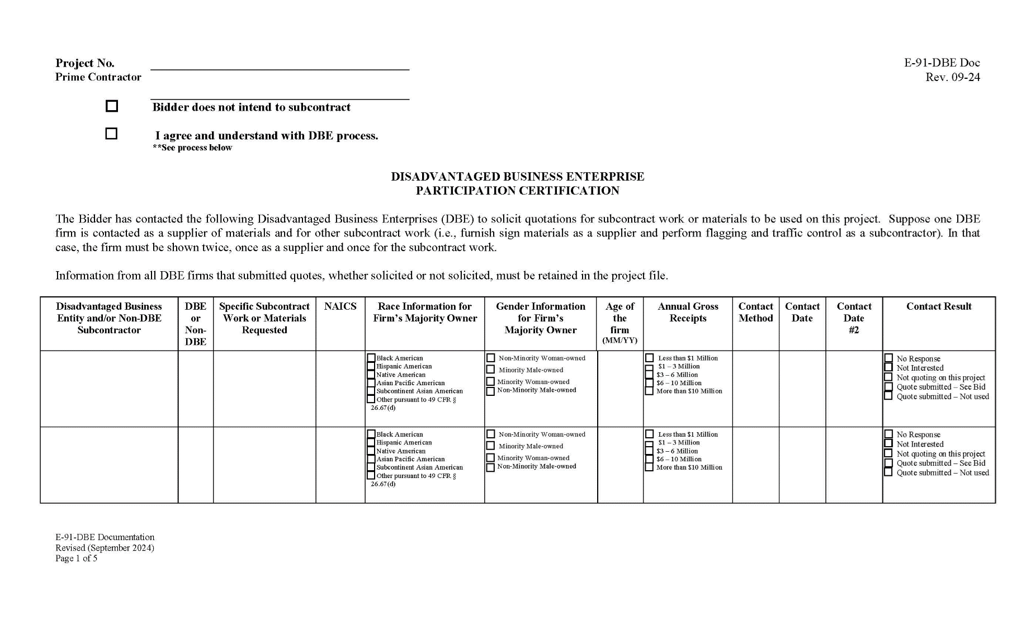
DBE Requirements
Notes:
Initially, this information will be collected by a letter of request to be sent to all firms listed on the Invitation to Bid (prime/subcontractors, DBEs, suppliers, etc.) and Prequalified Contractors lists, along with any additional information available from the EBS or E-91. The bidders list in entirely is reviewed yearly; however, the relevant data is maintained throughout the year.

Slide 36
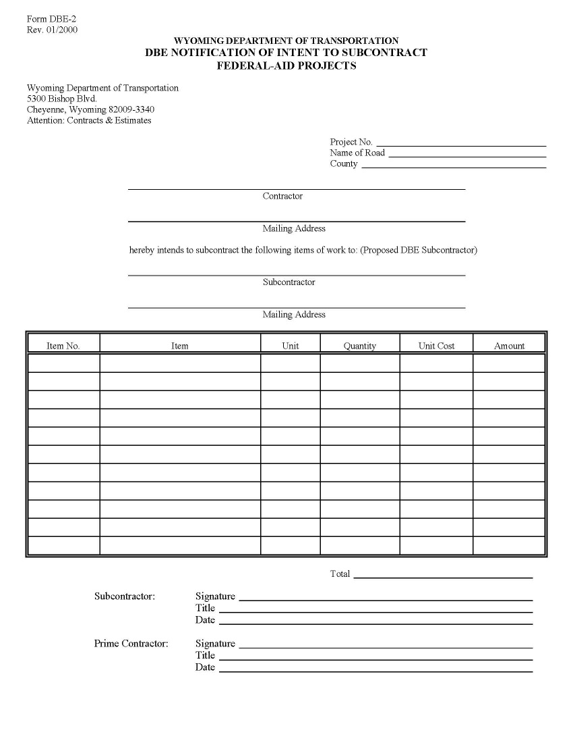
DBE Requirements
DBE firms cannot be removed from a project after an award for Good Faith Effort reasons
Notification/Intent to Subcontract
DBE 2 Form
Notes:
Notification of Intent to Subcontract on Federal-aid Projects (Form DBE-2)

Slide 37
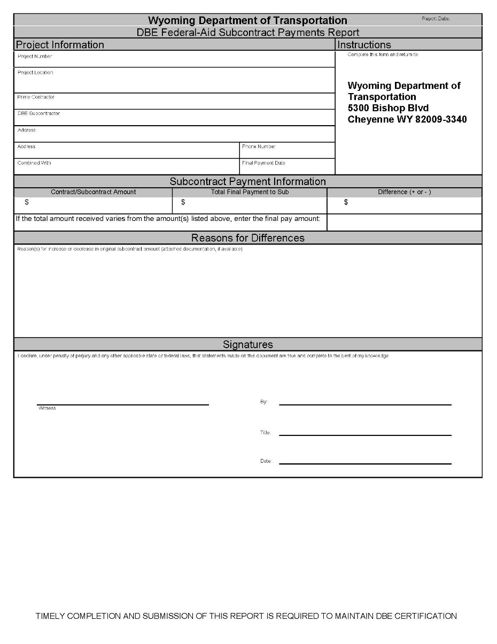
DBE Requirements
Prompt Payment
30 days ALL WYDOT- 14 Days
Final Attainment
DBE 3 Form
Notes:
DBE Federal-aid Subcontract Payments Report (Form DBE-3)

Slide 38
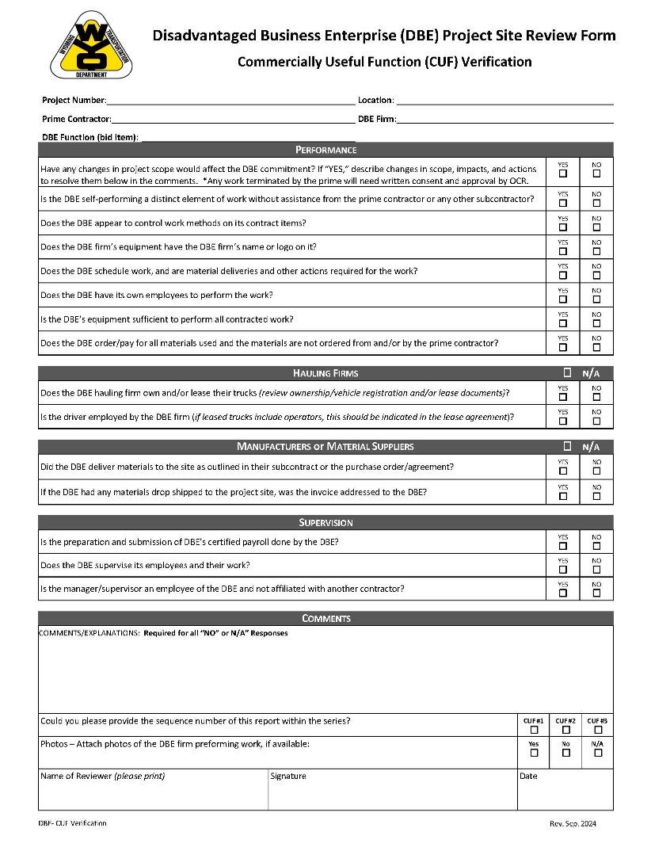
DBE Requirements – Monitoring Tools
Commercially Useful Function (CUF) verification
Notes:
Ensure the DBE performs a commercially useful function (CUF) in the work of a contract.
A DBE is considered to perform a CUF when it is solely responsible for executing a distinct element of a contract's work and carrying out its responsibilities by performing, managing, and supervising the work involved, consistent with industry practices.
In determining whether a DBE has performed a CUF in the work of a contract, the amount of work subcontracted, industry practices, and other relevant factors will be evaluated. Only expenditures to a DBE that performs a CUF in the work of a contract will be counted toward DBE participation.

Slide 39
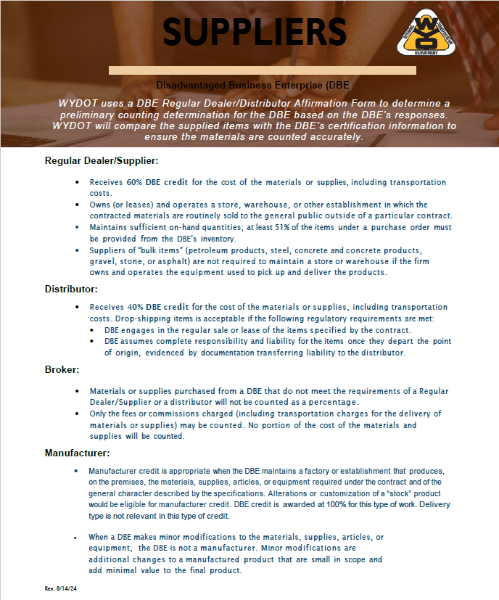
Dealership/Distributors – Goal Percentages
Goal Percentages
CUF -
Suppliers
Regular Dealers Supplier – 60%
Distributor – 40%
Manufacturer – 100%

Slide 40
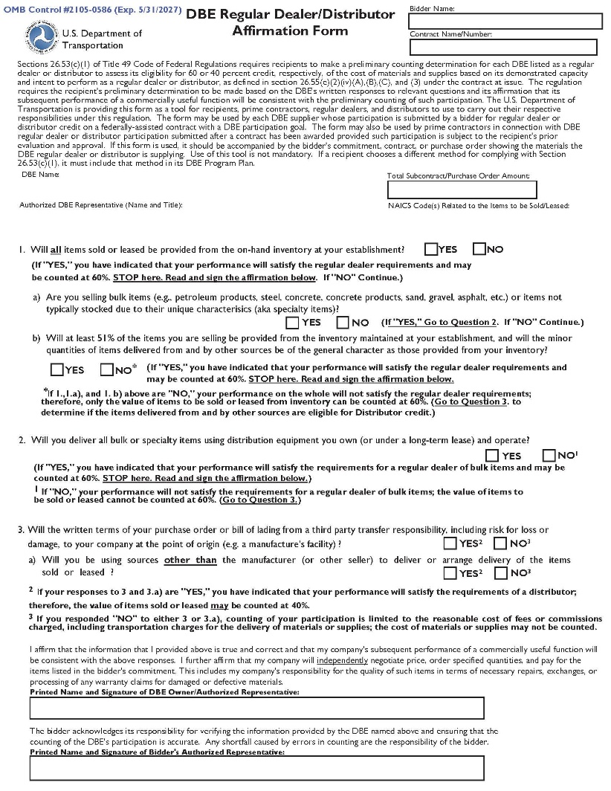
DBE Requirements – Monitoring Tools
Regular Dealers with establishments (26.55 €(2)(ii)
Commercially Useful Function
(CUF) verification
Notes:
This requirement may be administered through questionnaires, inventory records reviews, or other methods to determine whether each DBE supplier has the demonstrated capacity to perform a commercially useful function (CUF) as a regular dealer prior to its participation. The system you implement must be maintained and used to identify all DBE suppliers with capacity to be eligible for 60 percent credit, contingent upon the performance of a CUF. This requirement is a programmatic safeguard apart from that described in § 26.53(c)(1)
Determines whether each DBE supplier to be eligible for regular dealer credit, over a reasonable period of time, keeps sufficient quantities and regularly sells the items in question
Determines whether each DBE supplier has the demonstrated capacity to perform a commercially useful function (CUF) as a regular dealer prior to its participation

Slide 42
DBE Program – Forms
DBE 1
DBE 2
DBE 3
CUF 1 – onsite
Completed by WYDOT/LGA/Appointed staff
The CUF is not completed until it is Approved
CUF 2 – Dealers/Distributor – Prior to bid submission
Prior to bid submission
Commercially Useful Function (CUF) verification
Prior to work being done
Accountability
DBE – work to be done
Completed by the Prime
Notification/Intent to Subcontract
Final Payment
completed and Signed by the DBE
Final Attainment

Slide 43
Civil Rights Program Reviews

Slide 44
Policy Reviews
The Civil Rights Office will conduct compliance reviews annually.
Ensuring non-discrimination throughout organization policies and procedures.
Example of compliant policy statement:
LPA is ensuring that no person shall on the grounds of race, color, national origin, sex, age or disability as provided by the Civil Rights act of 1964 and the Civil Rights Restoration Act of 1987, be excluded from participation in, be denied the benefits of, or be otherwise subjected to discrimination under any program or activity. WYDOT further assures every effort will be made to ensure nondiscrimination in all of it’s programs and activities, whether those programs and activities are federally funded or not. (continues)

Slide 45
Collaborative Effort:

Slide 46
Questions? Comments?
Jeff White
Civil Rights Program Manager
(307) 777-4457
jeff.white1@wyo.gov
Lillian Zuniga
DBE Program Coordinator
(307) 777-4268
lillian.zuniga1@wyo.gov
Courtney Herceg
ADA Program Coordinator
(307) 777-4359
courtney.herceg4@wyo.gov

