Slide 1
Requirements for Federal Aid Contracts
Putting the pieces together

Slide 2
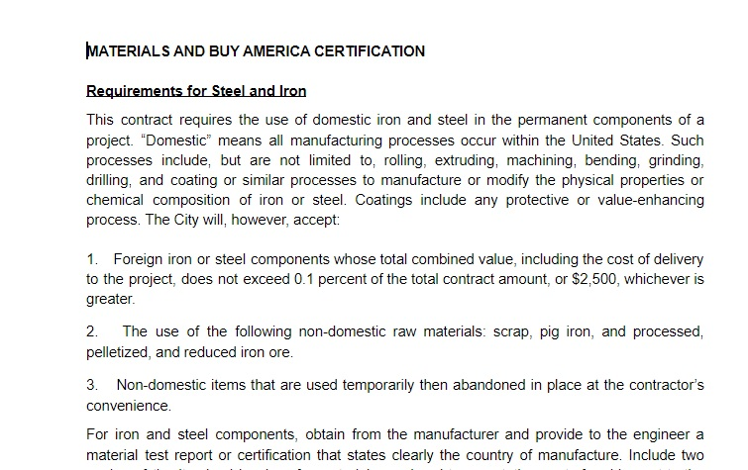
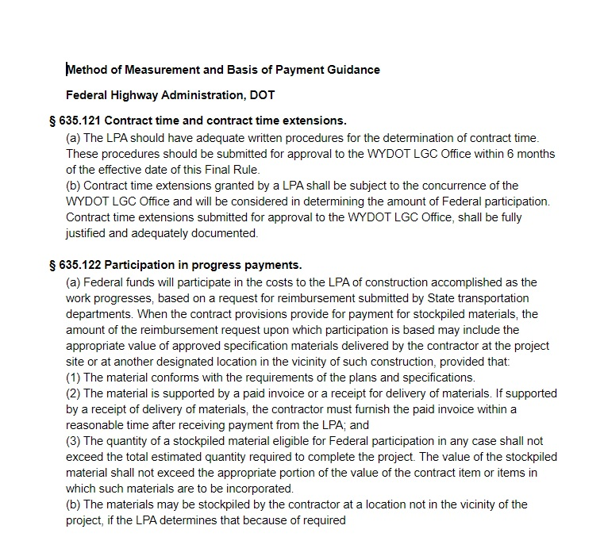
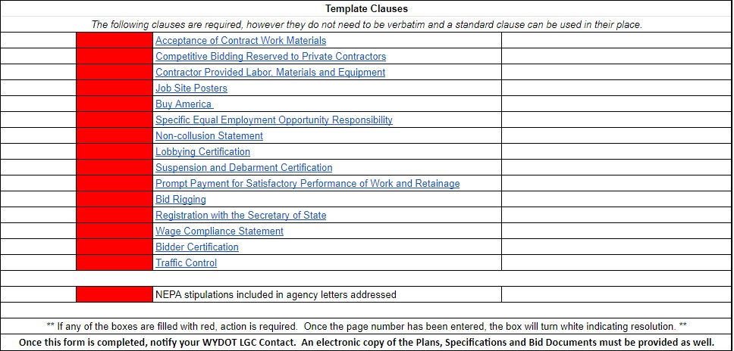
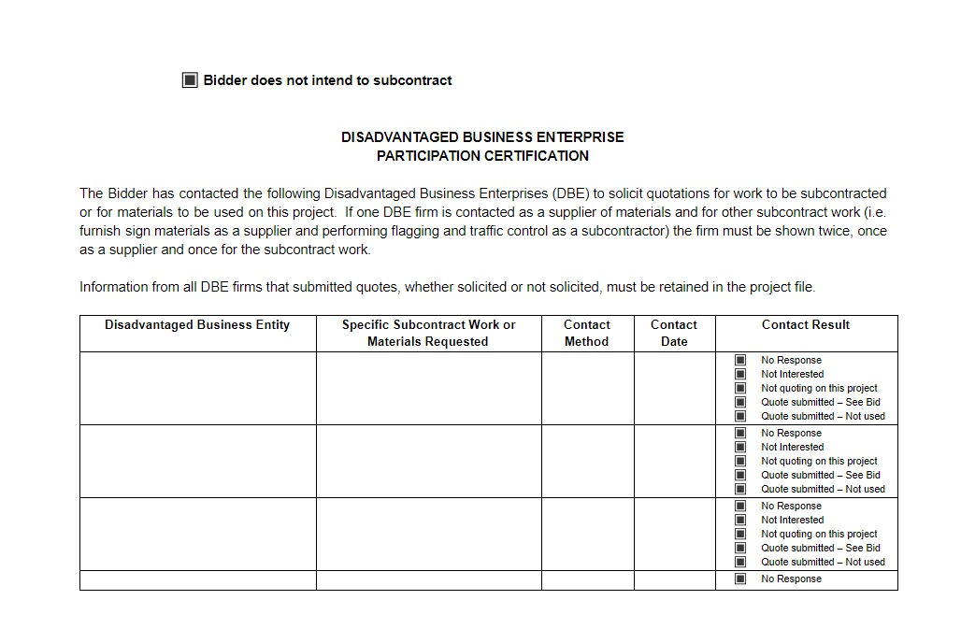
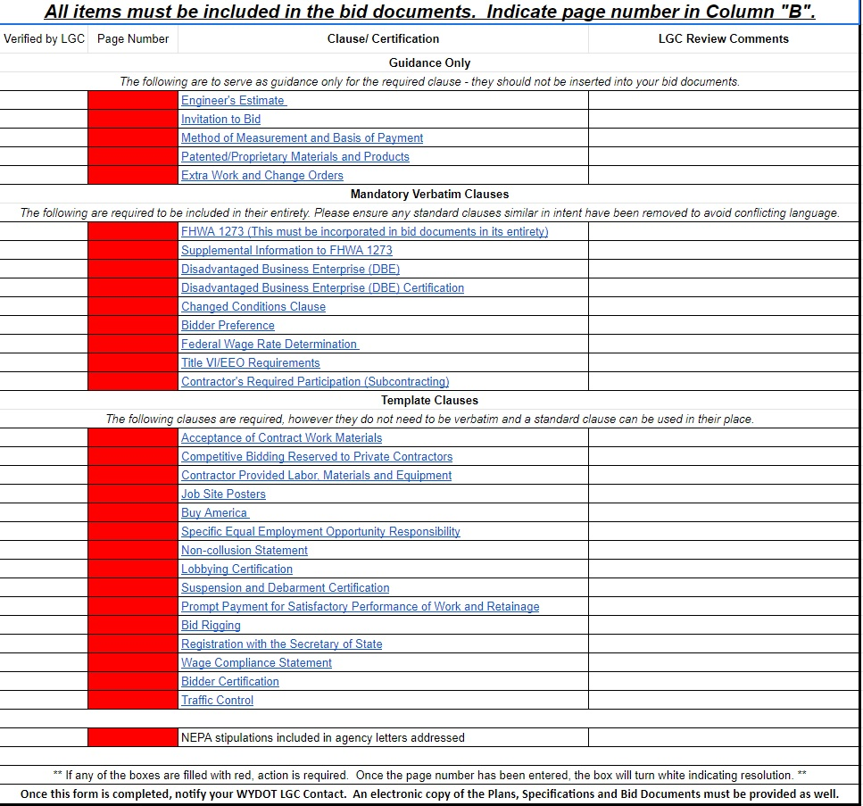

Slide 3
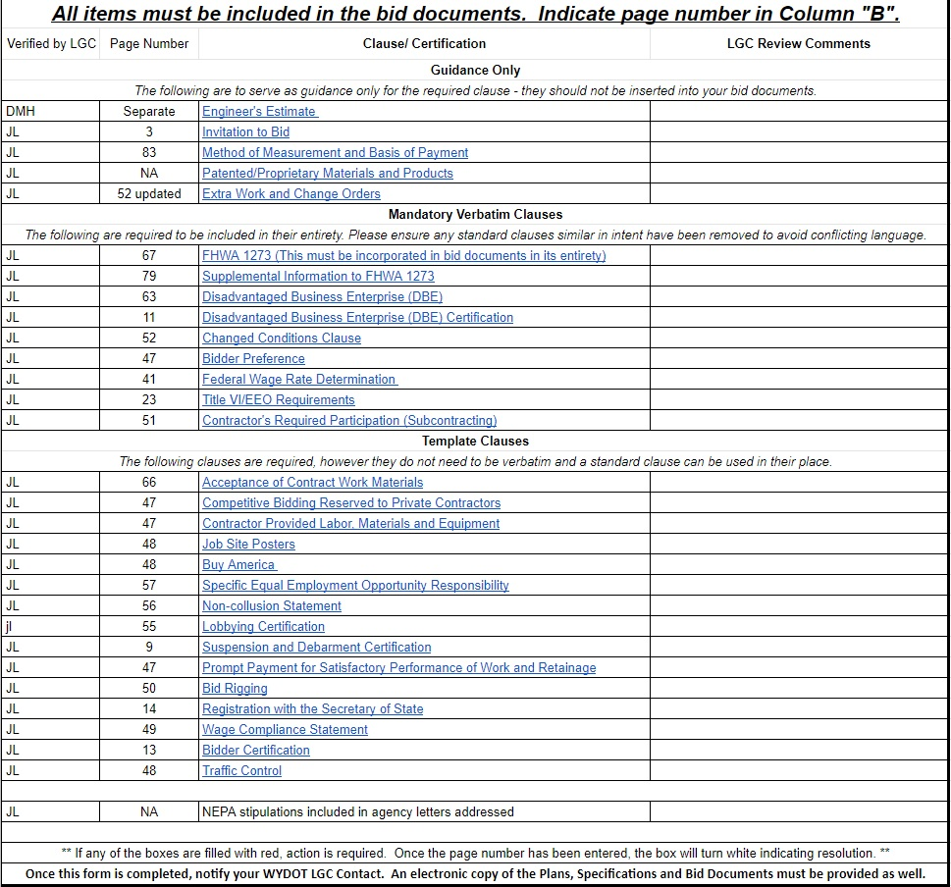

Slide 4
Advertisement & Award
Proof of Advertisement
DBE Certification Information
Verification of non-suspension/debarment
Open and Read at a Public Meeting

Slide 5
Contract Administration
Have someone who knows Contract Administration
NEPA Stipulations addressed
Contract Language
Review / Get to Know the Plans & Contractor
Special Provisions / Specifications
Details / specific notes on plan sheets
Relationship with the Contractor

