Slide 1
Local Public Agency Guide to Getting through NEPA
October 2024

Slide 2
Overview of NEPA
NEPA – National Environmental Policy Act
Enacted by Congress in 1969
First Major Environmental Law
NEPA requires relevant federal agencies to “consider the environmental effects of proposed major Federal actions.”
Two Major Purposes
Help Agencies to make Informed Decisions
Increase Citizen Involvement

Slide 3
FHWA and NEPA
FHWA is committed to, and required by NEPA to, the examination and avoidance of potential impacts to the social and natural environment when considering approval of proposed transportation projects. In addition to evaluating the potential environmental effects, FHWA must also take into account the transportation needs of the public in reaching a decision that is in the best overall public interest. The FHWA NEPA project development process is an approach to balanced transportation decision making that considers those potential impacts.

Slide 4
More Information on NEPA
WYDOT Environmental Services webpage
http://www.dot.state.wy.us/home/engineering_technical_programs/environmental_services.html
FHWA Environmental Review Toolkit
https://www.environment.fhwa.dot.gov/
Code of Federal Regulations (23 CFR 771)
https://www.ecfr.gov

Slide 5
Why do LPAs have to comply with NEPA?
NEPA is required on Federal Actions
Federal Money
Federal Permit or Decision
Federal Land
Transportation Alternatives
Congestion Mitigation Air Quality
High Risk Rural Roads
Industrial Road Program
Local Agencies
and the Public

Slide 6
Levels of NEPA
There are three levels of NEPA.
Categorical Exclusions
Do not have an significant impact on the environment
Environmental Assessments
Uncertain if there is an significant impact on the environment
Environmental Impact Statements
Certain there is a significant impact on the environment
99% of WYDOT’s projects are CEs
100% of pass-thru LPA projects are CEs

Slide 7
PCE Agreement
FHWA / WYDOT have a Programmatic Agreement regarding the processing of actions classified as Categorical Exclusions
Applies to all WYDOT projects and pass through funding from FHWA.
This agreement sets the thresholds on what type of CEs WYDOT can approve.
WYDOT will make the determination on the correct NEPA level on LGC projects.
The LGC Environmental Template meets the requirements of the PCE Agreement

Slide 8
Before You Begin
Use the most recent template
Do not modify the template
It is locked down to let you only type where you need to type
Most Recent Template
Wrong
or
Modified
Templates
Review the template and based on your project you may not need to hire a consultant to fill this form out.

Slide 9
Agency Scoping Letters
U.S. Army Corps of Engineers
U.S. Fish and Wildlife Services
Wyoming Game and Fish
WYDOT Environmental Services
*Must send scoping letters to WYDOT and WGFD on all projects.
Email WYDOT Environmental Services – Do not send a hard copy

Slide 10
Optional Agency Scoping Letters
Local Floodplain Coordinator
U.S. Bureau of Land Management
U.S. Forest Service
Natural Resources Conservation Svc.
Tribal Coordination
Local landowners

Slide 11
What to include in Scoping Letters
Detailed Location of the Work
Including City, State and County.
Legal description (Township, Range, Section, ¼ , ¼ )
Description of Work
Including map showing the location of the work and the proposed improvements.
Scoping letter contacts and example letters are found in your TAP Project Forms that the LGC Office provides.
Make sure to include the WYDOT project number on all consultation letters.

Slide 12
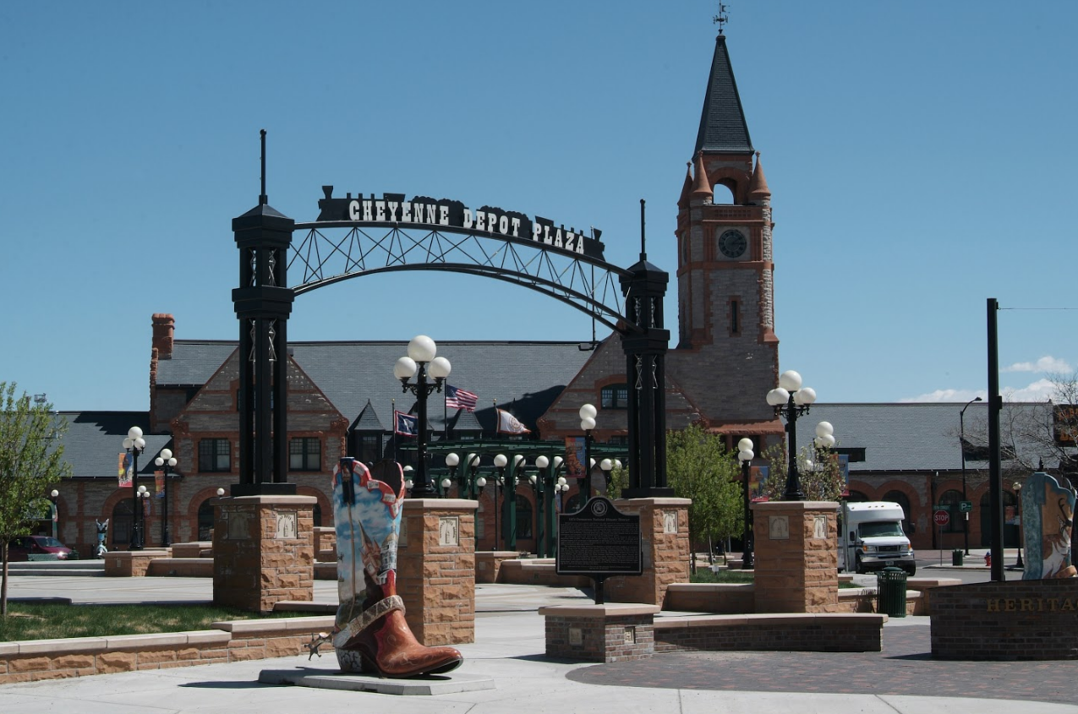
Why do we Scope WYDOT ES?
Determinations of the Area of Potential Effect, level of cultural investigation and determinations of eligibility are all made by the lead federal agency per 36 CFR 800.
FHWA is the lead federal agency and has designated WYDOT to make these determinations on their behalf.

Slide 13
WYDOT Scoping Letter Process
WYDOT will review the project based on the information provided in the scoping letter and ask “Is there a potential to affect historical properties?”
NO
YES
WYDOT will provide language to include in the Environmental Template
WYDOT will consult with SHPO and provide a copy of their response and language for the Environmental Template
OR
Will let you know that a consultant will be required to produce a Cultural or Historical Report and further coordination with WYDOT will be required

Slide 14
LGC Environmental Template
Instructions
Cover/Approval Page
Project Location
Purpose and Need
Proposed Improvements
Affected Environment
Social Impacts
Archaeological and Historic Impacts
Natural Resources
Physical
Public Participation
Commitments
Preparer

Slide 15
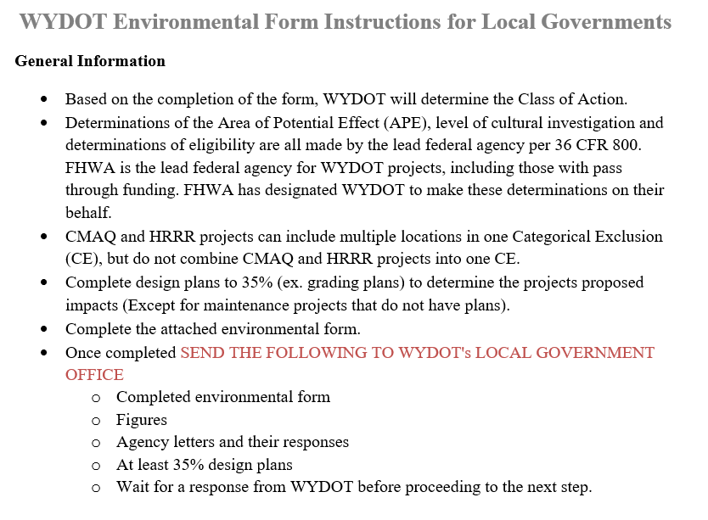
Instructions - General

Slide 16
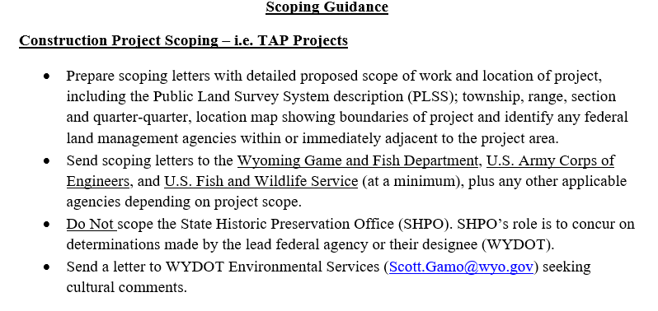
Instructions - TAP

Slide 17
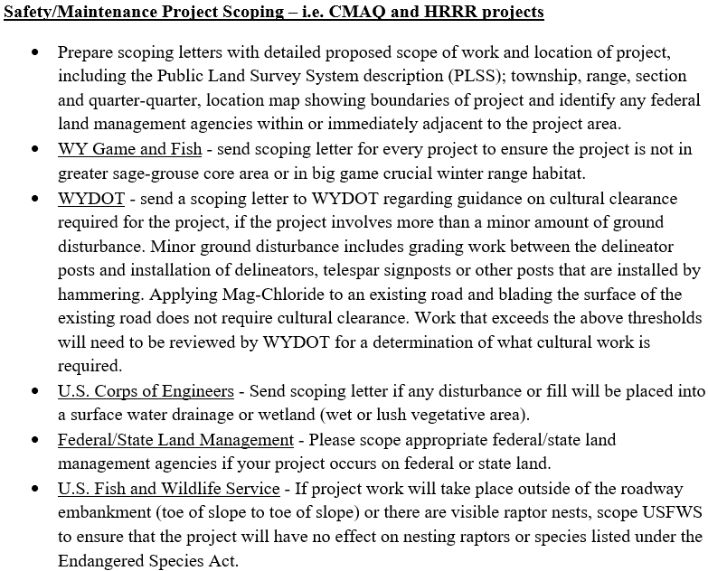
Instructions – CMAQ/HRRR

Slide 18
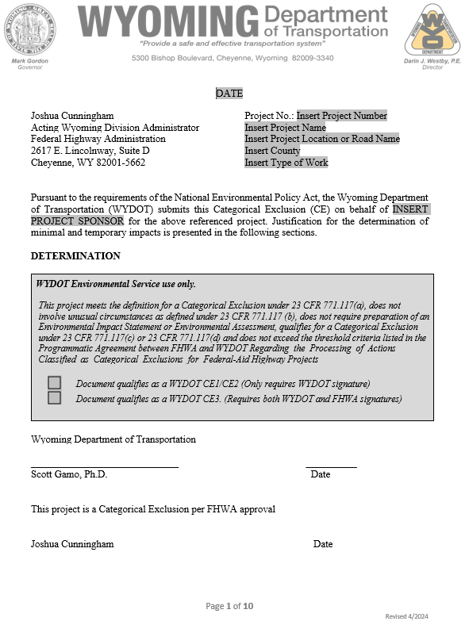
Template – Cover/Approval Page
Revised 04/2024

Slide 19
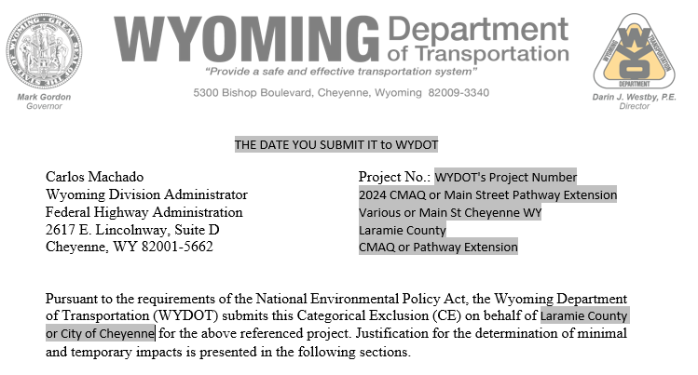
Ex. Title Block
WYDOT Project Numbers
CM – CMAQ
HR – HRRR
CD - TAP

Slide 20
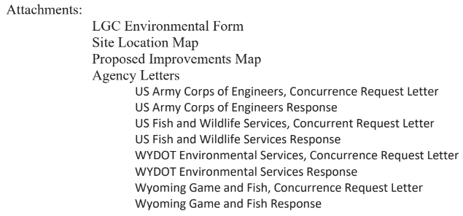
Template/Ex. - Attachments

Slide 21
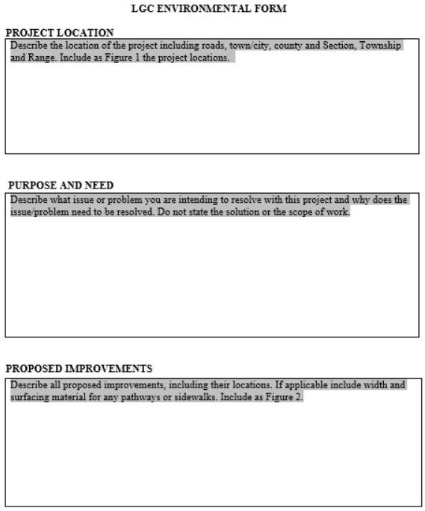
Template – Location, P&N, Improvements

Slide 22
Example - Location

Slide 23
Example – Purpose and Need

Slide 24
Example – Improvements

Slide 25
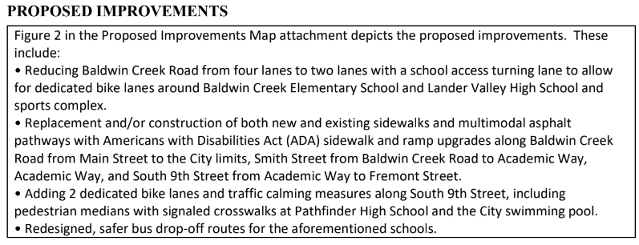
Example – Improvements cont.

Slide 26
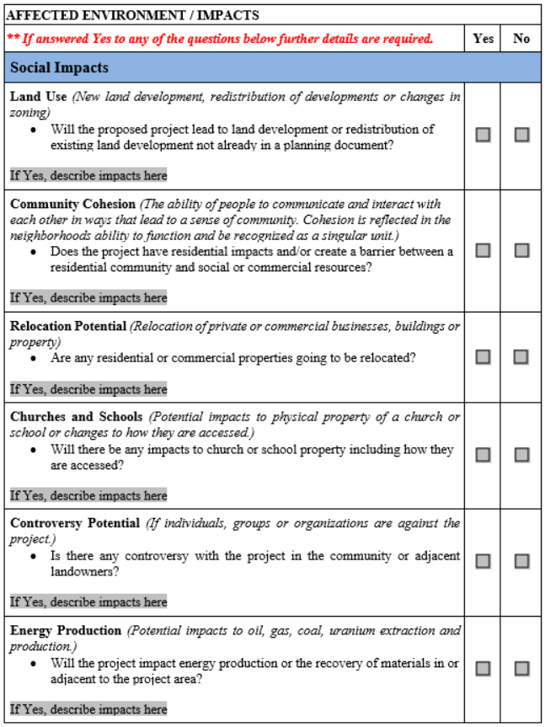
Template - Affected Environment
CMAQ/HRRR should be able to select “NO” on all of these.

Slide 27
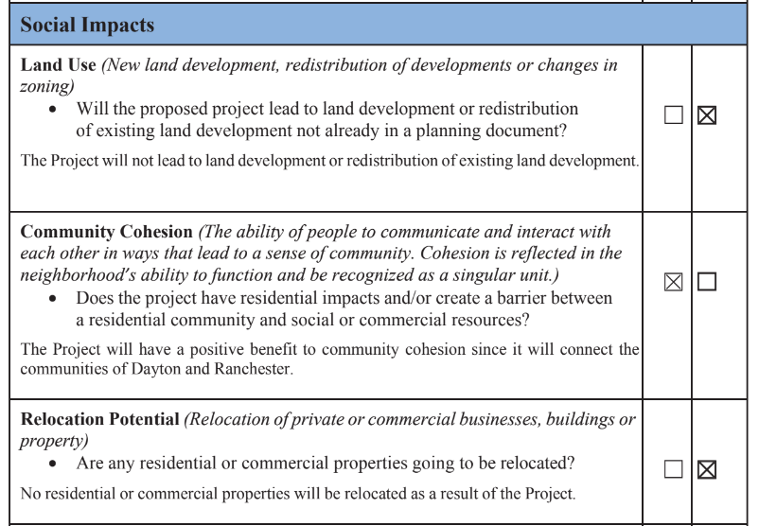
Ex. – Land, Community, Relocation

Slide 28
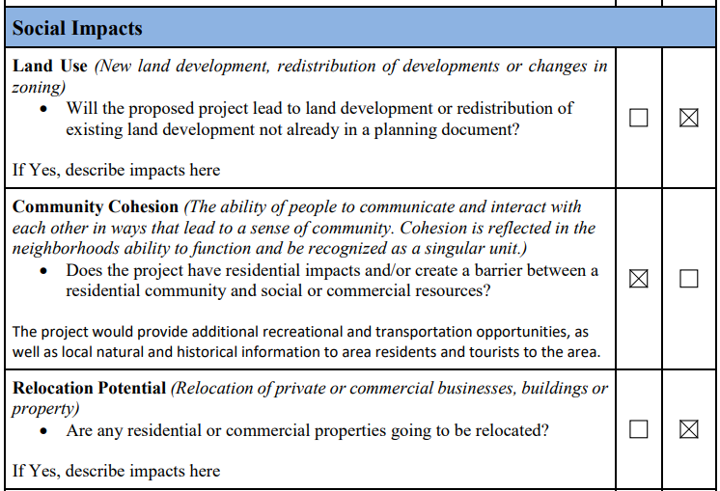
Ex. – Land, Community, Relocation cont.

Slide 29
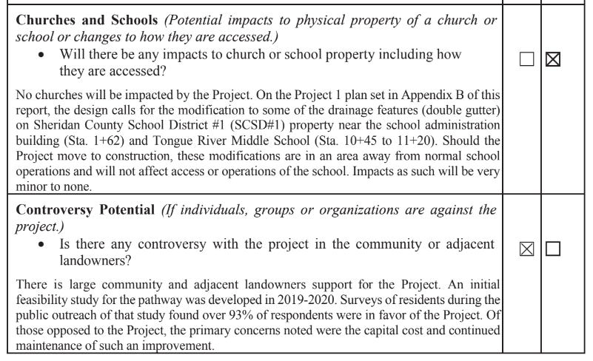
Ex. – Churches/Schools, Controversy

Slide 30
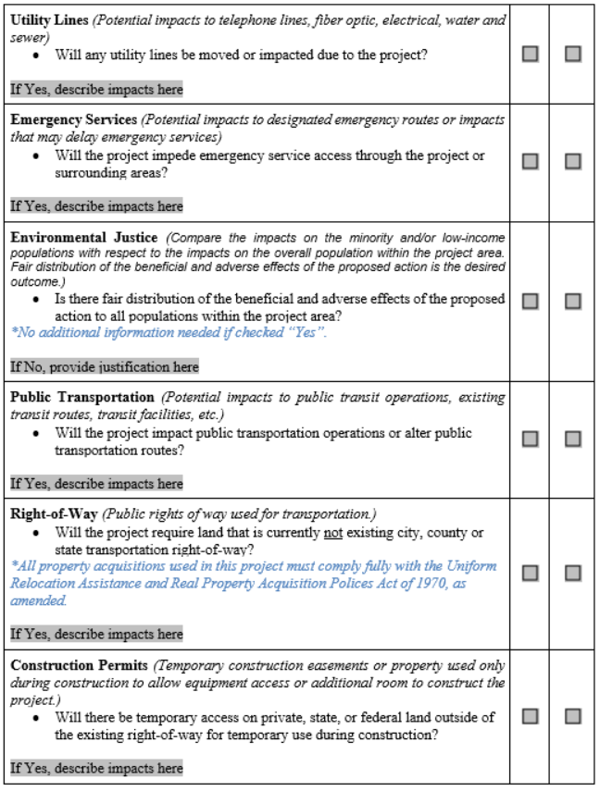
Template – Affected Environment cont.
CMAQ/HRRR the two big ones to pay attention on here are ROW and construction permits

Slide 31
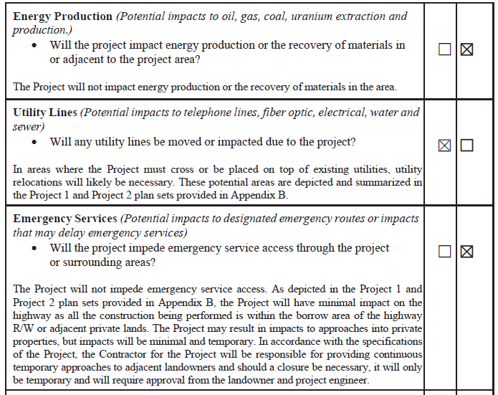
Ex. – Energy, Utility, Emergency

Slide 32
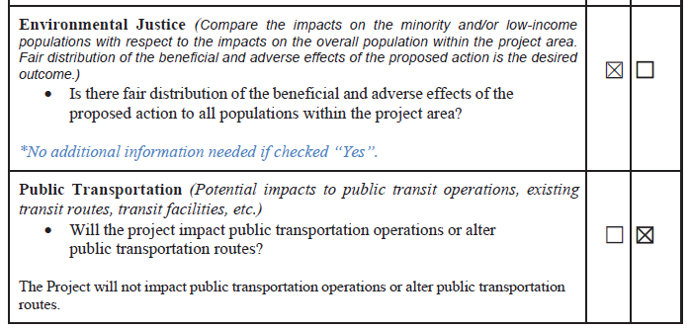
Ex. Env Justice, Public Transportation

Slide 33
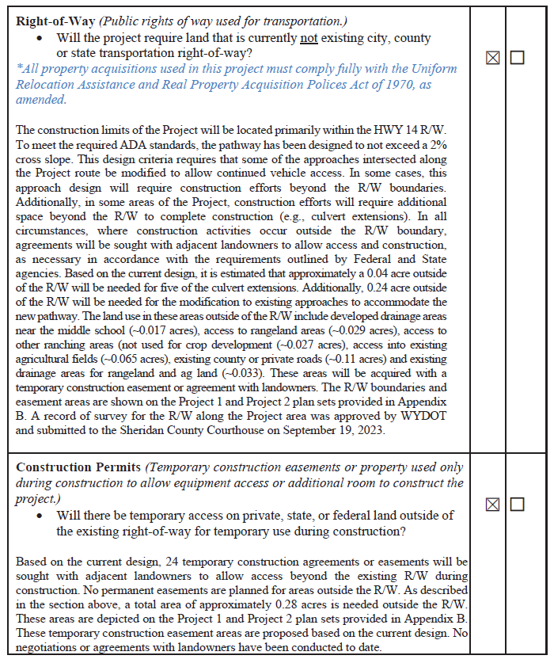
Ex. R.O.W, Construction Permits

Slide 34
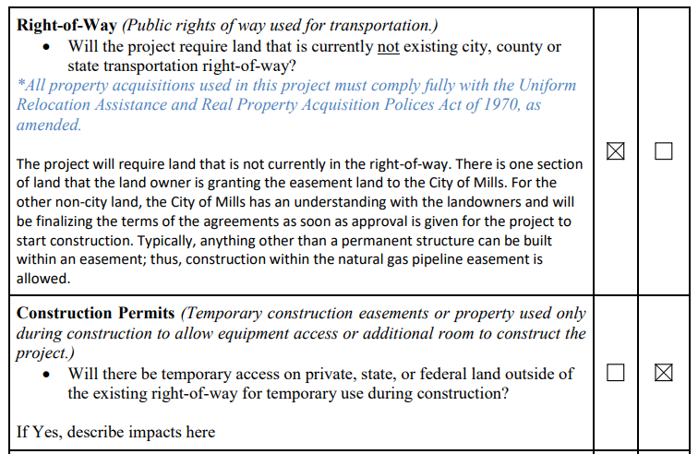
Ex. ROW, Construction Permits

Slide 35
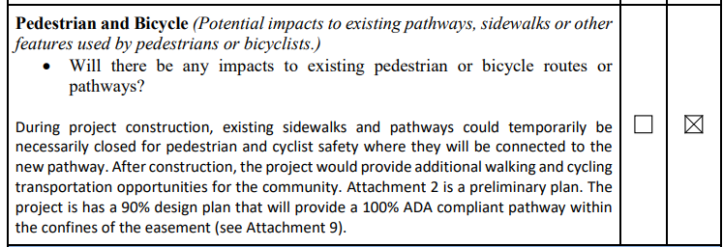
Ex. Ped/Bike

Slide 36
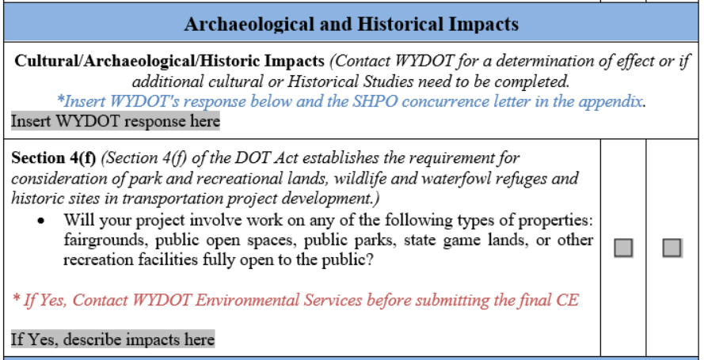
Template – Arch/Cultural, 4(f)

Slide 37
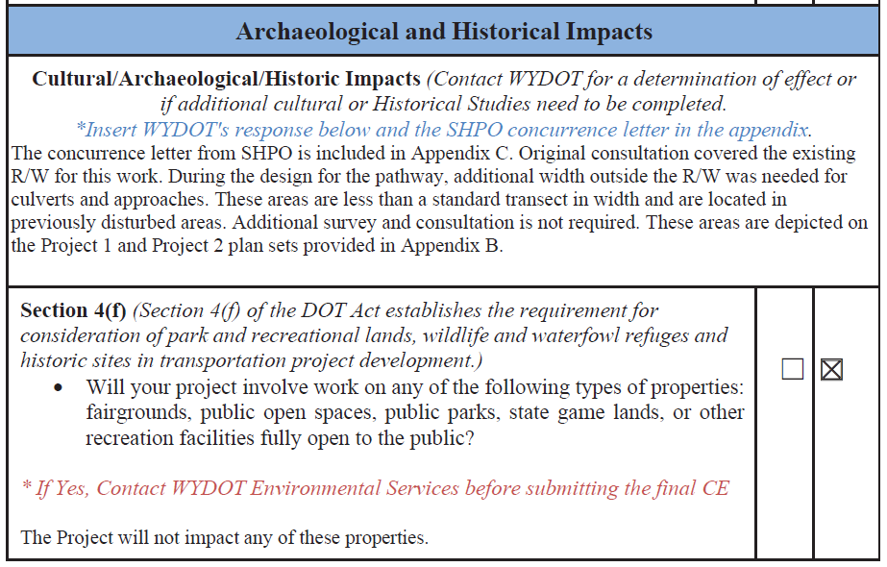
Ex. – Arch/Cultural, 4(f)

Slide 38
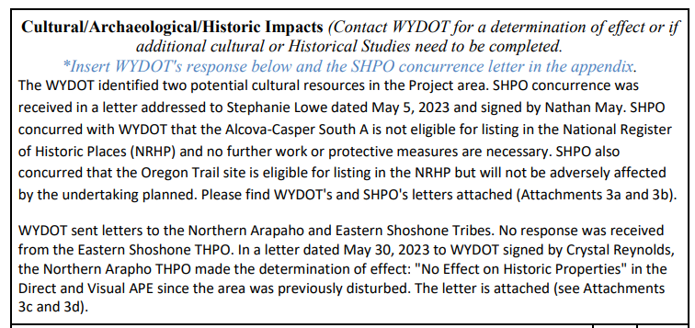
Ex. – Arch/Cultural, 4(f)

Slide 39
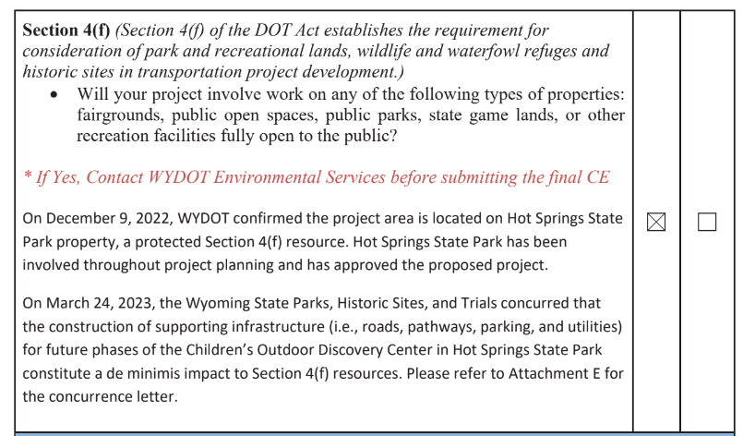
Ex. – 4(f)

Slide 40
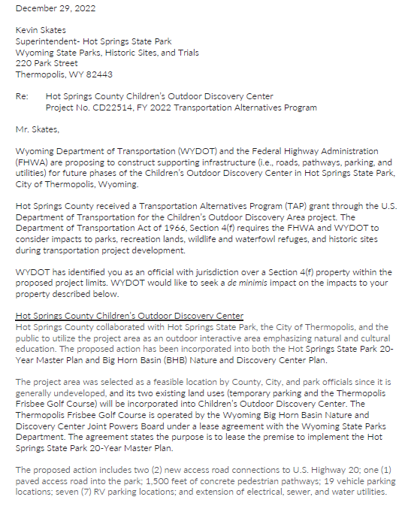
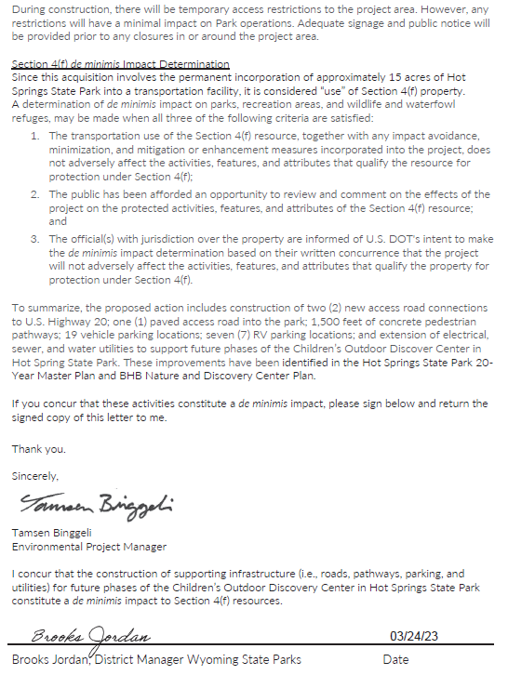
Ex. – 4(f) Letter

Slide 41
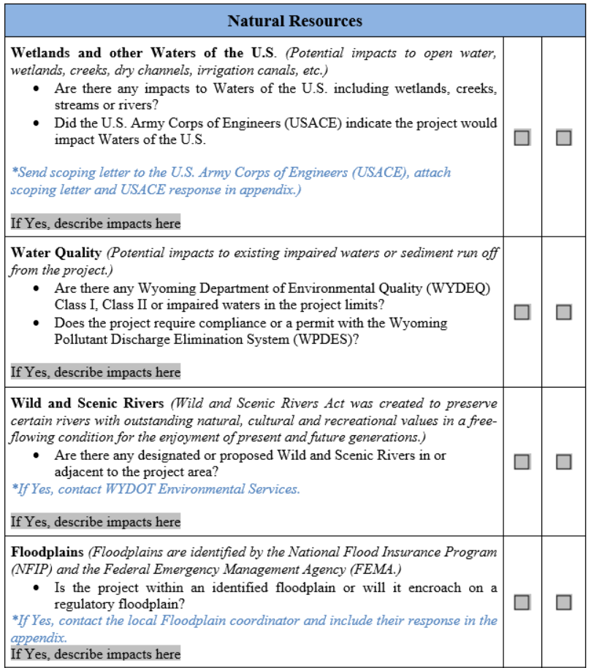
Template – Natural Resources Wet
CMAQ/HRRR should be able to select “NO” on all of these.

Slide 42
Ex – Natural Resources Wet

Slide 43
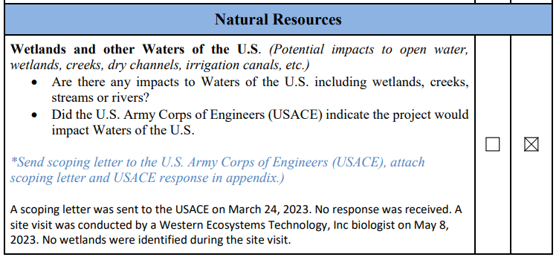
Ex – Natural Resources Wet
consultant

Slide 44
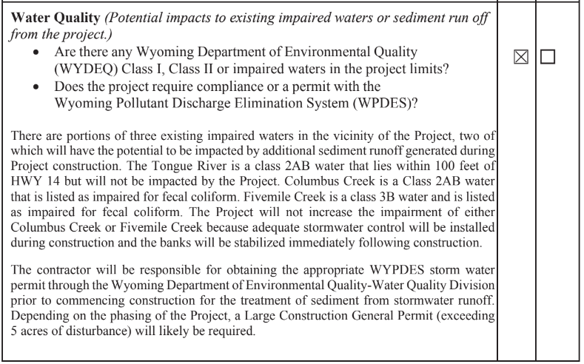
Ex – Natural Resources Wet

Slide 45
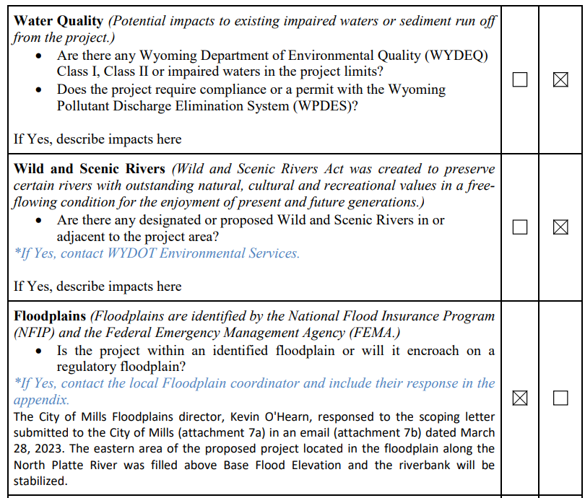
Ex – Natural Resources Wet

Slide 46
Template/Ex. – Farmlands

Slide 47
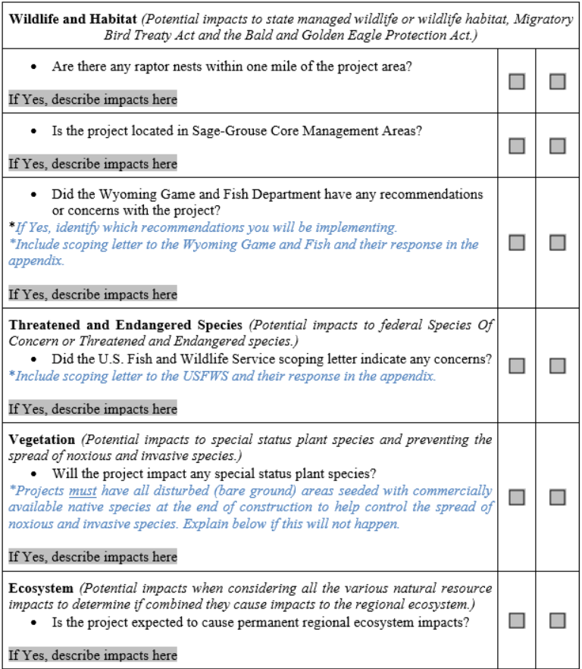
Template – Natural Resources Bio
CMAQ/HRRR scoping the Game and Fish will help you fill out this section.

Slide 48
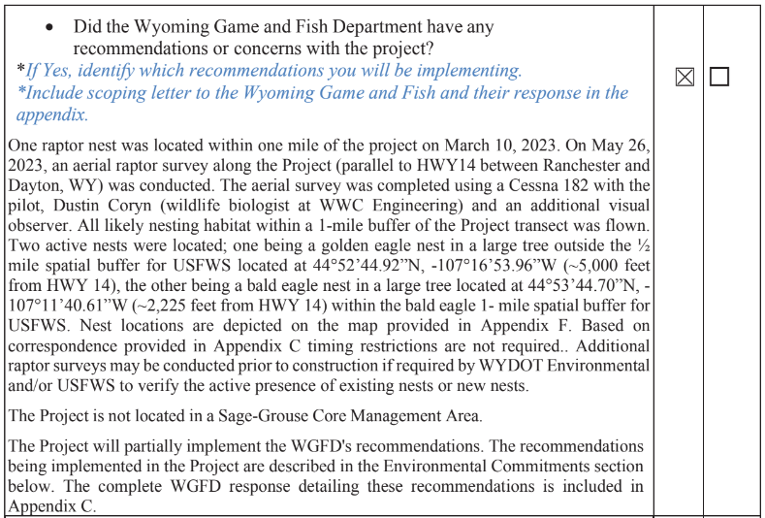
Ex. – Natural Resources Bio

Slide 49
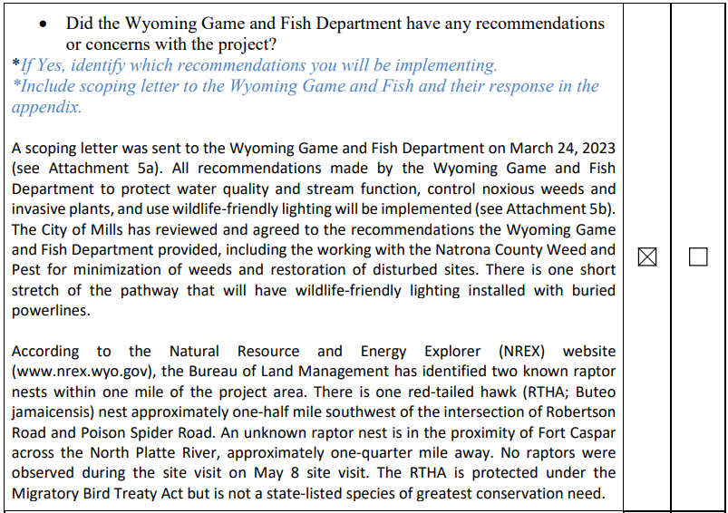
Ex. – Natural Resources Bio

Slide 50
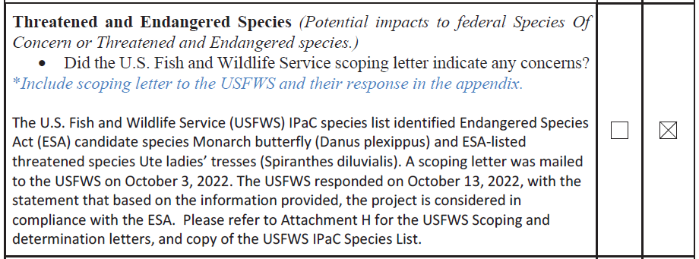
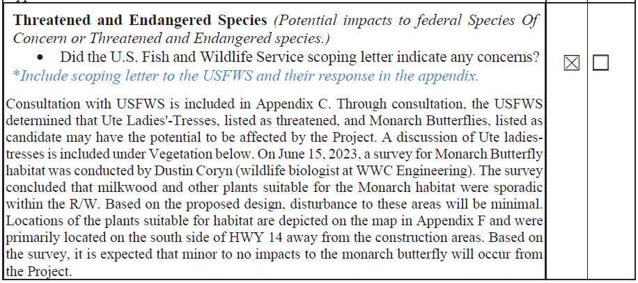
Ex. – Natural Resources Bio

Slide 51
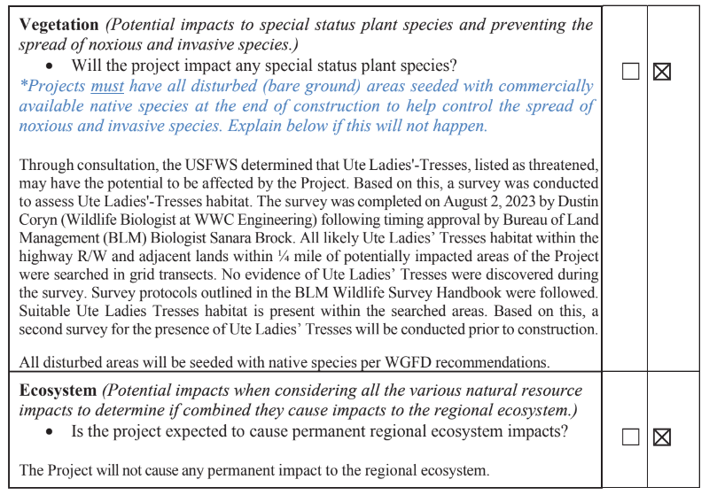
Ex. – Natural Resources Bio

Slide 52
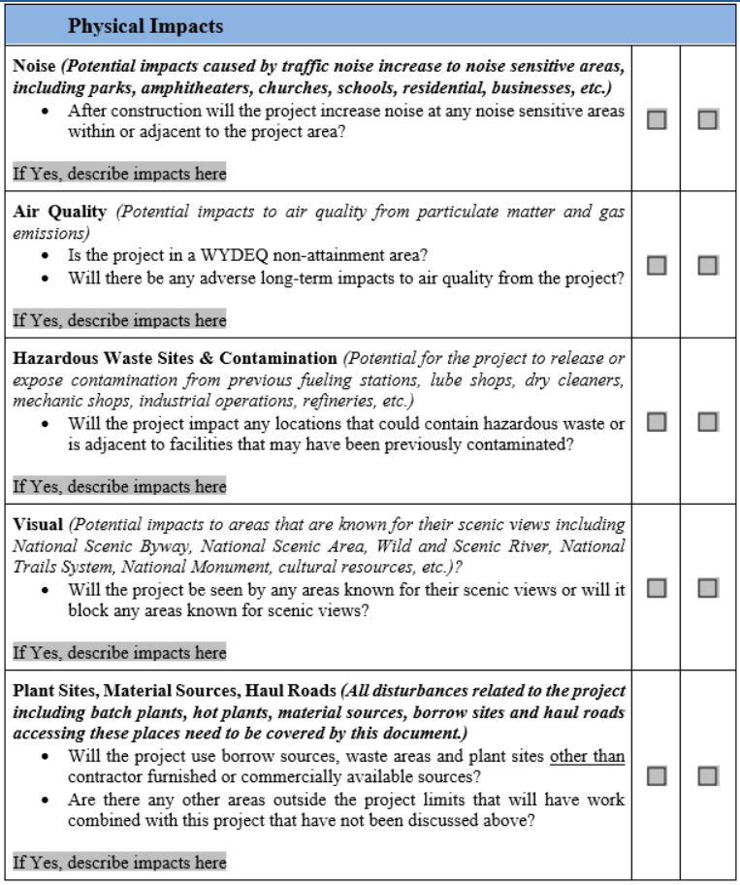
Template – Physical Impacts
CMAQ/HRRR should be able to select “NO” on most of these. Please review the material sources and temporary impacts.

Slide 53
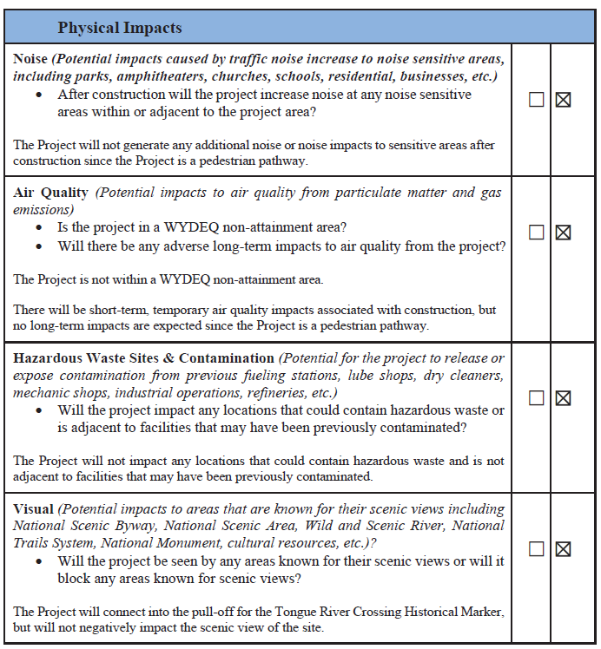
Ex. – Physical Impacts

Slide 54
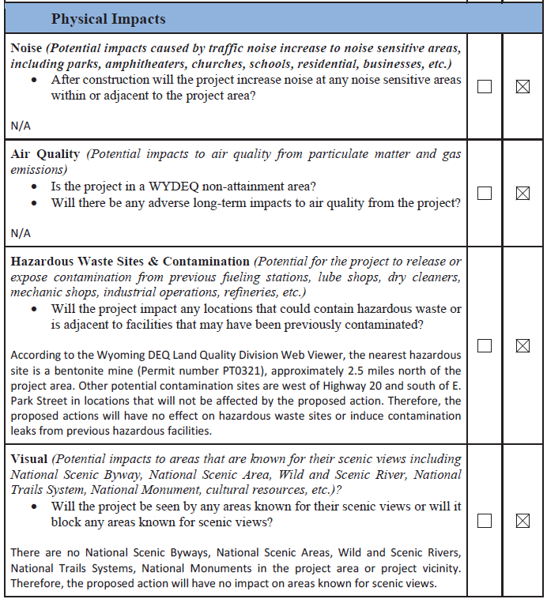
Ex. – Physical Impacts

Slide 55
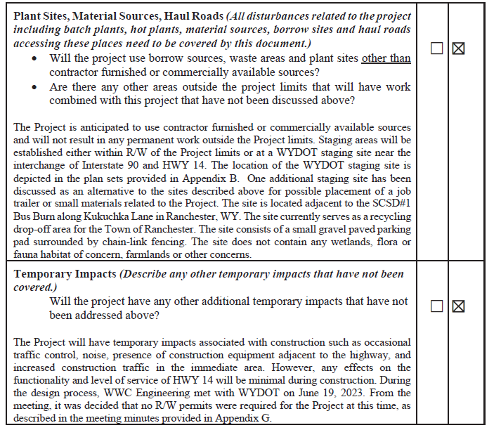
Ex. – Physical Impacts
Consultant

Slide 56
Template/Ex. – Public Participation

Slide 57
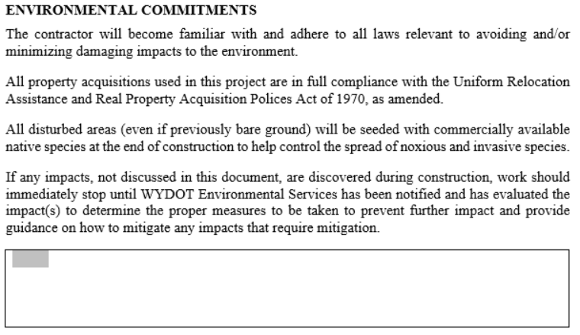
Template – Env Commitments

Slide 58
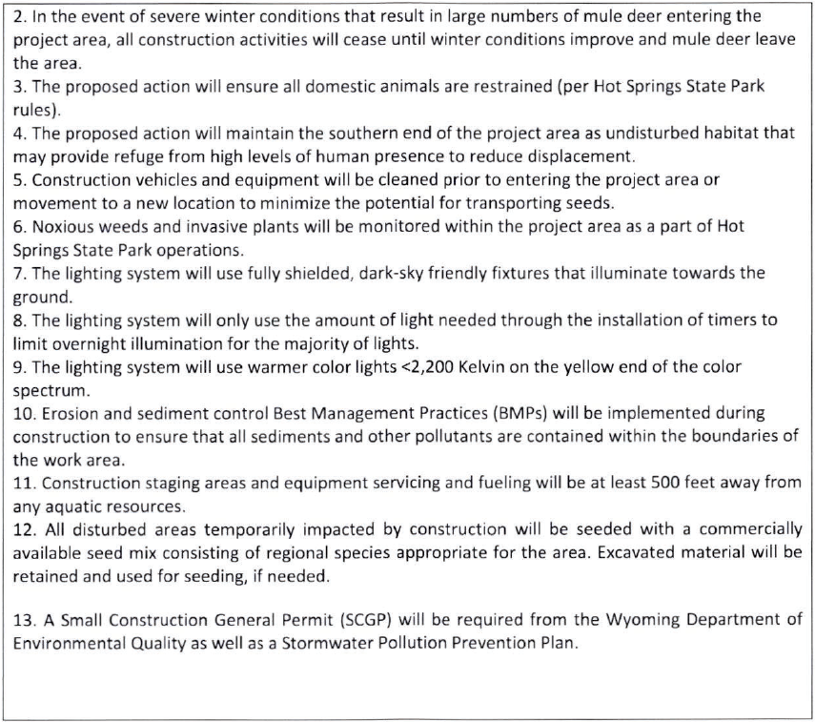
Ex. – Env Commitments

Slide 59
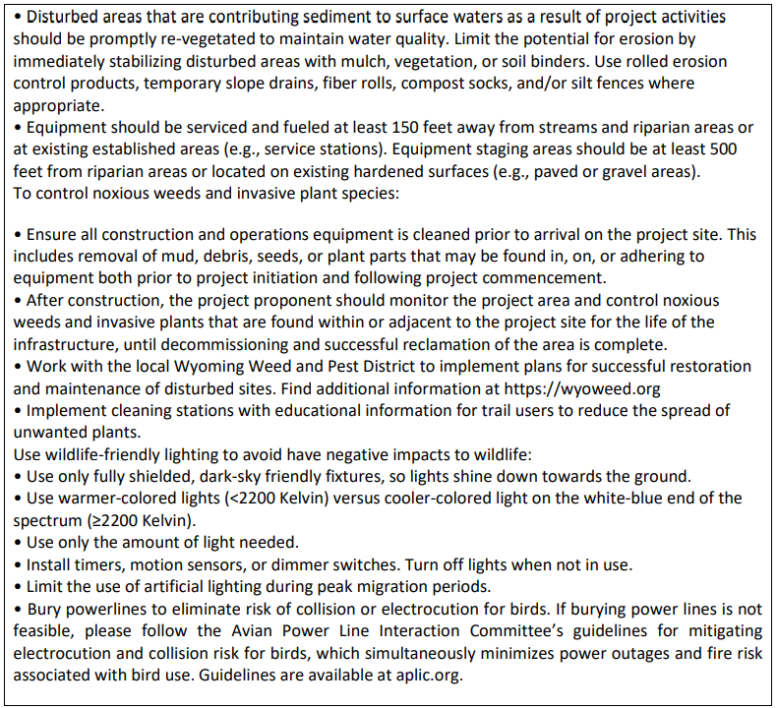
Ex. – Env Commitments
You do not need to regurgitate the whole Game and Fish Letter in this section.
You also do not have to implement all of their recommendations.
You must implement timing restrictions and sage grouse restrictions
If you mention any commitments in above sections they must be put here too.

Slide 60
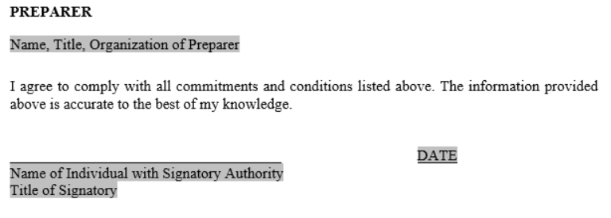
Template - Signatures
The person(s) who filled out the Environmental Template.
Date which was signed. Should also be the same or within a day or two of the date on page one.

Slide 61
Pitfalls to Avoid

Slide 62
Pitfalls on the Template
The Template is a word document and is fillable. Do not take a PDF and add text to it.

Slide 63
Pitfalls - Arch/Cultural

Slide 64
Pitfalls – T&E
Does not include if they are impacting any of these species or habitat.

Slide 65
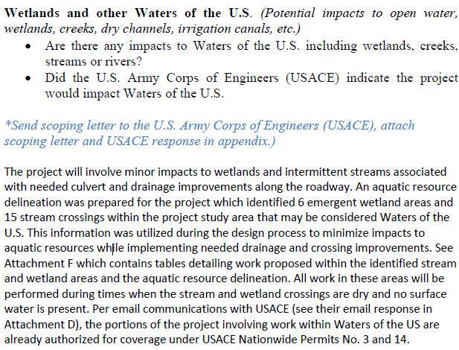
Pitfalls - Wetlands
Good – A aquatic resources delineation was completed.
Good – Coordination with the USACE occurred
Stated that design would minimize impacts. However did not show impacts in plans and did not discuss total wetland and waters of the U.S. impacts.

Slide 66
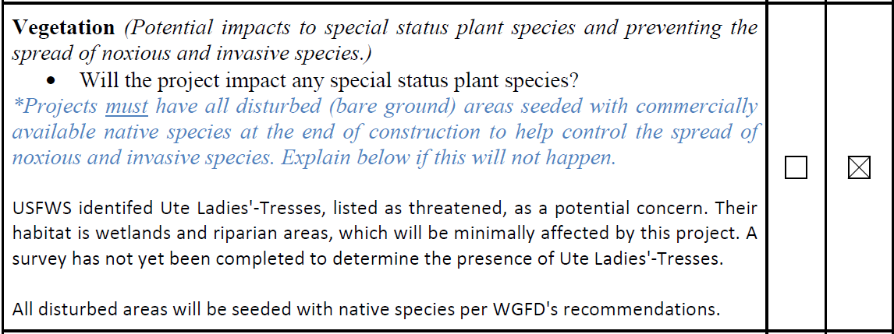
Pitfalls – Vegetation
Ute Ladies’-Tresses is a T&E species and it would be more appropriate to discuss this in the T&E Section.
This CE has an issue with stating there will be an impact to wetlands and riparian areas. Then in this section it says minimally affected, what does that mean?
The Ute ladies’-tresses orchid survey is not completed yet. Do not wait until the last minute and then try to rush through the project.
Does not state if Ute ladies’-tresses orchids that will be impacted.
This is good to state and should also be stated in the commitment section at the end of the CE

Slide 67
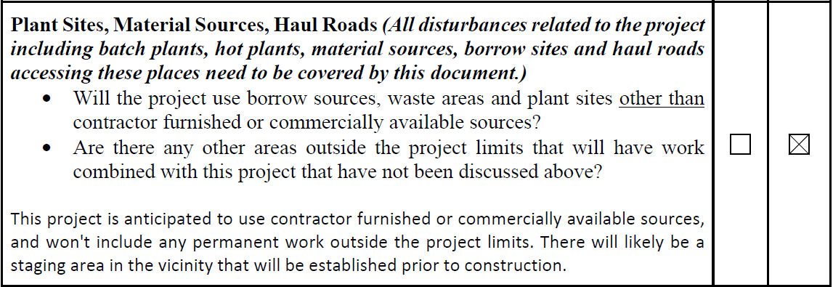
Pitfalls – Physical Impacts
Please try and figure all the areas you need now. It is easier to get them all cleared at the same time then have to send a consultant back out later.
Plus the CE needs to cover all areas that you will impact that are related to the project.

Slide 68
Questions

