Slide 1
FHWA Updates and TAP Lessons Learned
Lisa Fresquez
Civil Rights and Right of Way Program Manager

Slide 2
Infrastructure Investment and Jobs Act
Also known as the Bipartisan Infrastructure Law or BIL
Increase in overall funding
Change in Transportation Alternatives Set Aside funding categories
Large increase in number of Discretionary Grants
Changes to Buy America (BABA)

Slide 3
Funding Increases
Total FY23 Funding $346,180,057
~25% increase from FY20 and FY21
FY24 Estimated Funding $403,808,170
Supplementary Tables to be released
TAP FY22 $4,665,818
Nearly Double FY21
Similar in FY23 and FY24
CMAQ generally the same
Increase in Off System Bridges (BROS)

Slide 4
Funding Category Changes
Pre-BIL Population Categories
Post BIL Population Categories
TA for any area
Areas < 5k
5k ≤ Areas ≤ 200k
Areas > 200k
TA for any area
Areas < 5k
5k ≤ Areas < 50k
50k ≤ Areas ≤ 200k
Areas > 200k

Slide 5
Funding Category Changes
50k ≤ Areas ≤ 200k
Casper MPO
Cheyenne MPO
Bar Nunn
Casper
Evansville
Mills
Natrona County
Cheyenne
Laramie County

Slide 6
BIL Grant Opportunities
Hurdles to Applying
Match Requirements
Many allow 100% for rural areas
Can be creative
Application Cost
~$25k-$30k from scratch application
~$25k-$30k from scratch BCA
Single Audit
Required if you spend $750k Federal $ in your FY
Cost is eligible for grant fund reimbursement

Slide 7
BIL Grant Opportunities
Program Name | Amount | Additional Info
Safe Streets for All | $6 Billion | Provides funding directly to local and tribal gov to support advancement of “vision zero”
Rebuilding American Infrastructure with Sustainability and Equity (RAISE) | $15 Billion | Surface transportation projects of local and/or regional significance
Infrastructure or Rebuilding America (INFRA) | $14 Billion | Offer needed aid to freight infrastructure for projects of regional or national significance
Federal Transit Administration (FTA) Low and No Emission Bus Programs | $5.6 Billion | Expands program for state and local gov to purchase or lease zero or low emission busses and build supporting facilities
FTA Buses + Bus Facilities Competitive Program | $2 Billion | Replace, rehabilitate, and purchase buses and related equipment and/or construct bus-related facilities

Slide 8
BIL Grant Opportunities
Program Name | Amount | Additional Info
Capital Investment Grants (CIG) | $23 Billion | New high-capacity transit projects
Federal Aviation Administration (FAA) Terminal Program | $5 Billion | Airport terminal development and other landside projects
MEGA Projects | $15 Billion | National Infrastructure Project Assistance grant program projects of national or regional significance
Promoting Resilient Operations for Transformative, Efficient, and Cost-saving Transportation (PROTECT) | $8.7 Billion | Increase resilience of transportation systems: evacuation routes, coastal resilience, moving infrastructure continuously impacted by extreme weather and natural disasters
5307 Ferry Program | $150 Million | Funds ferries for urbanized areas
Electric or Low Emitting Ferry Program | $500 Million | Transition passenger ferries to low or zero-emission

Slide 9
BIL Grant Opportunities
Program Name | Amount | Additional Info
Rural Ferry Program | $2 Billion | Funds essential ferry service in rural areas
FHWA competitive grants for nationally significant and other bridges | $15.77 Billion | Rehabilitate or replace bridges/culverts. Large projects and bundling of smaller bridges are eligible
FTA All Station Accessibility Program | $1.75 Billion | Funding for legacy transit and commuter rail to upgrade existing station to ADA standards
Charging and fueling infrastructure | $2.5 Billion | Charging infrastructure where people live, work, and shop
Reconnecting Communities Pilot Program | $1 Billion | Planning, design, demolition, and reconstruction or street grids, parks, or other infrastructure
FHWA Nationally Significant Federal Lands and Tribal Projects | $1.78 Billion | Construction, reconstruction, and rehabilitation of nationally-significant projects within, adjacent to, or accessing Federal and tribal lands.

Slide 10
BIL Grant Opportunities
Program Name | Amount | Additional Info
Strengthening Mobility and Revolutionizing Transportation (SMART) | $1 Billion | State, local, and tribal governments for projects that improve transportation safety and efficiency
Rural Surface Transportation Grant Program | $2 Billion | Improve and expand infrastructure in rural areas increasing connectivity, improving safety and reliability of moving people and freight, and generate regional economic growth
Information from: https://www.transportation.gov/sites/dot.gov/files/2022-01/BIL_Wyoming.pdf

Slide 11
Discretionary Grants
Airport Terminal Program
Improve passenger experience
Bridge Investment Program
Replace, rehabilitate, preserve or protect NBI bridges
Replace or rehabilitate culverts
Buses and Bus Facilities Program
Replace, rehabilitate and purchase buses, vans, and related equipment and construct bus related facilities
Capital Investment Grants
Rail, BRT, and ferries
Charging & Fueling Infrastructure
EVS, buses, and ferries
PROTECT Grants
Planning and resilience improvements concerning weather
Railroad Crossing Elimination Grants
Closures, relocations, or improvements

Slide 12
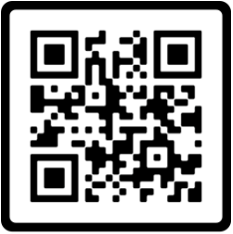
Discretionary Grants
Safe Streets and Roads for All
Safety planning, design, and projects
State of Good Repair and Rail Vehicle Replacement Program
Maintain, rehabilitate, and replace assets. Rolling stock and transit asset management plans
SMART grants
ITS related items and traffic signals
QR Code below is for a “complete" list of grants

Slide 13
BIL Grant Opportunities
EV Charging grants are open now
Notice of Funding Opportunities (NOFO) forthcoming for others
NOFO announcements typically include informational and/or training webinars
Visit the site below to get additional info
https://www.transportation.gov/grants

Slide 14
BIL Grant Opportunities
A few application tips
A consultant is not needed to write a good application
Address every criteria
Focus on going above and beyond for each criteria
Get the broadest range of stakeholders possible
Private funding goes along way
Planning grants are scored based on the proposed benefit of your entire wish list
Construction grants are held to the items listed in your application

Slide 15
Buy America
Significant changes
Referred to as “Build America, Buy America Act”
BABA
Items must be classified as:
Iron or steel;
Manufactured product; or
A construction material

Slide 16
Build America
Buy America
Build America, Buy America
Steel and Iron
Permanently incorporated
Includes all coatings
Manufactured goods
Currently have a waiver
Buy America items
Non-ferrous metals
Plastic and polymer-based products
Glass
Lumber
Drywall

Slide 17
TAP Projects Lessons Learned
Communication
Most issues stem from poor or missing communication
Application
Must be competitive
Project needs to remain in scope
More than one project is okay
Project Development
Moving forward without concurrence

Slide 18
TAP Projects Lessons Learned
Construction
Paying the Contractor without supporting documentation
Project Closeout
Timeliness for re-obligation
Schedule
Projects are taking too long
Money is only available for 4 years

Slide 19
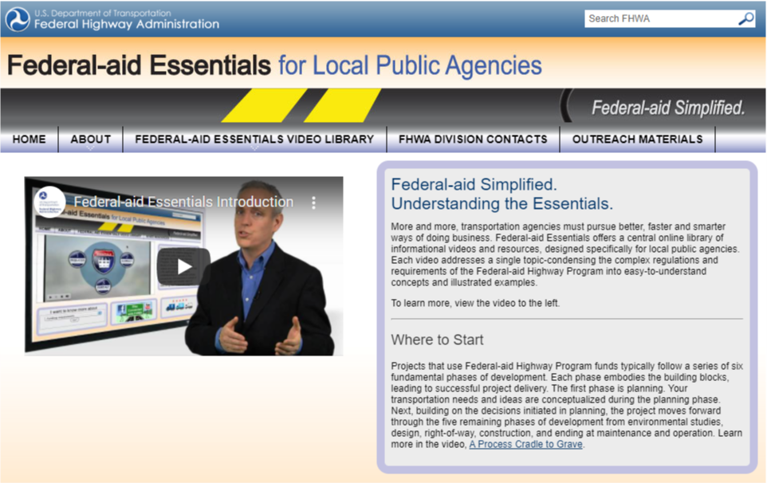
Federal-Aid Essentials
Federal-Aid Program Overview
Finance
Right-of-Way
Environment
Civil Rights
Project Development
Project Construction and
Contract Administration
Other
CMAQ
Safety
Consultant Services

Slide 20
Resources
Federal-Aid Essentials
https://www.fhwa.dot.gov/federal-aidessentials/
Consultant Selection
https://www.fhwa.dot.gov/programadmin/consultant.cfm
Required Contract Provisions
https://www.fhwa.dot.gov/construction/contracts/provisions.cfm
WYDOT Standard Plans (Sidewalk and ADA Accessibility)
https://www.dot.state.wy.us/files/live/sites/wydot/files/shared/Engineering_Services/Standard%20Plans/608-1B%20%20(JUL_2018).pdf
ADA Standards
https://www.ada.gov/2010ADAstandards_index.htm

Slide 21
Questions?
Scott Stone, P.E.
Engineering and Operations Supervisor
FHWA - Wyoming Division Office
2617 E. Lincolnway, Suite D
Cheyenne, WY 82001

