Slide 1
Local Programs “How To”
Sara B. Janes
Local Government Coordinator
Sara.Janes@wyo.gov
Cole Bostron
Local Programs Coordinator
Cole.Bostron@wyo.gov
Alyssa Quinn
Local Government Specialist
Alyssa.Quinn1@wyo.gov
Samuel Desrosiers
Local Government Specialist
Samuel.Desrosiers@wyo.gov
Lenaya Alverson
Transit Program Coordinator
Lenaya.Alverson1@wyo.gov
Shauna Perkins
Local Government Specialist
Shauna.Perkins2@wyo.gov
Leanna Humble
Local Government Specialist
Leanna.Humble@wyo.gov
Joni Kithas-Harlan
Transit Fiscal Consultant
JKH@rtconnect.net

Slide 2
District Map

Slide 3
LGC’s Methods
STREAMLINED
Project Specific
Google Sheets
Electronic
Office
Google Drive
1 Point of Contact
Google Docs

Slide 4
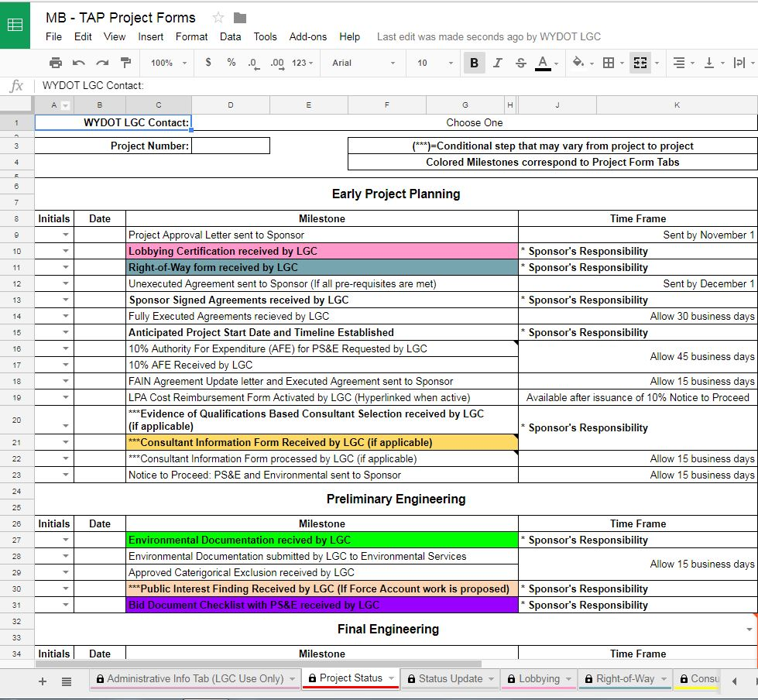
Project Forms Sample

Slide 5
Things you’re going to hear a lot
Call/email your LGC Contact.
DO NOT DO ANYTHING WITHOUT A NOTICE TO PROCEED!
If you’re not sure…ask!

Slide 6
Initial Project Planning
Planning Study
Coordinate w/District Engineering Staff
Ensure Matching Funds
Highly encouraged
Can apply for funds to create a planning document
Should be reviewed and updated every 3-5 years
Do this BEFORE you submit an application
Notes:
RR- 1st Step in the lifecycle of your project:
Formal study prior to applying for funding to determine feasibility of the project and address logistics of all parties involved.
Helps mitigate unforeseen issues and identifies priorities, particularly if the project will have multiple phases.
If plan is in place when applying for funding it will likely rank higher with the Advisory Selection Committee.
Exhibiting you’ve done your diligence in thoroughly planning your project.
If a local entity does not have a formal Planning Study and would like assistance, Federal Funding is available.
Make sure plan stays current- priorities may change over time.
You (local entities) should coordinate with District staff for assistance in planning your projects. District staff can help identify ROW and environmental issues.
Local governments have proper funding allocated or committed for your project.

Slide 7
Preliminary Engineering
Consultant Selection
Environmental Document
Preliminary Design
Must be qualifications based
In-house design can be done; engineer MUST be a full-time employee of the sponsor
Complete this first so any issues can be addressed in design
60% design plans must be submitted for review and comment
90% design plans must be submitted and reviewed with LGC representative
DO NOT DO ANYTHING FURTHER UNTIL YOU RECEIVE A NOTICE TO PROCEED

Slide 8
Final Engineering
Submit Final Plans/Bid Docs
Notice to Proceed on Bid Advertisement
90% Plans submitted to WYDOT review committee
All stipulations contained within the approved NEPA document must be incorporated into project manual
Verify updated federal documents are included into project manual
Will be issued by LGC contact
DO NOT DO ANYTHING FURTHER UNTIL YOU RECEIVE A NOTICE TO PROCEED
Notes:
LGC will conduct a final review. Then NTP will be sent out..
Let me reiterate- **ONLY TO ADVERTISE BID** NOT AWARD!

Slide 9
Project Bidding and Award
Project Advertised
Bid Tabulation Received
Concurrence and Bid Award
Executed Contract with Contractor
Project should be advertised for minimum of 3 weeks (21 days)
Best practice is to advertise for 4 weeks
Plans must be available for the 3 week (21 day) period
Proper DBE solicitation for all sub-contracts
(Must contact twice)
Along with all signed documents
Send Bid Tabs and attachments via email to LGC contact
DBE Form E-91 must accompany all submitted bids in order to be responsive and responsible
LGC will review Bid Tabs and attachments
Will send a letter awarding concurrence, then you can award the project
Email LGC contact a copy of your signed contractor agreement
Attach FHWA 1273 to contract
DBE-2 - Notification of Intent to Subcontract form completed on all DBE subcontractors
Notes:
MJ

Slide 10
Construction
Notice to Proceed on Construction
Monitor the Project
Wage Interviews
CONSTRUCTION CANNOT BEGIN UNTIL NOTICE TO PROCEED WITH CONSTRUCTION IS RECEIVED FROM LGC CONTACT
The engineer will ensure project stays on schedule and is being constructed as designed
DBE-1 Commercially Useful Function (CUF) Form completed on all DBEs
100% of workers at least one time during construction must complete a wage interview
Notes:
RR
If you have an Engineer- need to monitor the construction from start to finish.
Labor Wage and Compliance Interview will need to be conducted.
You’ll conduct your interviews and email forms (from your Project Status tab of your Project Forms Google Docs) to your LGC rep. We’ll assist you on the process from there.
CALL US for questions!

Slide 11
Project Final Acceptance
LPA Submits Final Acceptance & Evaluations
WYDOT Issues Final Acceptance
WYDOT Processes Final Reimbursement
LPA’s responsibility to make sure all requirements were met
Contract is between LPA and Contractor
Evaluations completed
WYDOT will do a brief inspection of the project and sign off
Follow-up with LPA, if requested or necessary regarding evaluations.
Final 10% of the total project cost is reimbursed once the LPA and WYDOT have accepted the project
DBE-3 - Subcontractor payment report submitted for all DBEs
Notes:
MJ
Form in Project Forms
Should be submitted with final bill.

Slide 12
Reimbursements
Reimbursement Request Submitted to LGC
Bills must be paid prior to submission of request
Reimbursement Completed
All programs are reimbursement based
Minimum of one Reimbursement per quarter
LGC Review
Verifies that the numbers add up
Ensures reimbursement items are eligible
Copies of cancelled checks and/or EFTs must be provided.
Budget Office Reviews
LGC Submits Request to Budget Office
Notes:
MJ
You pay first then request reimbursement
Keep us updated ! Send in invoices as you pay bills!
Inactive list
Once your funds becom

Slide 13
Reimbursement - Supporting Documentation
linked in the Project Status Tab
Cost Reimbursement Form
Reimbursement
Requests
for the invoices
received from Contractor or other vendors
Copies of Proof of Payment
Copies of Detailed Invoices
Notes:
MJ

Slide 14
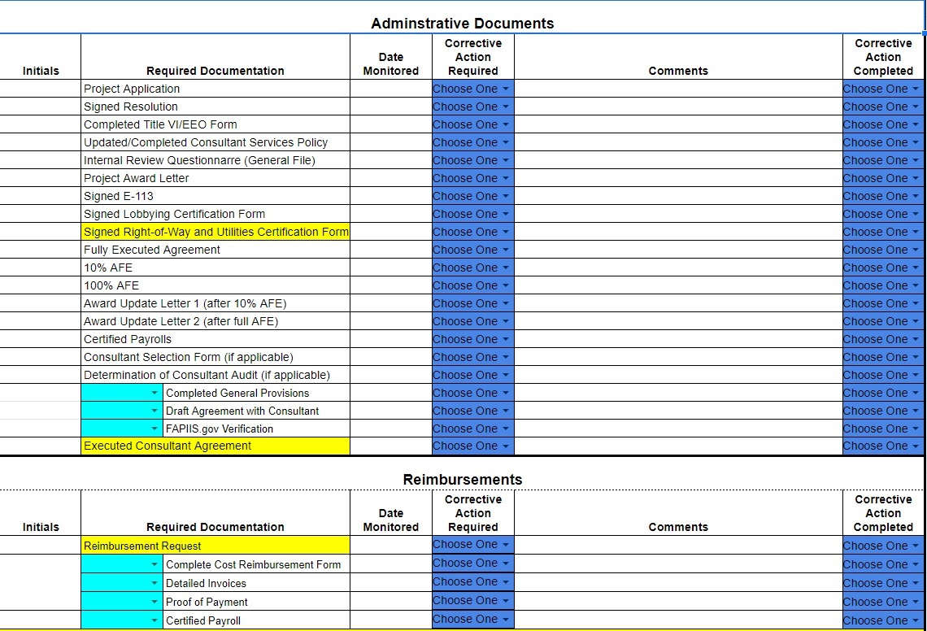
Project Monitoring by LGC
Notes:
MJ

Slide 15
End of Project Evaluations
Consultant Performance Review
by LPA
Process Review
by LPA
LPA Performance Review
by LGC
Notes:
MJ

Slide 16
What NOT to do

Slide 17
What NOT to do
#10
Sending documents to anyone other than your LGC Contact
LGC CONTACT

Slide 18
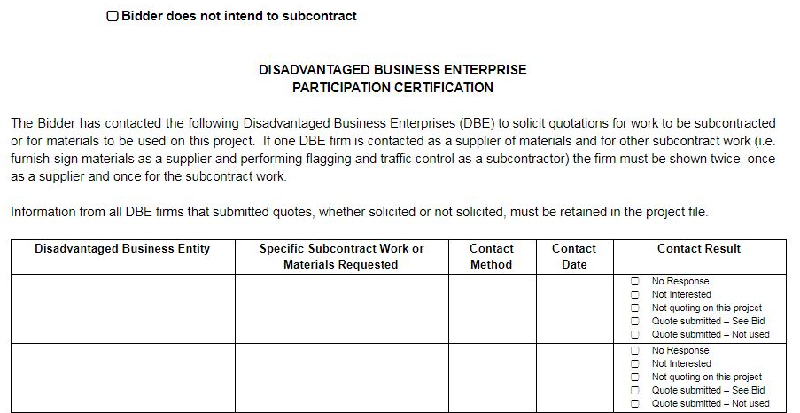
What NOT to do
#9
Expect Concurrence in Bid without proper DBE solicitation
No DBE Solicitation
Pro-Forma Solicitation

Slide 19
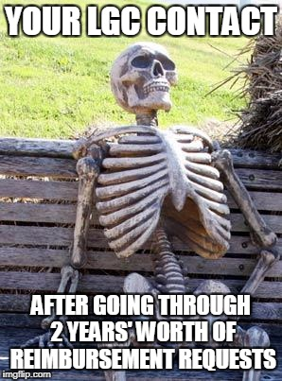
What NOT to do
#8
Not submitting any Reimbursement Requests until the project is complete

Slide 20
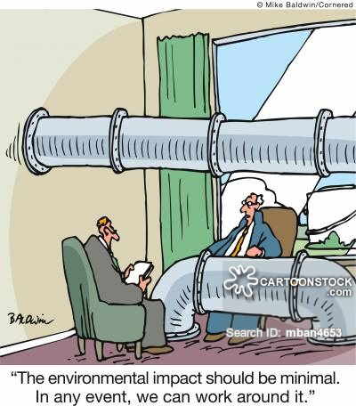
What NOT to do
#7
Final design without environmental clearance

Slide 21
What NOT to do
#6
Asking for forgiveness instead of permission

Slide 22
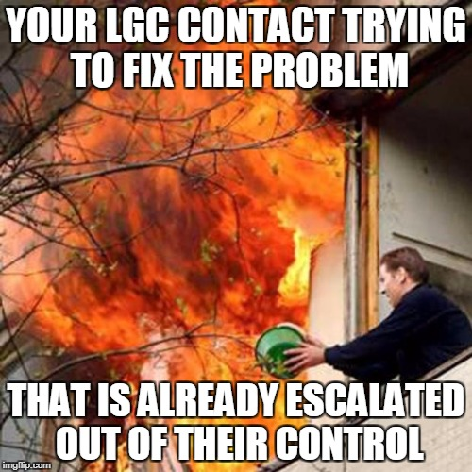
What NOT to do
#5
No contact with us until something goes wrong

Slide 23
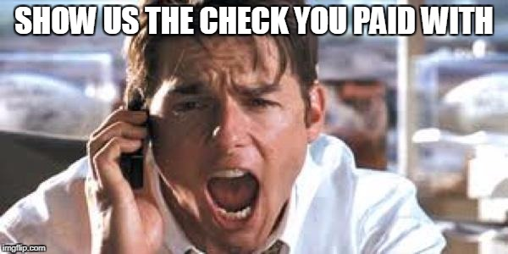
What NOT to do
#4
Sending in a request for reimbursement without a copy of the cancelled check or EFT.

Slide 24
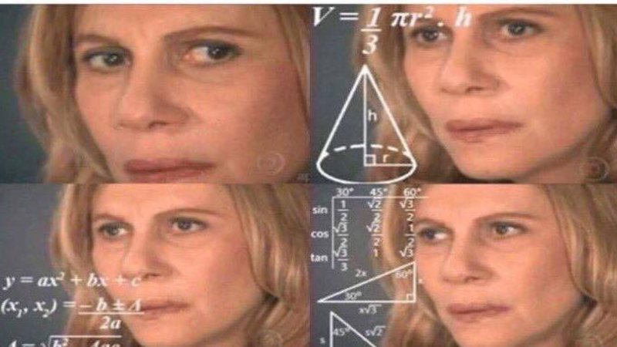
What NOT to do
#3
Advertising on Saturday, Sunday, and the next Sunday and calling it 3 weeks
Your LGC contact should not have to get creative with counting to figure your 3 weeks of advertising

Slide 25
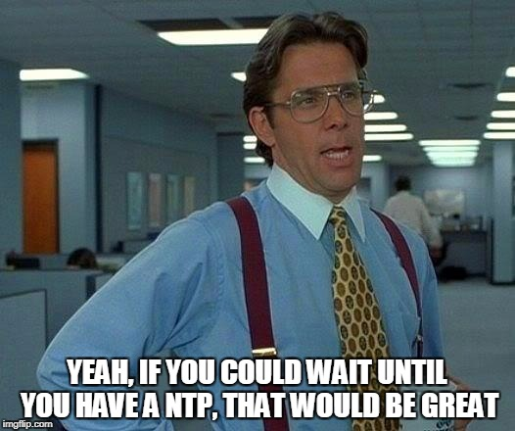
What NOT to do
#2
Do ANYTHING without a Notice to Proceed

Slide 26
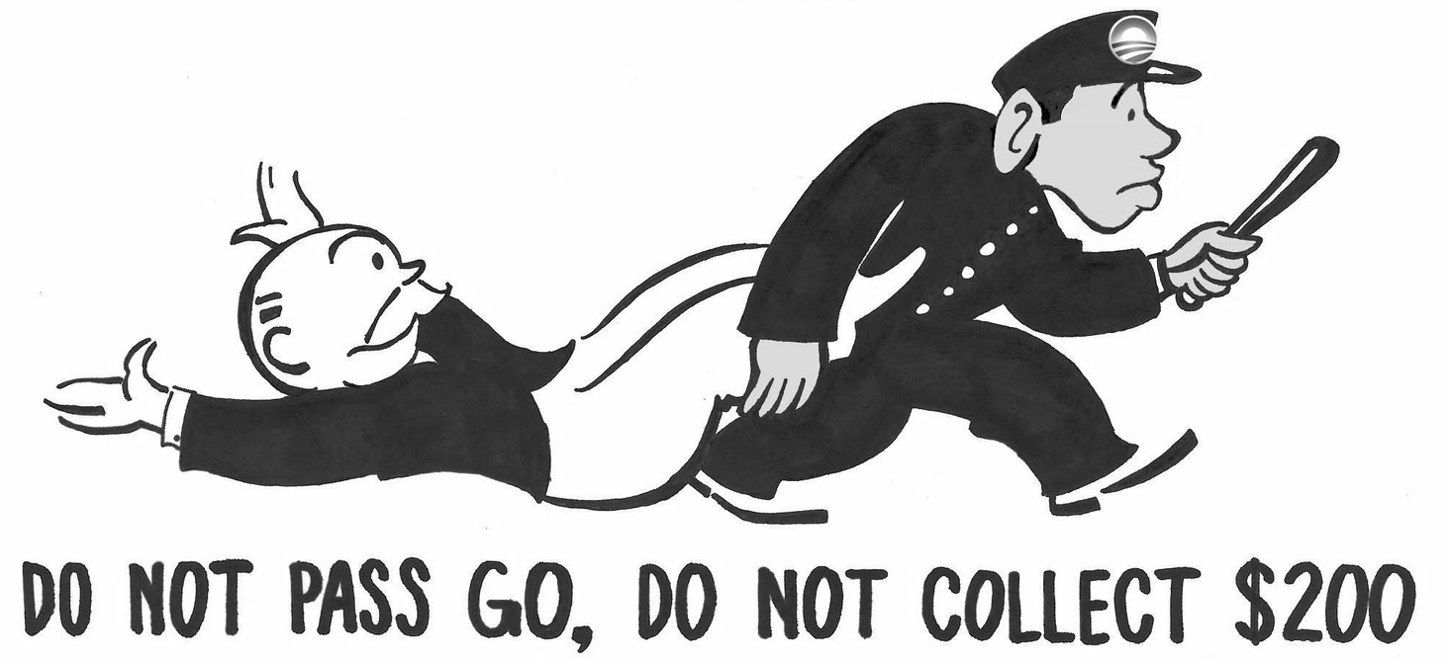
What NOT to do
#1
Constructing the project before completing any other steps
(Actual photo of the Feds taking away money for not following guidelines)

Slide 27
Celebration of Knowledge time!!

