Slide 1
LPA Success Stories
Why we do what we do!

Slide 2
Local Public Agency Funding
Fiscal Years 2015-2023
$180,467,873
894 Projects
Congestion Mitigation Air Quality (CMAQ)
Transportation Alternatives Program (TAP)
High Risk Rural Road (HRRR)
Public Transportation Programs (5304, 5310, 5311, 5339)
Notes:
Average of almost 99 projects per year
Average ~ $18.3M awarded annually

Slide 3
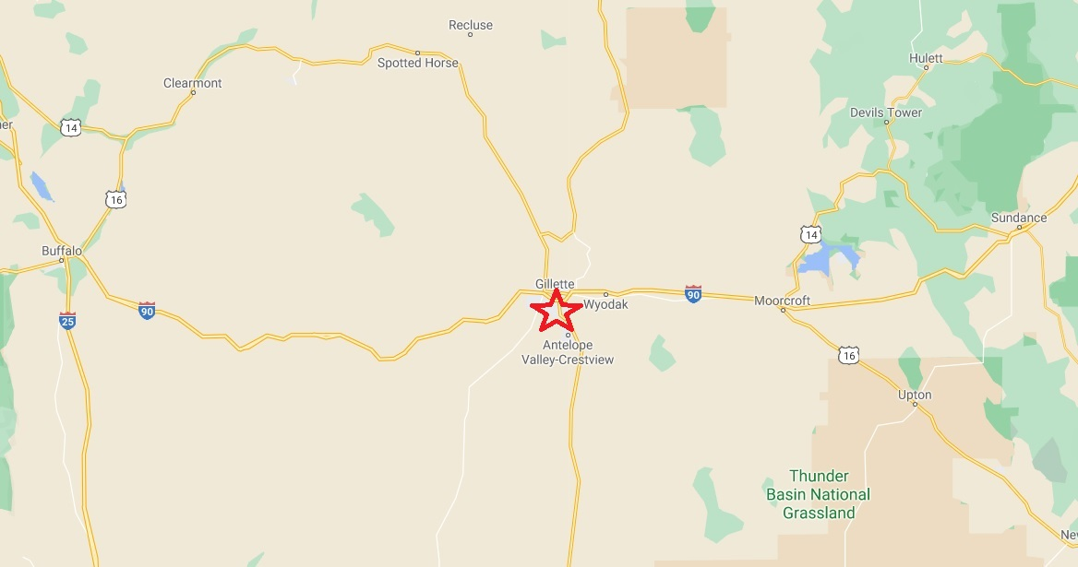

Slide 4
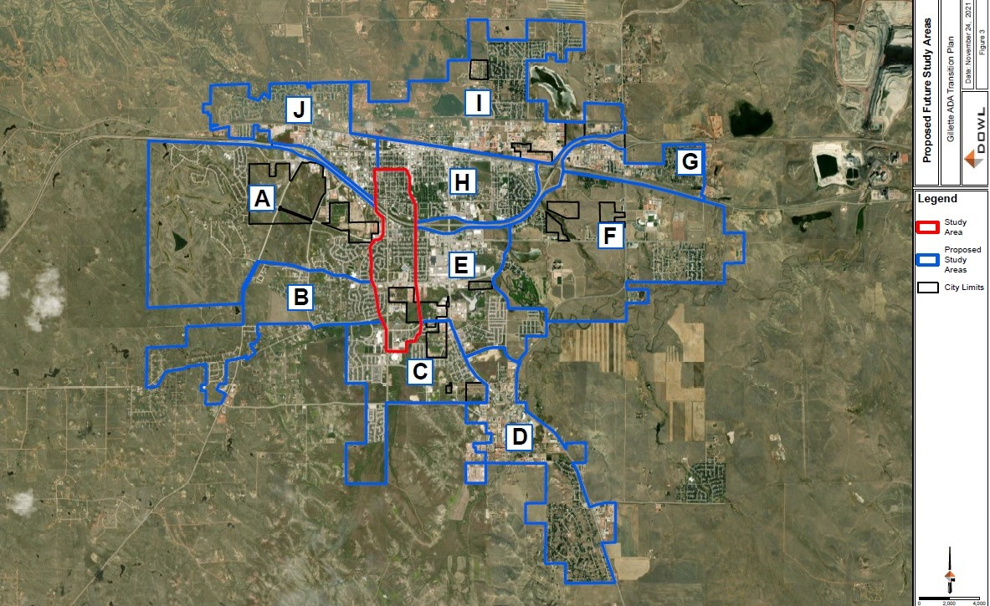
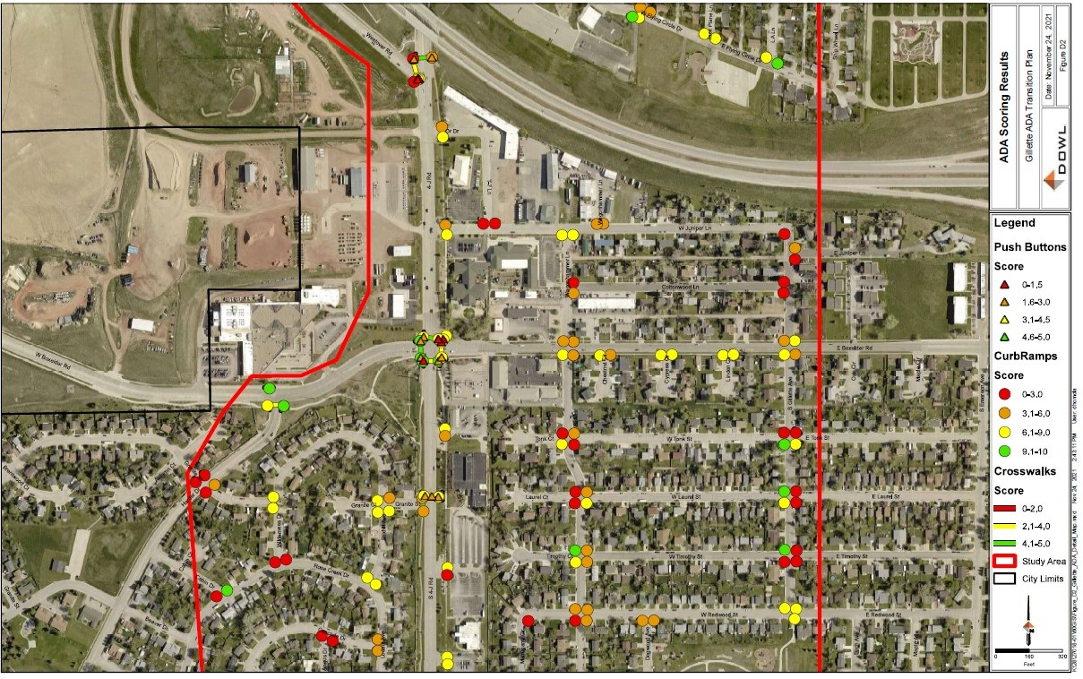
City of Gillette:
Federal Award Amount: $180,000
Year Awarded: FY20
Project Type: TAP - ADA Transition Plan
Notes:
First Project
3 - Alpine (Planning Document)
How this project made a difference in the community:
Being awarded this grant has had a huge impact on the community. Greys River Road is the most traveled road excluding US Highways 26 and 89. This is the forest access and you can see children on scooters, all manner of ATVs, vehicle traffic, bicyclists, joggers, and almost everything else all on the same stretch of road. It is very dangerous. This pathway will mitigate a dangerous situation by separating motorized vehicles from pedestrians and other traffic. The public is very excited about this pathway. When we applied for the grant, a donor was at the same time donating and constructing a new children's park one block off of the Greys River Road and this pathway will be a safe route to the children's park. This has been very positive to Alpine, truly a win-win situation. The community buy-in for this project is amazing.
What was learned/experienced from this project:
The LPA process may at first blush seem a bit cumbersome, but having received the training and becoming familiar with the process as the project progresses, it is not so different from other grant procedures. The order of payment and submission is different, certifying more documents becomes a routine. There are additional steps and agencies involved, so the process is bound to move slower than other grant opportunities, but all of this is worthwhile if your project is for the health and safety of the community. This whole LPA process has to be weighed against the benefit to the community and in Alpine's case, it is definitely worth the extra steps.
Advice for LPAs considering projects:
My advice is to get your ducks in a row. This is a finely tuned group and they absolutely will know if you are not prepared or if you are trying to fake your way through without any real conviction. That is not to say that changes or modifications cannot be made. But have a clear vision of what you want to accomplish so you do not waste everyone's time. There are many requests and limited funding so you have to sell your project. The most important thing to me personally, is that David and everyone else has been willing to walk me through unfamiliar processes with seemingly infinite patience. Keep good records, follow directions and you should do well.
**Note to add - Alpine was awarded a construction project in FY20 for $480,000. That award was provided full support due to the planning document being in place.

Slide 5
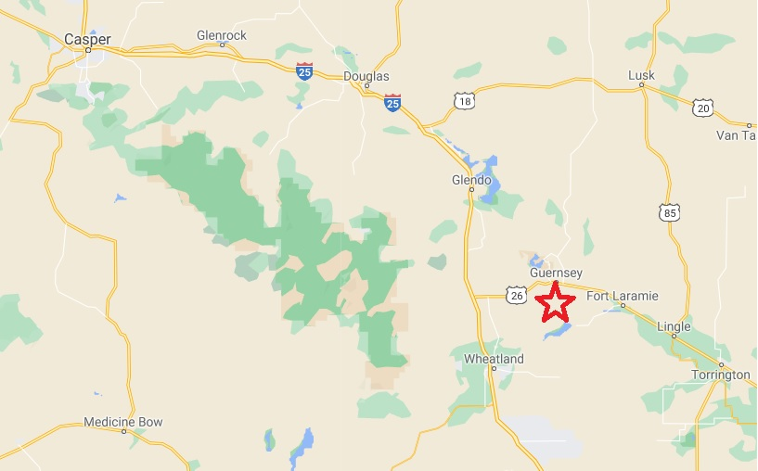

Slide 6
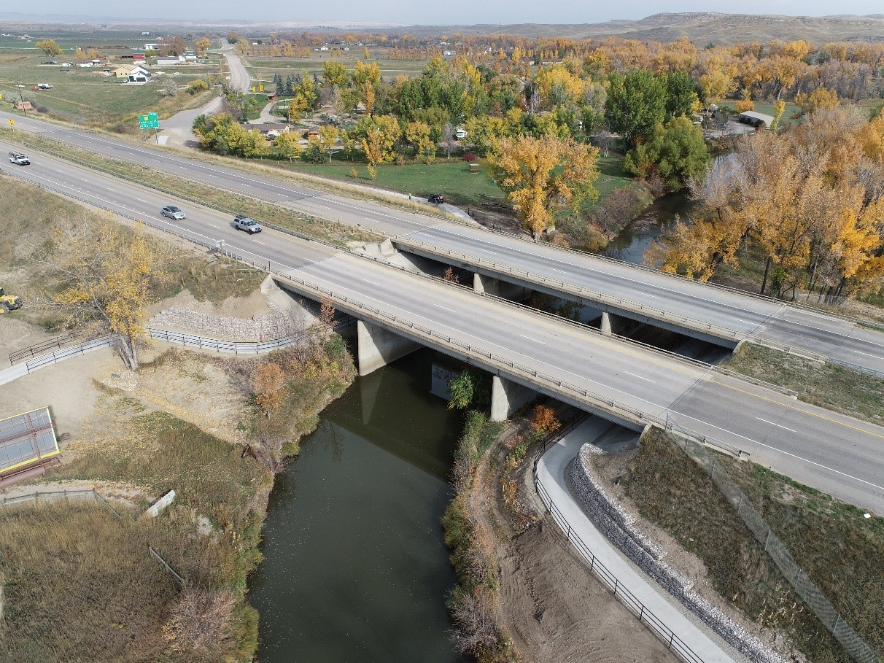
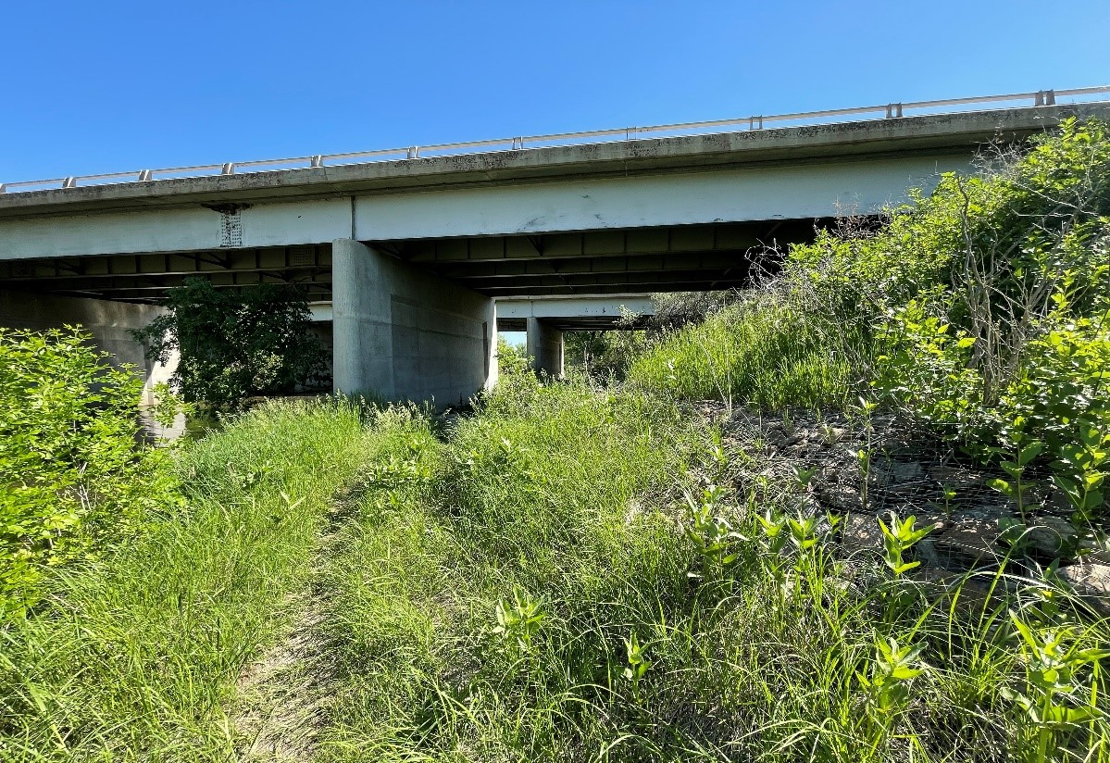
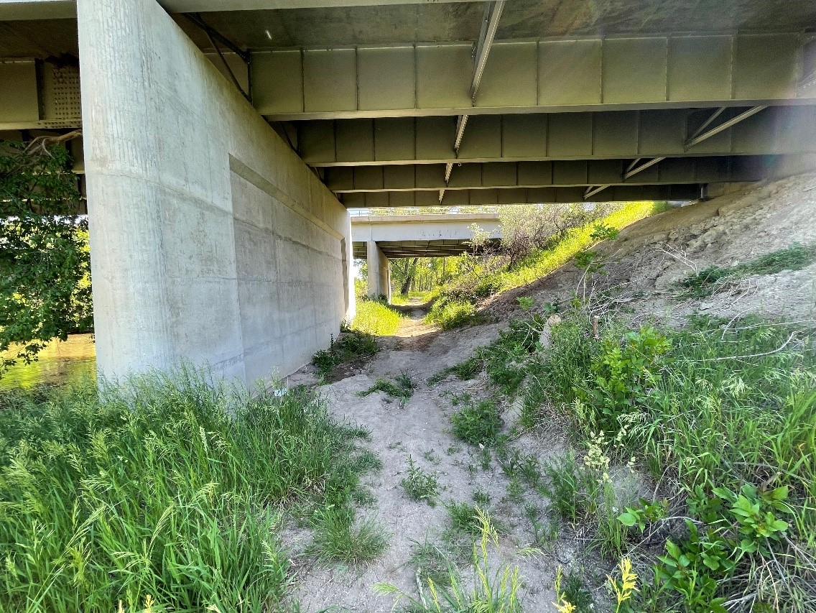
City of Sheridan:
Federal Award Amount: $250,000
Year Awarded: FY20
Project Type: TAP - Pathway
Notes:
Second Project
2 - Guernsey (Underpass) CD16206
How this project made a difference in the community:
The Walker’s Under the Bridge project was completed in the spring of 2018. This addressed the safety concerns of pedestrians and bicyclists getting across Highway 26 on the west side of the North Platte River bridge. The path was designed to provide a safe crossing of the highway without actually crossing traffic coming into Guernsey from the west. The path has been very beneficial to our community and it also doubles as a great fishing area for anglers.
What was learned/experienced from this project:
The WYDOT local program specialists were very helpful in the success of this project. The help that we received in picking an engineer and contractor made the project move forward and complete without any problems. They are there to answer any questions you may have about signage, construction, and procedures. The project is a great asset to the Guernsey community.
Advice for LPAs considering projects:
I would recommend all communities take advantage of the funding through WYDOT. It provides an opportunity to expand your recreation opportunities for community members as well as visitors in a fiscally responsible manner.

Slide 7
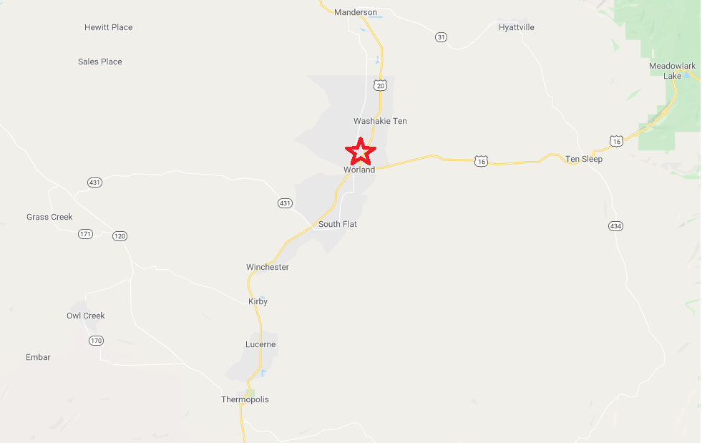

Slide 8
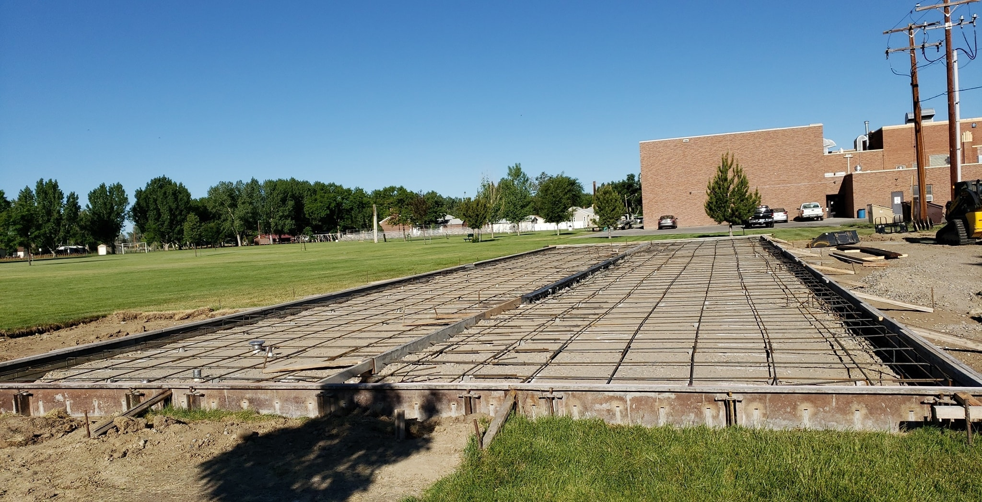
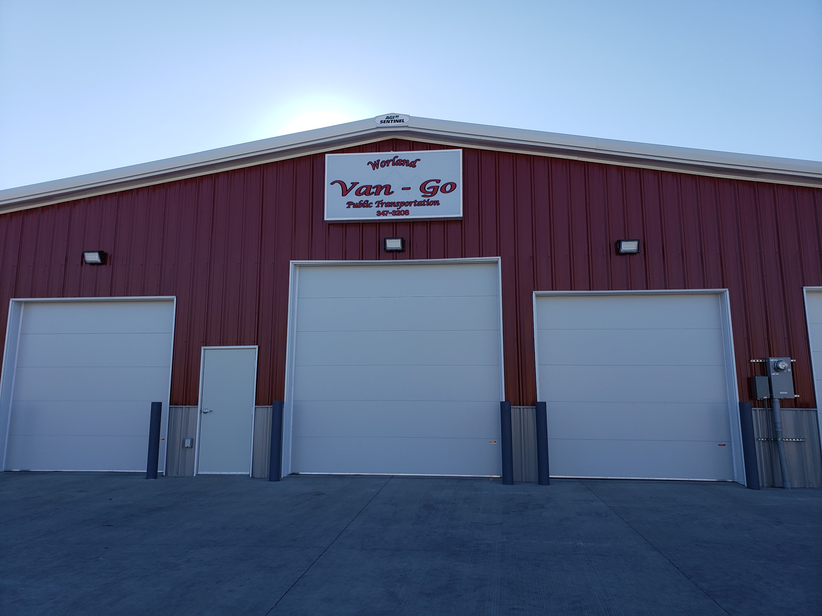
Washakie County Senior Center:
Federal Award Amount: $192,000
Year Awarded: FY18
Project Type: Public Transportation - Bus Garage
Notes:
Third Project
5 - Washakie County (Bus garage) slide made
How this project made a difference in the community:
With the completion of the garage, it enabled us to house our transportation vehicles. Having our fleet indoors adds longevity to them and lessens the exposure to the elements. It eliminates the difficulties caused by having our handicap accessible doors freeze shut, which prevented us from fulfilling our obligations to the community in the past. This will add years to the lifespan of our vehicles, cut down on fuel and man-hours, reduce maintenance expense, as well as provide a safe area to keep our vans secured.
What was learned/experienced from this project:
This project ended up being more in-depth than I would have ever imagined. This was five years in the making from obtaining the land to getting contractors, forming committees, and securing the match requirement. This is one of those things we don’t know how we ever survived without.
Advice for LPAs considering projects:
My advice to anyone taking on this kind of project would be to be patient. You will get there, it will be worth it, and your community deserves it. When the project is completed it will be amazing, we couldn’t wait and we are grateful for all the help along the way.

Slide 9
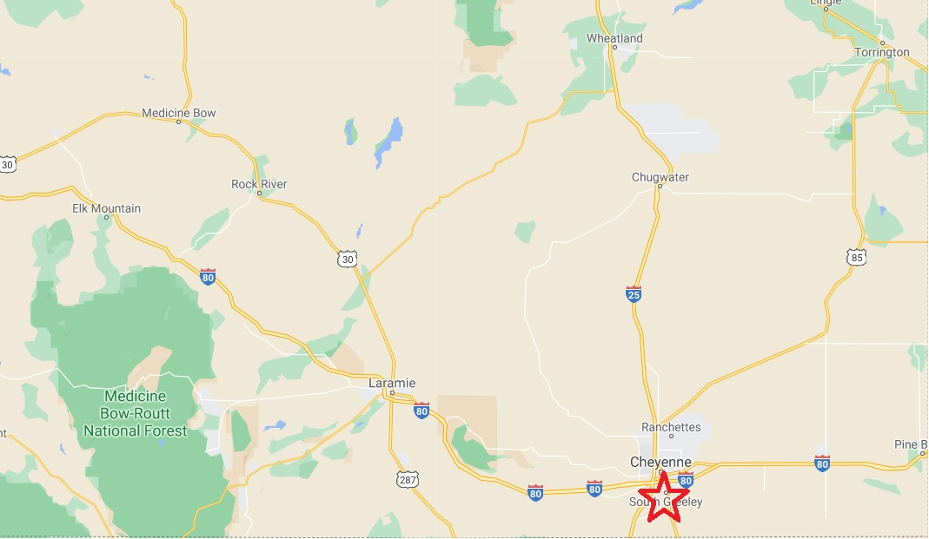

Slide 10
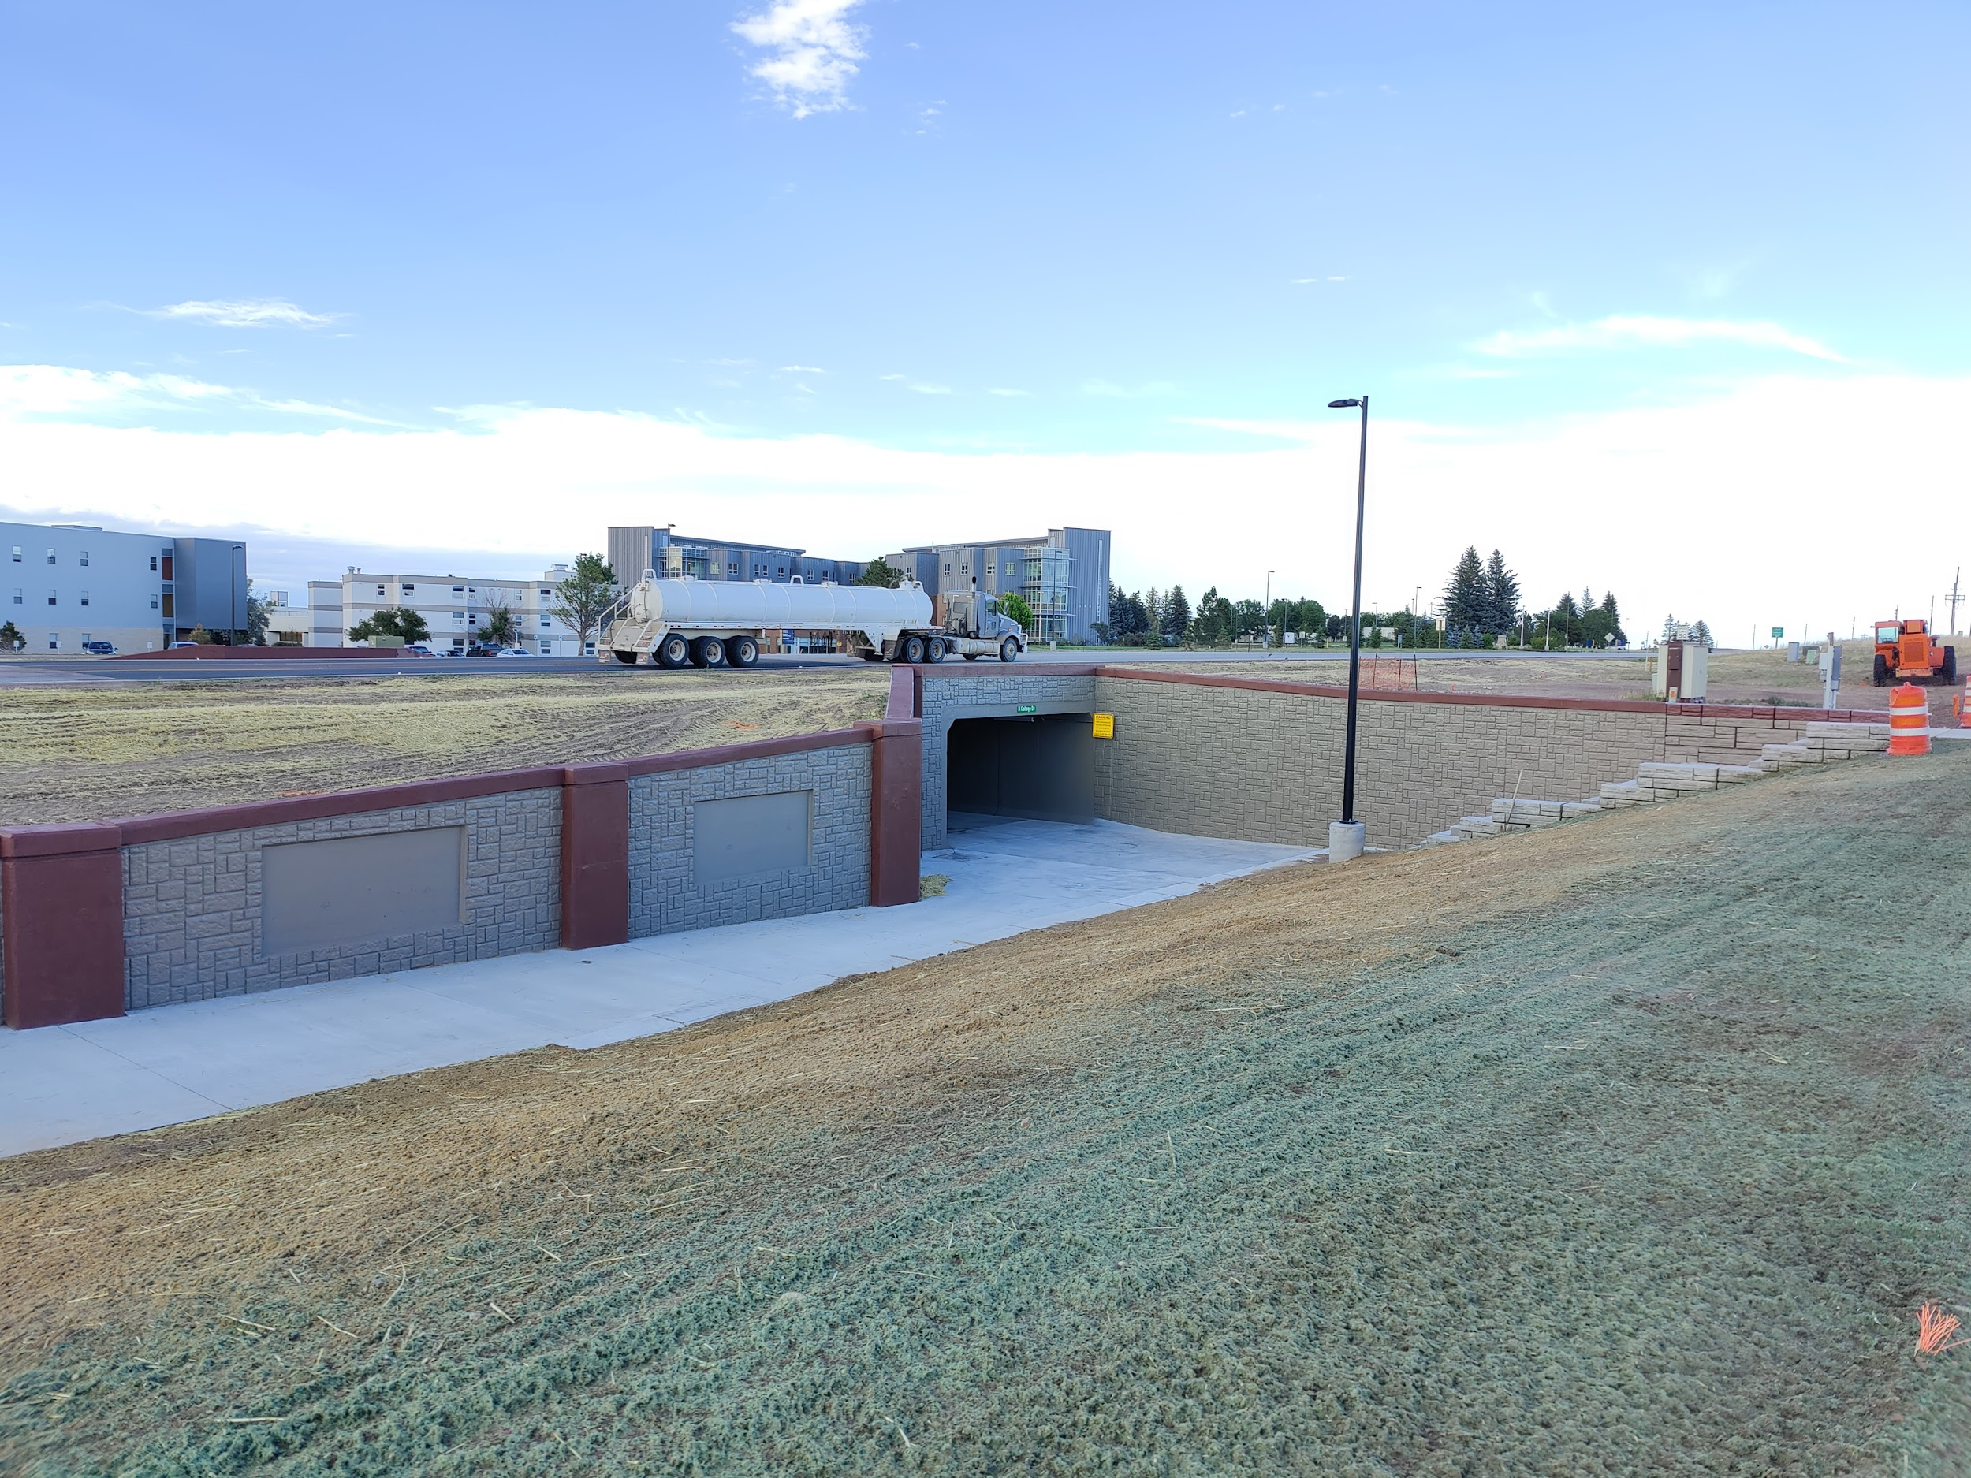
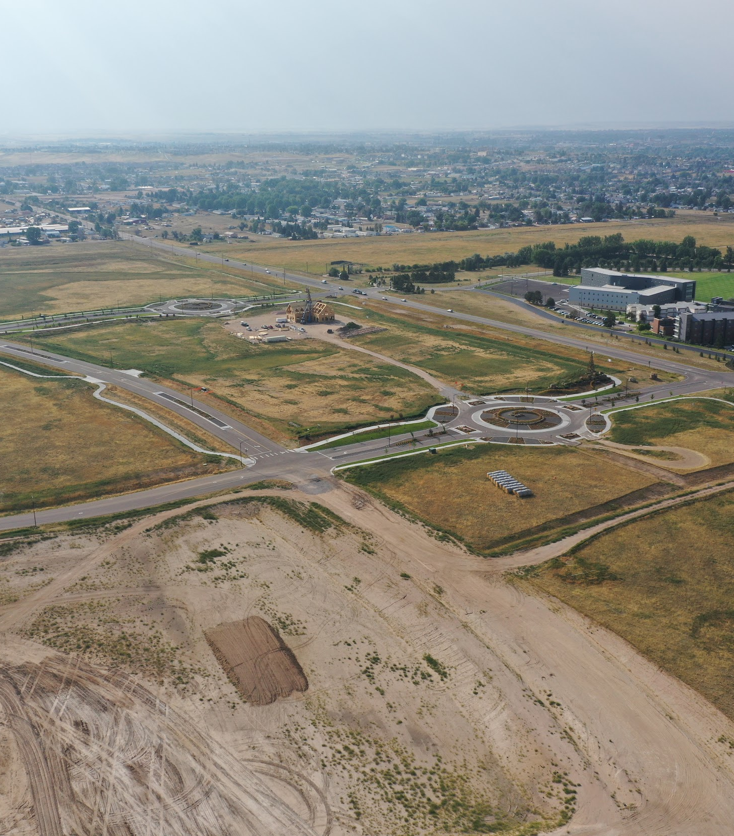
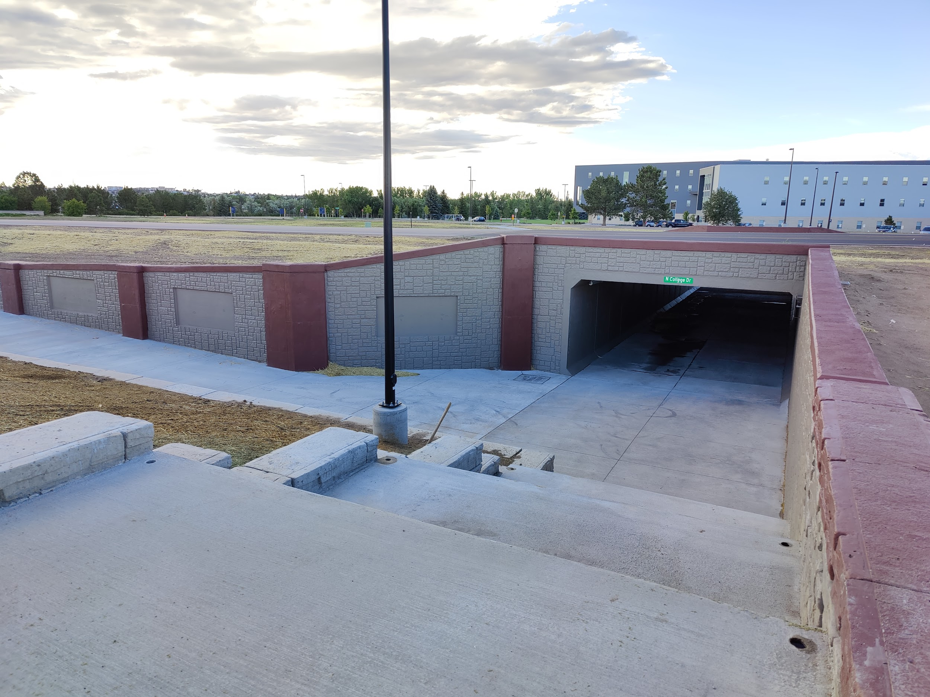
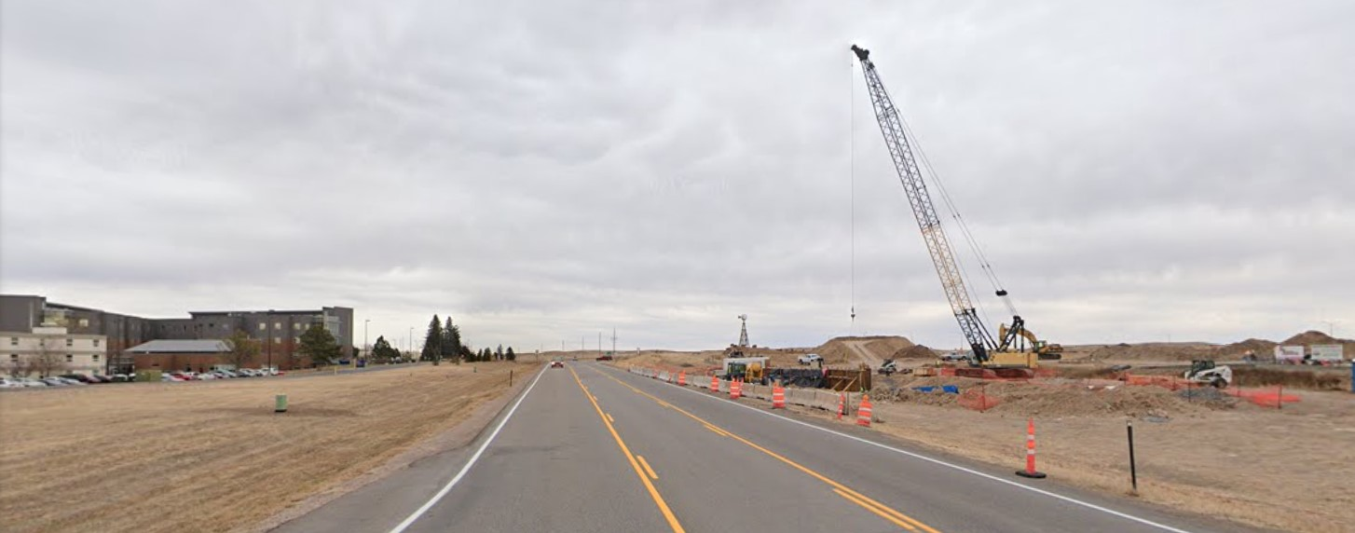
City of Cheyenne
Federal Award Amount: $500,000
Year Awarded: FY21
Project Type: TAP - Pedestrian Underpass
Notes:
Fourth Project
1 - Cheyenne - Allison Road (Pedestrian Safety and Traffic Calming)
How this project made a difference in the community:
This project provided much-needed safety improvements for students crossing Allison Road between two schools; especially during peak pick-up and drop-off times.
What was learned/experienced from this project:
There were several hurdles to overcome from beginning to end. After completing this project and experiencing all aspects of federally funded projects, future projects will run more smoothly as we know what to expect along the way.
Advice for LPAs considering projects: Transportation Alternatives funding is an incredible resource for communities looking to improve mobility and access for pedestrians. A lot of work is involved throughout the process but the payoff, in the end, is well worth it.

Slide 11
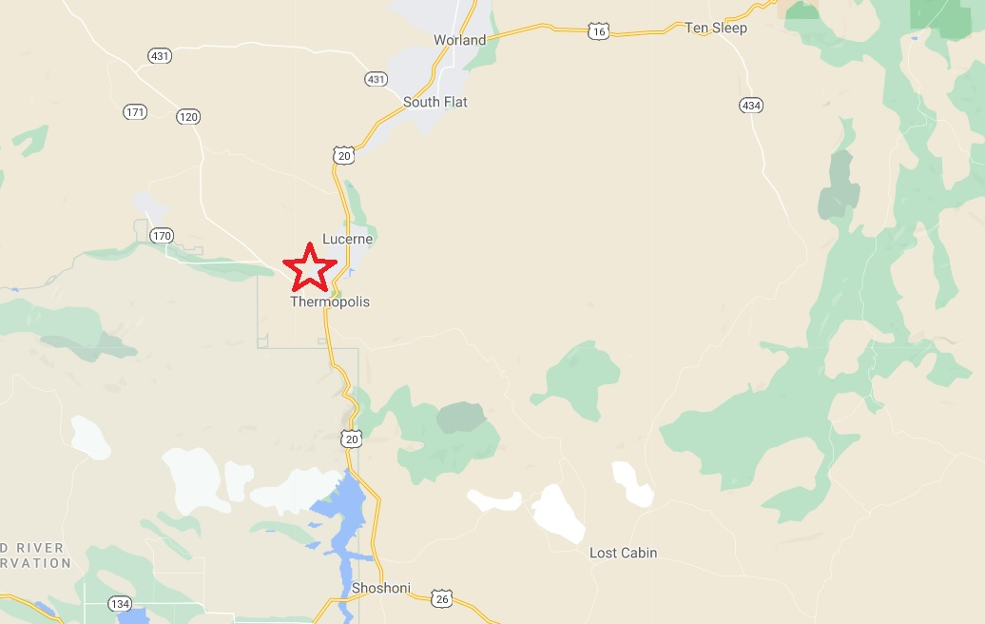

Slide 12
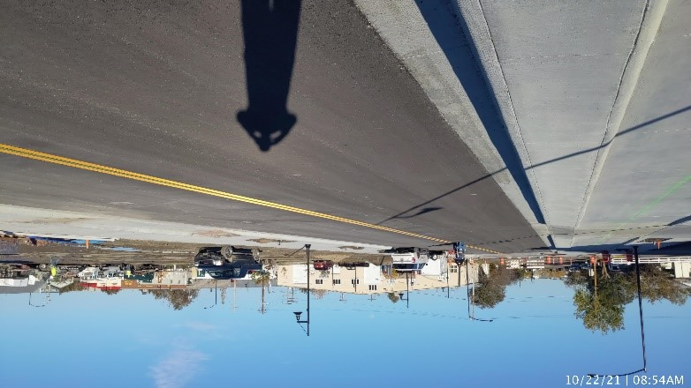
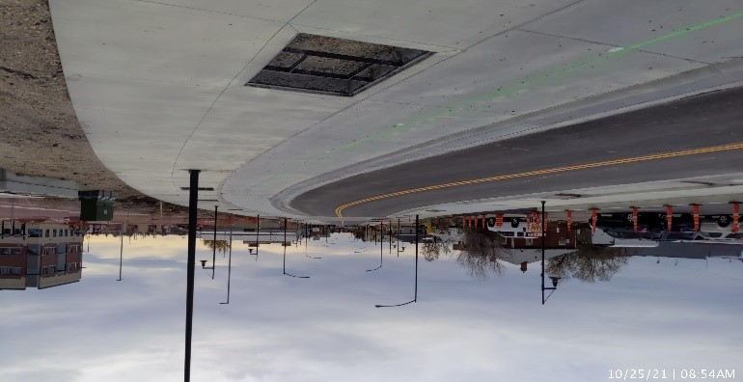
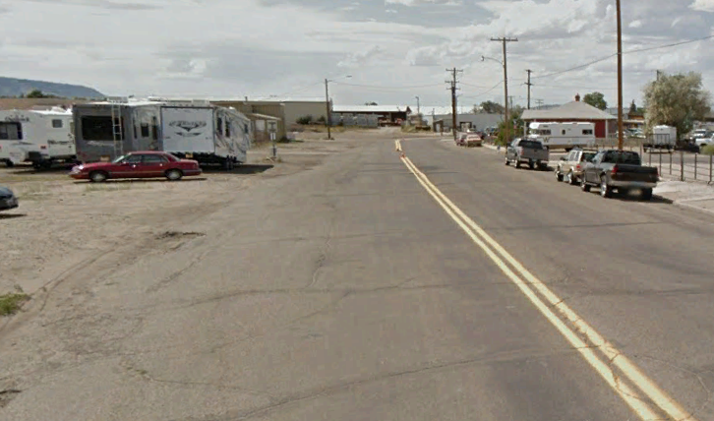
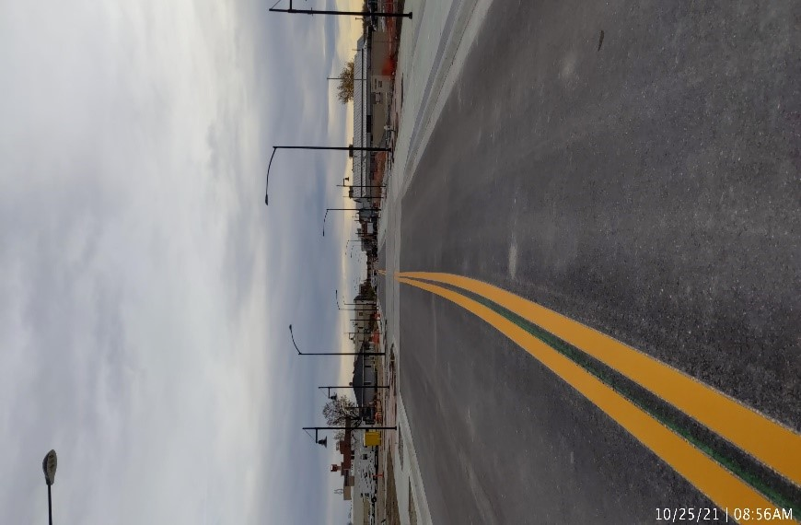
City of Casper
Federal Award Amount: $210,364
Year Awarded: FY20
Project Type: TAP - Bike Lanes/Pedestrian Development
Notes:
Fifth Project
4 - Gillette Boardwalk (Underpass and Connectivity)
How this project made a difference in the community:
This project is one of a series of projects tying the western portion of the city to the eastern portion, along with many parks, the Gillette College, and the commercial areas of the community. This project was the second portion and we have experienced at least a doubling of our biking and a substantial increase in walking and running in our city. We have also noted that community interest in our quality of life is being vocalized by citizens.
What was learned/experienced from this project:
As the LPA Coordinator for the City, I have experienced many ups and downs in the process. The major benefit is that funding from outside the City can be used to expand our budgets so that we can provide for citizens and are experiencing growth of our community in part from the quality of life we are offering all members of our City. The major downfall is that the process is somewhat slow and interested parties start to lose interest and not see the trails go in as fast as they would like. Being in local government for many years the program is one of the best ways to make improvements and get the best bang for the buck.
Advice for LPAs considering projects:
The City of Gillette has been using TAP funding for many years which started with the safe routes to school program and crossing improvements for individuals whose use of vehicles are limited to creating a pathway system that allows for all uses of non-motorized travel and brings the community together. We must recognize that the strains of the city’s budgetary process many times do not allow a community to perform everything the citizens would like, but the use of the TAP program is a way of moving the town into the years to come. Keep trying and plan well.

Slide 13
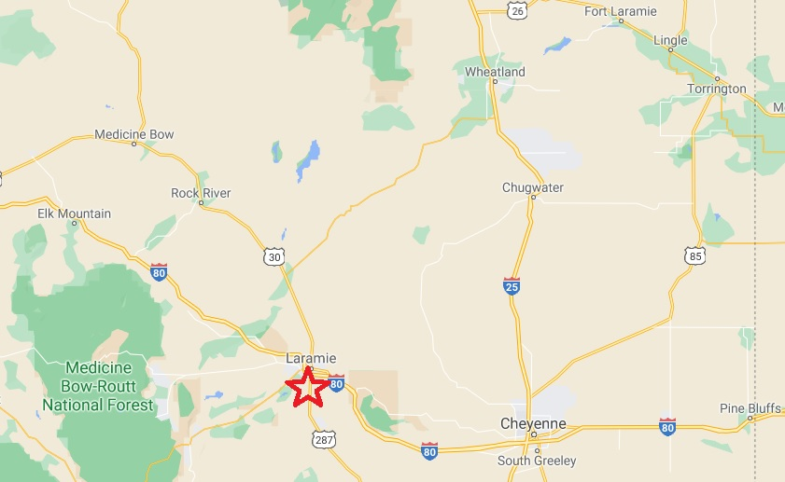
Map for each

Slide 14
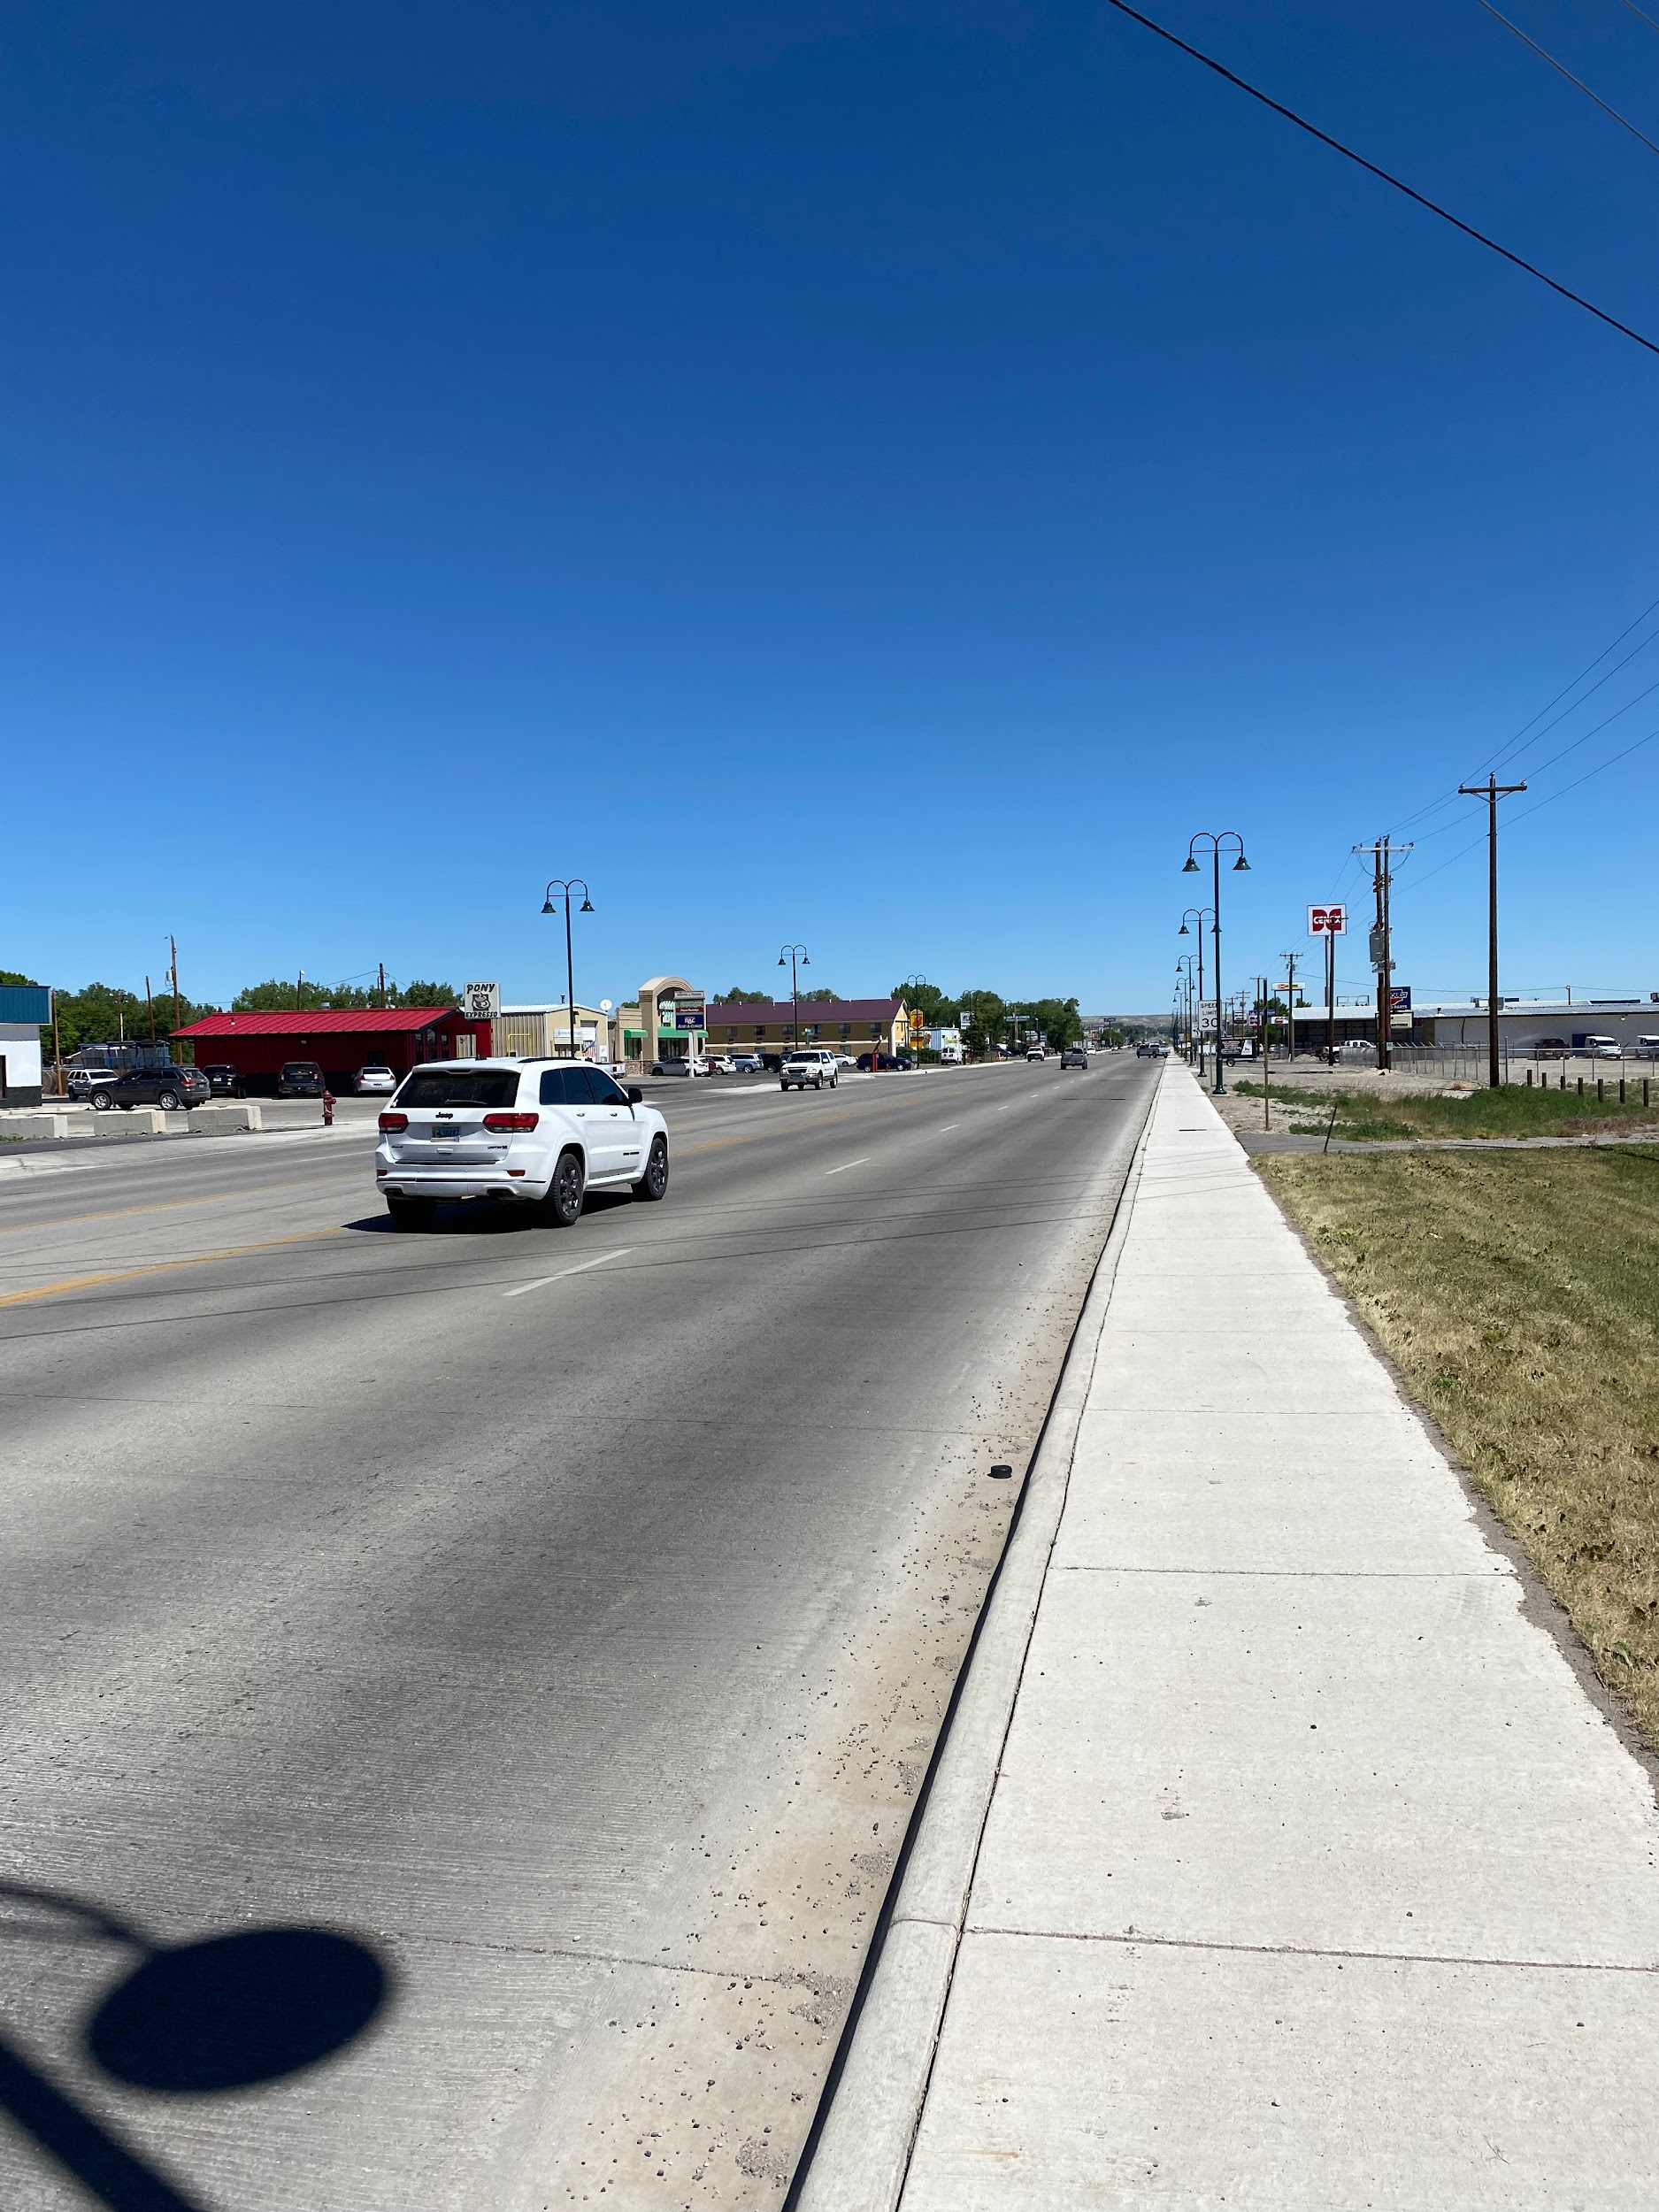
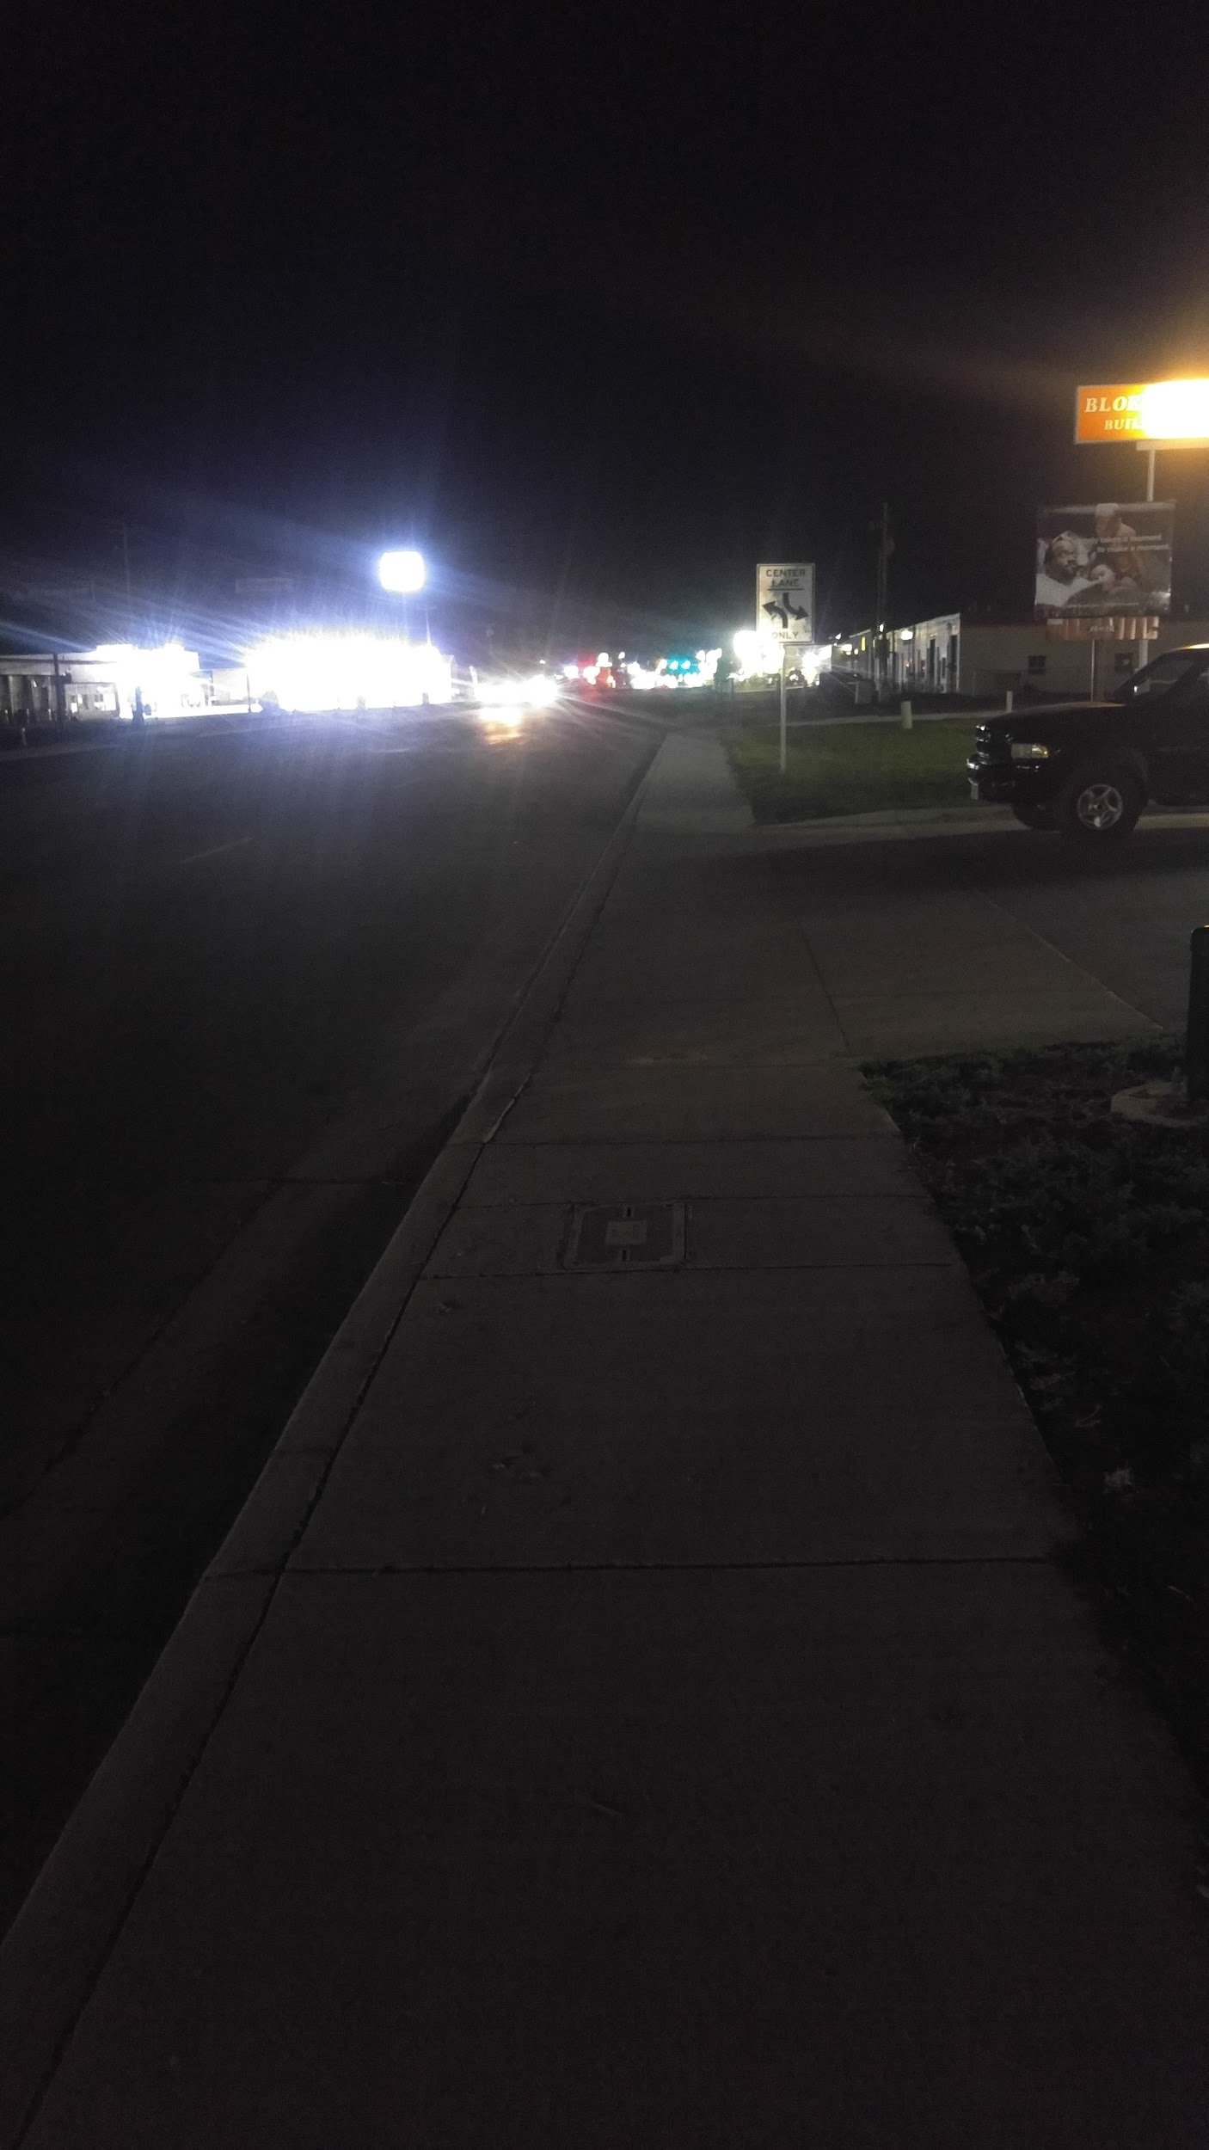
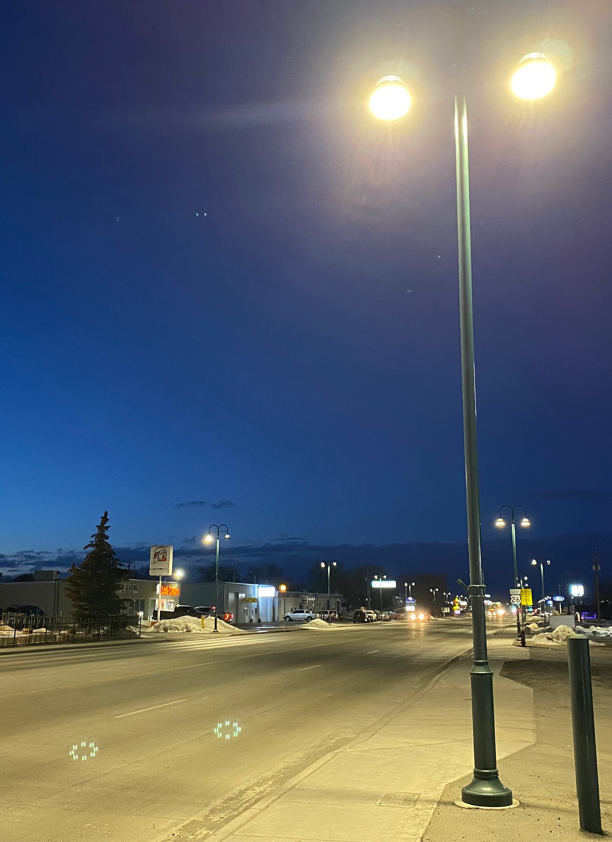
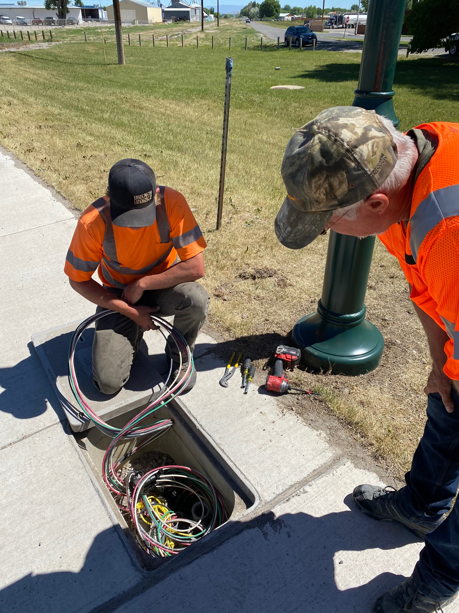
City of Riverton
Federal Award Amount: $437,488
Year Awarded: FY21
Project Type: TAP - Pedestrian Safety & Lighting
Notes:
Eighth Project
1 - Laramie's Spring Creek design project (Design - Pathway)
How this project made a difference in the community:
The City of Laramie is proud to have received a Transportation Alternatives Program award the Spring Creek Trail Phase 1. This project is the starting point for a future trail that will connect 30th Street to 3rd Street. This trail when completed will provide valuable, safe non-motorized transportation options for Laramie residents by connecting south Laramie to east Laramie. When completed this trial will allow residents and users to access schools, retail shopping areas, and fellow community members through a safe trail system. The funding received for this planning project provided the ability to design the “most difficult” portion of the trail connecting 30th Street to LaPrele Park. Often times when beginning a new trail system, the hardest part is getting started. Without the assistance of this award, the City of Laramie may not have been able to begin the process. We anticipate constructing Phase 1 of the designed trail in 2023.
What was learned/experienced from this project:
I can’t say enough about the LPA process and the benefits of the training provided by WYDOT’s Local Government Specialists. The training is fun and chalked full of valuable information. WYDOT’s staff is very, very good to work with. They are always knowledgeable, quick to respond to questions, and finding ways to help support these projects as they move through some of the requirements of the Federal Highway Administration.
Advice for LPAs considering projects:
The advice I would give anyone planning to apply for a future grant includes
1. Start the process early. Reach out to the WYDOT Local Government office and discuss the project prior to applying. Make sure it fits the program, that it is easy to understand, that it is of value to your community.
2. Ask questions. WYDOT’s Local Government Specialists are great to work with. It’s better to ask questions and get answers than to make a mistake.
3. Involve your local WYDOT District Engineer. The knowledge and support of the District Engineer is vital to your success.

Slide 15
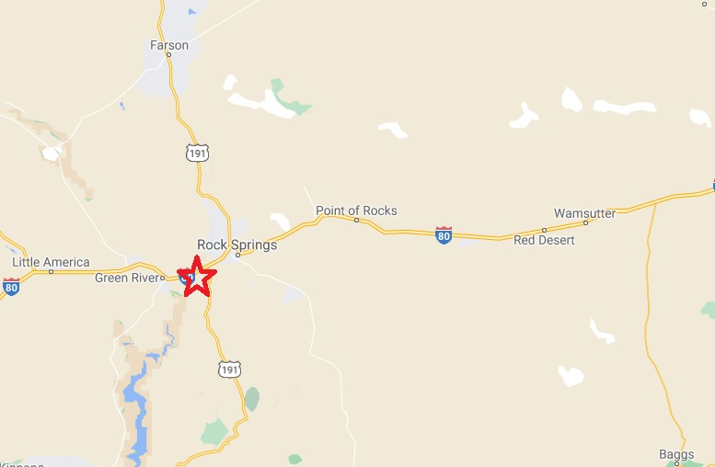
Map for each

Slide 16
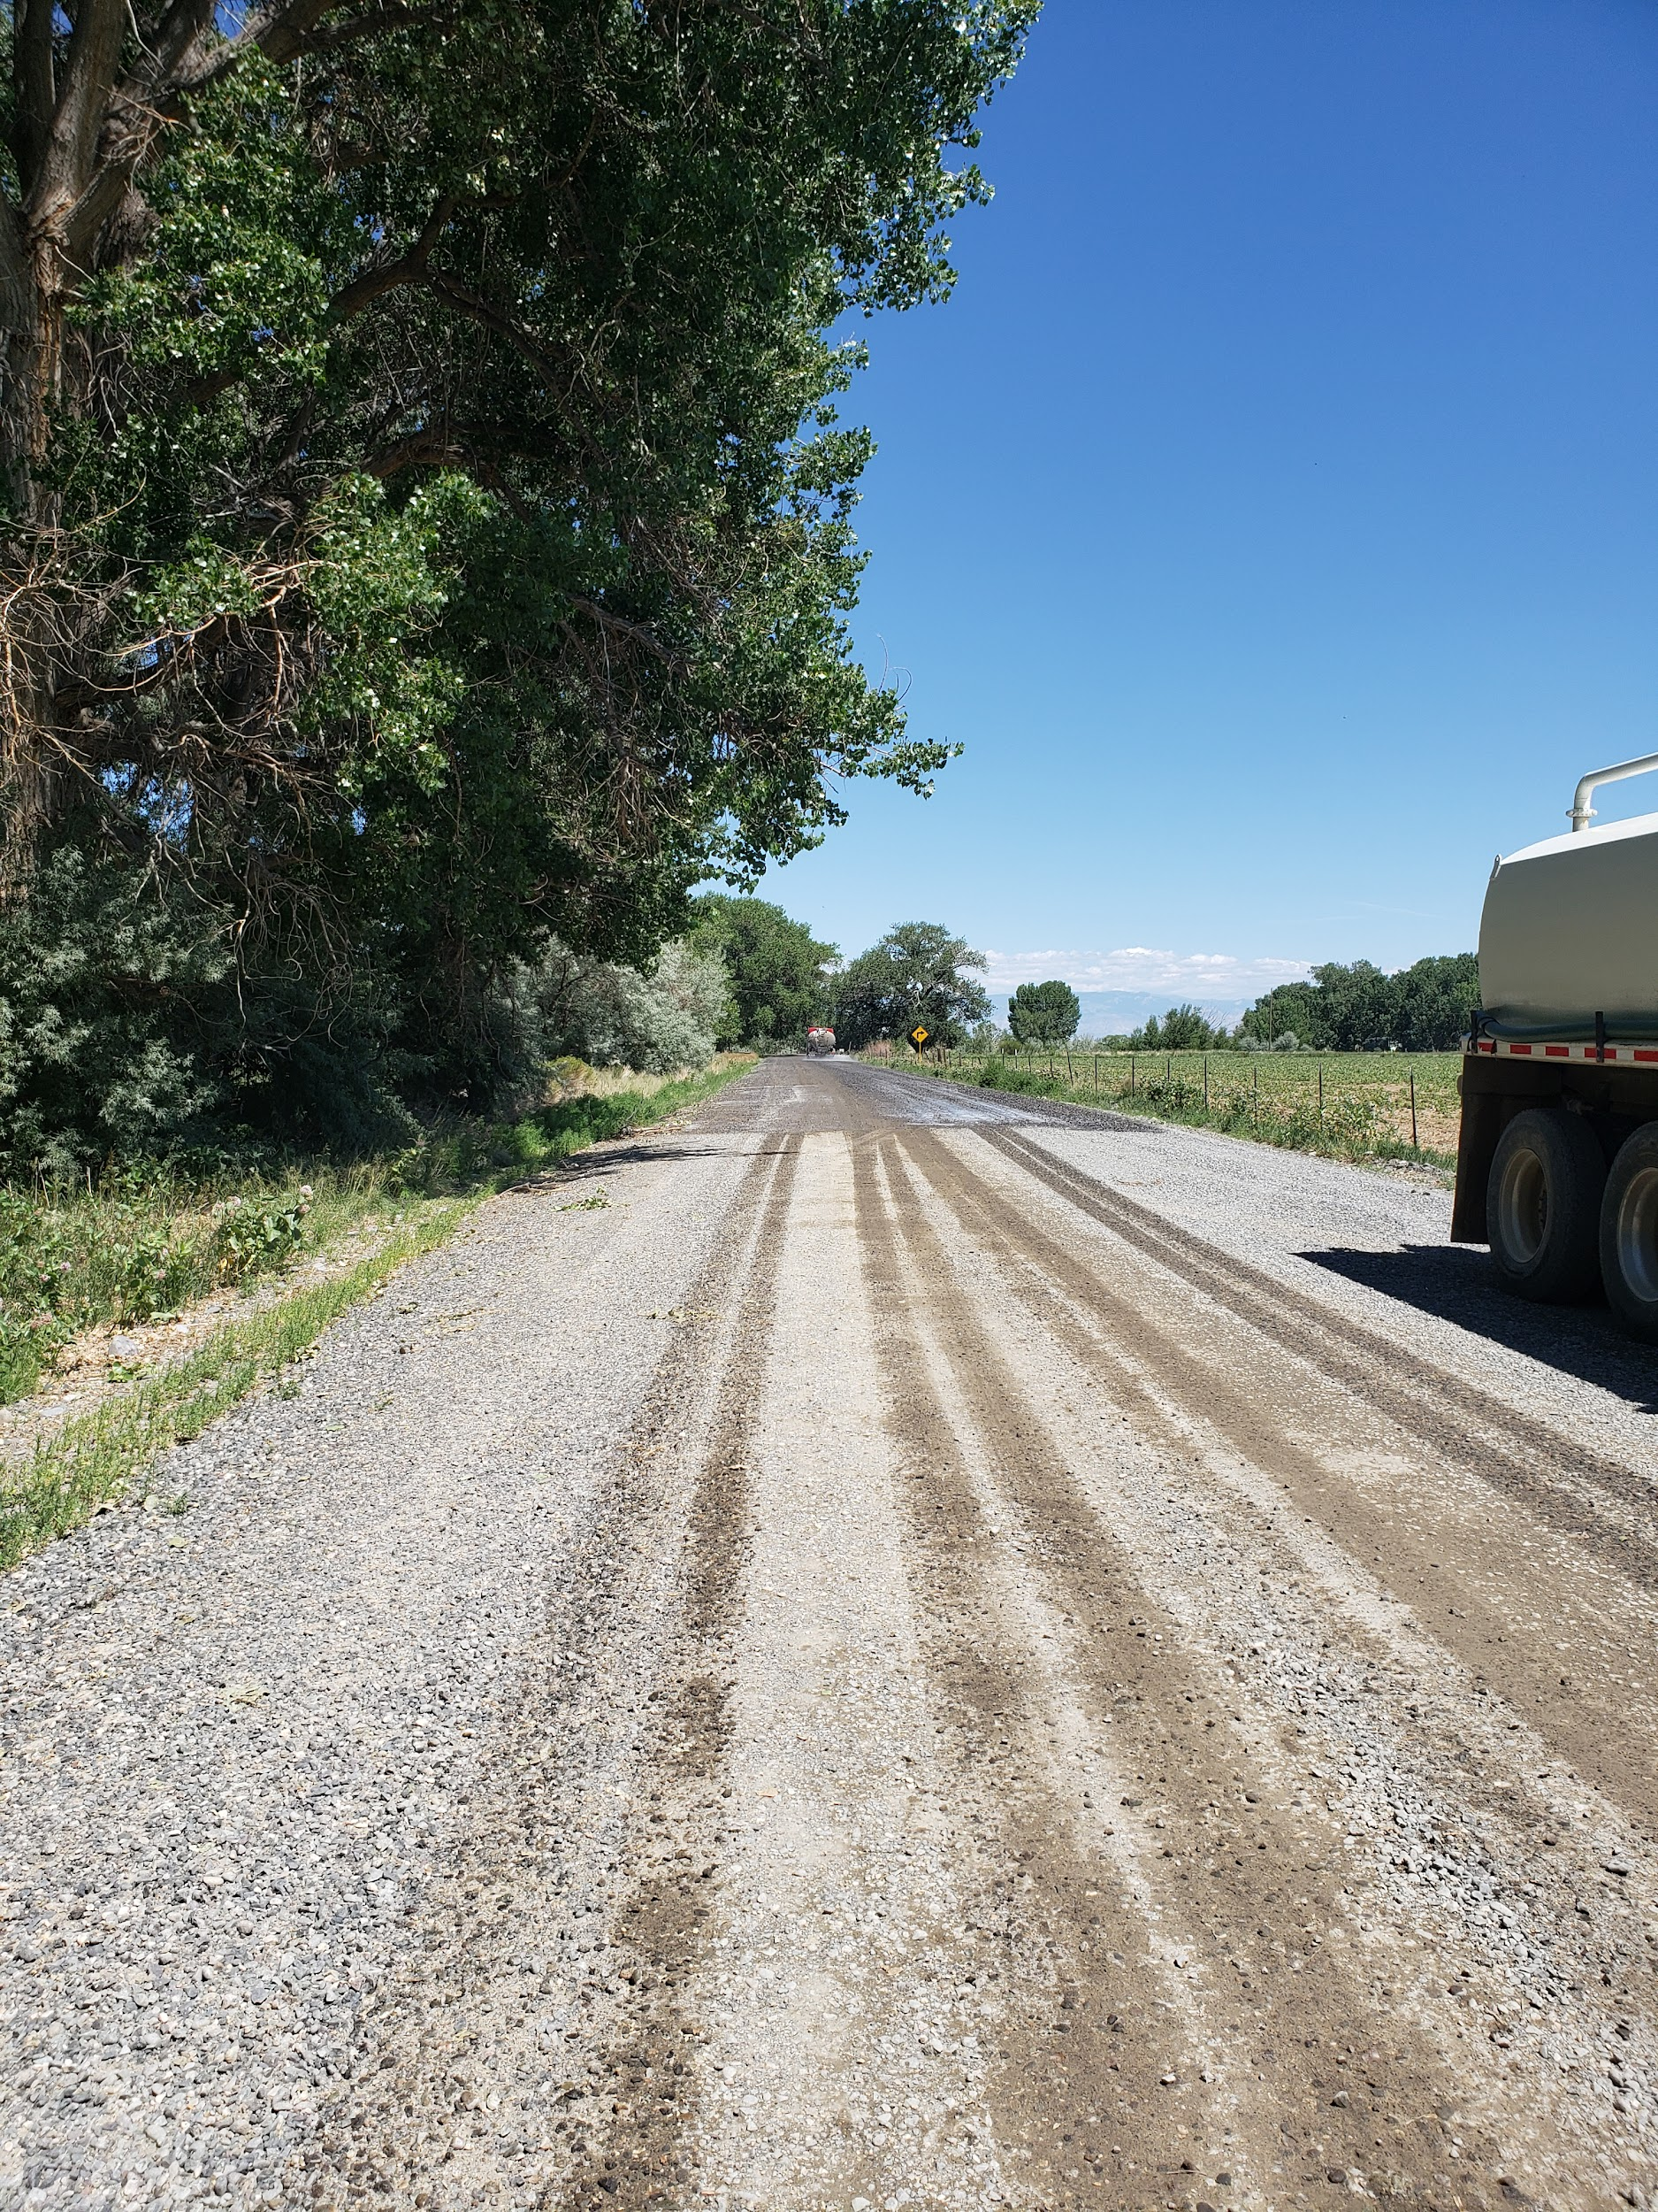
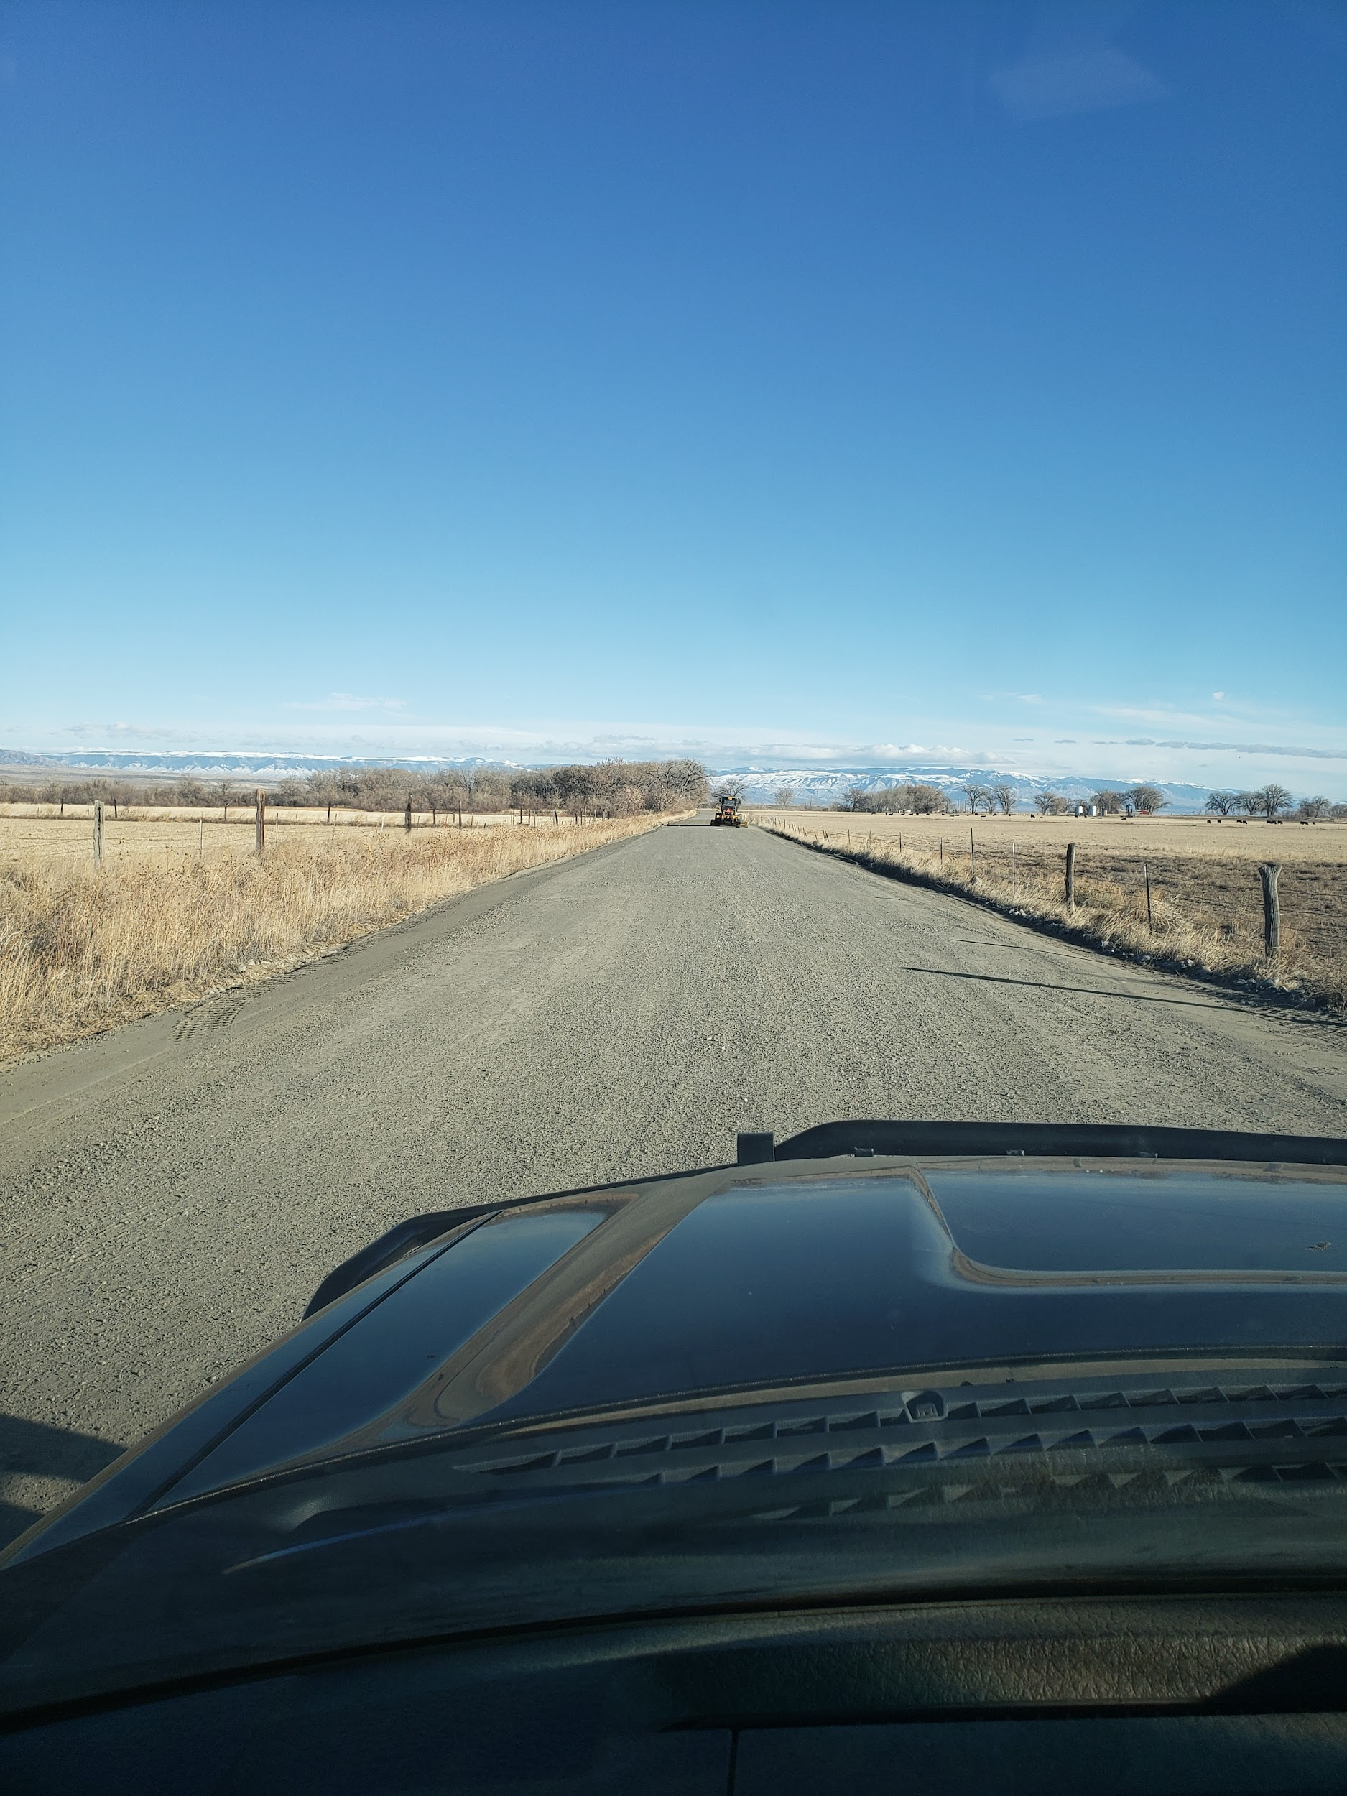
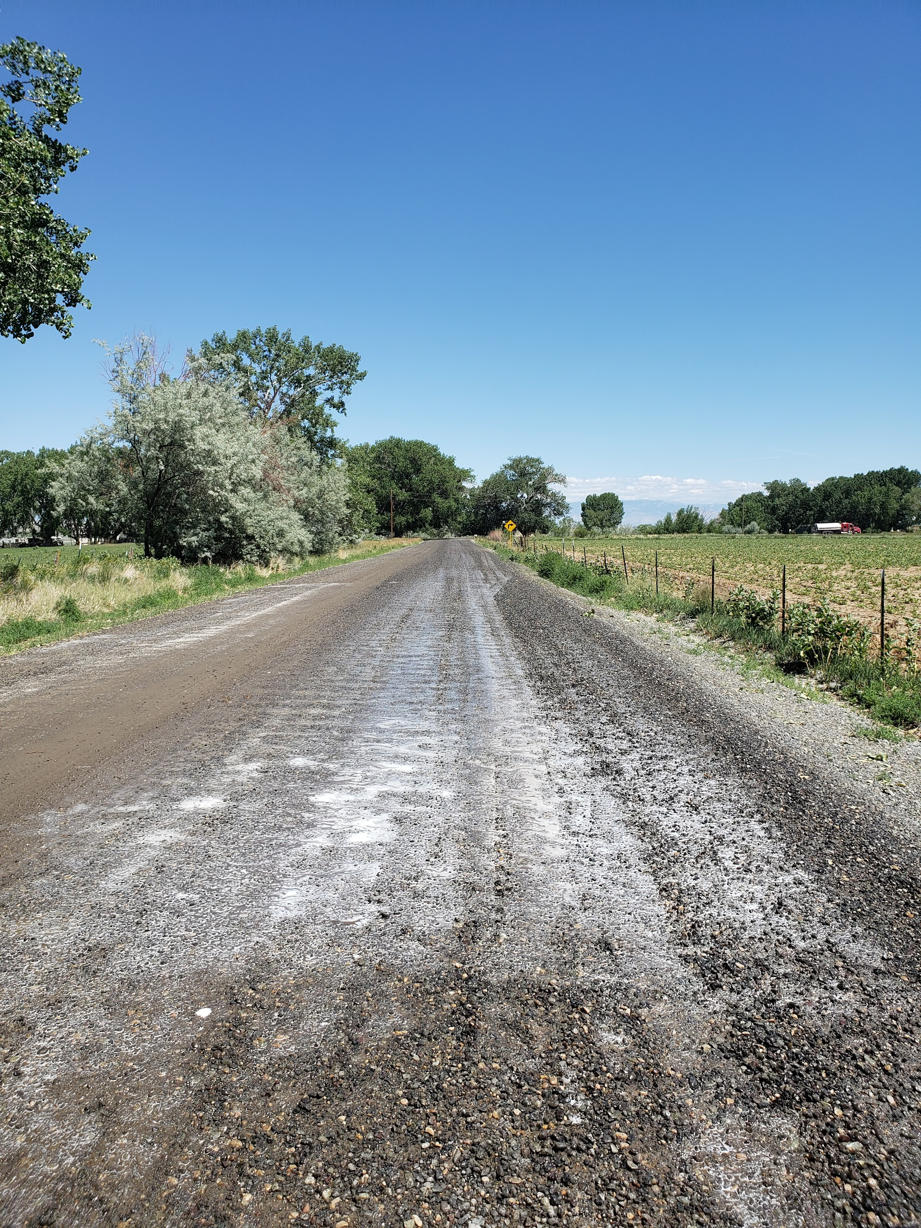
Park County
Federal Award Amount: $71,040
Year Awarded: FY21
Project Type: CMAQ - Chemical Dust Suppression
Notes:
Ninth Project
3 - CMAQ - Sweetwater (Chemical Dust Suppression)
How this project made a difference in the community:
Sweetwater County has used magnesium chloride on its roads for dust suppression for more than 25 years. The impact that applying magnesium chloride on our county roads and more importantly the impact that the CMAQ projects have on these roads is very hard to quantify. This project allows Sweetwater County to do more miles of roadway than we would do without the CMAQ money. More miles of roadway equates with more people that are positively affected by these types of projects. This effect comes from safer roads (through better visibility), a better quality road surface (less wear and tear on vehicles) because we can keep the fine particles on the road surface longer. These fine particles bind the base together and prevent raveling and washboards. The more particles we can keep on the roadway the longer our road lasts. Transportation costs in Sweetwater County on gravel are the main costs we deal with when it comes to placing a roadbase. We only have three (3) suppliers within Sweetwater County and all of their pits are within a 25 square mile area located along the Green River. These pits are located 80 plus miles away from our most heavily used industrial roads in the county. The more material that I can not lose to dust the less material that I have to haul.
What was learned/experienced from this project:
The LPA process is very easy to go through because of the staff. The staff at WYDOT is very willing to help with questions regarding the process or application wording. They have always been very responsive and timely with their answers. They are willing to give you advice and review your application before the deadline. I have only been submitting going through the LPA process for four (4) years and the first time I was very nervous about it. Thanks to the staff at WYDOT they made the process very easy to understand and simple to go through. I wish all federal grant money was this easy and simple to apply for.
Advice for LPAs considering projects:
Since I am selfish and I don’t want to share the limited pot of CMAQ money with any more people than we have to. I would tell them not to apply. In all honesty, I would take a look at all of the different ways that a project of this type can benefit your roadway system. When you benefit your roadway system by keeping it well maintained it benefits the public that travels our roads.

Slide 17
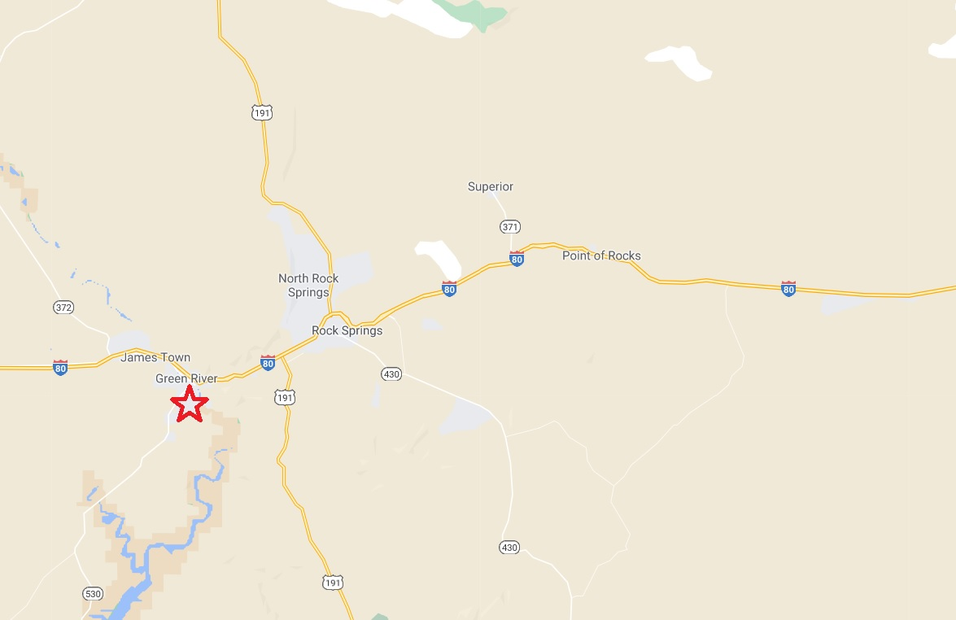

Slide 18
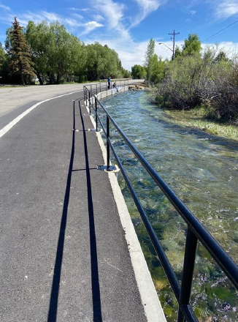
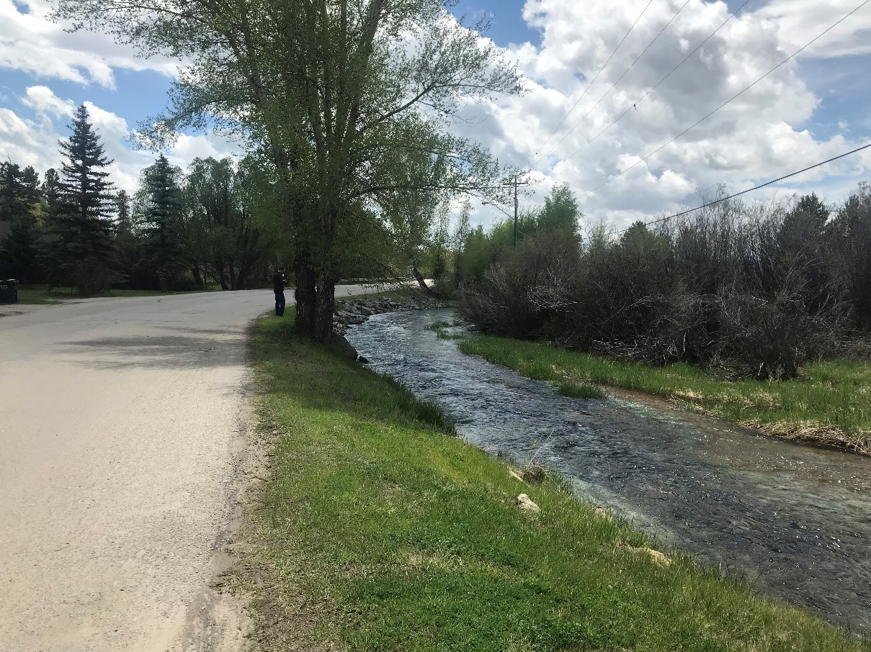
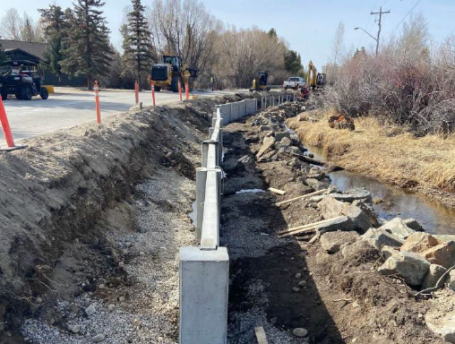
Town of Pinedale
Federal Award Amount: $618,840
Year Awarded: FY19 & FY21
Project Type: TAP - Multi-Phase
Notes:
Seventh Project
3 - Green River (ADA) CD16308
How this project made a difference in the community:
The project was designed to address ADA ramp compliance at three intersections in the city. Project locations were selected not only to address ADA compliance deficiencies, but due to the locations being adjacent to low-income, senior, and disabled housing, and an elementary school. This project has allowed easier access for individuals to walk their grandchildren home from the adjacent elementary school. It allows low-income and disabled residents easy access to the only grocery store in the city and a pharmacy. Most importantly it provides a sense of freedom and independence to individuals in their daily lives.
What was learned/experienced from this project:
Our experience through the LPA process was positive. The LPA staff was great to work with and helped us through any question that came up. With any project there are unknowns, but through these unknowns, lessons are learned. All anyone can do is to take these lessons and keep moving forward with the LPA process. The LPA staff was always reachable when I had a question and was very helpful. Bundling will get your community a better bang for your buck. Our project started as a single ADA issue, but we were able to see similar situations in the area. We bundled these together to make a more effective project.
Advice for LPAs considering projects:
My advice to any community considering applying for an ADA project is to take a holistic look at your community. Don’t submit a project just to spend money or to pacify a single citizen. Look at the challenges your residents face. With the match on the awards, it only takes a small dollar amount to install ADA ramps. Small projects can make a large impact. Think of those grandparents that can now safely navigate sidewalks with their motorized wheelchair in order to walk home with their grandchild after school. That time and those conversations cannot be replaced. What would each of you give to have one more conversation with your grandfather?

Slide 19
Map for each

Slide 20
Sponsor Name:
Federal Award Amount:
Year Awarded:
Before and after pictures

Slide 21
Map for each

Slide 22
Sponsor Name:
Federal Award Amount:
Year Awarded:
Before and after pictures

