Slide 1
Consultant Selection, Negotiation, & Contract Execution
Hank Doering, P.E.
Engineering Services Engineer

Slide 2
Consultant Agreements - LPA
Handouts
Handout # 1: Local Public Agency Guidelines
Handout # 2: Consultant Services Policy
Handout # 3: WYDOT Consultant Selection Procedure & Forms
Handout # 4: Determination of Consultant Audits for Local Public Agencies (LPA)
Handout # 5: Consultant Risk Assessment – Audit Type
Handout # 6: WYDOT Consultant Performance Review Form

Slide 3
Consultant Agreements - LPA
Handout # 1 – Local Public Agency Guidelines
Handout # 1 describes requirements for LPA’s to follow for consultant procurement
LPA’s are required to have a written policy describing procurement procedures
LPA’s have 3 options to develop their policy:
Use the Template Policy that WYDOT has developed (Handout # 2)
Modify WYDOT’s Template Policy
Develop your own policy

Slide 4
Consultant Agreements - LPA
Handout # 1 – Local Public Agency Guidelines
If LPA’s adopted WYDOT’s Policy use Handout # 2 and fill in the red italics with the LPA name
If LPA’s choose Option 2 or 3, then the LPA’s need to ensure:
Policy is in writing
Policy addresses all 18 items as described in 23 CFR 172.5(c)
Policy must be approved prior to procurement

Slide 5
Consultant Agreements - LPA
Handout # 2 – Consultant Services Policy
Key items described in LPA template policy
Definition of Architectural & Engineering (A&E) services
Services that are A&E in nature which require a license
Services that alter real property
Services that an individual in A&E profession would normally perform
Federally funded A&E agreements must follow the Brooks Act
Brooks Act = Qualification-based selection

Slide 6
Consultant Agreements - LPA
Handout # 2 – Consultant Services Policy
Section II. Consultant Procurement – General
2 consultant selection processes
Informal consultant selection when total agreement amount < Simplified Acquisition Threshold (SAT)
Formal consultant selection when consultant services > SAT
SAT is currently set at $250,000
If using County Road Fund Manual, SAT is set at $50,000
Total agreement amount includes change orders

Slide 7
Consultant Agreements - LPA
Handout # 2 – Consultant Services Policy
Section IV. A – Small Agreement-Estimate cost < SAT
Informal Selection
Generate a consultant list, either from WYDOT Engineering Services or generate your own list
Consider a minimum of 3 firms from the list
Qualification based selection (no fee proposals!!!)
Review Statements of Interest of the 3 firms
Select the consultant and document the basis of selection

Slide 8
Consultant Agreements - LPA
Handout # 2 – Consultant Services Policy
Section IV. B – Large Agreement-Estimate cost > SAT
Formal Selection
LPAs may solicit for Letters of Interest through a public announcement and/or a consultant registry
A minimum of 7 days for an announcement period & a minimum of 5 firms should be short-listed to receive an RFP
Non-select letters should be sent to the firms who were not short-listed
LPAs may go directly to the RFP process
A minimum of 14 days for an announcement period

Slide 9
Consultant Agreements - LPA
Handout # 2 – Consultant Services Policy
Section IV. B – Large Agreement-Estimate cost > SAT
Formal Selection
RFP must include specific items
Scope of Work
Technical requirements
Evaluation criteria & weighting factors
Anticipated schedule for selection
CNTE or Lump Sum agreement
Whether or not interviews will be conducted
Will consultants be able to submit questions
Answers need to be provided to all consultants

Slide 10
Consultant Agreements - LPA
Handout # 2 – Consultant Services Policy
Section IV. B – Large Agreement-Estimate cost > SAT
Formal Selection
Selection committee meeting
Review all proposals & supporting documentation
Complete the evaluation, ranking, & selection process
LPAs must notify all respondents who the top 3 firms were in ranking order
Retain documentation supporting solicitation, received proposals, evaluations, and selection
WYDOT Grant Administrator must approve LPA’s selection before proceeding

Slide 11
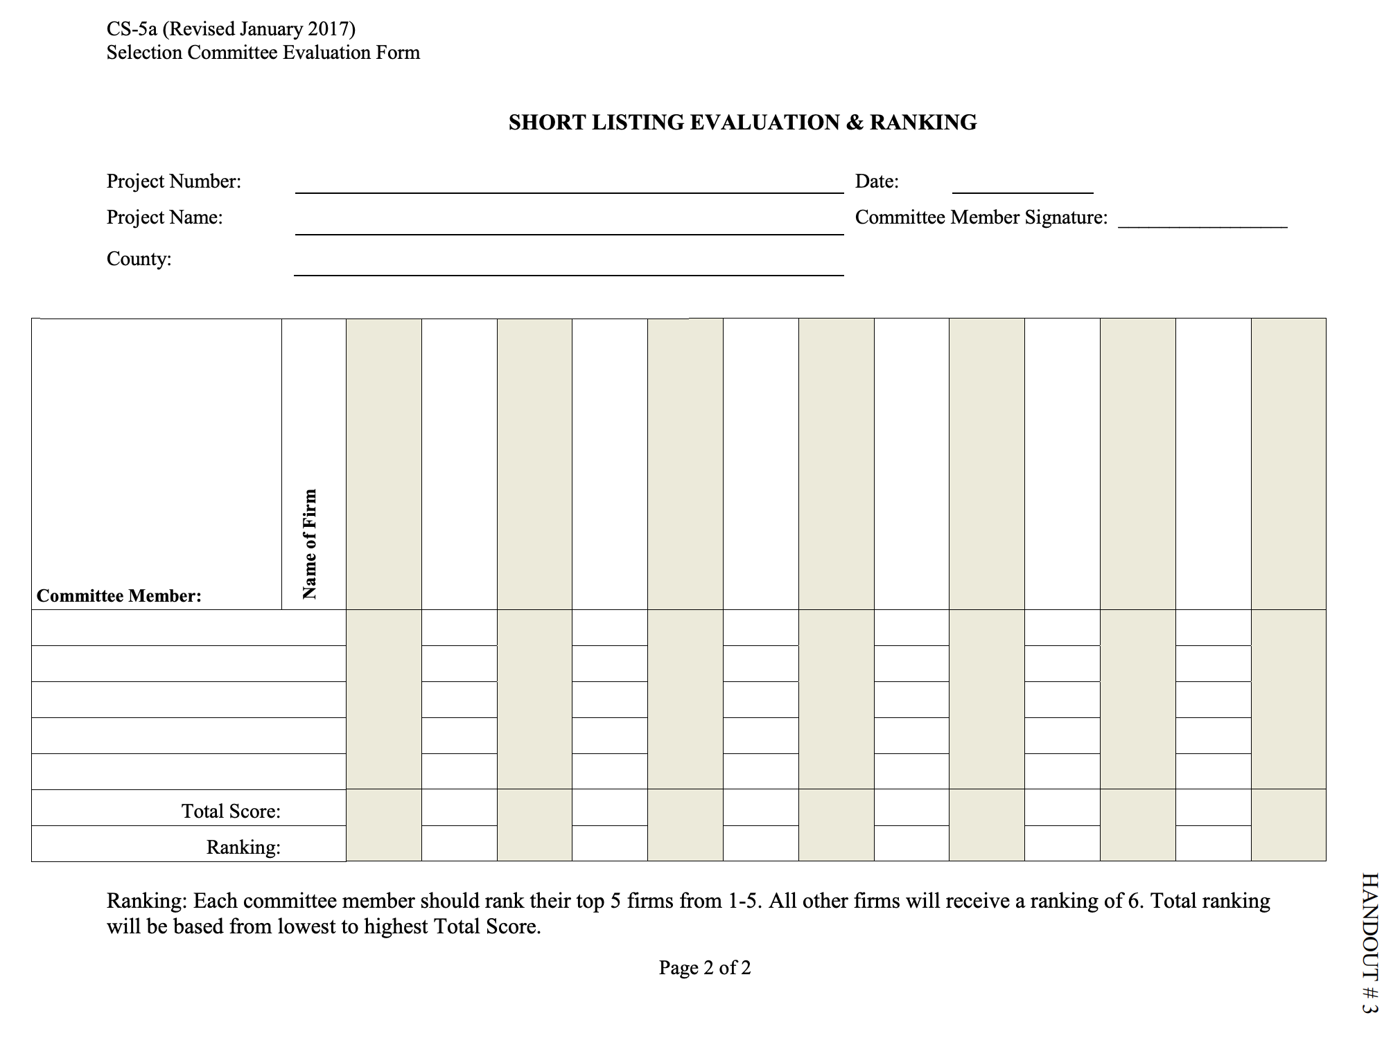
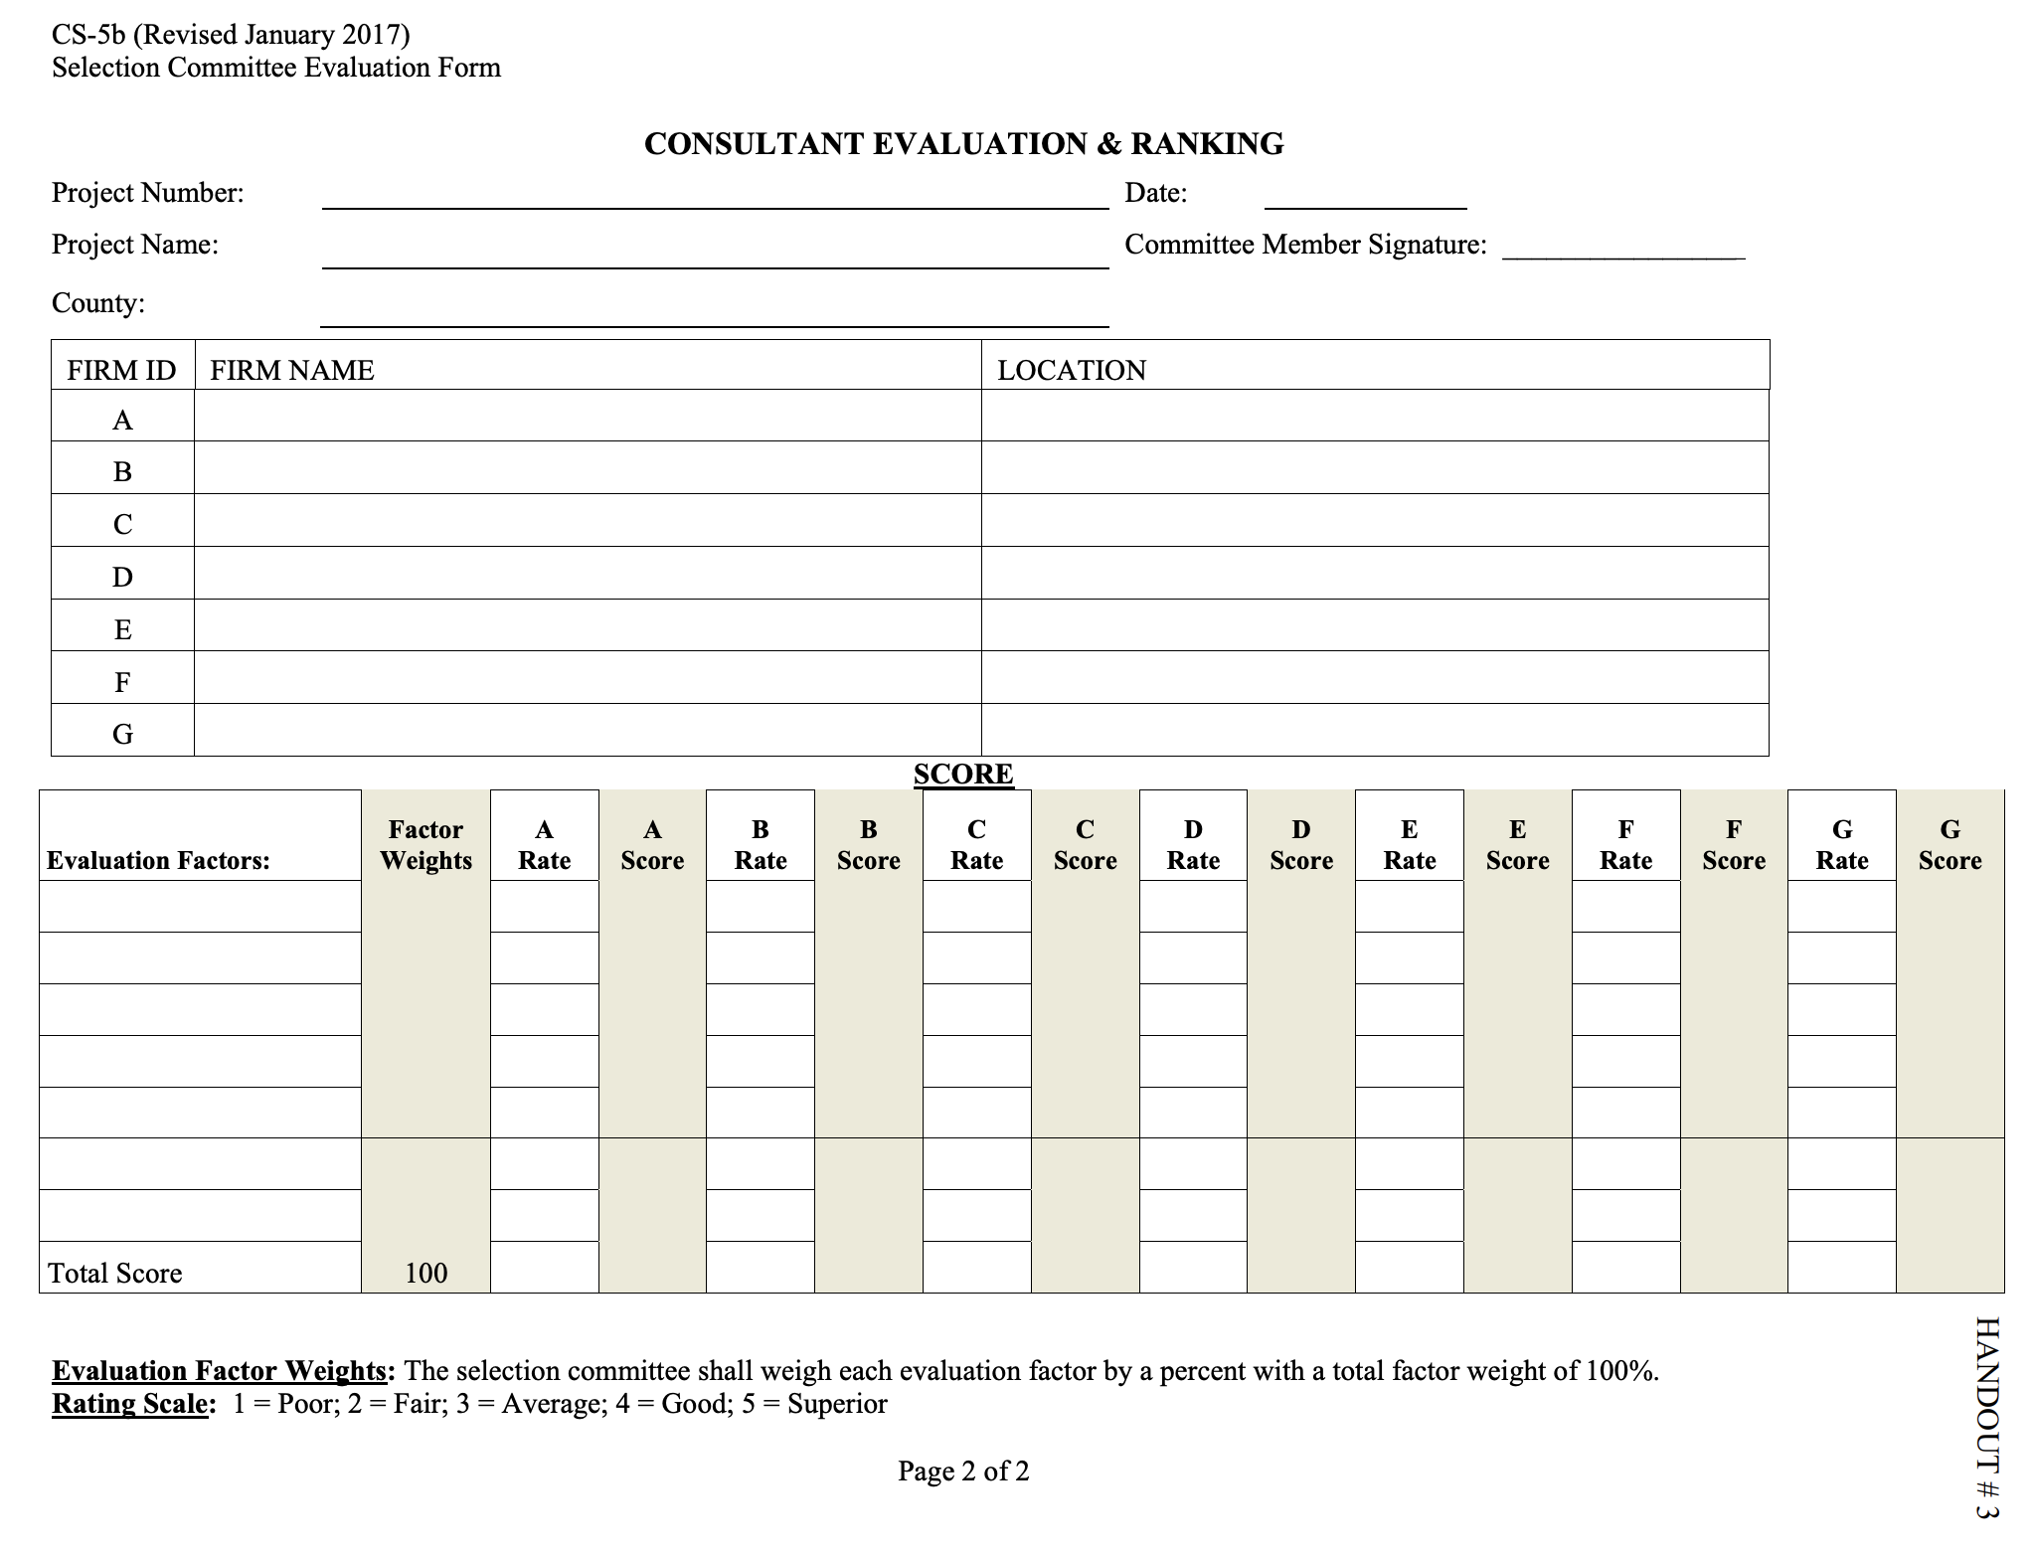
Consultant Agreements - LPA
Handout # 3 – Consultant Selection Forms
Short-listing form
Consultant Selection form

Slide 12
Consultant Agreements - LPA
Handout # 4 – Determination of Consultant Audits
Information LPA’s need to provide Internal Review
Consultant’s name
Contact info
Scope of Work
Approximate value of agreement
Funding type
Expected execution date of agreement
Internal Review will determine if and what kind of audit is required

Slide 13
Consultant Agreements - LPA
Handout # 5 – Consultant Risk Assessment
Information regarding steps Internal Review takes to approve an overhead rate
If the selected consultant has either an approved overhead rate or approved billing rate with WYDOT, those rates must be used
If a subconsultant has an overhead rate approved by another state by a cognizant letter, they are required to use that rate on WYDOT agreements
During negotiations, if you are unable to come to an agreement with Firm # 1, you can terminate negotiations and go the Firm # 2.
You cannot go back to Firm # 1 once you terminate

Slide 14
Consultant Agreements - LPA
Handout # 2 – Consultant Services Policy
Section IX. – Agreement Provisions
Drafting Agreement
Following must be included in each agreement
Name of authorized representative
Representative responsibilities
Project location
Scope of Work
Applicable plans & specifications
Authorize commencement of work
Fee & basis of payments
Completion date

Slide 15
Consultant Agreements - LPA
Handout # 2 – Consultant Services Policy
Section IX. – Agreement Provisions (Cont.)
Drafting Agreement
Attachment 1 – Federal General Provisions
Must be included in all Federal Aid consultant agreements
Breach of agreement
Attachment 2 – Breach of Agreement
This should not be included as part of the agreement
Discusses procedures for administering breach of agreement
Work closely with WYDOT Grant Administrator and document everything

Slide 16
Consultant Agreements - LPA
Handout # 2 – Consultant Services Policy
Section X. – Execution of the Agreement
After negotiation of scope & fee proposal the agreement can be finalized
The final agreement must be approved by WYDOT Grant Administrator before execution

Slide 17
Consultant Agreements - LPA
Completion/Termination of Agreement
After agreement completion/termination
Retain all documents for 3 years related to:
Selection
Negotiations
Administration
Follow-up with a Performance Appraisal
Handout # 6 – Consultant Performance Review Form

Slide 18
Consultant Agreements - LPA
Summary
Have an approved written Consultant Procurement Policy
Select consultant based on qualifications only
Do not discuss cost during selection
Consultant cost < SAT: Informal selection
Consultant cost > SAT: Formal selection with RFP
WYDOT Grant Administrator must approve selection before drafting agreement
WYDOT Grant Administrator must approve agreement before routing for signatures

Slide 19
Questions ???
All references available at:
www.dot.state.wy.us
Business with WYDOT
Local public Agencies

