Slide 1
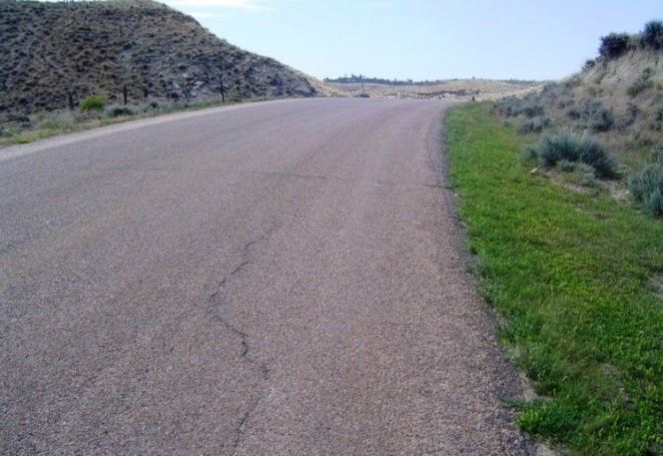
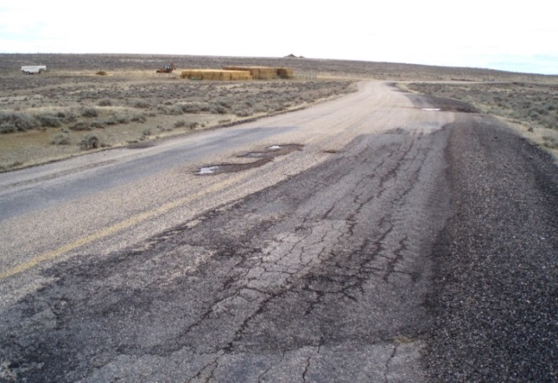

Wyoming County Paved Roads Management and Monitoring
Khaled Ksaibati, Ph.D., P.E.
STIC
June, 2014

Slide 2
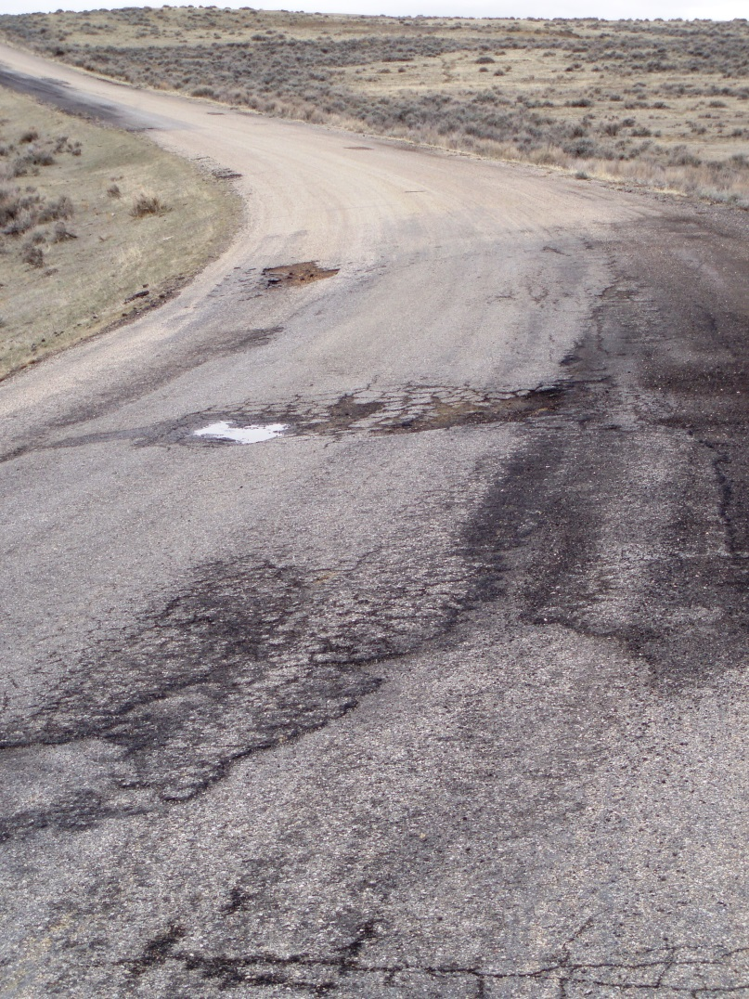
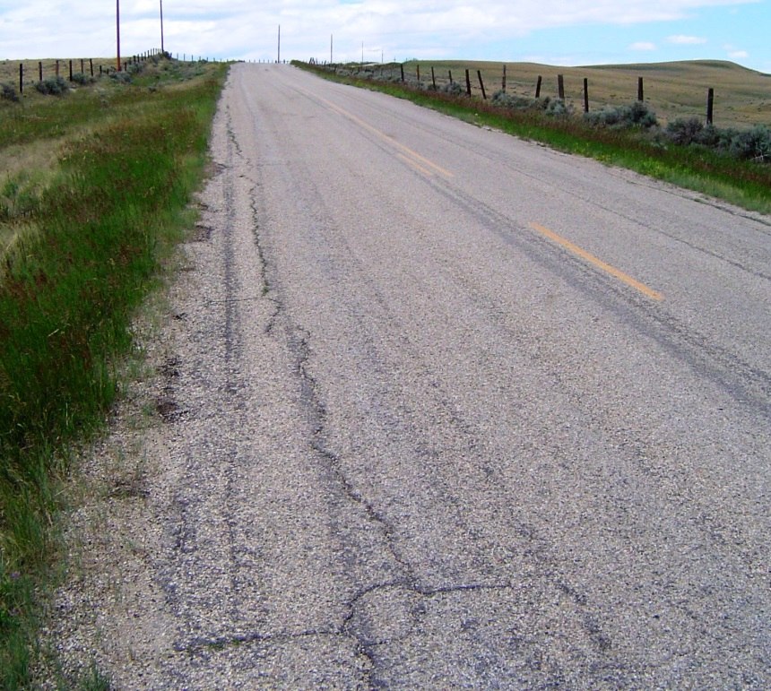
Why monitor paved county roads?
Wyoming counties face significant risk if heavy truck traffic increases on many paved county roads.
Notes:
In one spring, roads can go from left to right or worse with heavy truck traffic. Any treatment is then expensive.

Slide 3
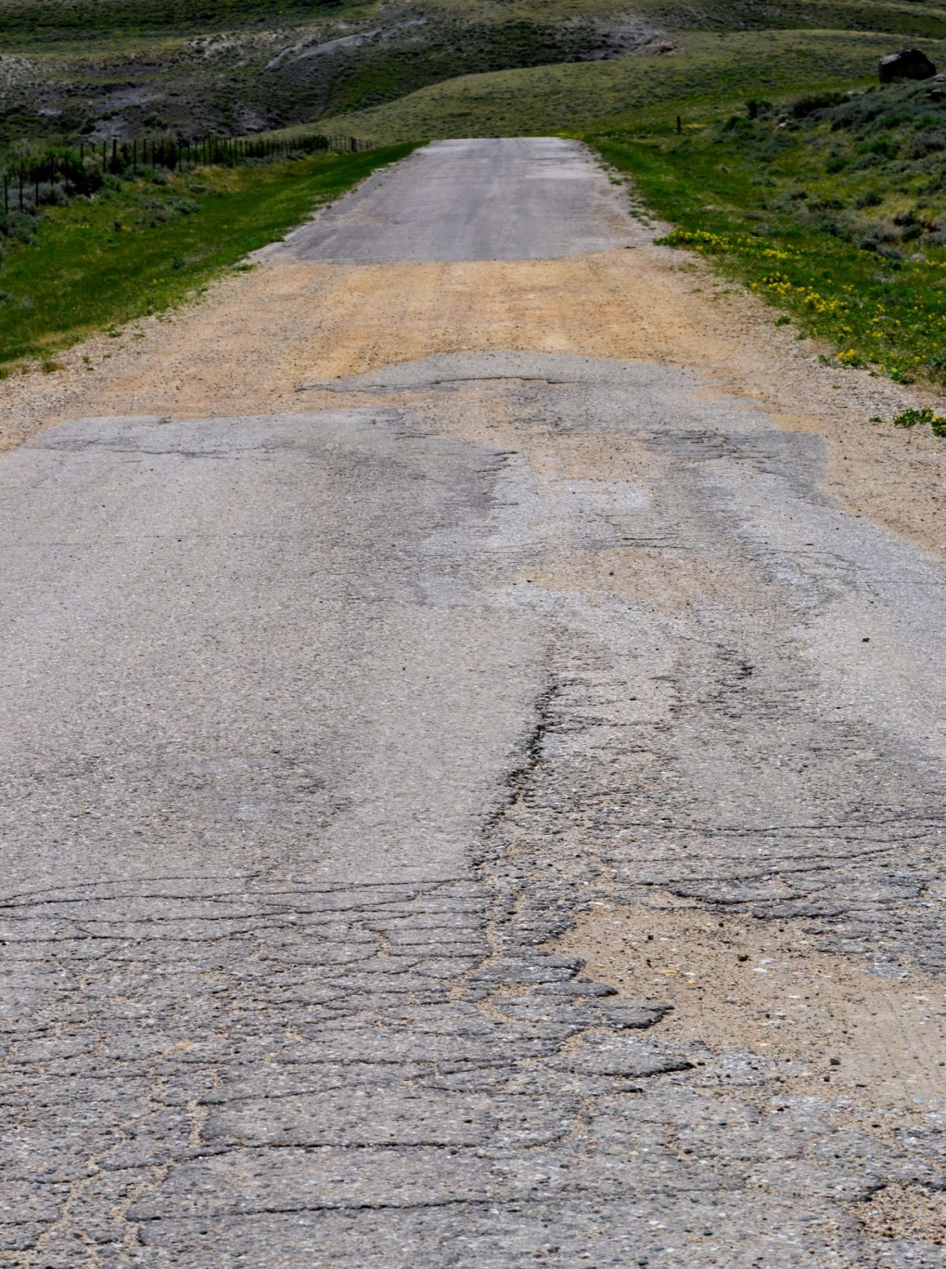
What if they fall apart?
No inexpensive options. You can’t blade this.

Slide 4
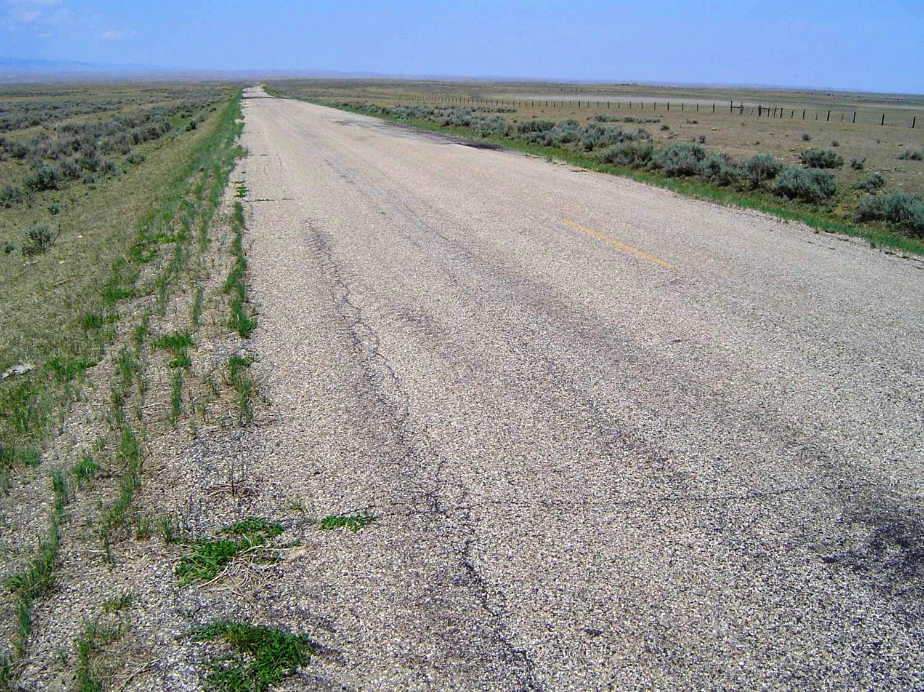
Why are we in this situation?
Many roads were paved in the 1950’s, ‘60’s and ‘70’s.
  Designed for lighter loads, if they were designed at all.
  Asphalt was better, aggregate was cheaper.
The asphalt has aged. It is brittle. It cracks easily if heavy loads are applied, specially if the base is soft due to water. Water enters through cracks, softening the base so potholes form and the road falls apart.

Slide 5
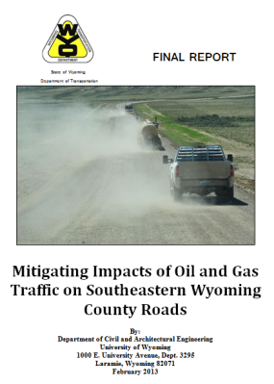
Magnitude of Risk

Slide 6
Why do paved roads present a much greater risk than unpaved roads?
Typically 20% or less of a county’s road mileage.
Unpaved roads can be restored with new gravel for about $50,000 per mile.
Paved road restoration costs far more. Even returning to a gravel road could be several hundred thousand dollars per mile.
The annual cost of additional truck traffic on unpaved roads will rarely be over $30,000 per mile, but the one-time cost to restore a destroyed paved road could easily be over $500,000 per mile.

Slide 7

Part of the Problem
11½’
11½’
Overlaid Pavement Structure
C
L
12’
12’
Original Pavement Structure

Slide 8
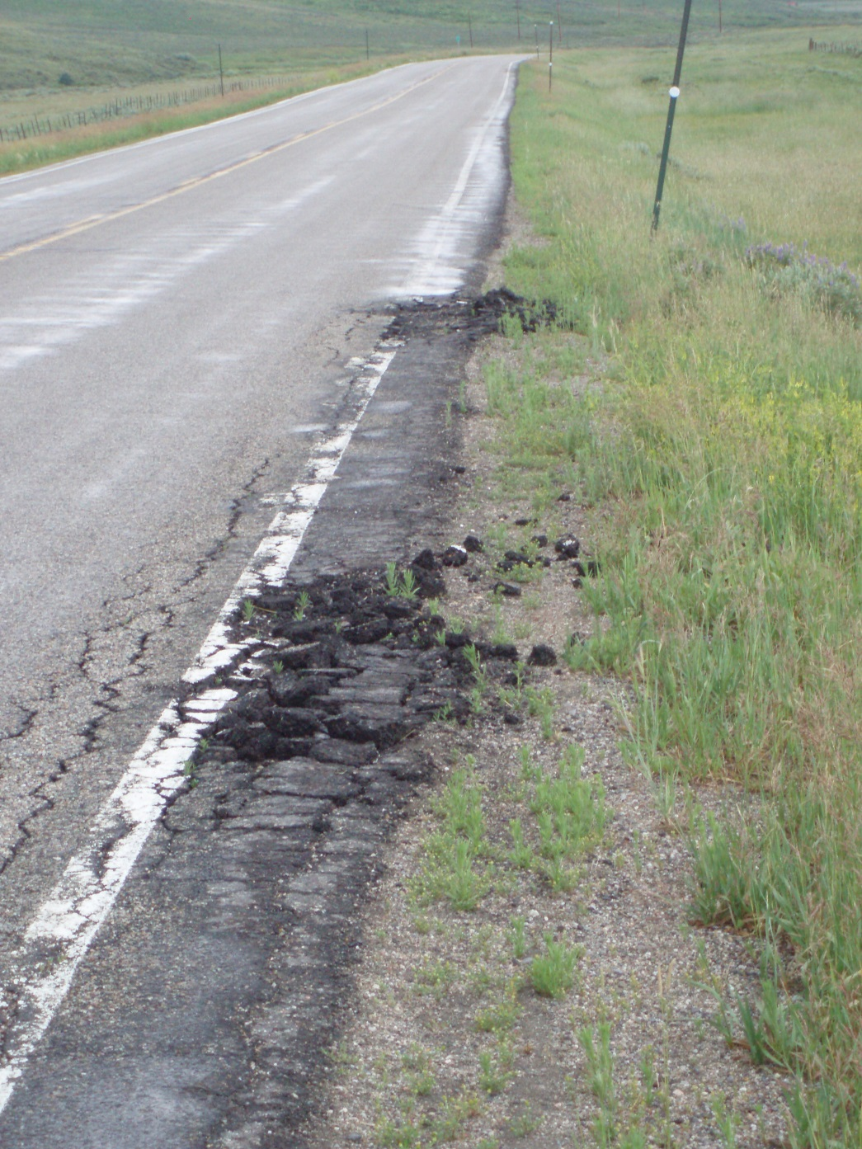
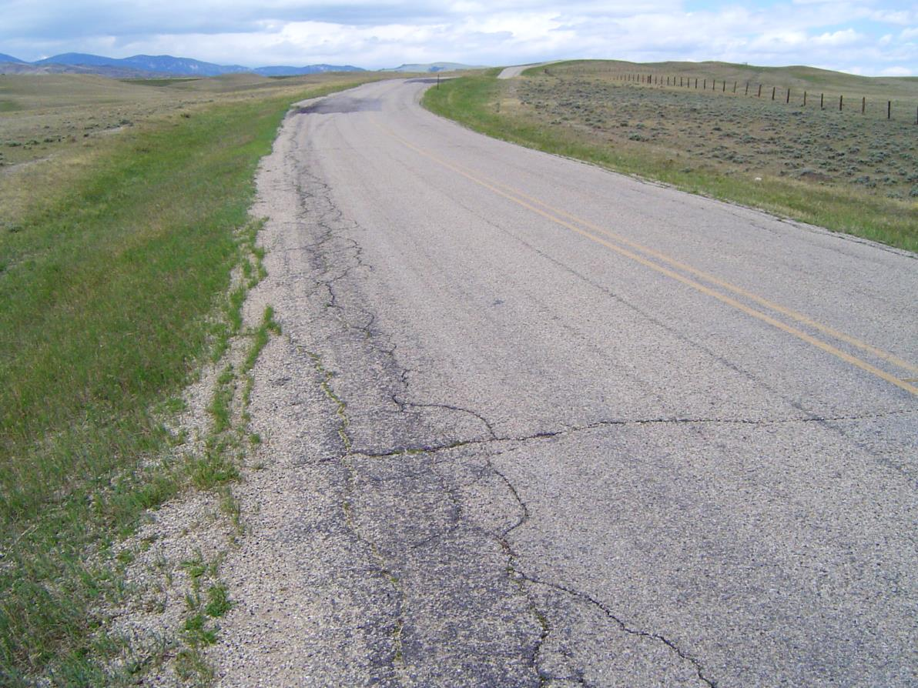
Narrow tops are…
More dangerous.
More prone to edge breakup.

Slide 9
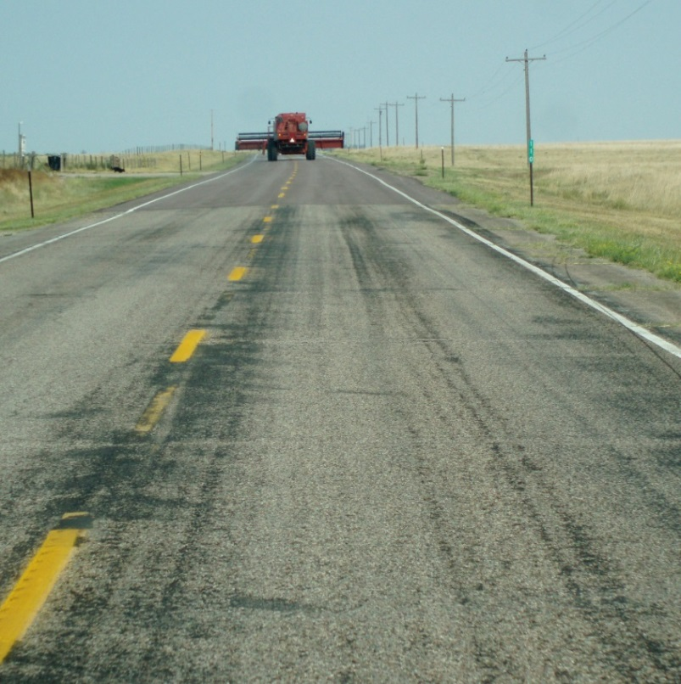
Objectives
Document current conditions.
  Enable counties to determine impacts of industrial or other activities using paved county roads.
  Compare to state highways
Project future conditions.
Establish maintenance, repair, rehabilitation and reconstruction strategies.

Slide 10
Pavement Monitoring Benefits
Current conditions identified, allowing appropriate decision to be made.
Impacts from oil and gas drilling and other industries assessed and evaluated.
Other counties’ treatment methods can be quantitatively evaluated and implemented.
WYDOT pavement management system data and decision processes can be applied to county road networks.

Slide 11
Pavement Monitoring Benefits
Appropriate treatment strategies developed for individual roads at various traffic levels.
Future maintenance and rehabilitation needs projected.
No need for counties with limited resources to develop their own monitoring or analysis methods.
Provide the state legislature with defensible data justifying funding for paved county roads.

Slide 12
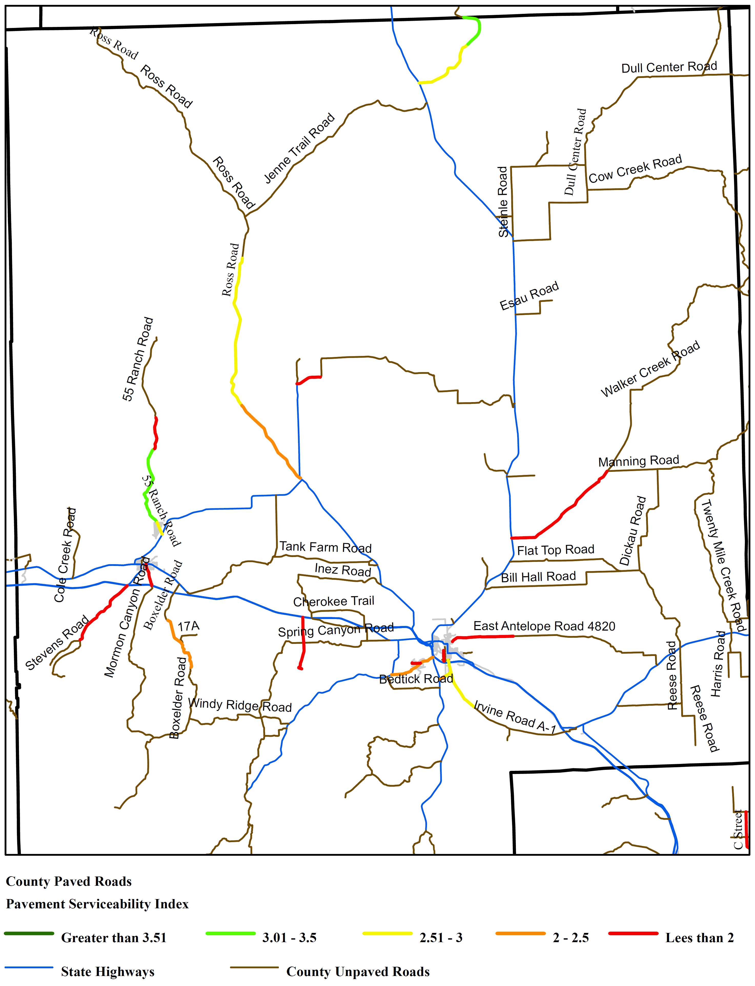
Converse County PSI
PSI > 3.5: Excellent
3.5 > PSI > 3.0: Good
3.0 > PSI > 2.5: Fair
2.5 > PSI: Poor

Slide 13
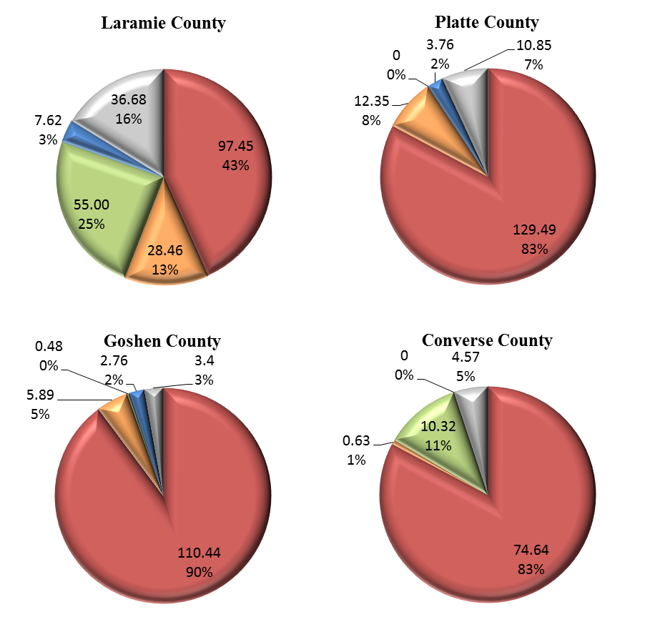
Paved County Road Conditions from PSI

Slide 14
PSI Mileages by Road Class

Slide 15
Paved County Road Widths

Slide 16

Proposed Monitoring Options
Pavement Thicknesses
  Ground Penetrating Radar (GPR)
Pathway Services® van
  Hired annually by WYDOT
  Direct measurements
    Roughness
    Rutting
  Video logs
    May be evaluated in the office to generate a pavement condition index (PCI).
    Provide a log of pavement surface and roadside conditions.

Slide 17
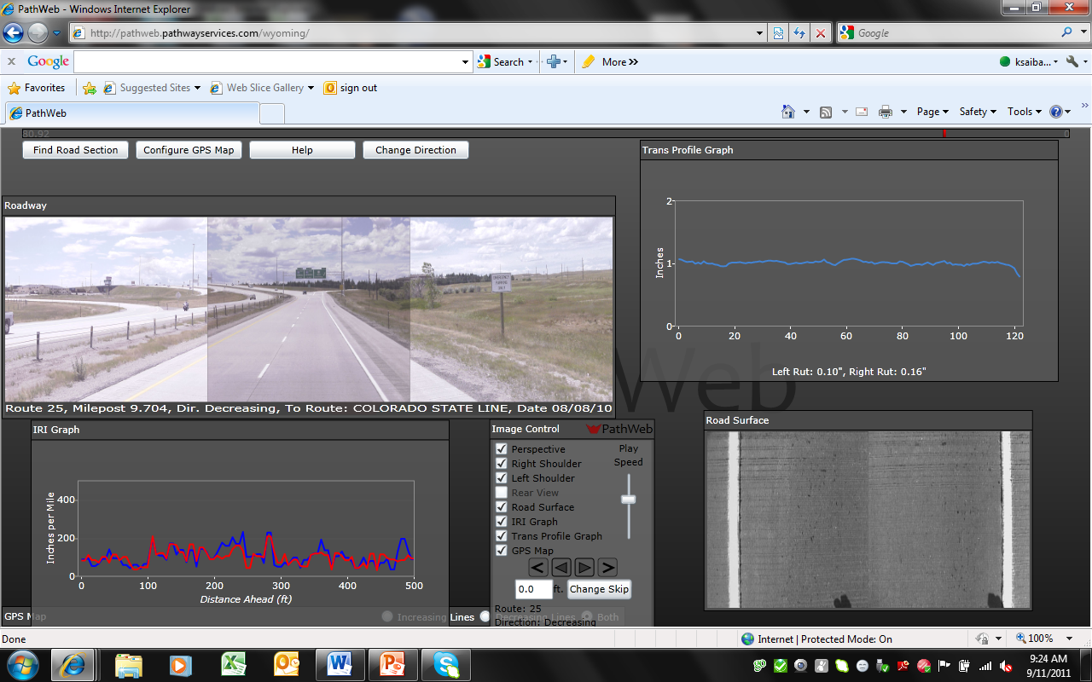
Video Logs

Slide 18
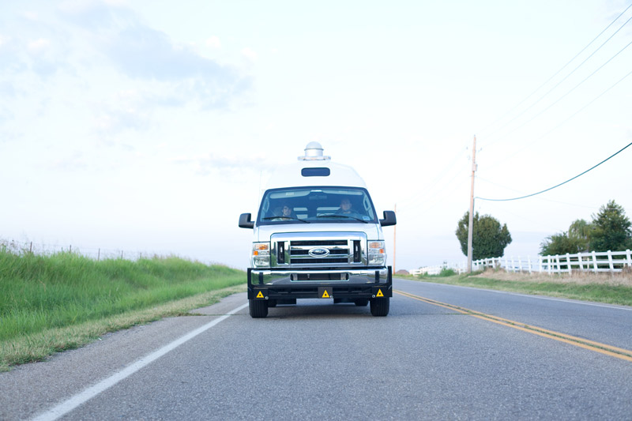
Data Compilation and Analytical Options
None
Pavement Condition/Cracking Index (PCI)
Data Summary
Data Analysis

Slide 19
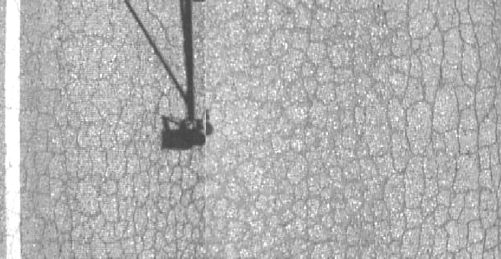
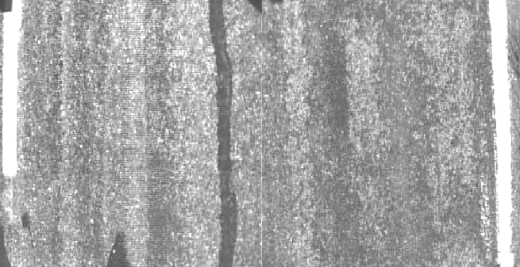
Pavement Condition Index
From Pathway video logs
  Numerical index from 0 to 100 quantifying the condition of a roadway based on surface distresses.
    Extracted from 1000’ sample sites per mile of paved roadway.
  Manually measured and interpreted through road surface videos collected by Pathway van at highway speeds.

Slide 20
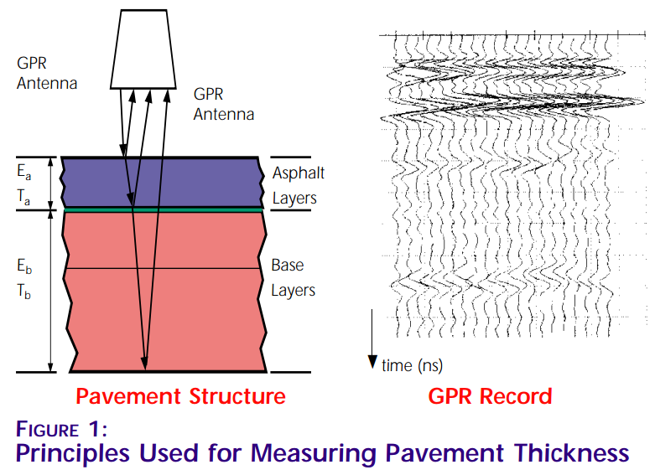
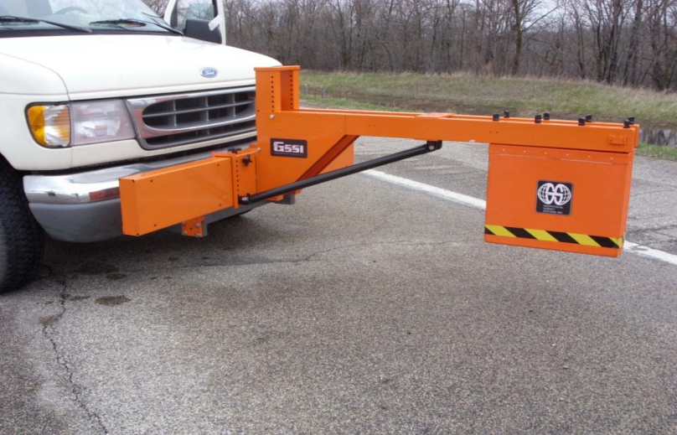
Ground Penetrating Radar (GPR)
Assessment of asphalt and base thicknesses.
  Essential for design and for durability analyses.
Conducted by a specialized van at highway speeds.

Slide 21
Options Presented to WACERS

Slide 22
Inventory and Segmentation
Pathway Services® Van
GPR Provider (TBD)
Roughness
Asphalt Surface Thicknesses
Rutting
Base Thicknesses
Video Logs
Storage on Website
Pavement Condition Index (PCI)
Data Analysis and Reports
Data Summaries
Remaining Service Lives
Tables
Treatment Recommendations
Maps
Comparisons to State Highways

Slide 23
Option Developed by WACERS

Slide 24
Inventory and Segmentation
Pathway Services® Van
GPR Provider (TBD)
Roughness
Asphalt Surface Thicknesses
Rutting
Base Thicknesses
Video Logs
Storage on Website
Pavement Condition Index (PCI)
Data Analysis and Reports
Data Summaries
Remaining Service Lives
Tables
Treatment Recommendations
Maps
Comparisons to State Highways

Slide 25
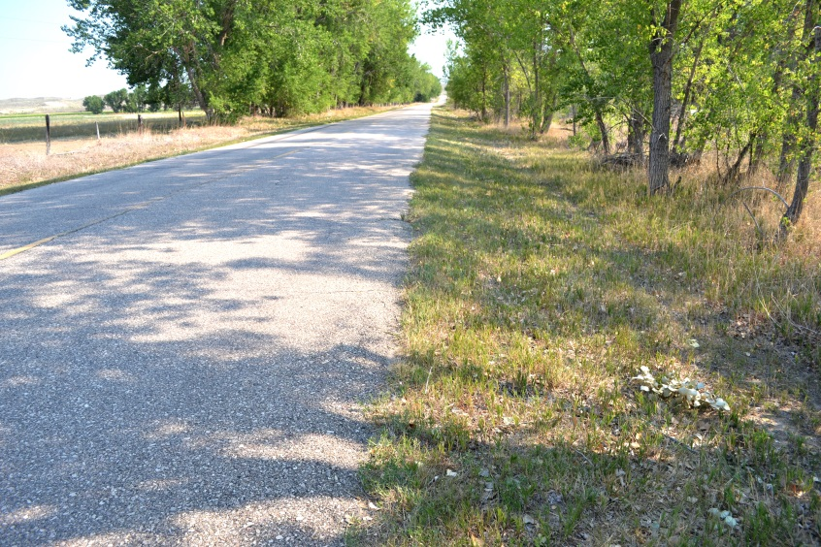
WACERS’ Recommendation
Collect all data.
  Ground Penetrating Radar (GPR)
  Roughness
  Rutting
  Video logs
    Pavement Condition Index (PCI)
Data Collection Frequency
  Every 2 years
No analysis.
  Many analytical options remain open once the data is collected and stored.

Slide 26
Data Collection Frequency
First Year: Monitor all paved county roads.
Subsequent Years: Monitor half the state each year.
W – 1,270 miles; E – 1,241 miles
SW – 1,278 miles; NE – 1,233 miles

Slide 27
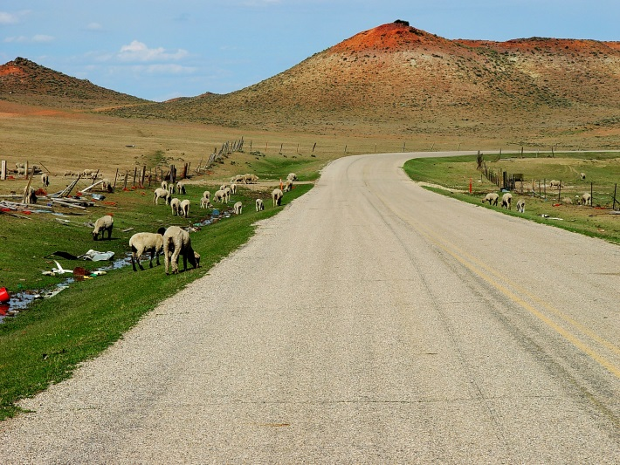
Work to be Performed
Wyoming T²/LTAP
  Inventory and Segmentation
  Pavement Condition Index (PCI) processing
  Host website containing raw data
Pathway Services®
  Roughness
  Rutting
  Video Logs
Commercial GPR Tester (TBD)
  Asphalt and Base Thicknesses

Slide 28
Budget Summary

Slide 29
Cost Allocation
WYDOT will cover $215,584 in the first year.
$100,000 is requested from the STIC in the first year.
Counties have agreed to cover the running cost for subsequent years.

Slide 30
Second and Subsequent Years Costs

Slide 31
Funding
39‑17‑111. Distribution.

Slide 32
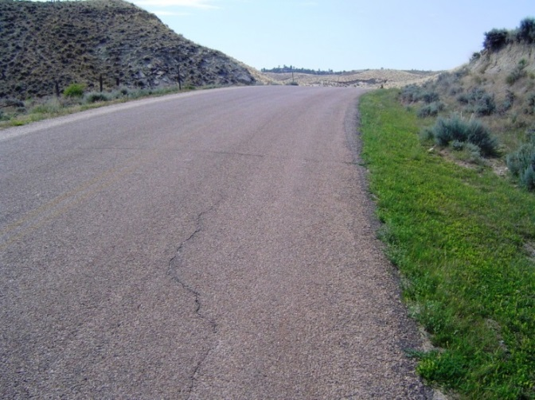

Wyoming County Paved Roads Management and Monitoring
Questions? Comments?
Khaled Ksaibati, Ph.D., P.E.
STIC
June, 2014

