Slide 1
OSHA Webinar #0066 Standards and Citation Policy for Roadway and Highway Work Zone Inspections
March 11, 2013

Slide 2
Welcome and Introduction
Charlie Shields, Director
OSHA Training Institute
Directorate of Training and Education

Slide 3
Presenters
Jake Ladd, Region II
Rodger Frey, Region II

Slide 4
Objectives
Explain general inspection procedures for roadway and highway work zones
Describe how the Manual on Uniform Traffic Control Devices (MUTCD) is used for citation purposes
Identify the proper use of OSHA standards, including 5(a)(1) General Duty Clause, for the issuance of citations
Obtain working knowledge of CPL 02-01-054

Slide 5
Manual on Uniform Traffic Control Devices (MUTCD)

Slide 6
MUTCD
Written for Engineers Involved in Establishing Temporary Traffic Control In and Around Highway Work Zones
Key word is Uniform
Federal Highway Administration (FHWA)
Rules on and publishes MUTCD
Part VI
Covers temporary traffic control
Sections A-H
Specific language used- Shall, Should, May
Notes:
Recall some of the things in the first webinar and discuss the importance of shall should and may.

Slide 7
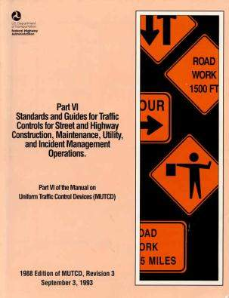
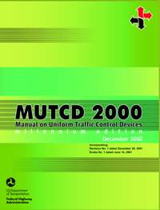
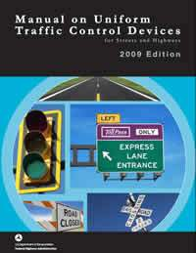
http://mutcd.fhwa.dot.gov
Notes:
Explain the importance of the three books and begin to discuss the use of the different manuals.

Slide 8
MUTCD
1988 Edition:
During any time the normal function of a roadway is suspended, temporary traffic control planning must provide for continuity of function (movement of traffic, pedestrians, transit operations, and access to property/utilities)
Millennium Edition:
When the normal function of the roadway is suspended, temporary traffic control planning provides for continuity of the movement of motor vehicle, bicycle, and pedestrian traffic; transit operations; and access to property and utilities
Notes:
Explain when the MUTCD comes into play and highlight the importance of normal function. Discuss in the manual that features of the road should be maintained as much as possible. Cover roadside recovery.

Slide 9
MUTCD
1926.200(g)(2): All traffic control signs or devices used for protection of construction workers shall conform to Part VI of the Manual of Uniform Traffic Control Devices (MUTCD"), 1988 Edition, Revision 3, September 3, 1993, FHWA-SA-94-027 or Part VI of the Manual on Uniform Traffic Control Devices, Millennium Edition, December 2000, FHWA, which are incorporated by reference
Notes:
Highlight that there are mandatory statements on what is a sign or device and that this is the beginning of uniformity.

Slide 10
MUTCD
1988 Edition Section 6B (Fundamental Principles):
All traffic control devices used on street and highway construction, maintenance, utility, or incident management (temporary traffic control) operations shall conform to the applicable specifications of this manual
Millennium Edition Section 6F.01 (Types of Devices):
All traffic control devices used on street and highway construction, maintenance, utility, or incident management operations shall conform to the applicable provisions of this Manual
What are Signs and Devices?
Notes:
Build on the previous slide and highlight the mandatory requirement to conform to the manual. Discuss how this begins to build on the uniformity.

Slide 11
MUTCD
1988 Edition Section 6F (Types of Devices):
A traffic control device is a sign, signal, marking or other device placed on or adjacent to a street or highway (by authority of a public body or official having jurisdiction), to regulate, warn, or guide traffic
Millennium Edition (Section 6F.01):
Traffic control devices shall be defined as all signs, signals, markings, and other devices used to regulate, warn, or guide traffic, placed on, over, or adjacent to a street, highway, pedestrian facility, or bikeway
Notes:
Highlight how specific these mandatory statements are and how quickly you are covered by the manual. Discuss how this is done on purpose to ensure the uniformity of these projects.

Slide 12
Temporary Traffic Control Zone
Area of highway where road user conditions change because of
Work Zone
Incident Zone
Planned Special Event

Slide 13
Work Zones
A brief overview of the parts of a work zone and discussion of some terminology to aid in documenting violations and general understanding of work zone conditions

Slide 16
Advance Warning Area

Slide 17
Advance Warning Areas Cont.
MUTCD explains the function, design, application, spacing requirements and recommendations for advance warning signs (Section 6F-1b/6F.15)
Examples areas that require advance warning:
Closed shoulder
Work on the traveled way
Closed lanes
Notes:
Explain the examples on page 16 for the citing of .200(g)(1) vs. .200(g)(2)

Slide 18
Advance Warning Area
Advance Warning Area:
Most Important Area:
Road users are informed of what to expect about the upcoming work zone
Both editions have similar language:
May vary from a single sign to a series of signs in advance of the activity area
Notes:
Discuss non-mandatory sign spacing for advance warning signs.

Slide 19
Advance Warning Area
Advance Warning Area:
Important for CSHOs to drive beyond the work zone to observe any advance warning set up
Could be specific requirements for signs and what messages are conveyed
Advance warning can affect traffic in both directions in some circumstances

Slide 21
Transition Area

Slide 22
Transition Area
Transition Area
Road users are redirected out of their normal path
Setup greatly affects the flow of traffic into and beyond the work zone
Smooth transitions are important to the safety of the workers within the work zone
Second most important

Slide 23
Transition Area
Transition Area
In mobile operations, the transition area moves with the work space
Transition areas usually involve strategic use of tapers
Notes:
Discuss guidance and tables in charts but keep it basic- Tapers will be discussed in the violations section.

Slide 24
Mobile Operations With Wrong Sign
Transition areas move with the work zone
Notes:
Explain the examples on page 16/17 for the citing of .200(g)(1) vs. .200(g)(2)

Slide 25
Mobile Operations
Transition areas move with the work zone
Notes:
Explain the examples on page 16/17 for the citing of .200(g)(1) vs. .200(g)(2)

Slide 26
Activity Area

Slide 27
Activity Area

Slide 28
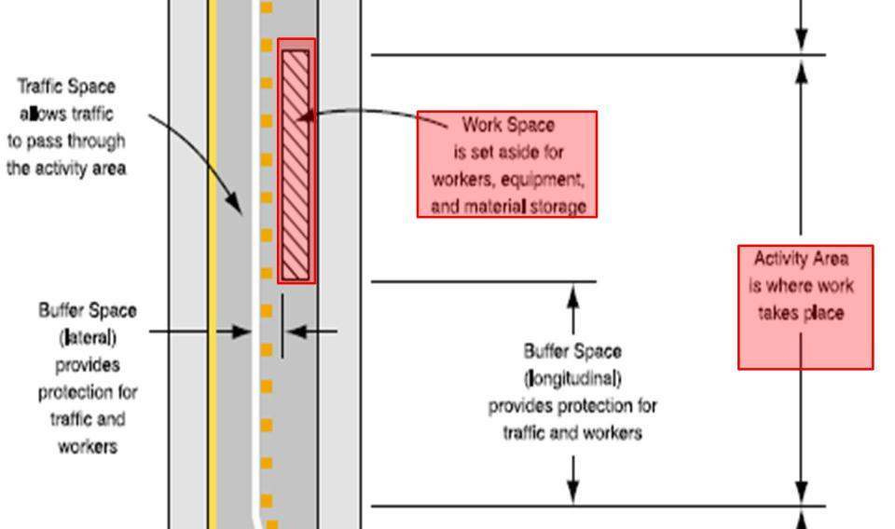
Activity Area

Slide 29
Activity Area
Work space
Portion closed to road users
Set aside for workers, equipment, and material
Usually delineated by channelizing devices or by temporary barriers
May be stationary or move as work progresses
May be several work spaces (some separated by several miles) within the project limits
Each work space should be adequately signed to inform and reduce confusion

Slide 30
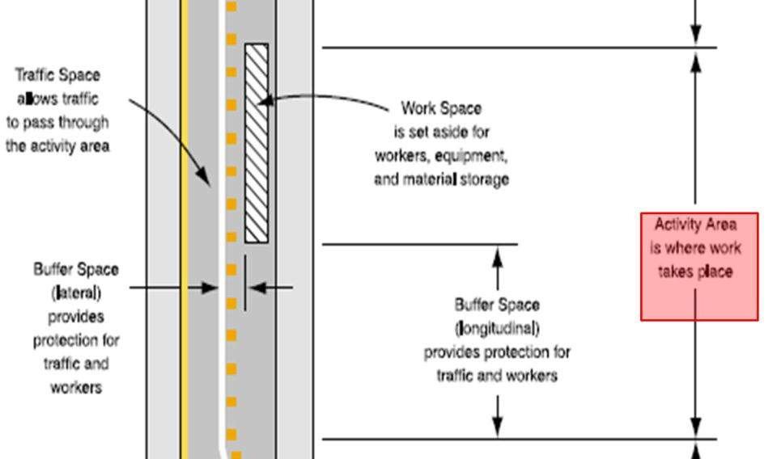
Activity Area

Slide 31
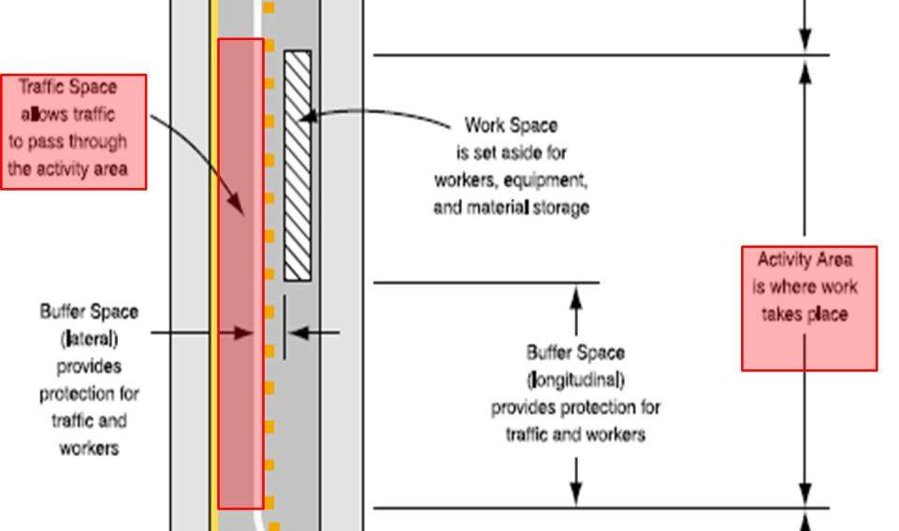
Activity Area

Slide 32
Activity Area
Traffic space
Road users are routed through the activity area
Delineated by devices
Motorists can see the physical length of the project and understand they are in a work zone

Slide 33
Activity Area

Slide 34
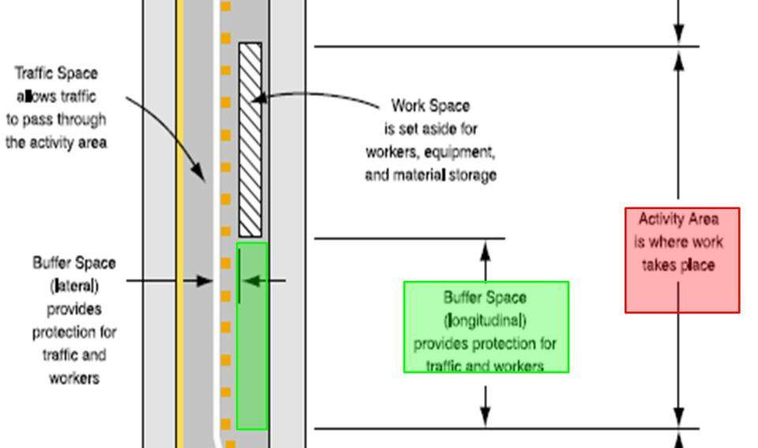
Activity Area

Slide 35
Activity Area

Slide 36
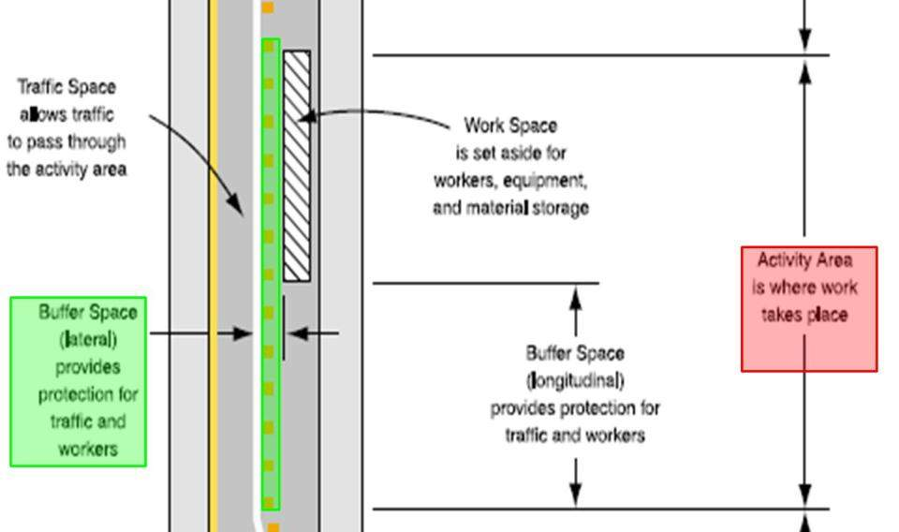
Activity Area

Slide 37
Activity Area
Buffer space 6C-2c(3) (6C.06) (Optional)
Area that separates road user flow from the work space or an unsafe area, and might provide some recovery space for an errant vehicle
Neither work activity nor storage of equipment, vehicles, or material should occur within a buffer space
May be positioned either longitudinally or laterally with respect to the direction of road user flow

Slide 38
Activity Area
Buffer space
Activity area may contain one or more buffer spaces
May be placed in advance of a work space
May also be used to separate opposing road user flows that use portions of the same traffic lane
Width of a lateral buffer space should be determined by engineering judgment

Slide 40
Termination Area

Slide 41
Termination Area
Termination Area
End of the work zone

Slide 42
Termination Area
1988 Edition Section 6C-2D:
The termination area is used to return traffic to the normal traffic path. The termination area extends from the downstream end of the work area to the END ROAD WORK signs, if posted. Conditions May be such that posting of END ROAD WORK signs is not helpful. For example, the END ROAD WORK signs SHOULD normally not be used if other temporary traffic control zones begin within a mile of the end of the work space in rural areas, or about a quarter-mile within urban areas. For normal daytime maintenance operations, the END ROAD WORK SIGN is optional.
Notes:
Highlight this what one edition says and how permissive it is.

Slide 43
Termination Area
Millennium Edition Section 6C.07:
The termination area shall be used to return road users to their normal path. The termination area shall extend from the downstream end of the work area to the END ROAD WORK signs, if posted.
Notes:
Highlight the difference in how mandatory this statement is and pose the question; Could there be a violation here?

Slide 44
Some Things to Consider…
OSHA and MUTCD:
Still must prove OSHA violation elements!!!
SASVEEEK
Standard Applies
Standard Was Violated
Employee Exposure
Employer Knowledge
Notes:
Highlight the differences in the books and remind them that they still have to prove OSHA’s requirements. In the case of the termination, more than likely there would be no employee exposure.

Slide 45
General Inspection Procedures

Slide 46
Coordination with other Governmental Entities
Local Traffic Engineering Departments
Collision data
Permits
Traffic patterns
Construction Schedules
Often approve employer Traffic Control Plans (TCP)
Federal/State Department of Transportation
Often act as the General/Controlling Contractor
Might design employer’s TCP
Some State DOTs administer MUTCDs

Slide 47
Law Enforcement
Area Directors can meet with local law enforcement to discuss OSHA’s objectives with respect to work zones and CSHO safety
CSHOs should consider utilizing Law Enforcement when arriving and leaving larger work zone projects
Notes:
Mention establishing the relationship in writing per the directive F.3.a (page 11-12)

Slide 48
Two Aspects of Work Zone Inspections
Inspection of the construction work
Noise, Dust, Illumination, PPE, Scaffolds, Fall Protection, Material Handling Equipment, Excavations, Precast/Poured Concrete, Steel Erection, and Cranes
Inspection of temporary traffic controls
Signs
Devices
Procedures
Notes:
Re-emphasize that there are all of the normal inspection hazards with the addition of internal and external struck by hazards. Highlight that you are still concerned with all of the other standards we use every day.

Slide 49
Case File Documentation
Some situations need spacial layouts to make sense for settlement
Specific statements in interviews can be key
Video is an awesome tool!
Can be useful in showing work zone and employee proximity to traffic or to document specific activities as well
Can help to emphasize traffic volume and flow through work zone

Slide 50
Case File Documentation
Approach:
Park vehicle in a safe location away from any traffic hazards
Make sure any operators see you before moving towards a piece of equipment
Remember you are now on an active work zone; you must maintain your situational awareness

Slide 51
Case File Documentation
Interact:
Identify self and try to talk with Foreman/ Company Official in charge
What job performing
How long in that location
Training
Interview affected employees
Questions regarding specific training related to traffic control
Reason job being performed
PERFORM INTERVIEWS IN A SAFE LOCATION

Slide 53
Case File Documentation
Document key points:
advance warning sign locations (document number and type)
Number of devices and spacing
Barricades
Flagger locations and setup
Truck Mounted Attenuator (TMA)

Slide 54
Case File Documentation
Field diagram can help with recreation
Ask Employer For:
Start of taper to activity area
Width of offset (the amount of lateral space taken by the taper)
Width of normal lane
Width of shoulder
Proximity of items within work zone to live traffic
Location of fixed objects such as telephone poles, fire hydrants, etc. can greatly increase accuracy of diagramming

Slide 56
Standards and Citation Policy
CPL 02-01-054
Inspection and Citation Guidance for Roadway and Highway Construction Work Zones
October 16, 2012

Slide 57
Construction vs. General Industry (Maintenance)
Employer/Industry term for “road maintenance” could be construction work (e.g. crack sealing, overlaying, surface treatments)
Task factors to consider while evaluating:
Improves the original (1926) or preserves it (1910)
Replacement-in-kind (1910)
Scheduled at regular intervals (1910)
Scale and complexity (1926)
System-wide impact (1926)
Notes:
Start with explaining the definition of construction work as found in Section XIV – A of the directive, page 18 and then explain the bullets

Slide 58
Construction vs. General Industry (Maintenance) Cont.
Construction examples:
Moving/relocating of existing power lines and supporting utility poles
Replacement of a utility pole (with new parts)
Complete re-striping of a roadway
Pavement overlaying/resurfacing
Bridge rehabilitation
General Industry examples:
Scheduled touch-ups of striping in short spans
Minor spray-patching, pothole filling/repairs
Notes:
Explain examples in detail using info from XIV – B pages 18-19

Slide 59
Standards Cited for Construction Work Zones
1926.200(g)(1) – Traffic Signs
1926.200(g)(2) – Traffic Control Signs & Devices
1926.201(a) – Signaling
1926.202 – Barricades and Barriers
1926.20(b)(1) – Accident Prevention
1926.21(b)(2) – S & H Training
Section 5(a)(1) – General Duty Clause

Slide 60
Standards Cited for General Industry Work Zones
1910.268(d)(1) – Traffic Control in the Telecommunication Industry
No reference to MUTCD
Channelize traffic and protect workers by use of
Signs
Flags
Devices
Barrier
Barricades
Notes:
Explain that these items are not covered in the directive however, they need to be aware of them. Explain that it is important to examine the project and the work to make sure you are in the appropriate standard.

Slide 61
Standards Cited for General Industry Work Zones
1910.269(w)(6)(i)- (ii)- Traffic control for “Qualified Employees” exposed to traffic while performing work related to electrical power transmission and distribution lines
269(w)(6)(i)- Signs and devices must meet 1926.200(g)(2)
269(w)(6)(ii)- Signs, Flags, Devices to alert and warn traffic
269(w)(6)(iii)- Use of barricade for further protection

Slide 62
Standards Cited for General Industry Work Zones
Section 5(a)(1) General Duty Clause
Struck by hazard from inadequate work zone setup and proximity to vehicular traffic
Examples of documentation you should use to establish hazard recognition:
MUTCD
ANSI/ASSE A10.47-2009: Work Zone Safety for Highway Construction- Scope covers “Workers engaged in construction, utility work, maintenance, or repair activities on any area of a highway” and refers asphalt operations to A10.17-1997
ANSI A10.17-1997: Safe Operating Practices for Hot Mix Asphalt construction- Scope covers “Those operations involving hot mix asphalt mixtures and materials for construction and resurfacing”
Notes:
Give them a little insight into ANSI and how much more restrictive it is in certain aspects.

Slide 63
Citable Edition Policy
Section XII(B):
OSHA revised 1926.200(g)(2) in 2002 to adopt and incorporate Revision 3 and the option to comply with the Millennium Edition
Cite the 1988 Edition, Revision 3 by default
Cite the Millennium Edition when the employer indicates this is the Edition used at the work zone
2009 Edition is the most recent edition of the MUTCD
Under OSHA's de minimis policy, compliance with more current DOT requirements, ANSI requirements, or other applicable nationally recognized consensus standards, is acceptable so long as such standards are at least as protective as the OSHA requirement.
Notes:
Thoroughly explain the need to find out what book they will be using. Explain the difference and what to do in the case that the employer doesn’t know about the manual and if they say they are using 2009.

Slide 64
Traffic Signs
1926. 200(g)(1) - Construction areas shall be posted with legible traffic signs at points of hazard
Cite when there is NO traffic sign warning of a point of hazard OR the traffic sign at the point of hazard is illegible
Use provisions of the MUTCD, including non-mandatory provisions to identify points of hazards
Example citation in Appendix D of Directive
Notes:
Section XIII A page 13/14 – comments for this slide

Slide 65
Traffic Control Signs and Devices
Mandatory provisions under 1926.200(g)(1)
Be Aware There Are Differences between 1988 Edition and Millennium
6F-1b(2) 1988 Edition states that “When roadway is obstructed or closed, advance warning signs are required to alert traffic well in advance…” --- Also it states in 6H-2(e) “When a lane is closed on a multilane road……Typically the advance warning area contains three signs such as Road Work Ahead, Right or Left Lane Closed Ahead, and Lane Reduction Sign.”
(6F.21) Millennium Edition states that “The LANE CLOSED sign shall be used in advance of that point where one or more through lanes of a multiple lane roadway are closed.”
Notes:
Highlight the areas where they may use this standard and that each book may be different.

Slide 66
Traffic Control Signs and Devices
Mandatory provisions under 1926.200(g)(1)
Be Aware There Are Similarities between 1988 Edition and Millennium
Use only for NO signs or ILLEGIBLE signs *if the signs are WRONG use 1926.200(g)(2)
6G-2b(4) 1988 Edition: “Advance warning must provide a general message that work is taking place, information about specific hazards, and actions the driver must take to drive through the temporary traffic control zone.”
6G.03 Millennium Edition: “When the work space is within the traveled way, except for short-duration and mobile operations, advance warning shall provide a general message that work is taking place, shall supply information about highway conditions, and shall indicate how motor vehicle traffic can move through the temporary traffic control zone.”

Slide 67
Traffic Control Signs and Devices
1926.200(g)(2) – All traffic control signs or devices used for protection of construction workers shall conform to Part VI of the Manual of Uniform Traffic Control Devices (MUTCD), 1988 Edition, Revision 3, September 3, 1993, FHWA-SA-94-027 OR Part VI of the Manual on Uniform Traffic Control Devices, Millennium Edition, December 2000, FHWA, which are incorporated by reference.
Example citation in Appendix D of Directive
Notes:
Section XIII B page 14 – all paragraphs should be mentioned, especially the “Note – only cite the Millennium Edition when the employer indicates that edition is used at the work zone”

Slide 68
Traffic Control Signs and Devices
Mandatory provisions under 1926.200(g)(2):
1988 Edition (Millennium Edition):
6C-2b (6C.05)- Channelization
6H-2e (6G.11)- Merging taper for lane closure on multi-lane road
Notes:
Quick overview! Explain these are going to quickly be covered and that the webinar will be made available and they should review the document to become familiar with the standards.

Slide 69
Traffic Control Signs and Devices
Mandatory provisions under 1926.200(g)(2):
1988 Edition (Millennium Edition):
6D-1 (6D.01)- Requirement for devices to be crashworthy
6F-1 (6F.02)- Signs
Retro reflective signs at night and their condition
Flags and warning lights not blocking signs
Colors, sizes, and deviations
6F-1a(1) (6F.05)- Regulatory signs authorized
6F-1a(3) (6F.07)- Regulatory signs covered when temporary signs are different
Notes:
Quick overview!

Slide 70
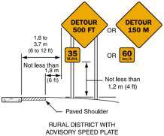
Traffic Control Signs and Devices
Mandatory provisions under 1926.200(g)(2):
1988 Edition (Millennium Edition):
6F-1 (6F.15)- Shape and color for signs
6F-1b(23) (6F.45)- Advisory speed plaque
6F-1 (6F.02)- Colors for guide signs
6F-1c(4) (6F.50)- Marking of detours
6F-2a(1)(a) (6F.52)- Auto adjusting Portable Changing Message Sign brightness (PCMS)
6F-2a(1) (6F.52)- PCMS control system
6F-2a(1)(d) (6F.52)- Mounting of PCMS
Notes:
Quick overview!

Slide 71
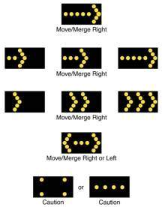
Traffic Control Signs and Devices
Mandatory provisions under 1926.200(g)(2):
1988 Edition (Millennium Edition):
6F-3a (6F.53)- Arrow boards
Shape, finish
Mounting
Mode selections
Capabilities/ parameters
6F-3b (6F.53)- Arrow board use
Caution mode for shoulder or near shoulder
Vehicles with arrow boards must have rotating or strobe lights
Not used for a shift of all lanes on multi-lane roads
Generally means a lane drop
Notes:
Quick overview!

Slide 72
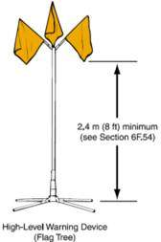
Traffic Control Signs and Devices
Mandatory provisions under 1926.200(g)(2):
1988 Edition (Millennium Edition):
6F-1c(2) (6F.54)- Requirements of high-level warning devices
6F-5 (6F.55)- Channelizing Devices
Warning light requirements
Retro reflective material requirements
Replace if damaged or lost reflective material
Notes:
Quick overview!

Slide 73
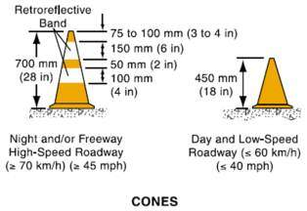
Traffic Control Signs and Devices
Mandatory provisions under 1926.200(g)(2):
1988 Edition (Millennium Edition):
6F-5b(1) (6F.56)- Cones
Materials
Colors
Day and Nighttime requirements
Retro reflective material sizes and requirements
Notes:
Quick overview!

Slide 74
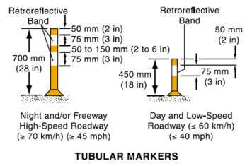
Traffic Control Signs and Devices
Mandatory provisions under 1926.200(g)(2):
1988 Edition (Millennium Edition):
6F-5c(1) (6F.57)- Tubular markers
Materials
Colors
Day and Nighttime requirements
Retro reflective material sizes and requirements
Attachment requirements
Notes:
Quick overview!

Slide 75
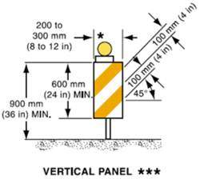
Traffic Control Signs and Devices
Mandatory provisions under 1926.200(g)(2):
1988 Edition (Millennium Edition):
6F-5d(1) (6F.58)- Vertical Panels
Materials
Colors
Day and Nighttime requirements
Retro reflective material sizes and requirements
Sloping requirements for chevrons
Notes:
Quick overview!

Slide 76
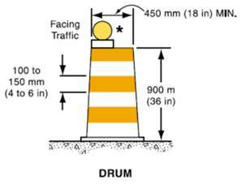
Traffic Control Signs and Devices
Mandatory provisions under 1926.200(g)(2):
1988 Edition (Millennium Edition):
6F-5e(1) (6F.59)- Drums
Materials
Colors
Day and Nighttime requirements
Retro reflective material sizes and requirements
Ballast requirements
Notes:
Quick overview!

Slide 77
Traffic Control Signs and Devices
Mandatory provisions under 1926.200(g)(2):
1988 Edition (Millennium Edition):
6F-5h (6F.63)- Temporary Raised islands
6F-6a (6F.65)- Pavement markings
Maintaining
Requirements
Day and night review requirements
Obliteration requirements
6F-b (6F.66)- Interim/ temporary Pavement Markings
Cycle length
Identification of no-passing zones
Notes:
Quick overview!

Slide 78
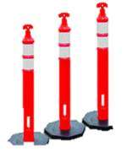
Traffic Control Signs and Devices
Mandatory provisions under 1926.200(g)(2):
1988 Edition (Millennium Edition):
6F-6d (6F.68)- Delineators
Used to supplement other controls
Mounting requirements
Colors
6F-7b (6F.70)- Glare of floodlights
6F-7c (6F71)- Flashing beacon requirements
Notes:
Quick overview!

Slide 79
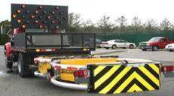
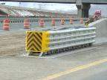
Traffic Control Signs and Devices
Mandatory provisions under 1926.200(g)(2):
1988 Edition (Millennium Edition):
6F-7e (6F.72)- Warning light specifications, not to be used as delineators, and visibility requirements
6F-8a (6F.76)- Attenuators/ crash cushions, crashworthy and periodically inspected, repaired or replaced if damaged
6F-8a(2) (6F.76)- Truck mounted attenuator positioning
6G-2a(1) (6G.02)- Retro reflective or illuminated devices in long term stationary zones
Notes:
Quick overview!

Slide 80
Traffic Control Signs and Devices
Mandatory provisions under 1926.200(g)(2):
1988 Edition (Millennium Edition):
6H-2c(2) (6G.02)- Mobile operations require rotating or flashing lights and a sign or a shadow truck with appropriate lighting and sign
Notes:
Quick overview!

Slide 81
Signaling
1926.201(a) – Signaling by flaggers and the use of flaggers, including warning garments worn by flaggers shall conform to Part VI of the Manual on Uniform Traffic Control Devices, (1988 Edition, Revision 3 OR the Millennium Edition), which are incorporated by reference in §1926.200(g)(2).
Notes:
Section XIII C page 14/15

Slide 82
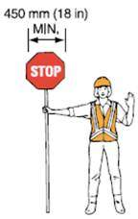
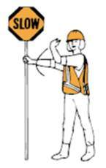
Signaling
Mandatory provisions under 1926.201(a):
1988 Edition (Millennium Edition):
6E-3 (6E.02)- Flaggers hi-visibility clothing/ retro reflective clothing at night and must be visible through a range of motions
6E-4 (6E.03)- Stop/Slow paddle and flag size, color, and retro reflective requirement for night
6E-6 (6E.05)- Flagger station location
6F-1c(5) (6C-13)- Mounting of PILOT CAR sign
Notes:
Quick overview!

Slide 83
Signaling
Mandatory provisions under 1926.201(a):
1988 Edition (Millennium Edition):
6F-8c (6F.74)- Traffic signal and control equipment
Must meet specifications in Part IV
One-lane, two-way traffic requires all red interval of sufficient length
Safeguards to prevent possibility of conflicting signals
6C-5 (6C.10)- Coordinated movements from each end where traffic from both sides must use a single lane
Notes:
Quick overview!

Slide 84
Barricades and Barriers
1926.202 – Barricades for protection of employees shall conform to Part VI of the Manual on Uniform Traffic Control Devices (1988 Edition, Revision 3 OR Millennium Edition), which are incorporated by reference in §1926.200(g)(2).

Slide 85
Barricade Types
Notes:
Discuss the importance of the striping and relate it to uniformity.

Slide 86
Barricades and Barriers
Mandatory provisions under 1926.202:
1988 Edition (Millennium Edition):
6D-1 (6D.01)- Longitudinal Barrier
Short non-continuous segments of barrier are not to be used
Upstream leading ends flared or protected by impact attenuators
Adjacent sections connected for overall strength
Normal vertical curbing cannot substitute where barrier is needed
Notes:
Quick overview!

Slide 87
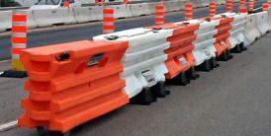
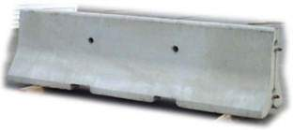
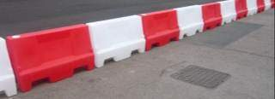
Barricades and Barriers
Mandatory provisions under 1926.202:
1988 Edition (Millennium Edition):
6F-5f(1) (6F.60)- Barricades
Type I, II, and III
Stripe color, size, and sloping
Minimum requirements for high speed roads
Ballast requirements
6F-8b (6F.75)- Portable barrier at night supplemented with delineation, markings, or channelizing devices
6G-7 (6D.11)- Portable barrier near traveled way supplemented with delineation, markings, or channelizing devices
Notes:
Quick overview!

Slide 88
Barricades and Barriers
Mandatory provisions under 1926.202:
1988 Edition (Millennium Edition):
6G-9b (6G.14)- 1 lane of a normally divided highway opposing traffic separated by portable temporary barrier
Notes:
Quick overview!

Slide 89
S&H Program and Training Citations
1926.20(b)(1) should be cited when the presence of a particular hazard indicates the employer has not reasonably conformed its safety program to address such hazards
1926.21(b)(2) should be cited when the employer fails to instruct its employees in the recognition of and avoidance of hazards
Notes:
Highlight the importance of a good safety and health program and that the employees should be trained before being placed on a road. Discuss these projects not being emergencies.

Slide 90
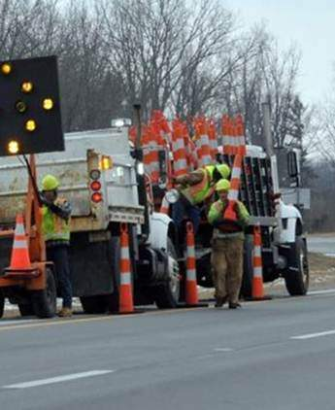
Citing of Section 5(a)(1)
Examples of using 5(a)(1):
Setting and Retrieving Traffic Cones (Devices)
Crossing Live Lanes of High-Speed Traffic
High-Visibility Apparel
Notes:
Explain bullet points from XVI on page 20

Slide 91
Citing of Section 5(a)(1)
ANSI/ASSE A10.47-2009: Work Zone Safety for Highway Construction:
4.5 Set Up and Removal of Traffic Control Devices:
Traffic control devices shall be set up and removed by properly trained worker(s) under the supervision of the traffic control supervisor. Where feasible control devices should be set up or removed using automatic devices or from protected areas of a vehicle. Traffic control devices shall be set up starting upstream from the road taper and removed starting on the downstream end

Slide 92
FIELD INSPECTIONS WITH CITATIONS ISSUED

Slide 93
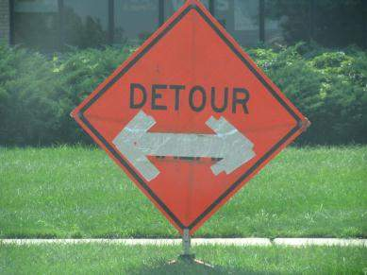
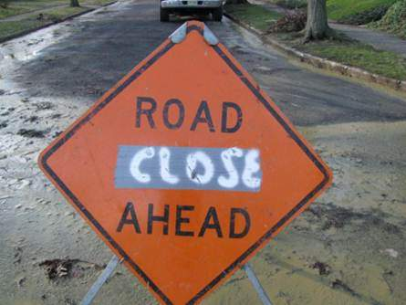

Slide 94
What to Cite
29 CFR 1926.200(g)(2)
1988 Edition:
Section 6F-1:
Warning signs in temporary traffic control zones SHALL have a black legend on an orange background
Millennium Edition:
Section 6F.15:
Warning signs SHALL be diamond-shaped with a black symbol or message and border on an orange background
Notes:
Highlight the fact that the signs were there and while they were modified in some way which makes them illegible the more vertical section is the would be 200(g)(2) because it is not a uniform sign which meets the requirements of the manual.

Slide 95
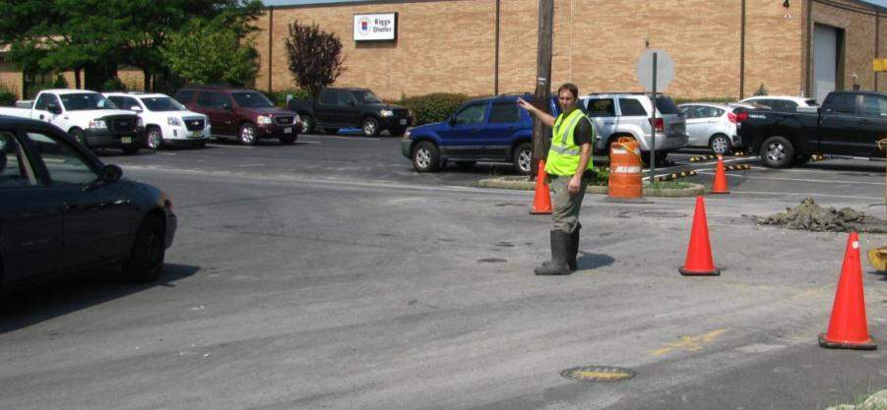
Case Study

Slide 96
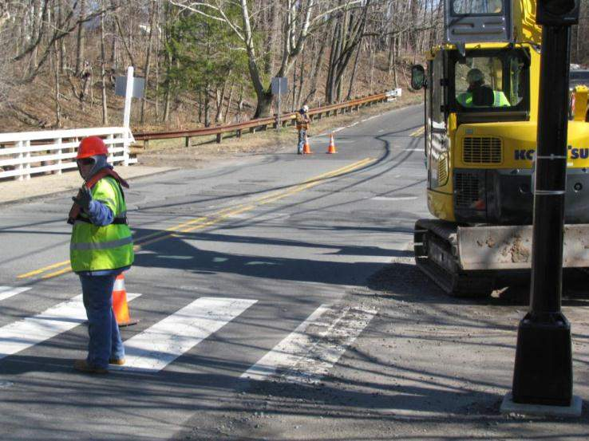
Case Study

Slide 97
What to Cite
29 CFR 1926.201(a)- Using a STOP/SLOW Paddle
1988 EDITION:
Section 6E
Millennium Edition
Section 6E.03
These sections of the manual mandate the size, shape, color, retroreflectivity of the STOP/SLOW paddle

Slide 98
What to Cite
29 CFR 1926.201(a)- Using a Flag
1988 EDITION:
Section 6E-4:
Flags used for signaling SHALL be a minimum of 24 inches square, made of a good grade of red material, and securely fastened to a staff about 3 feet long. The free edge SHOULD be weighted so the flag will hang vertically, even in heavy winds. When used at night, flags SHALL be retroreflective red
Millennium Edition:
Section 6E.03
Flags, when used, SHALL be a minimum of 600 mm (24 in) square, made of a good grade of red material, and securely fastened to a staff that is approximately 900 mm (36 in) in length

Slide 99
Additional Citations
29 CFR 1926.201(a)
1988 EDITION:
Section 6E-5
Millennium Edition
Section 6E.04
These sections cover proper flagging procedures
Flagger did not have a hand signaling device
Use this section to support the violation

Slide 100
Additional Citations
29 CFR 1926.201(a)
1988 EDITION:
Section 6E-6:
Flagger stations SHALL be located far enough ahead of the work space so that approaching traffic has sufficient distance to stop before entering the work space
Millennium Edition:
Section 6E.05:
Flagger stations SHALL be located far enough in advance of the work space so that approaching road users will have sufficient distance to stop before entering the work space

Slide 101
Additional Citations
29 CFR 1926.21(b)(2)
The employer shall instruct each employee in the recognition and avoidance of unsafe conditions and the regulations applicable to his work environment to control or eliminate any hazards or other exposure to illness or injury

Slide 102
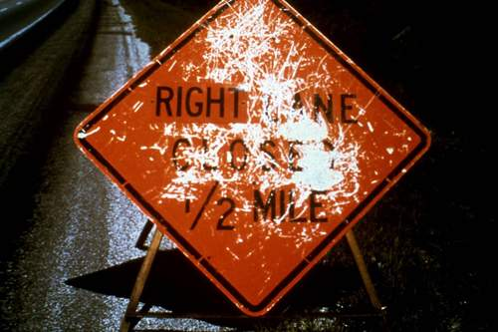
Notes:
Explain this is a clear 200(g)(1) because it was a uniform sign which met the requirements of the manual at one point but has since become illegible and rendered it ineffective to warn motorists.

Slide 103
What to Cite
29 CFR 1926.200(g)(1): Construction areas shall be posted with legible traffic signs at points of hazard
1988 Support:
Identify the point of hazard:
Where any part of the roadway is obstructed or closed, advance warning signs are required to alert traffic well in advance of these obstructions or restrictions
Support the violation:
All signs used at night SHALL be either retroreflective, with a material that has a smooth, sealed outer surface, or illuminated to show similar shape and color both day and night. Sign illumination MAY be either internal or external. Roadway lighting does not meet the requirements for sign illumination
Notes:
Discuss the directive and identifying points of hazard. Discuss using non-mandatory guidance. Discuss the support of the violation through sections of the manual.

Slide 104
What to Cite
29 CFR 1926.200(g)(1): Construction areas shall be posted with legible traffic signs at points of hazard
Millennium Support:
Identify the point of hazard:
6F.15: Where any part of the roadway is obstructed or closed by work activities or incidents, advance warning signs SHOULD be installed to alert road users well in advance of these obstructions or restrictions.
Support the violation:
6F.04: Signs SHALL be properly maintained for cleanliness, visibility, and correct positioning. Signs that have lost significant legibility SHALL be promptly replaced.
6F.02: All signs used at night SHALL be either retroreflective, with a material that has a smooth, sealed outer surface, or illuminated to show similar shape and color both day and night.

Slide 105
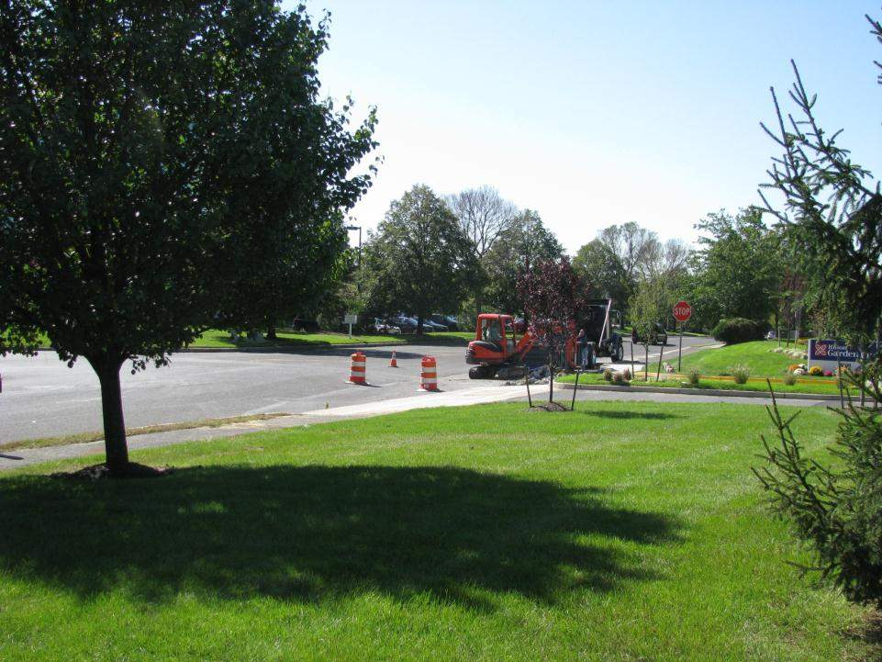

Slide 106
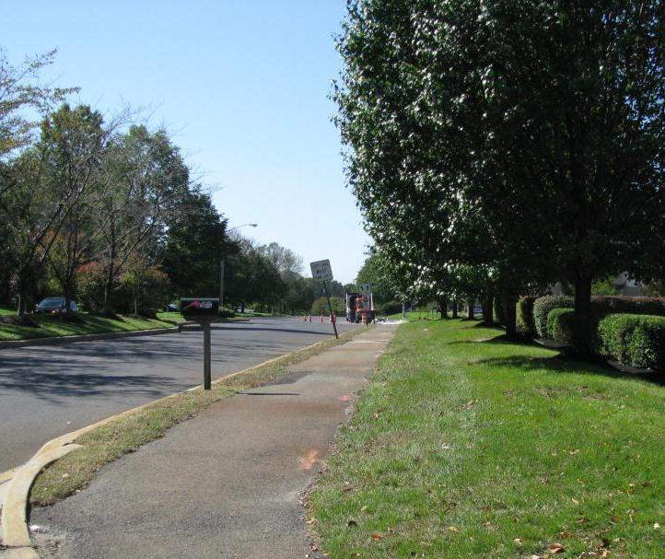

Slide 107
What to Cite
29 CFR 1926.200(g)(1)
The employer did not provide the requisite advance warning of construction work being conducted on the traveled way
1988 Edition: 6G-2b(4)
Millennium Edition: 6G.03
Directive offers sample citation for this violation located on page D-2
Notes:
Emphasize there were no signs.

Slide 108
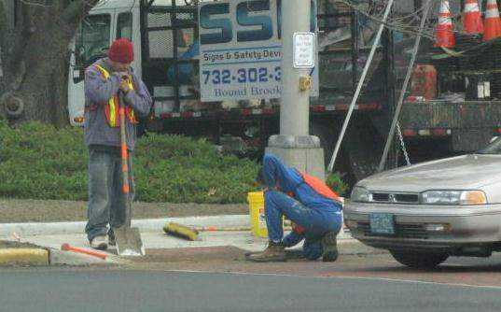
Case Study

Slide 109
What to Cite
29 CFR 1926.200(g)(2)
1988 Edition:
Section 6C-2b
Millennium Edition:
Section 6C.05
When redirection of the driver’s normal path is required, traffic MUST- 1988 (SHALL- Millennium) be channelized from the normal path to a new path

Slide 110
Additional Citations
29 CFR 1926.21(b)(2)
The employer shall instruct each employee in the recognition and avoidance of unsafe conditions and the regulations applicable to his work environment to control or eliminate any hazards or other exposure to illness or injury

Slide 111
DIAGRAMMING WORKZONES FOR CASEFILES
Notes:
Quickly review the next several slides. Highlight the importance diagramming has in recreation. Discuss settlement and explain the difficulty in understanding a work zone if you have not seen it. Relate this to the AAD or AD settling the case.

Slide 112
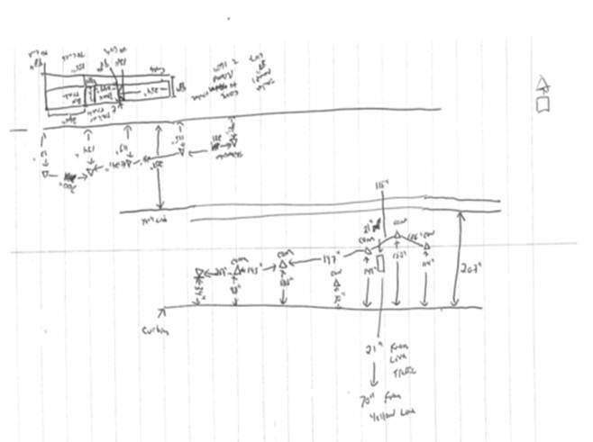
Field Diagram

Slide 113
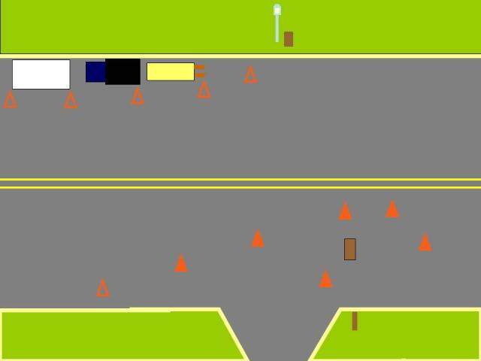
Field Diagram

Slide 114
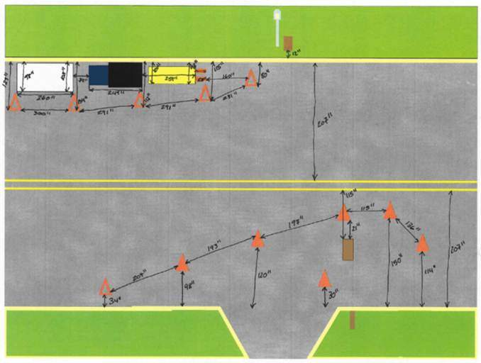
Field Diagram

Slide 115
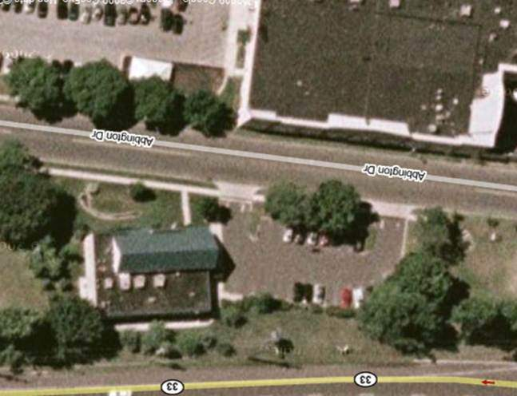
Field Diagram

Slide 116
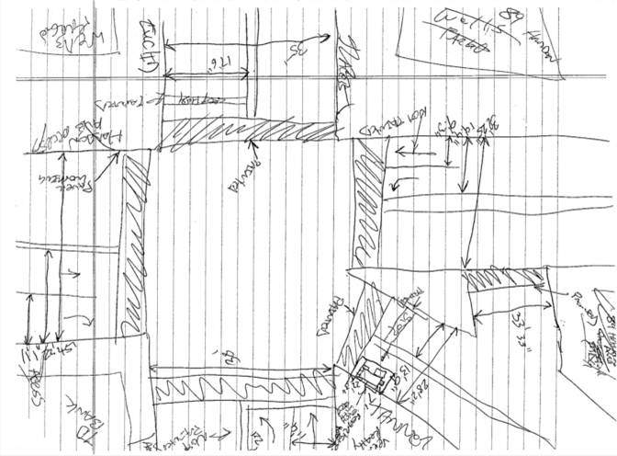
Field Diagram

Slide 117
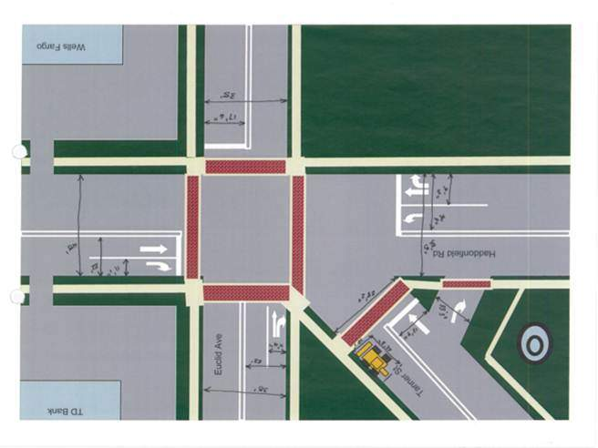
Field Diagram

Slide 118
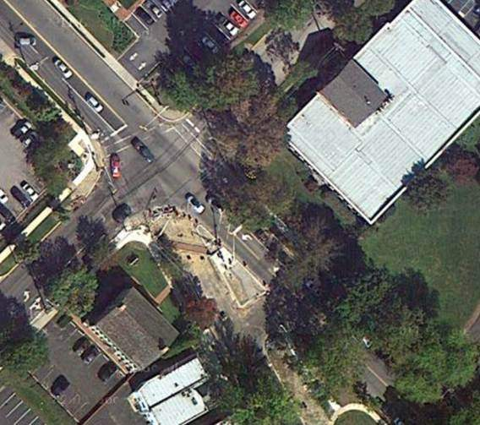
Field Diagram

Slide 119
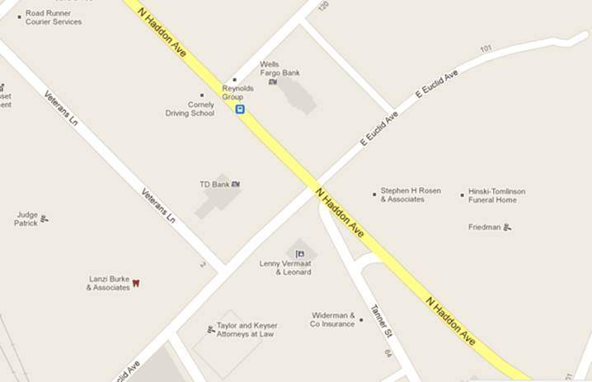
Field Diagram

Slide 120
Field Diagram

Slide 121
Questions?

Slide 122
Please Give Us Feedback!
The on-line evaluation survey for this web seminar is found at:
http://www.surveymonkey.com/s/8HLJFZK

