Slide 1
Using Blood Tests to Identify Babies and Criminals
Siguna Mueller, M.Sc., PhD (Mathematics),
PhD student in BMS, Fellow UW EE Nanotechnology, University of Wyoming
Adapted from Drs. Jennifer Doherty and Ingrid Waldron, Department of Biology, University of Pennsylvania
Notes:
Supported by UW EE Nanotechnology

Slide 2
True or False?
Blood transfusions can be done to save life.
They are always safe.
Our blood contains factors that can recognize foreign invaders, e.g. viruses or bacteria.
Certain properties in our blood can be used to detect criminals.
Certain properties in our blood can be used to determine who is related to whom.

Slide 3
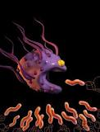
In Blood: Defense ag. Foreign Invaders
The immune system is the body's
defense against foreign substances
(that invade our body system and cause disease.)
Through a series of steps (=the immune response) the immune system attacks these foreign organisms and substances
The cells involved are white blood cells (=leukocytes).

Slide 4
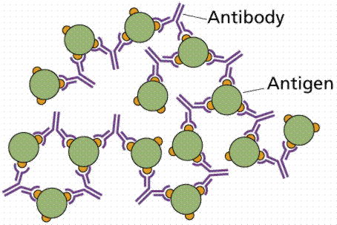
How it works
Antigens = foreign substances
that invade the body
Antigens are recognized as foreign
by specific cells.
These cells trigger special
lymphocytes to produce antibodies
Antibodies are specialized proteins
that lock onto specific antigens
Other immune system cells attack and destroy the substance.
Notes:
Can you think of a specific example?

Slide 5
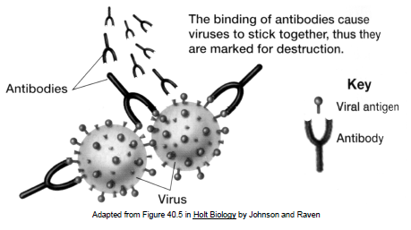
Example: Viruses killed by the IS
Antigens = the foreign substances that need to be killed
Are on the surface
of virus cells
Notes:
What is the effect of the binding of the antibodies?

Slide 6
Blood transfusions
Can be fatal!
What is needed before a blood transfusion can be done?
Need to know which blood type

Slide 7
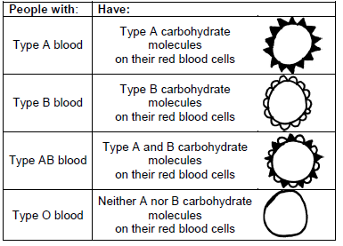
Blood Types and Classification
The ABO system
These blood types
refer to different
carbohydrate
molecules (complex
sugars) which are
present on the
surface of red
blood cells.

Slide 8
What’s so dangerous?
The Type A and Type B carbohydrate molecules are antigens
Is this a problem?
Why?

Slide 9
What’s so dangerous?
The Type A and Type B carbohydrate molecules are antigens
they can stimulate the
body to produce an
immune response
This can cause a harmful
reaction.

Slide 10
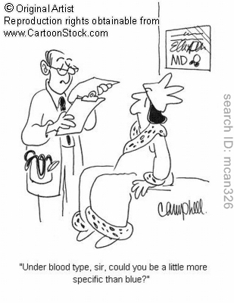
Normally, our bodies do not make antibodies against any molecules that are part of our own bodies.
antibodies help to defend
against FOREIGN invading
viruses and bacteria, but
antibodies do not attack
our own body cells.

Slide 11
Ex: people with type A blood
Have the A antigen on the surface of
their red blood cells
Do not make antibodies against the Type A antigen
Because this is present on their own red blood cells
Anti-A antibodies will not be produced by them because they would cause the destruction of their own blood.
Question: do they not make antibodies at all?

Slide 12
Ex: people with type A blood
Have the A antigen on the surface of their red cells
But they do make
antibodies against
the Type B antigen
The liquid portion of their blood has antibodies that fight against type B blood

Slide 13
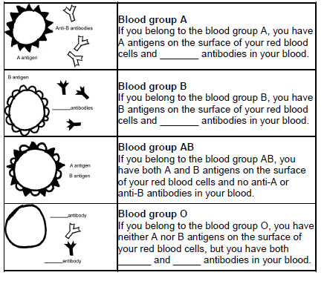
Can you complete the chart?

Slide 14
Can you complete the chart? Hints
You have A antigen = Type A blood
Your plasma has antibodies that fight
against type B blood.
The B antigen, you have type B blood.
Your plasma has antibodies that fight
against type A blood.
Both the A and B antigens = type AB.
Your plasma does not have antibodies
against type A or type B blood.
Neither the A nor B antigen = Type O.
Your plasma has antibodies that fight
against both type A and type B blood.

Slide 15
Dangerous or Not?
Blood received must have the same antigens as yours.
Give an ex. that would be ok
What will happen if a person who has Type A blood is given a Type B blood?
harmful reaction can cause
the donated red blood cells to
burst and/or clump together
and block blood vessels.

Slide 16
Applications in Crime Scene Investigation
Any ideas?
Practical Issues
How can the blood type be determined?
Can people change their blood type?
Is there a pattern b/w a specific blood type and family relationship?

Slide 17
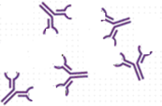
The ABO Blood Test
Mix your blood sample with
Antibodies against type A
Antibodies against type B
Then check the sample to see whether or not the blood cells stick together.
What does this mean?

Slide 18
The ABO Blood Test
Mix your blood sample with
Antibodies against type A
Antibodies against type B
If blood cells stick together, it means the blood reacted with one of the antibodies.
How does this tell the blood type?

Slide 19
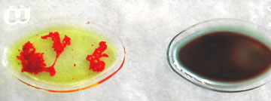
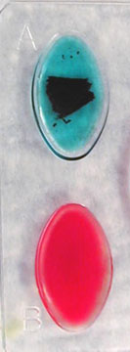
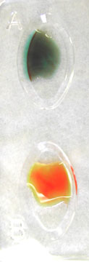
If your blood cells stick togeth. when mixed w/
Anti-A serum (right), you have type A blood
Anti-B serum (left), you have type B blood
Both anti-A and anti-B serums, you have type AB
If your blood cells do not stick together when anti-A and anti-B are added, you have type O.
Notes:
Which ones stick together? Which blood type can you identify?

Slide 20
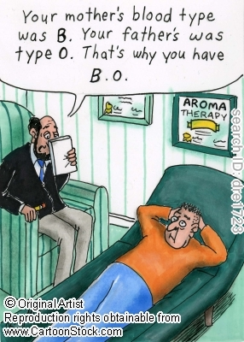
Genetics of Blood Types
The blood type gene has three different
versions or alleles:
IA results in A antigen on the RBC,
IB results in B antigen on the RBC,
i does not result in either antigen.
You receive one blood type gene from your
mother and one from your father.
How many ways are there these genes can combine?
(The genotype)
Anything wrong with the cartoon?
Notes:
6 combinations but only 4 blood types!!

Slide 21
The six possible combinations of alleles result in the four blood types
IA IA and IA i - both result in Type A blood,
IB IB and IB i - both result in Type B blood,
IA IB - resulting in Type AB blood,
i i - resulting in Type O blood.
Problem: In a heterozygous IA i person, which allele is dominant, IA or i?

Slide 22
Questions
Can both alleles in a heterozygous person be dominant?
Examples?
What is this called?

Slide 23
Questions
Can both alleles in a heterozygous person be dominant?
Example:
a person who has the IA IB genotype
will have Type AB blood.
Both antigens A and B are being made.
This is Codominance
neither allele is recessive
the contributions of both alleles are clearly visible and do not overpower each other ‘in the phenotype’.

Slide 24
Let’s practice
Each biological parent gives one of their two ABO alleles to their child.
For example, a father who has blood type AB has the genotype_____, so he will produce sperm with either an IA or an IB allele and he can give either an IA or an IB allele to a child of his.
If the mother has blood type O, her genotype must be _____, and she can only give an ______ allele to a child of hers.
Draw the Punnett for the possible genotypes for the children of these parents. Write in the blood type for each genotype.

Slide 25
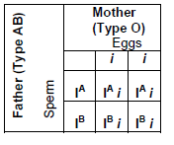
Phenotype | Genotype
A | IA IA or IA i
B | IB IB or IB i
AB | IA IB
O | ii

Slide 26
More practice…
Suppose that a mother has blood Type A and genotype IA i and the father has blood Type B and genotype IB i.
Draw a Punnett square to show the possible genotypes for their children.
Write in the blood type for each genotype.

Slide 27
I. Were the babies switched?
Two couples had babies in the same hospital at the same time.
Michael and Danielle had twins, a boy, Michael, Jr., and a girl, Michelle.
Denise and Earnest had a girl, Tonja.
Danielle was convinced that there had been a mix-up and she had the wrong girl, since Michael Jr. and Tonja were both light-skinned, while Michelle had darker skin.
Danielle insisted on blood type tests for both families to check whether there had been a mix-up.

Slide 28
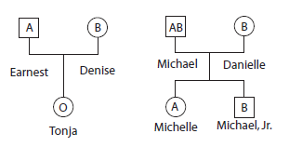
Is it possible for Michael and Danielle to have a child who has type O blood?
How do you know this?
Was a switch made at the hospital?
How could fraternal twins be as different in appearance as Michelle and Michael, Jr., (light skin opposed to dark skin)?

Slide 29
II. Who Killed Shamari Davis?
See
http://serendip.brynmawr.edu/exchange/waldron/bloodtests
Student Handout pp. 6-7

